Slide 1
Business Continuity And Preparedness
Developing a Plan to Safeguard Your Enterprise
Office of External Affairs | Private Sector Division

Slide 2
Why Plan?

Slide 3
What would be an emergency or disaster for your business?
Why Plan?
Up to 40% of businesses never reopen after a disaster
Small businesses are a vital part of the U.S. economy
99.7% of all employers
65% of net new jobs
97.5% of all U.S. exporters

Slide 4
Why Plan?
Protect the safety of employees, visitors, contractors and others at risk from hazards at the facility
Plan for persons with disabilities and functional needs
Maintain customer service by minimizing interruptions or disruptions of business operations

Slide 5
Why Plan?
Protect facilities, physical assets and electronic information
Prevent environmental contamination
Protect the organization’s brand, image and reputation

Slide 6
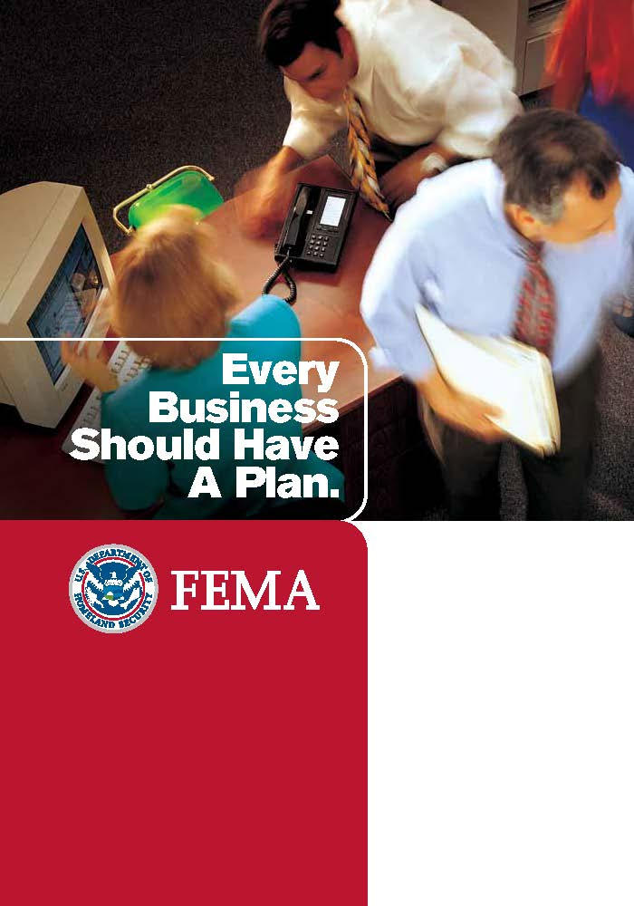
How to Plan?
Organize a business continuity team and compile a business continuity plan
Conduct a risk assessment to identify potential emergency scenarios
Implement a prompt warning for employees to signal the need to evacuate, take shelter or lockdown
Train employees to administer first aid or perform CPR

Slide 7
Questions to Consider
Is there a plan to account for employee safety?
Are electronic and/or paper records backed up offsite?
Is electrical equipment elevated to protect it from flood water?
How will employees assist in your recovery?

Slide 8
Legal Services
Assistance might be needed for:
Replacing legal documents lost due to flooding
Help with life, medical and property insurance-related claims
Building repair contracts and contractors
Counseling on landlord/tenant issues
Creditor/debtor matters
FEMA appeals

Slide 9
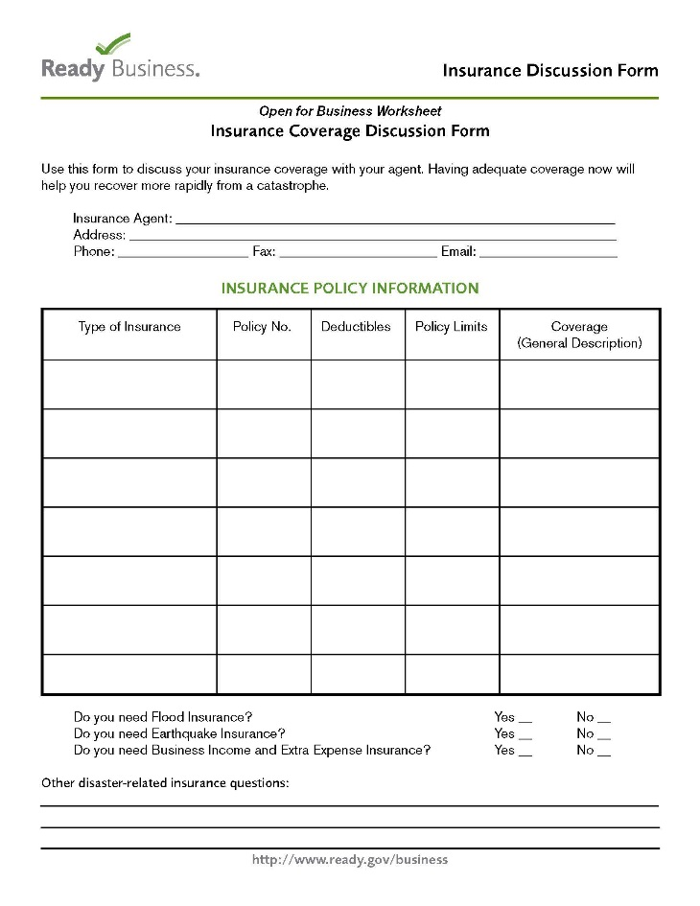
Review With Your Insurance Carrier
Flood insurance
Business interruption insurance
Deductibles

Slide 10
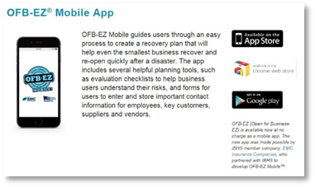
No Cost Solutions
Know what kinds of emergencies might affect your company internally and externally
Create procedures to quickly evacuate and shelter-in-place. Practice the plans.
Organize a team effort with your business neighbors to create a joint plan with each managing one part of the plan
Download free mobile apps for easy preparedness planning

Slide 11
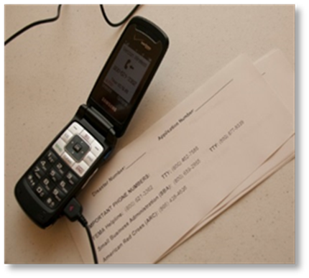
No Cost Solutions
Talk to your people about the company’s disaster plans. Two-way communication is central before, during and after a disaster
Create employee emergency contact information list
Create a list of critical business contractors and others whom you will use in an emergency
Stay profitable post disaster by being ready to supply “retail leakage” gaps in your community

Slide 12
Under $500 Solutions
Use and keep up-to-date computer antivirus software and firewalls
Attach equipment and cabinets to walls or other stable equipment. Place heavy or breakable objects on low shelves
Elevate valuable inventory and electric machinery off the floor in case of flooding
Make sure your building’s HVAC system is working properly and well-maintained
Back up your records and critical data – keep a copy offsite

Slide 13
Testing and Exercises
Benefits:
Train personnel; clarify roles and responsibilities
Reinforce knowledge of procedures, facilities, systems and equipment
Improve individual performance as well as organizational coordination and communications
Evaluate policies, plans, procedures and the knowledge and skills of team members

Slide 14
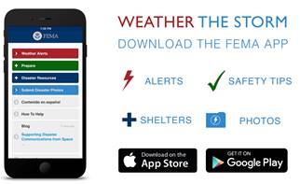
Stay Connected
Tim Cole | Private Sector Liaison | U.S. DHS - FEMA
Region 6 | james.cole@fema.dhs.gov | 940.898.5525
www.Ready.gov/Business
www.FEMA.gov/private-sector
www.FEMA.gov/email
www.Communities.FirstResponder.gov
www.fema.gov/mobile-app
www.disastersafety.org/ibhs-business-protection/
Website links provided are for reference only.
FEMA does not endorse any non-government websites, companies or applications.

Slide 15
"There's no way government can solve the challenges of a disaster with a government centric approach. It takes the whole team. And the private sector provides the bulk of the services every day in the community.”
– Craig Fugate, FEMA Administrator

