Slide 1
Governor’s Office of Homeland Security and Emergency Response State Directors Meeting
February 24, 2014
Bruce A. Davis, Ph.D.
Senior Program Manager
Resilient Systems Division
Science and Technology Directorate
Michael E. Hodgson, Ph.D.
Professor, Department of Geography
University of South Carolina

Slide 2
Department of Homeland Security (DHS) Science & Technology Directorate (S&T) Mission
Strengthen America’s security and resiliency by providing knowledge products and innovative technology solutions for the Homeland Security Enterprise
Notes:
2

Slide 3
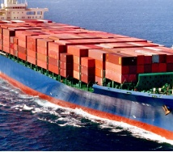
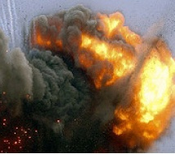
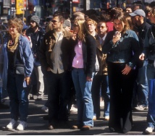
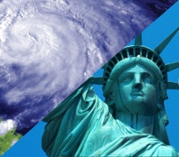
HSARPA Technical Divisions
Borders and Maritime Security Division (BMD) - Prevent contraband, criminals and terrorists from entering the U.S. while permitting the lawful flow of commerce and visitors
Chemical/Biological Defense Division (CBD) - Detect, protect against, respond to, and recover from potential biological or chemical events
Cyber Security Division (CSD) - Create a safe, secure and resilient cyber environment
Explosives Division (EXD) - Detect, prevent and mitigate explosives attacks against people and infrastructure
Resilient Systems Division (RSD) - Identify and analyze threats, enhance societal resilience, integrate human capabilities in technology development. Strengthen situational awareness, emergency response capabilities and critical infrastructure protection

Slide 4
Resilient Systems Division Research Thrusts and the Overhead Imagery Program
RSD R&D Thrusts
Overhead Imagery Focus
Screening, Search and Detection
Risk Assessment and Mitigation
Infrastructure monitoring and early anomaly detection Land cover change and threat identification
Rapid damage assessment
Agile Disaster Management
Effective search and rescue
Infrastructure Resilience
Rapid identification of priority needs for recovery operations
Community Resilience
Training, Education, and Performance

Slide 5
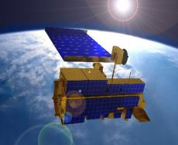
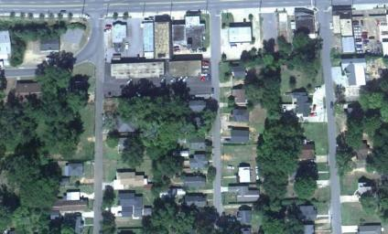
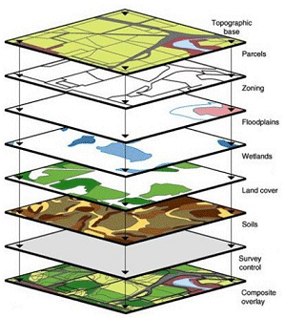
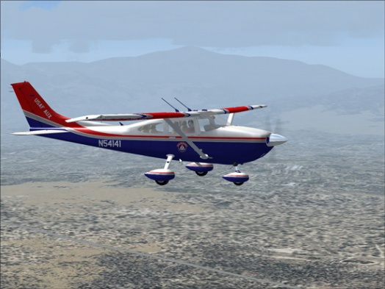
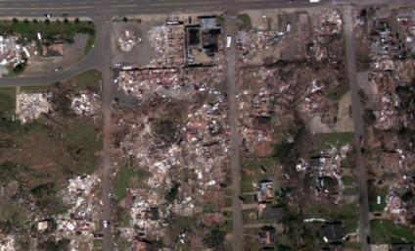
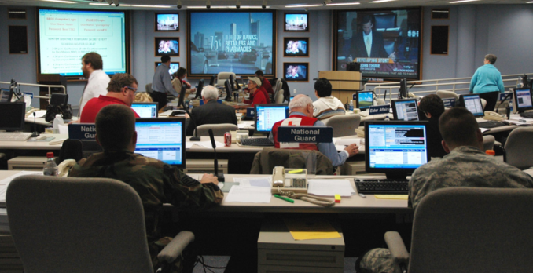
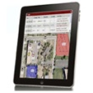
Improved Response using Aircraft and Satellite Imagery
Before
NOAA Photography
After
Incorporation of model results and GIS data to support analysis
Efficient tasking and acquisition of imagery
Rapid, accurate image analysis for disaster assessment
Analytical Cloud Environment
Library of validated analytical tools
Remote sensing data analysis in a distributed cloud architecture
Rapid incorporation of disaster assessment products for faster implementation of relief programs
Fast, accurate SA update for effective PDA and SAR

Slide 6
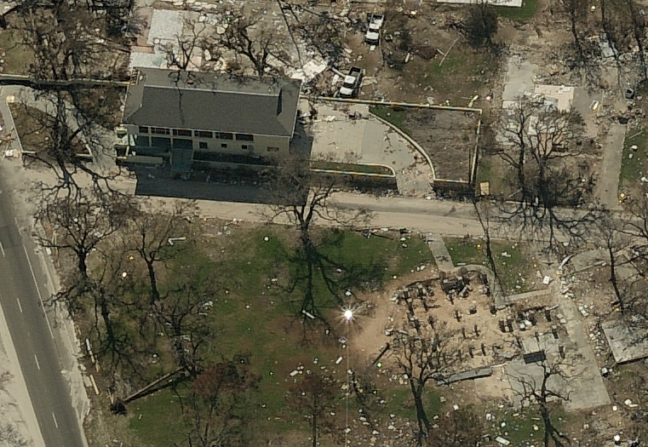
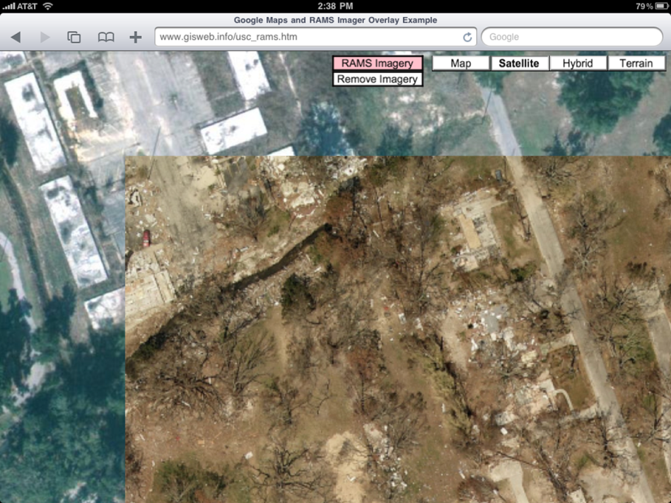
Mobile Image Analysis Tool
Utilizes the functionality of currently available mobile tablets and smartphones.
Provides a tool to use pre and post disaster images as an intelligent map.
Uses existing Parish and State GIS data.
Provides dynamic update of damage assessment from field teams.
Database of information available to all levels of incident command – Parish, State, Federal.
Works in a connected mode (WiFi or cellular) or disconnected mode.
Image by Pictometry

Slide 7
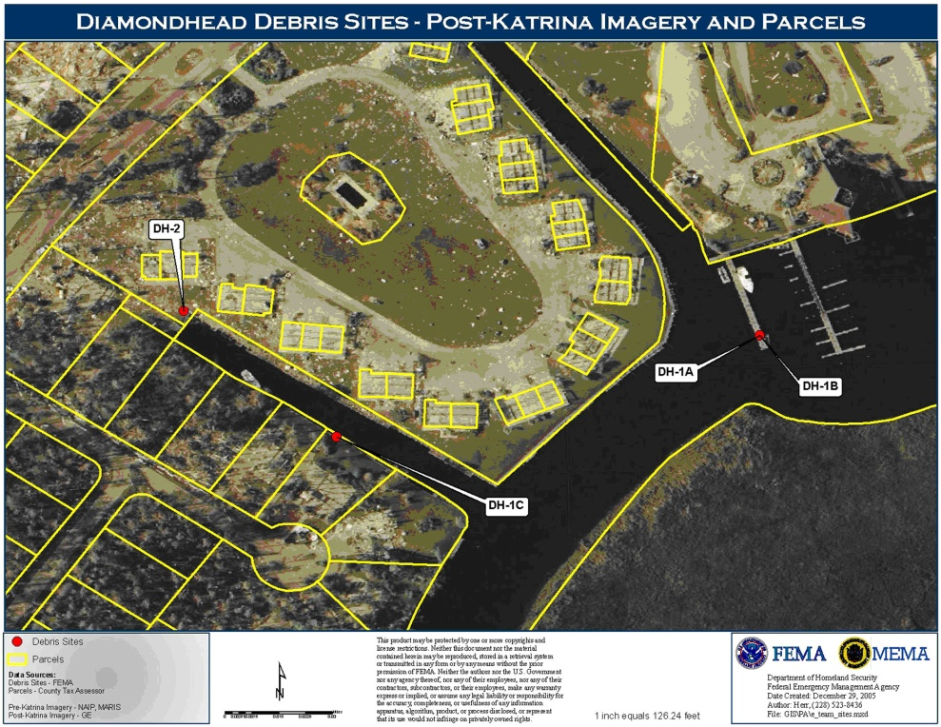
MIAT Project Status
Project initiated with St. Tammany Parish Fall of 2012.
Modifications to MIAT to focus on PDA application with device and license independence.
GOHSEP review Spring of 2013 and incorporation of GOHSEP PDA form.
GOHSEP and St. Tammany Parish technical November.
Decision to transition MIAT for GOHSEP use December 2013.
MIAT to be operational at GOHSEP by May 2014.

Slide 8
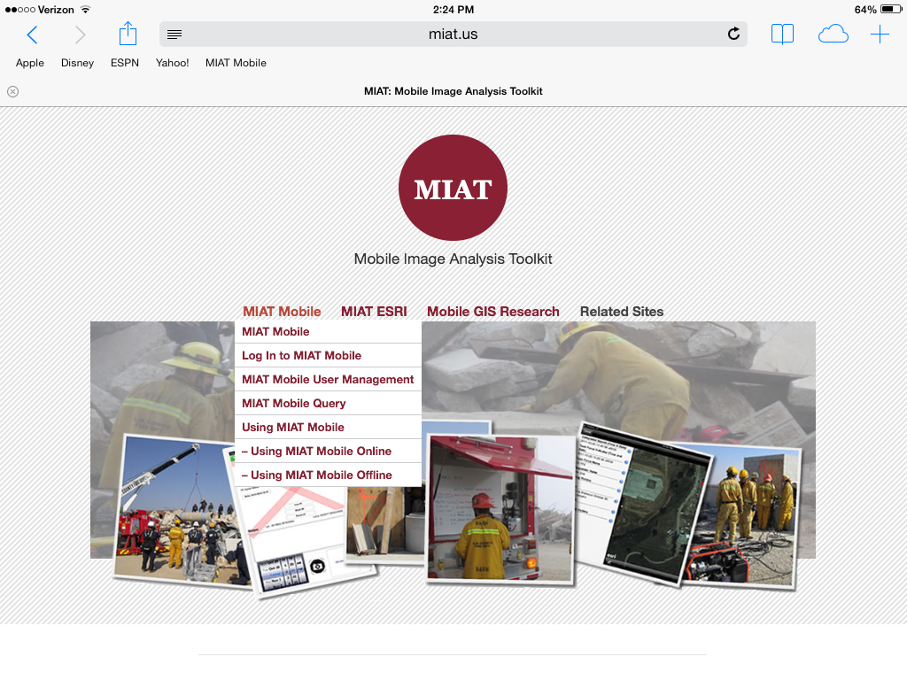
MIAT Overview – Main Page

Slide 9
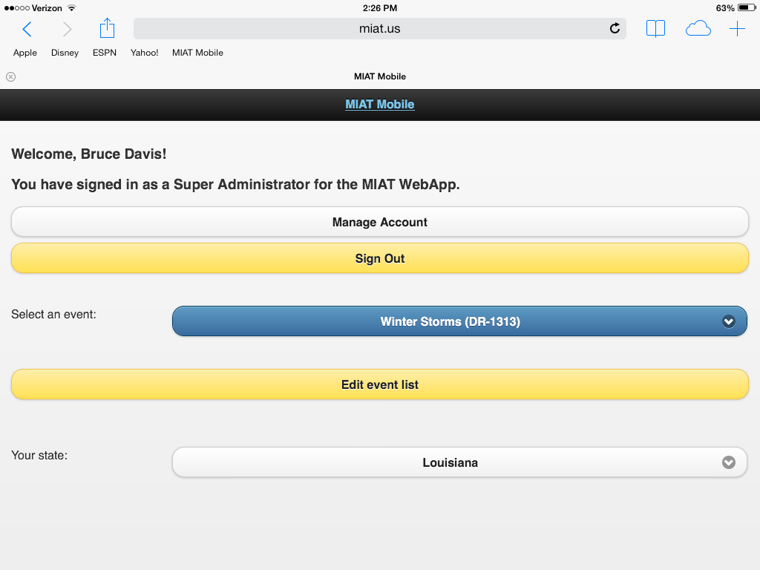
MIAT Overview – Log In

Slide 10
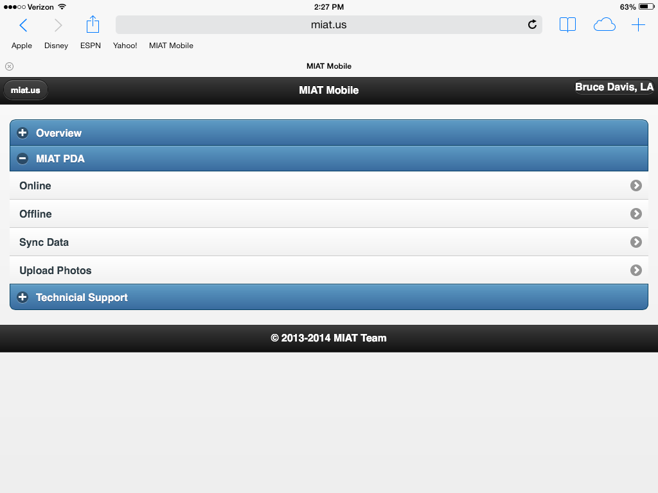
MIAT Overview – Mobile Menu

Slide 11
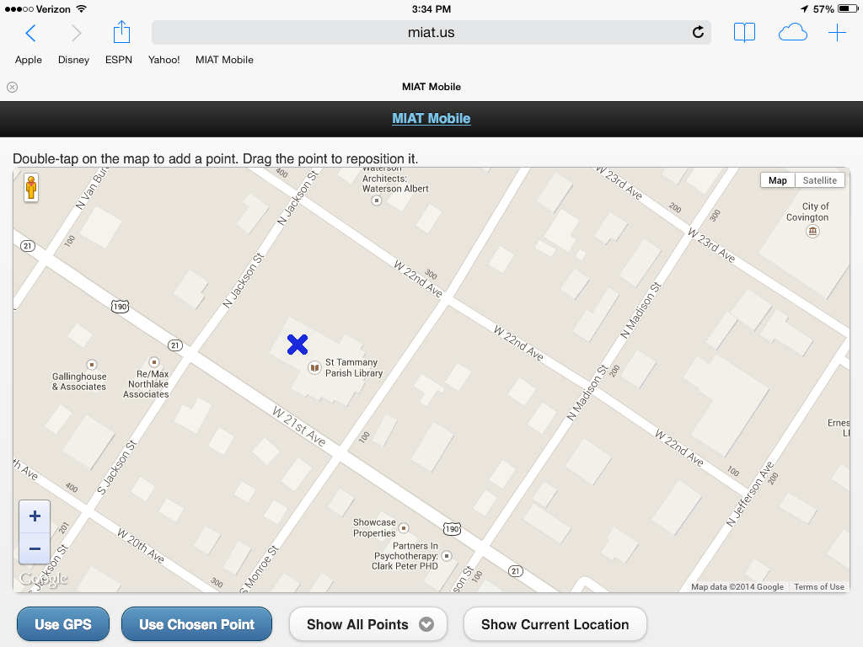
MIAT Overview – Select Point

Slide 12
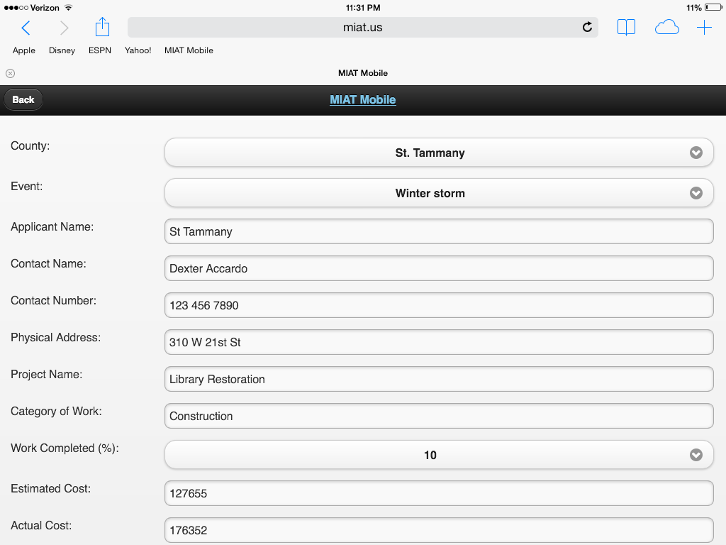
MIAT Overview – Data Entry

Slide 13
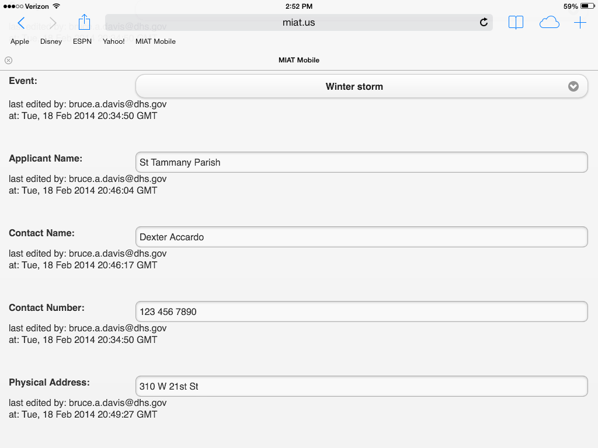
MIAT Overview – Data History

Slide 14
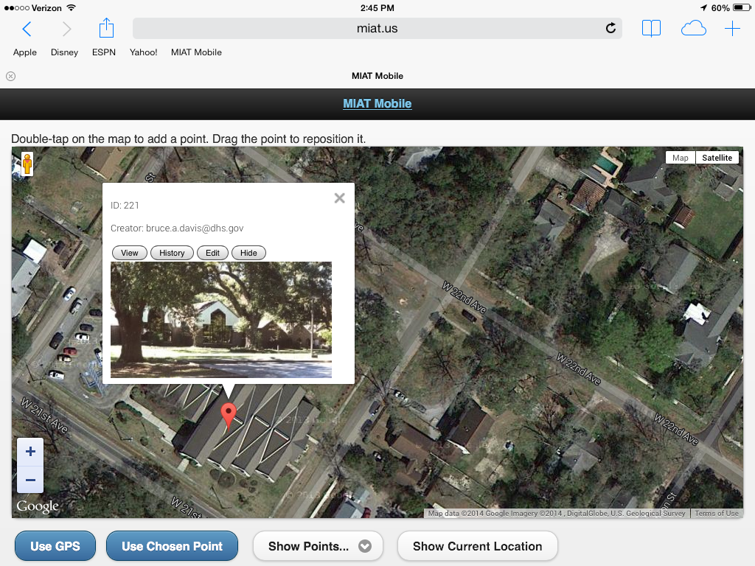
MIAT Overview – Data Review

Slide 15
MIAT Demo
Going to Dexter live outside the Crown Plaza Hotel!

