Slide 1
Office of Homeland Security and Emergency Preparedness
Hurricane Harvey
August 17 – August 31

Slide 2
Historical Facts
The eighth named storm of 2017
First Major Hurricane to make landfall in the United State since Hurricane Wilma in 2005.
Tied with Hurricane Katrina as the most costliest tropical cyclone on record, inflicting $125 billion in damage.
Floods inundated hundreds of thousands of homes, displaced more than 30,000 people, and prompted more than 17,000 rescues.
Harvey caused at least 106 confirmed deaths in the United States.

Slide 3
Creation of Hurricane Harvey
Harvey developed from a tropical wave to the east of the Lesser Antilles, reaching tropical storm status on August 17.
Harvey began to weaken due to moderate wind shear, and degenerated into a tropical wave north of Colombia, early on August 20.
Reach H-120 for Louisiana on August 21.
National Weather Service (NWS) Lake Charles, predicts a Category 1 hurricane with a storm surge of 6 – 8 inches for Calcasieu Parish

Slide 4
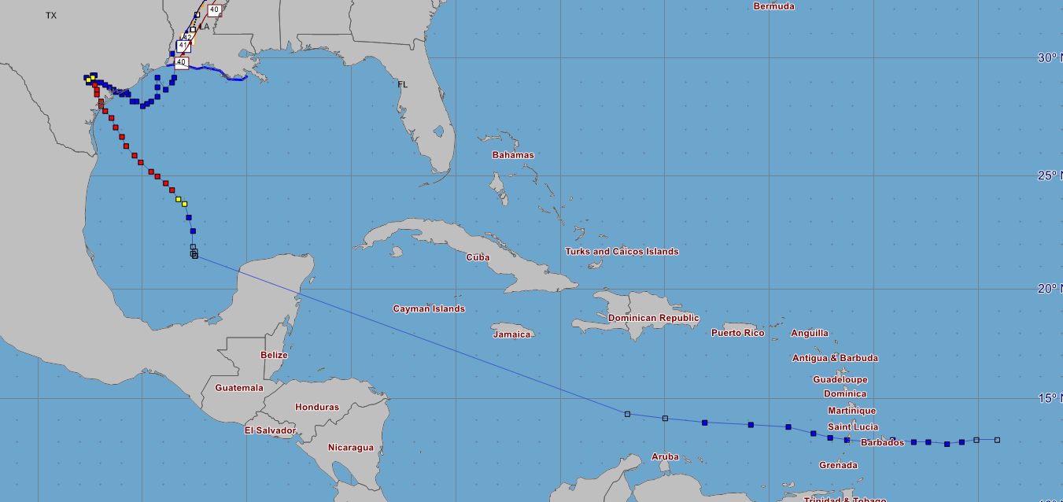
Hurricane Harvey Full Storm Track
August 21
OHSEP starts tracking
H-120

Slide 5
Wednesday August 23rd
Calcasieu Parish Emergency Operation Center Level 2
Declaration of Emergency was drafted, signed and filed by August 24th
Planning for a 6-8 storm surge began
Sandbagging Operations became priority
Landfall was predicted for Friday August 25th
Cameron Parish issued mandatory evacuation

Slide 6
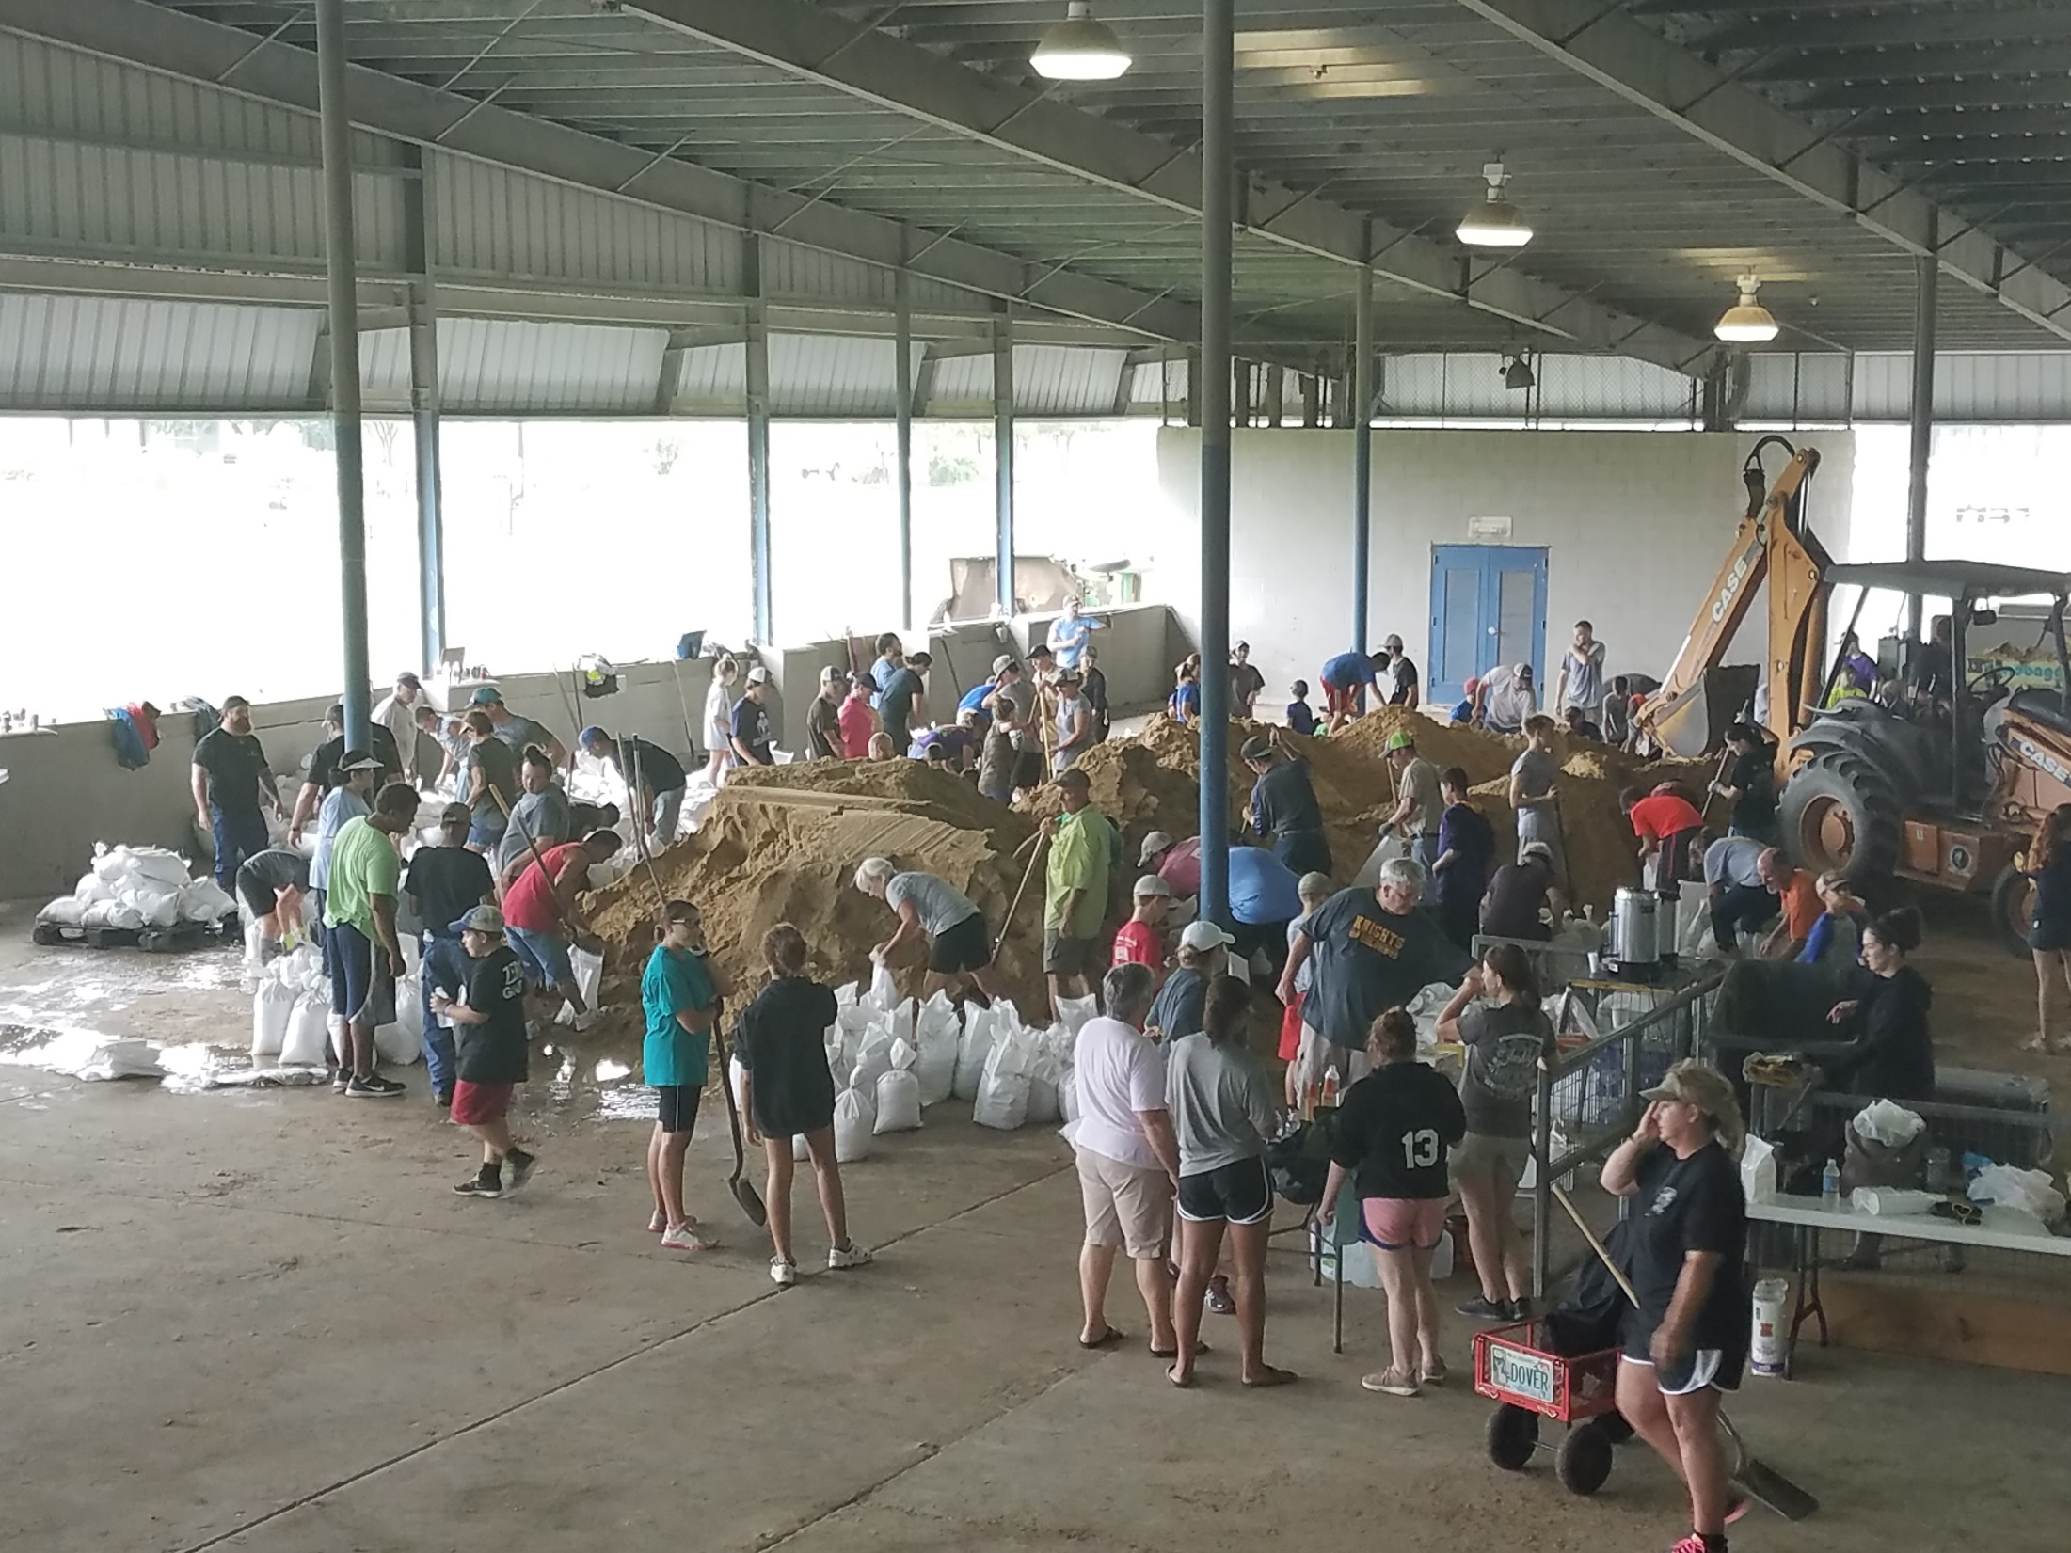

Slide 7
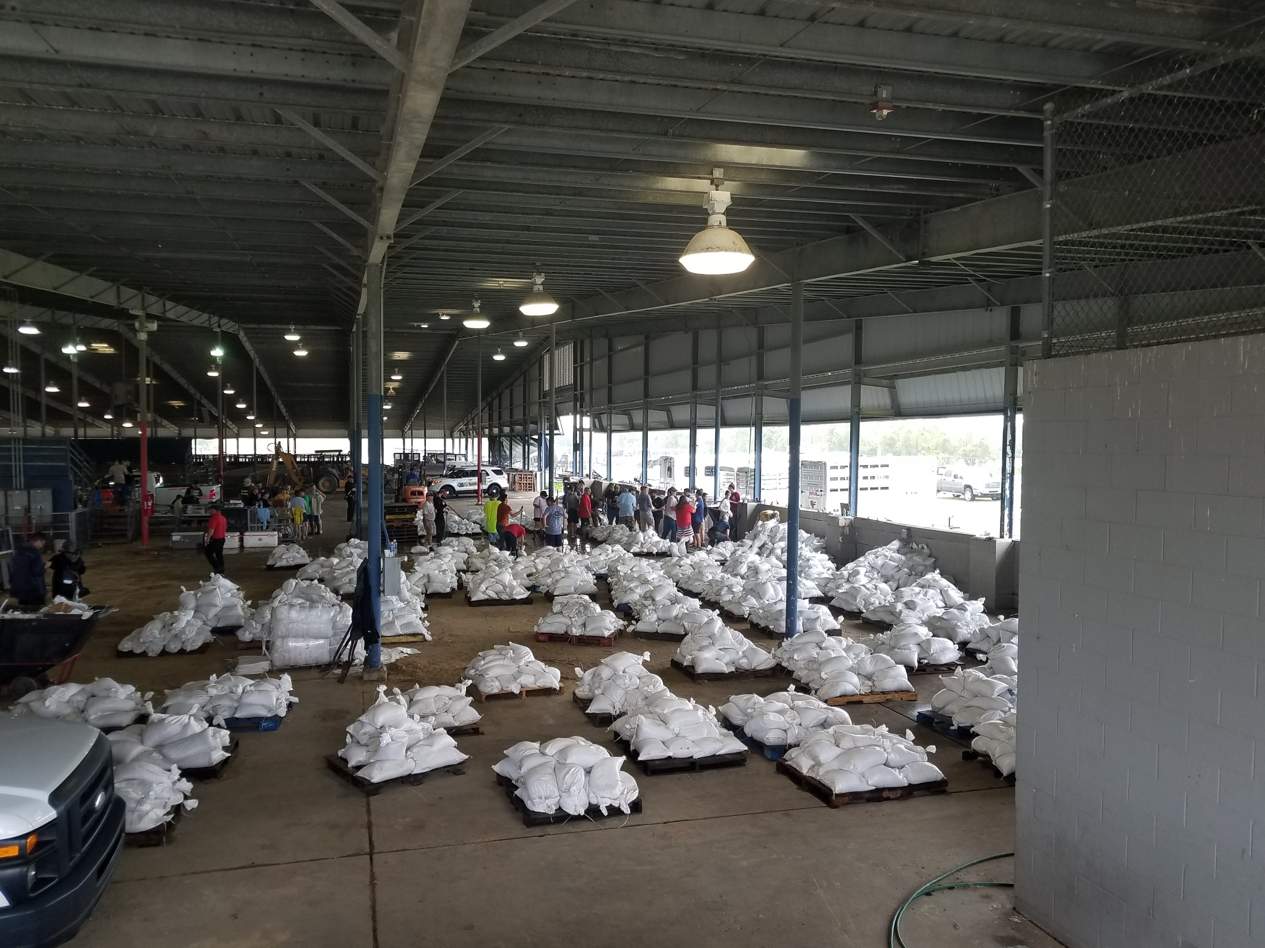

Slide 8
Hurricane Harvey enters the Gulf of Mexico
The remnants were monitored for regeneration as it continued west-northwestward across the Caribbean and the Yucatán Peninsula.
Started to redevelop over the Bay of Campeche on August 23.
Harvey then began to rapidly intensify on August 24, regaining tropical storm status and becoming a hurricane later that day.

Slide 9
Thursday August 24th
Harvey started to slow and gain strength and was predicted to make landfall as a major hurricane
Sandbagging Operations remained priority.
Landfall was moved to Saturday August 26th.

Slide 10
Major Hurricane Status
Became a major hurricane and attained Category 4 intensity on August 25th.
Harvey made landfall around August 26, 03:00 UTC at San José Island, Texas, at peak intensity (130 mph winds).
Second landfall on the Texas mainland (Holiday Beach ) three hours later as a Category 3 hurricane.
After striking land, Harvey rapidly weakened as its speed slowed dramatically to a crawl, and weakened to a tropical storm on August 26.
For about two days the storm stalled just inland, dropping very heavy rainfall and causing widespread flash flooding.

Slide 11
Friday August 25th

Slide 12
Friday August 25th at 2300 Landfall

Slide 13
Saturday August 26th

Slide 14
Hurricane Harvey moves toward Louisiana
Harvey's center drifted back towards the southeast, ultimately re-emerging into the Gulf of Mexico on Monday August 28.
On Wednesday August 30, it made its third and final landfall just west of Cameron, Louisiana, with winds of 45 mph (75 km/h).

Slide 15
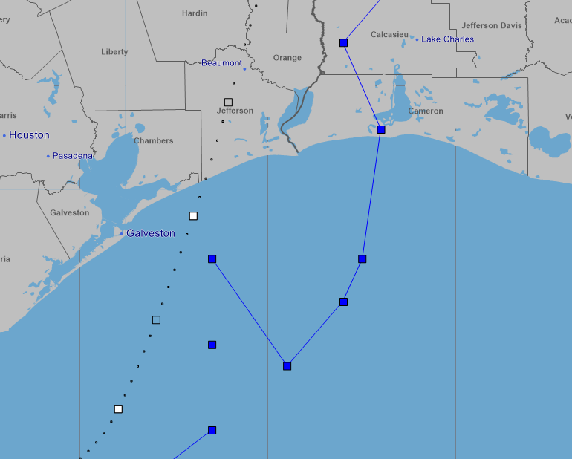
Wednesday August 30th at 1400 Third Landfall
Opened Civic Center as a shelter

Slide 16
Search and Rescue and First Major Shelter
Calcasieu Parish Search and Rescue Operations began on the night of Saturday August 26th.
Over 157 missions were conducting rescuing approximately 600 citizens.
On Sunday August 27th Lake Charles Civic Center was opened as a shelter.
With a capacity of 720.

Slide 17
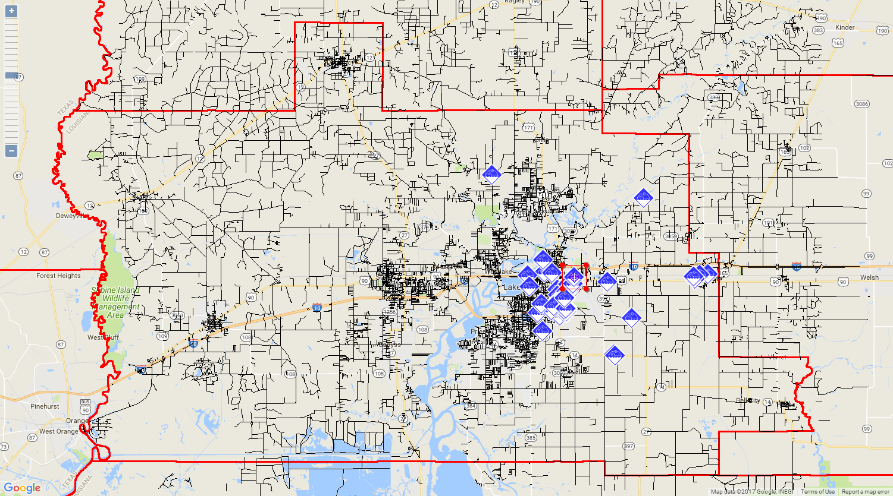
August 28th through August 30th Search and Rescue Missions in Calcasieu Parish EOC Level 1

Slide 22
Texas Evacuation
Wednesday August 30th, Texas EMA requested assistance for citizens of Orange, Vidor, and parts of Beaumont.
LA State Police notified Calcasieu Parish OHSEP of the need for a rescue mission.
Calcasieu Parish OHSEP requested LA National Guard Support for SAR operations in Texas and established two evacuation centers.
A forward command post was established and Maj. Duplechin took command of the LANG Soldiers with the integration of a Calcasieu Parish Emergency Management Team.
Over 3,000 citizens where moved to Lake Charles within the first 24 hours.

Slide 23
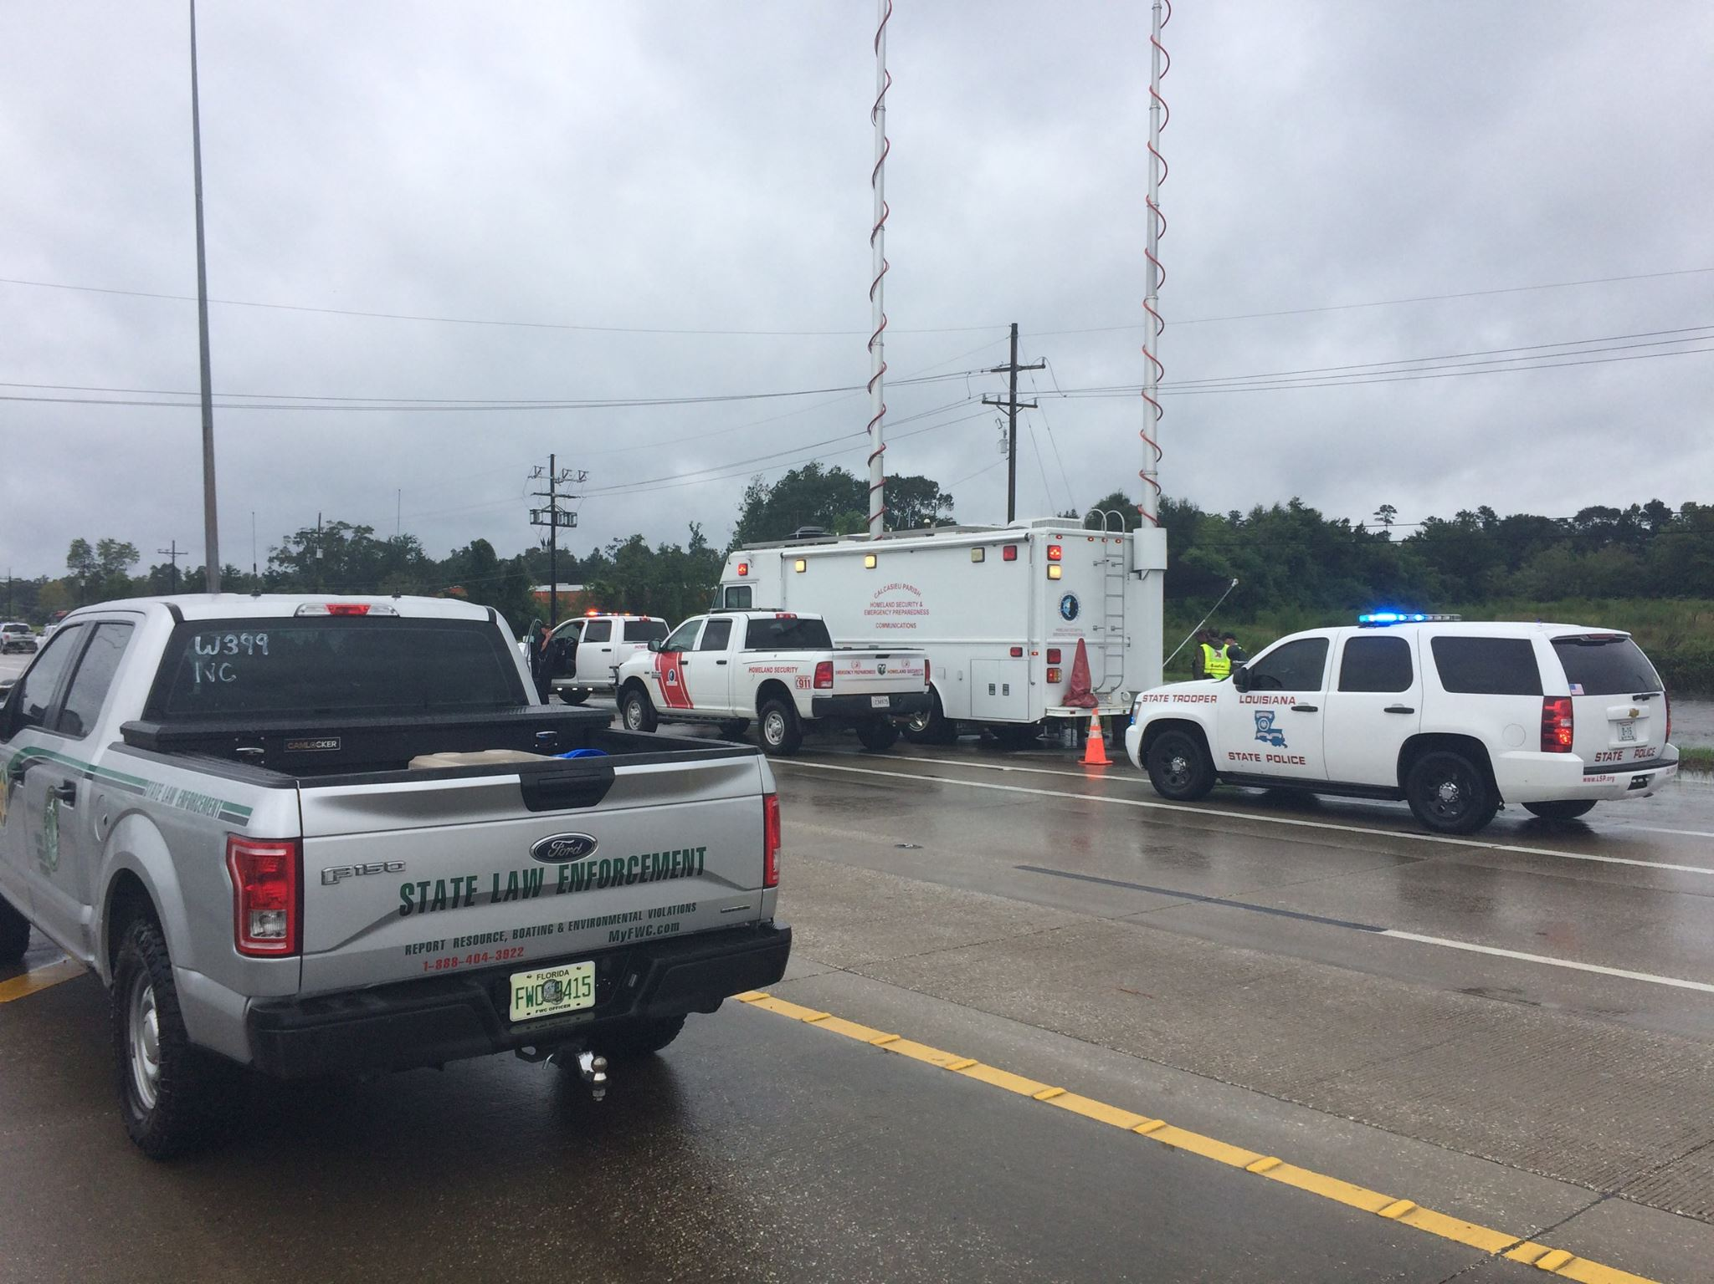

Slide 24
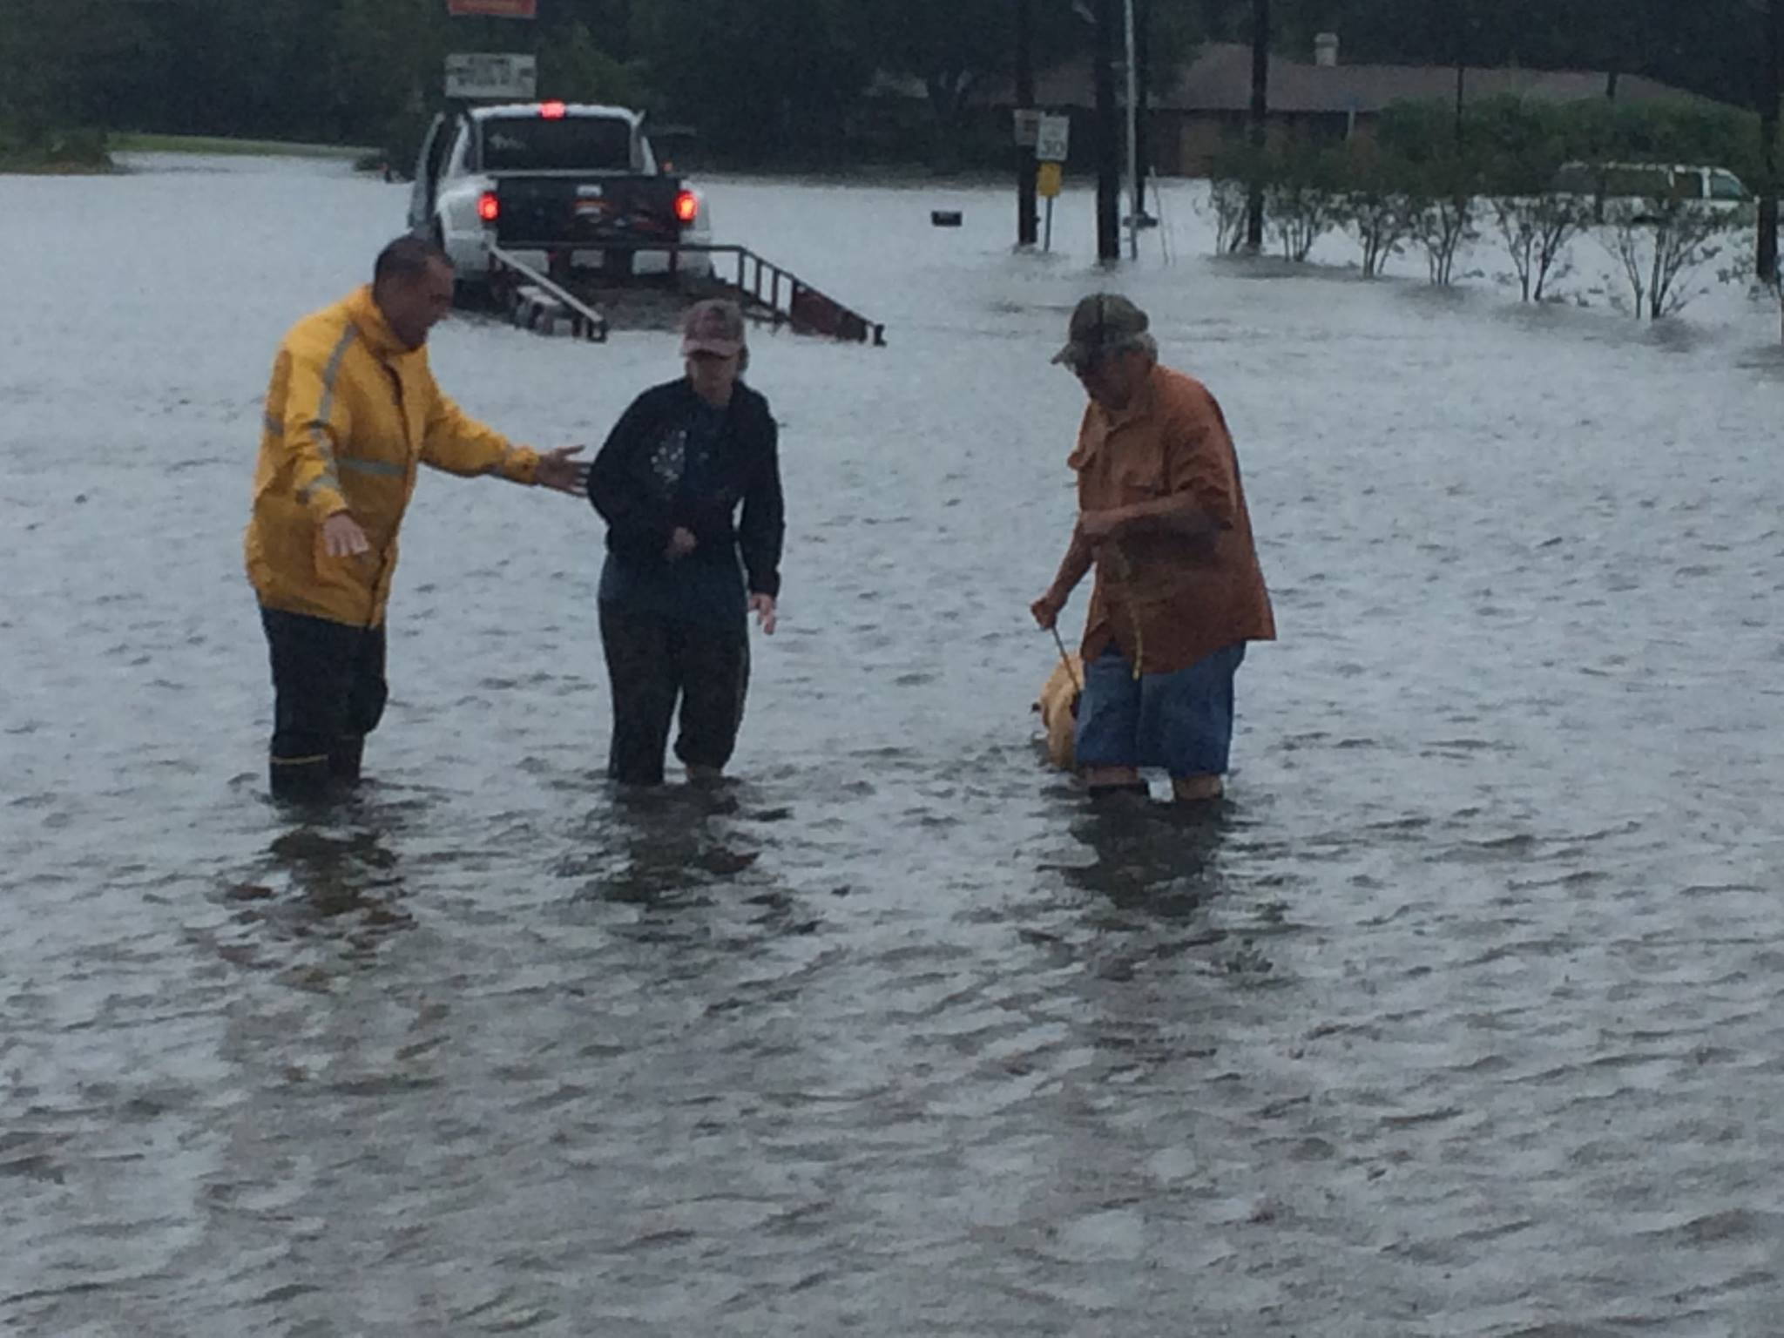

Slide 25
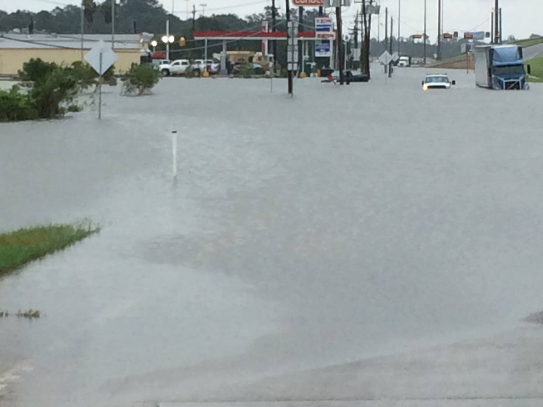

Slide 26
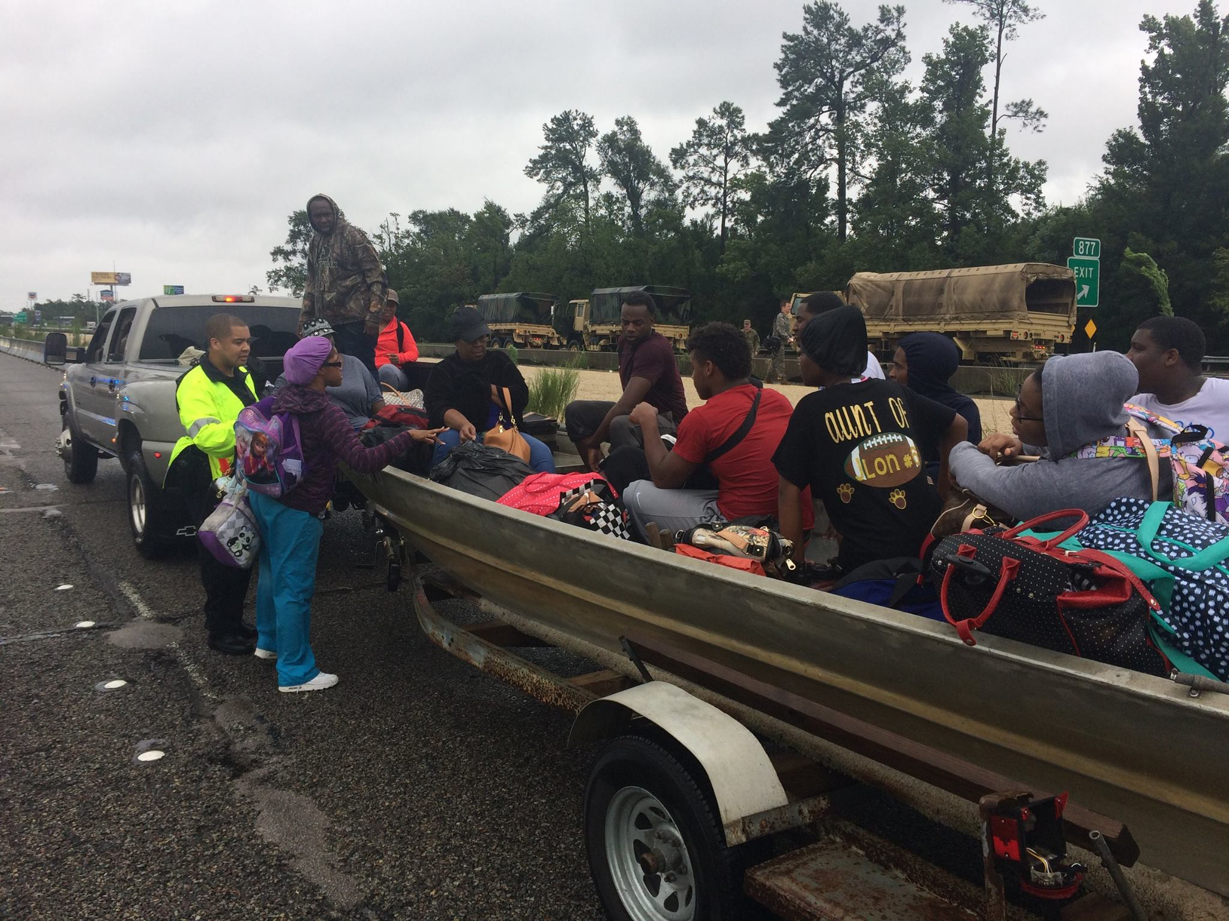

Slide 28
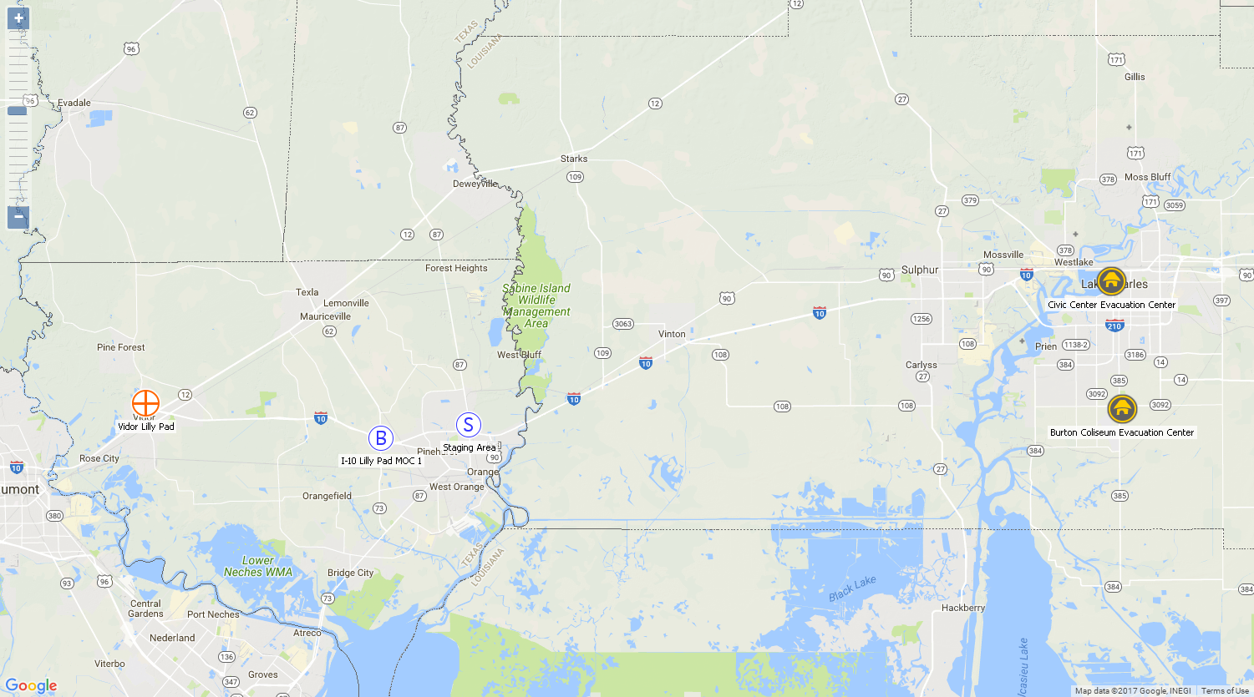
Wednesday August 30th to Friday September 1st Texas Evacuation to Lake Charles
Approximately 5,000 citizens where rescued and transported to Lake Charles

Slide 29
Second Shelter
On Wednesday August 30th the Burton Coliseum was opened as a Red Cross Shelter for the displaced Texas citizens.
The center capacity was 450 people.
The shelter was at capacity within 4 hours.

Slide 30
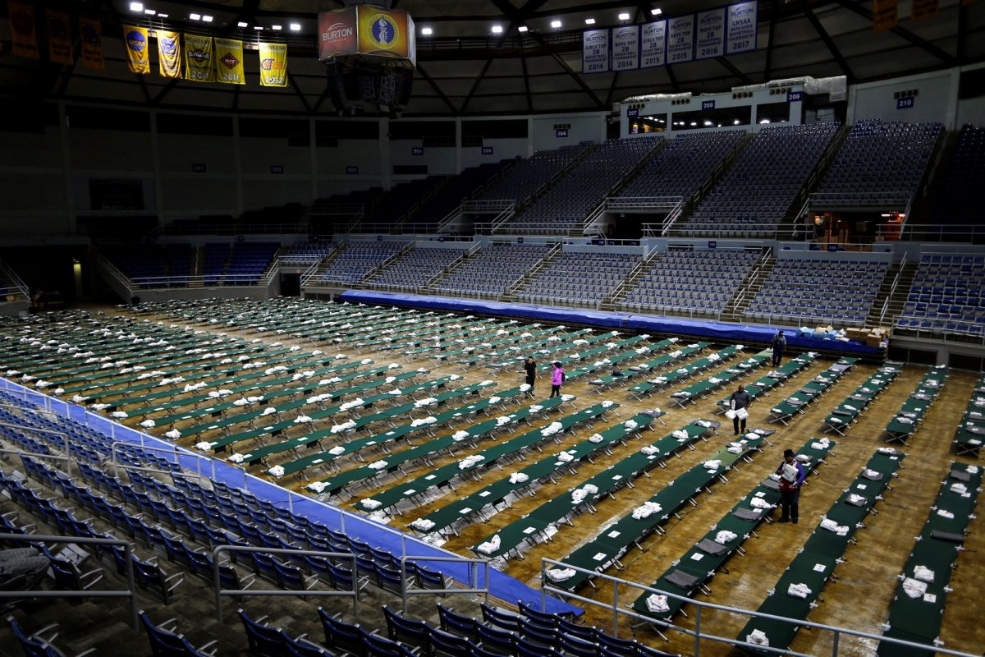

Slide 31
Bus Exchange Point
On Thursday August 31st, operations began to transport Texas citizens from Lake Charles to the state run Mega-Shelter in Alexandria LA.
Over 3,000 citizens were transferred total.

Slide 32
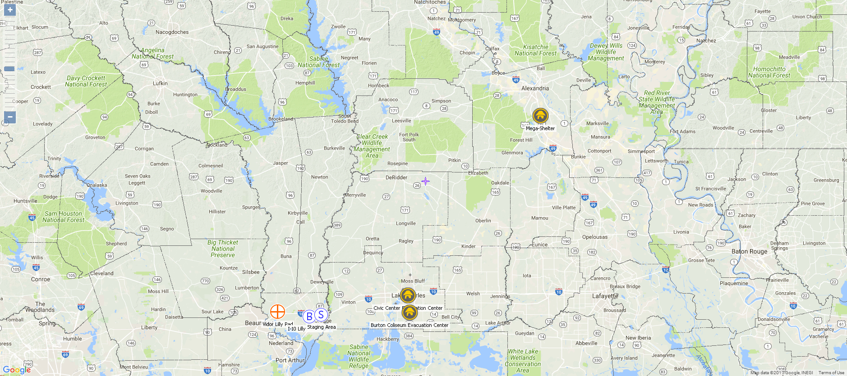
Thursday August 31st to September 2nd Transferring Houston citizen to Mega - Shelter Alexandria

Slide 33
Sabine River Flooding
On Friday September 1st, the Calcasieu Parish OHSEP in conjunction with the Calcasieu Parish Sheriff’s Office and LA Wildlife and Fisheries started working the Sabine River Flooding.
SAR missions were conducted and temporary shelters established in Vinton, LA and Starks, LA.
Over 2,000 residents had the potential of being displaced from their homes and over 1,000 various public and private structures were at risk of flooding.

Slide 34
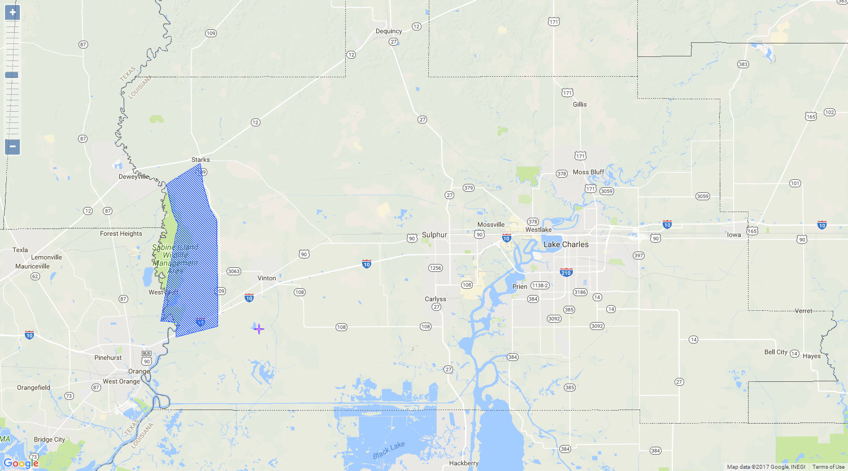
Sept 2nd Sabine River flooded coming close to the 2016 flood

Slide 35
QUESTIONS

