Slide 1
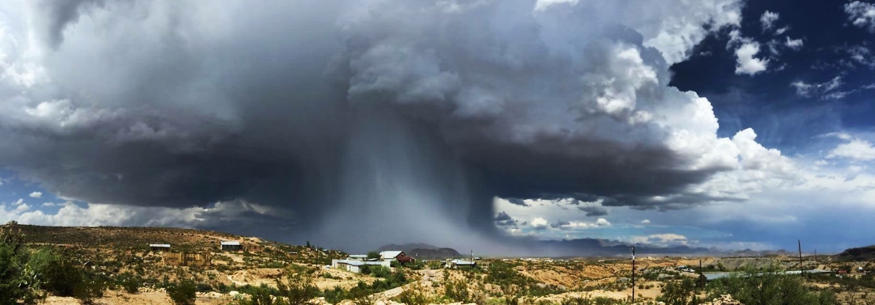
TEXAS
ESF 6

Slide 2
KNOW TEXAS
SIZE
Second to Alaska
267,820 Sq. miles
POPULATION
Second to California
26.45 million
DECLARED
DISASTERS
Most Total
336 variety

Slide 3
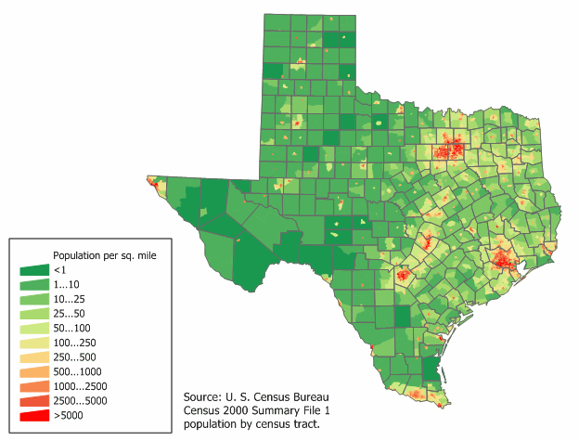
254 Counties

Slide 5
PRIMARY ESF-6
OBJECTIVES
Mass Care
Temporary Housing
Human Services
Emergency Assistance

Slide 6
Mass Care
Shelters
Feeding
PODs
Reunification

Slide 7
Emergency Assistance
VOADs
Donation Management
Evacuations
Pets

Slide 8
Temporary Housing
VAL
HHSC
TDHCA
GLO

Slide 9
Human Services
DSNAP
DCM
Crisis Counseling
Animal Care

Slide 10
SURPRISES
FLEXIBILITY
CONTACTS
The Key to Surviving in
Mass Care

