Slide 1
WebEOC Updates

Slide 2
The IMAC Process and WebEOC

Slide 3
What is IMAC?
IMAC (Intrastate Mutual Aid Compact) is a program that provides mutual assistance between parishes before, during, or in the aftermath of an emergency.
IMAC was created by Louisiana RS 29:739.
It enables parish-to-parish assistance when a mutual aid agreement is not already in place.
Authorized representatives from both the assisting and requesting parish enter into a contract to provide and reimburse for resources or services.

Slide 4
Requirements: Requesting Parish
Declare a State of Emergency before making request
Identify the resource or service needed
Agree on a price and scope
Keep documentation (from declaration to reimbursement)

Slide 5
Requirements: Assisting Parish
Verify the request details
Agree on price and scope
Confirm receipt of authorization from requesting parish before deploying resources

Slide 6
Requirements: Both Parties
Utilize the IMAC process in WebEOC
Adhere to NIMS guidelines
Participate in an After-Action Review (AAR) and implement corrective actions.

Slide 7
Requirements: GOHSEP
Oversee and maintain the IMAC process in WebEOC
Maintain the list of parish authorized representatives

Slide 8
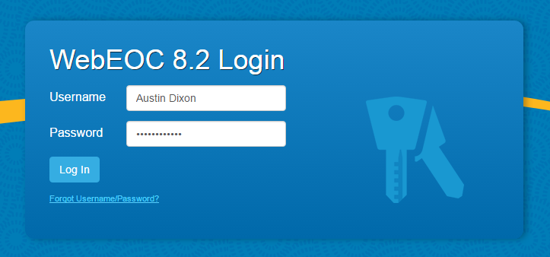
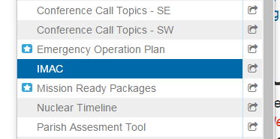
Accessing the IMAC Board
Log in to WebEOC and choose the appropriate incident. Then, click the IMAC option in the Control Panel.

Slide 9
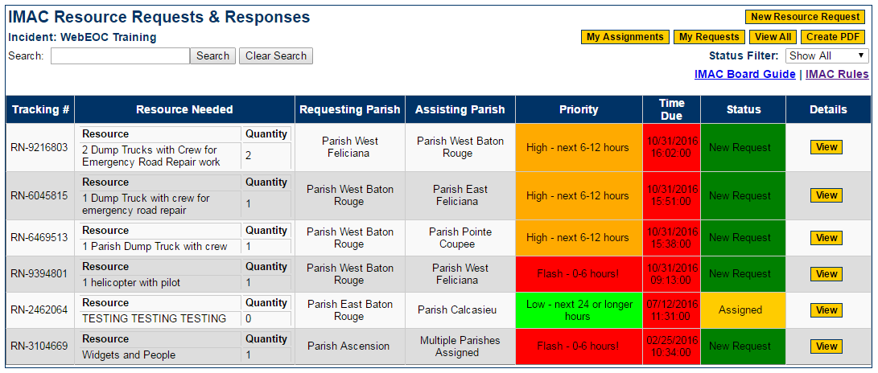
IMAC Board at a Glance

Slide 10
IMAC Board Header
Board Title
Incident Name
Search Feature (and clear button)

Slide 11
IMAC Board Header
New Request button will start a new request
My Assignments button displays your accepted requests
My Requests button displays requests you have made
View All button (default) displays all requests
Create PDF file of current table view
Status filter dropdown
Links to board guide and IMAC rules

Slide 12
IMAC Board Data
Each request is assigned a tracking number.

Slide 13
IMAC Board Data
The resource description and quantity are listed next.

Slide 14
IMAC Board Data
The next two columns are for the associated parishes.

Slide 15
IMAC Board Data
Priority is color-coded and has four categories.
Low – 24 hours or longer
Medium – 12 to 24 hours
High – 6 to 12 hours
Flash – 0 to 6 hours
Flash requests are typically reserved for life-saving or life-sustaining requests.

Slide 16
IMAC Board Data
The Time Due column displays the time and date a request is due.
The Time Due block turns red as soon as the request is past-due.

Slide 17
IMAC Board Data
A request can have the following statuses
New Request, Assigned, In Progress, Complete, and Cancelled (all color-coded)
The View button displays the request details. An Update button will also be available on your requests and will allow you to edit your request.

Slide 18
Submitting an IMAC Request

Slide 19
Submitting an IMAC Request
For demonstration purposes
Rapides Parish will be the requesting parish
Acadia Parish will be the assisting parish

Slide 20
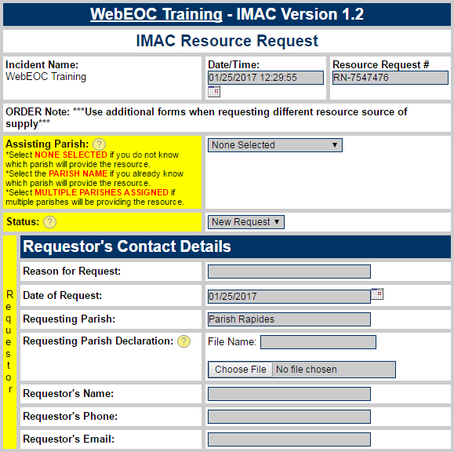
Submitting an IMAC Request
Clicking the New Resource Request button will open this display.
You can select an assisting parish, forward the request to multiple parishes, or open the request to all parishes by choosing “none selected.”

Slide 21
Submitting an IMAC Request
E-Mail notifications will be sent to the following
Single Parish – that parish will be notified
Multiple Parishes – the State EOC will be notified and will forward the request in order for a parish to support.
None Selected – all parishes will be notified
Regional coordinators and the State EOC receive notifications for each IMAC request.
If multiple parishes are needed to fulfill the request, create an individual IMAC request for each assisting parish.
In this instance, we’ll assume Rapides Parish and Acadia Parish have pre-arranged this request over the phone.

Slide 22
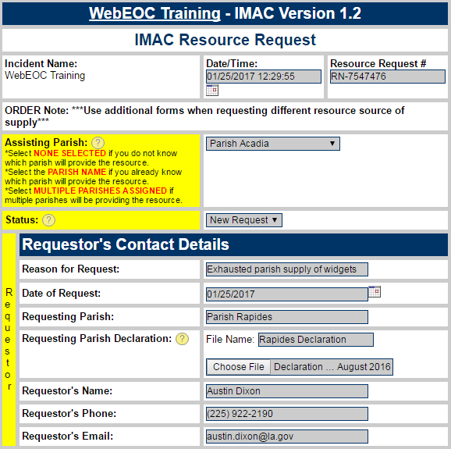
Submitting an IMAC Request
Next, enter the reason for request (Rapides has exhausted its supply of widgets).
Enter requestor contact information.
Upload your parish’s emergency declaration (an IMAC requirement).

Slide 23
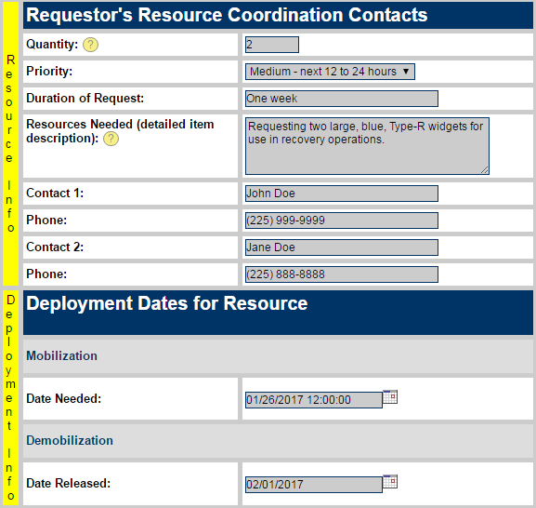
Submitting an IMAC Request
Enter the quantity using only numbers.
Add the priority and request duration info.
Describe the resource needed in detail.
Add contacts with knowledge of the request.
Add deployment dates as needed.

Slide 24
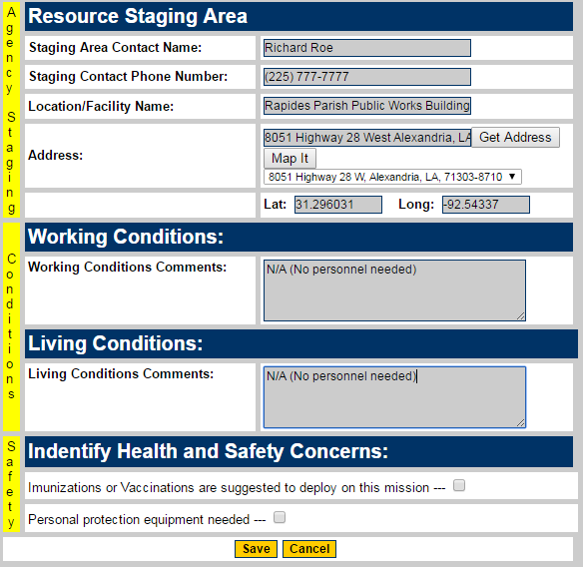
Submitting an IMAC Request
Enter delivery location details under the Resource Staging Area section.
If personnel are being provided, describe the working and living conditions.
Check the appropriate box if PPE, vaccinations or immunizations are needed.
Click Save when done.

Slide 25
Supporting an IMAC Request

Slide 26
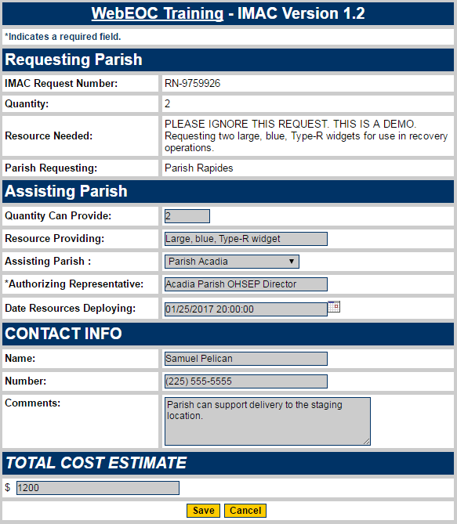
Supporting an IMAC Request
Enter the requested details under the Assisting Parish section. The authorizing representative must be the name of the Parish’s OHSEP Director.
Contact info can be for the authorizing representative or an OHSEP staff member with knowledge of the request.
Enter the cost estimate using only numbers, then click Save.

Slide 27
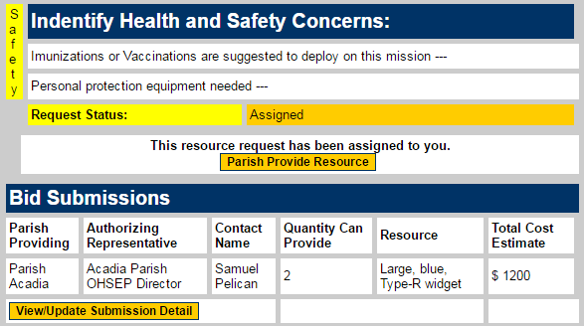
Supporting an IMAC Request
Once an assisting parish responds, its response details are listed on the details page as a bid.
Typically, only one bid will be issued, but bids can also be submitted by competing parishes if the request is not assigned to a single parish.
The assisting parish can also update its bid until the requesting parish takes action.

Slide 28
Supporting an IMAC Request
When logging in and opening the IMAC Board, Acadia Parish can click the View button to access the request details.

Slide 29
Accepting Support

Slide 30
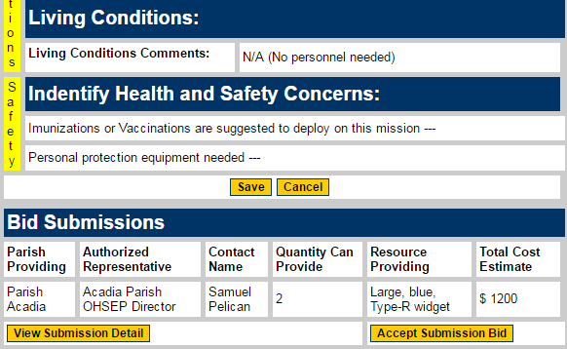
Accepting Support
The Rapides Parish staff monitoring the IMAC request will have noticed the bid submission as well.
If the delivery time and cost estimate are acceptable, the parish can accept the bid by clicking the “Accept Submission Bid” button.

Slide 31
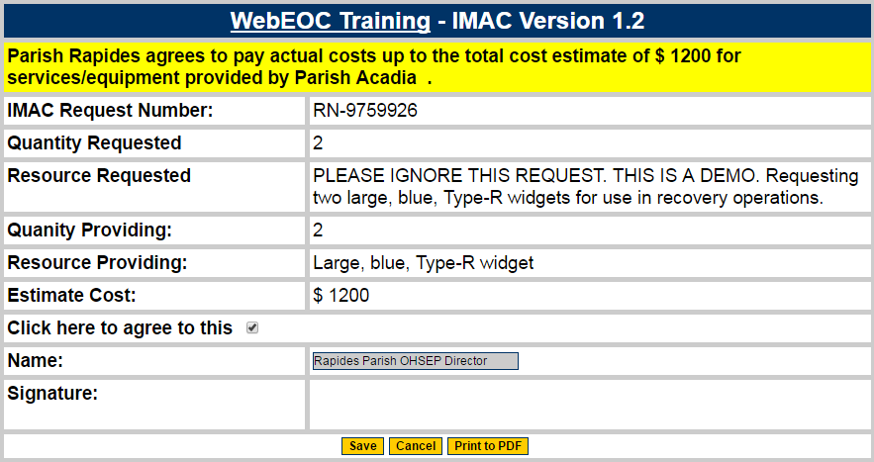
Accepting Support
To accept the bid and create a binding IMAC agreement, the authorized representative should leave his or her digital signature by clicking the agreement checkbox, typing his or her name in the field at the bottom of the form, and clicking Save.

Slide 32
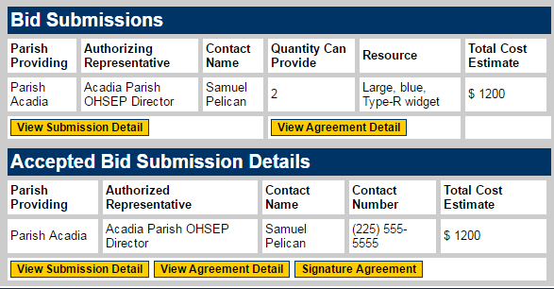
Accepting Support
Now that an agreement is in place, a Signature Agreement button appears on the request details screen for both parties. The two parishes can click the button to view the digital agreement.

Slide 33
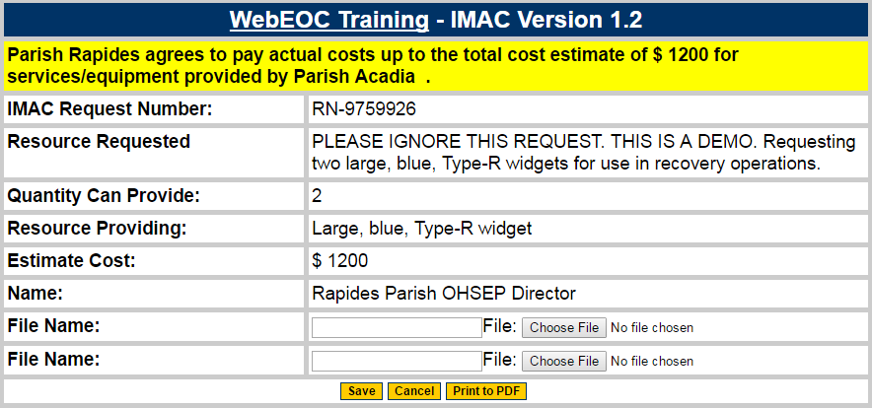
Accepting Support
One the Signature Agreement screen, there are two attachment fields for supporting documents.
A PDF button is available for both parishes to print or save a copy of the digital agreement.
Remember to update the request status as the request is completed and closed.

Slide 34
Contact Information
For IMAC-related questions:
Jason Lachney
Section Chief, Operations
(225) 358-5412
jason.lachney@la.gov
For WebEOC-related questions:
Austin Dixon
WebEOC Administrator
(225) 922-2190
austin.dixon@la.gov

Slide 35
Questions?

