Slide 1



PREPS:
Partial Repair and Essential Power for Sheltering
Texas General Land Office (GLO)
Texas Department of Emergency Management (TDEM)
Federal Emergency Management Agency (FEMA)

Slide 2
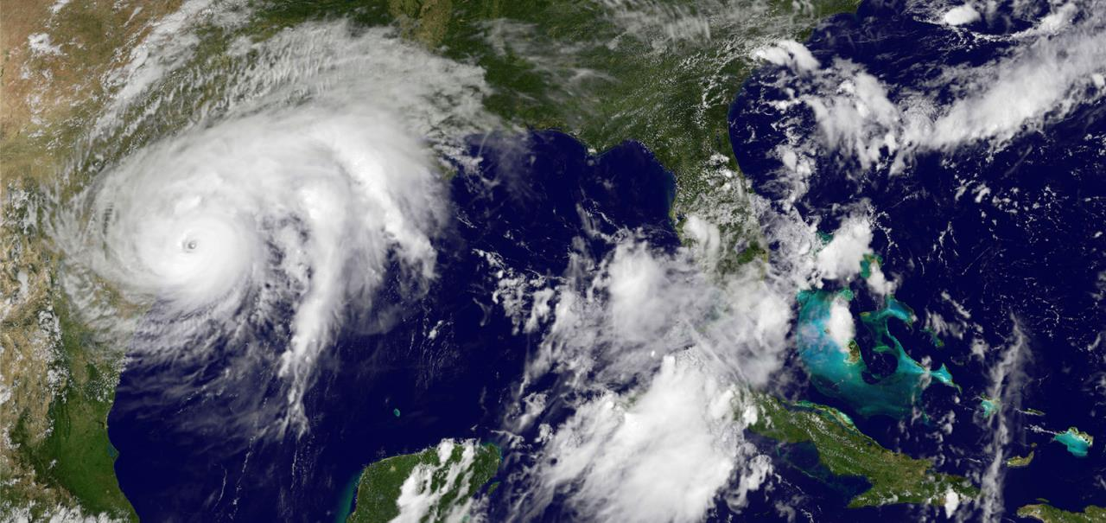
Hurricane Harvey - August 25, 2017

Slide 3
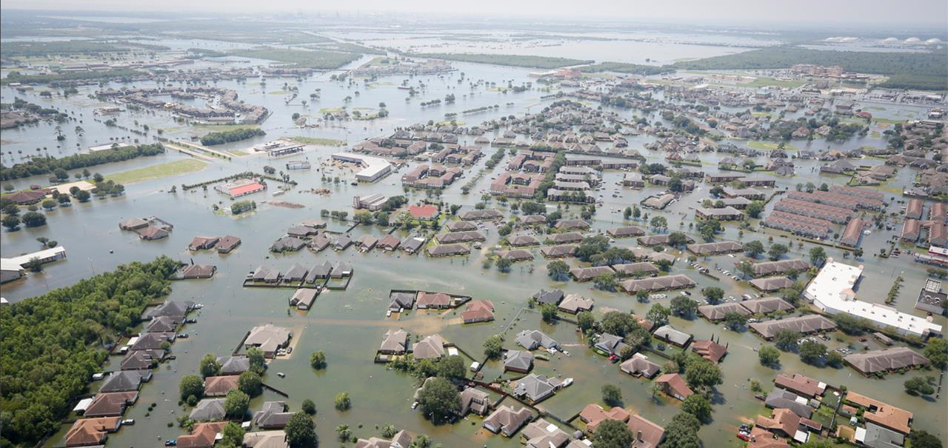
Hurricane Harvey – Record Rainfall

Slide 4
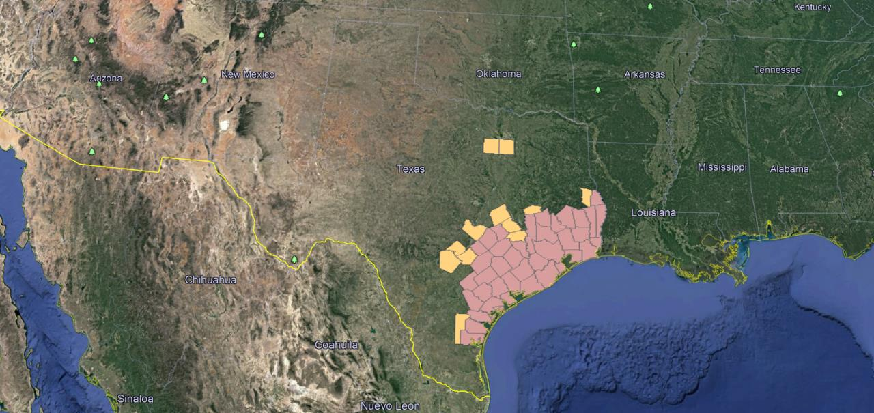
Hurricane Harvey - Affected Counties

Slide 5
PREPS by the Numbers
Applied for FEMA Assistance
~894,000
Eligible for PREPS
86,089
Opted into PREPS
28,767
Obtained Right of Entries
18,688
Opted out of PREPS
27,693
Received Work Orders
17,440
No Contact/Response
29,629

Slide 6
PREPS…
Stands for Partial Repair and Essential Power for Sheltering; Texas’ version of the Sheltering and Temporary Emergency Power (STEP) Program
Is a Public Assistance program funded under Section 403 of the Stafford Act
Is an emergency sheltering program intended to supplement existing sheltering options (ex: hotels, mass shelters)
Provides emergency, temporary repairs in disaster-damaged single-family owner-occupied residences
Allows homeowners to remain in their homes and their communities as they complete permanent repairs to their homes
Was previously implemented in Louisiana as the Shelter at Home (SAH) Program and New York as the Rapid Repair Program; is currently being utilized in Florida and Puerto Rico

Slide 7
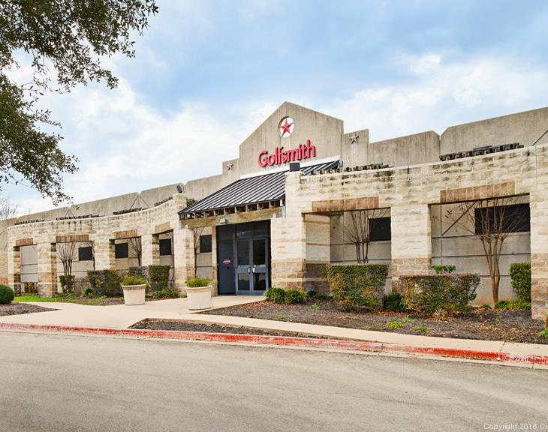
PREPS Eligibility Factors
Homeowner
Primary Residence
Reside in a Designated Individual Assistance County
FEMA Verified Loss < $17,000
Stand-alone homes (including duplexes, townhomes, and some mobile homes)
Storm-related damage
Able to make safe, habitable, and secure for less than $20,000 cap; extra $5,000 for Access and Functional Needs
FEMA determined eligibility

Slide 8
PREPS Lead Up

Slide 9
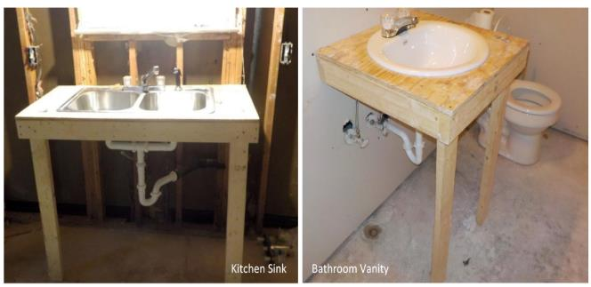
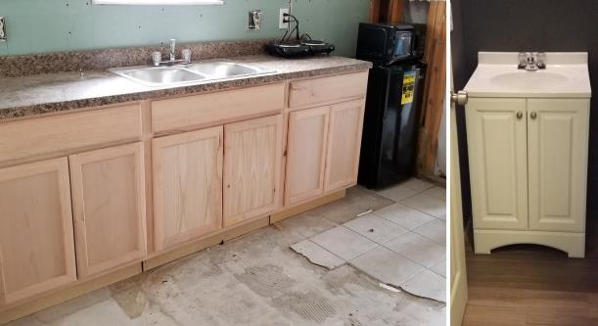
Implementing Lessons Learned from the Start
LA SAH
TX PREPS

Slide 10
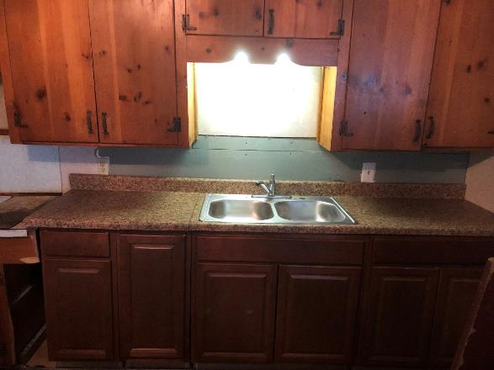
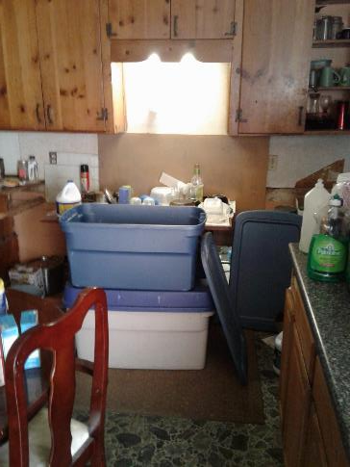
Example PREPS Repairs: Kitchen
BEFORE
AFTER

Slide 11
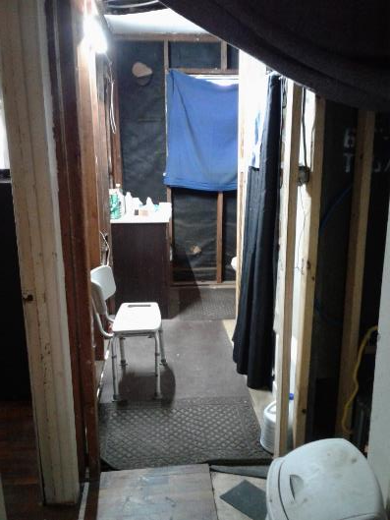
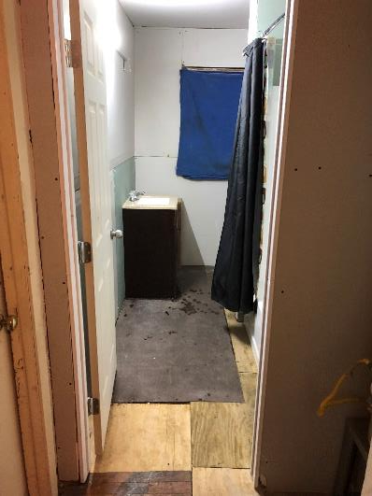
Example PREPS Repairs: Bathroom
BEFORE
AFTER

Slide 12
Day 1: FEMA Gives Authorization for PREPS
11/20/17

Slide 13
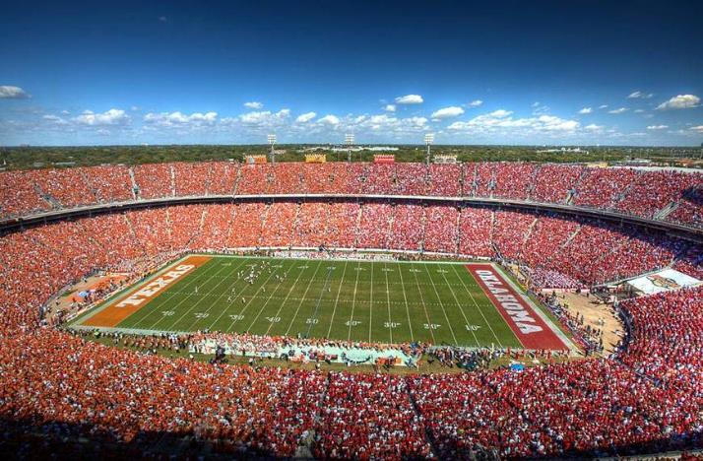
Day 24: Call Center is Live
Tasked to call ~86,000 potentially eligible applicants
Overall Outreach Statistics
290,000+ outbound calls made
66% contact rate
51% participation rate
188,817 emails sent
23,786 texts sent
51,242 postcards sent
12/13/17

Slide 14
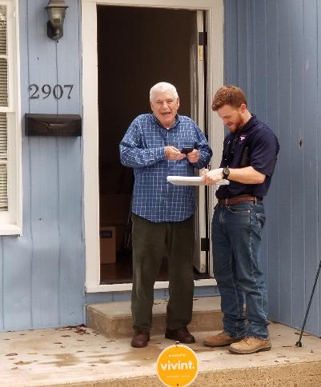
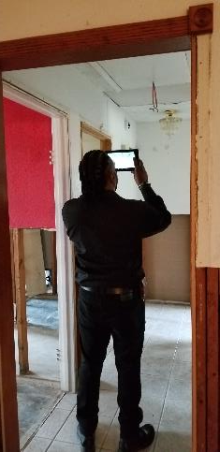
Day 28: First Home Inspection
Required signed Right of Entry (ROE) prior to performing the Initial Site Visit (ISV)
Best Practice: Encouraged contractor to join inspector on ISV
After Scope of Work created, Agreement to Participate was signed
26,898 total initial inspections made by 103 inspectors in 77 days resulting in 18,688 eligible ISVs
12/17/17

Slide 15
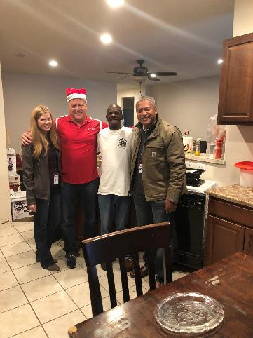
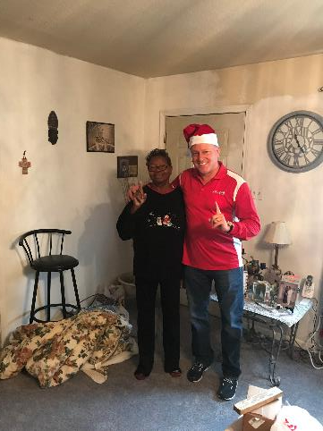
Day 34: First Home(s) Completed
Just in time for Christmas
Team worked holidays and accommodated families schedules
12/23/17

Slide 16
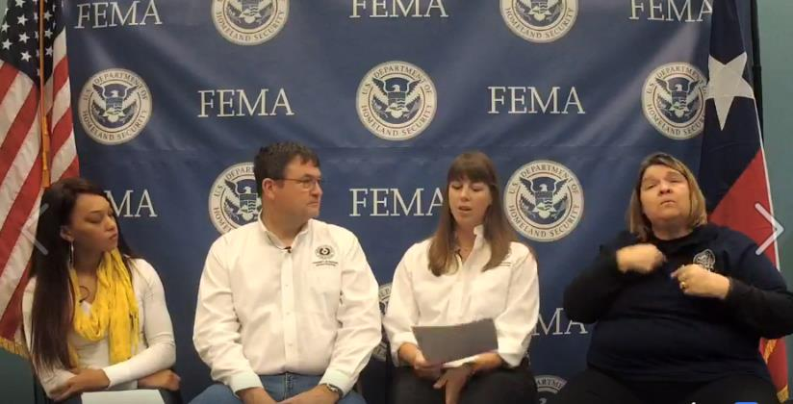

Day 51: 100 Homes Completed
Challenge: Scam Alert
PREPS-specific badges
Facebook Live event
1/9/18

Slide 17

Day 59: 500 Homes Completed
Approaching initial ROE deadline; granted 1st extension to 2/17/18
1/17/18

Slide 18
Day 66: 1,000 Homes Completed
Postcard mailed to those still with no response
1/24/18

Slide 19
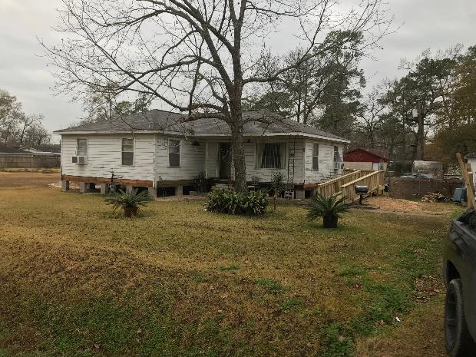
Day 96: 5,000 Homes Completed
Five new builders added for a total of 15 prime contractors
Granted 2nd ROE extension to 3/3/18
2/23/18

Slide 20

Day 122: 10,000 Homes Completed
Average cost of repairs is (currently) ~$11,000/home
Most commonly used scope items:
  Exterior sheetrock
  Cabinets
  Appliances
  Electrical outlets
3/21/18

Slide 21

Day 136: Today!
____________ Homes Completed
(Fill in the Blank)
4/4/18

Slide 22

Day 180: Construction Complete
It better be!!!
Prediction: 17,001 Homes Completed
Next Steps for Program Closeout:
  Final Invoicing
  Final Reimbursement Requests
  Capture Best Practices and Lessons Learned
  Continued Applicant Support
5/19/18

Slide 23
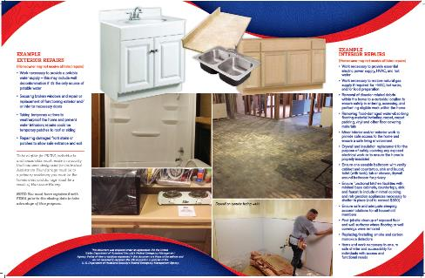
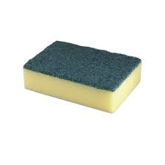
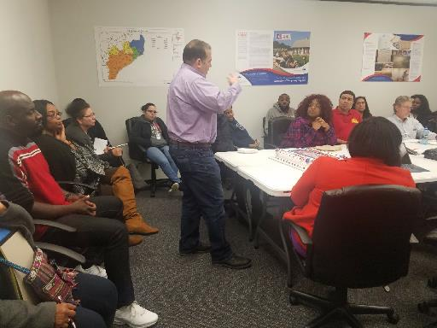
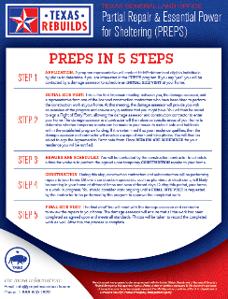
Best Practices / Key Takeaways
TOP FOUR:
Set proper expectations from the very beginning
Scrub the data
Implement Best Practices and Lessons Learned from previous programs
Communicate early and often

Slide 24
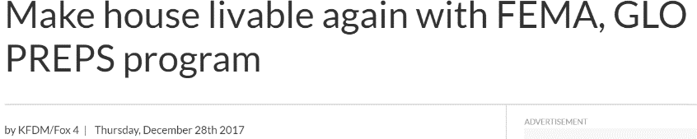

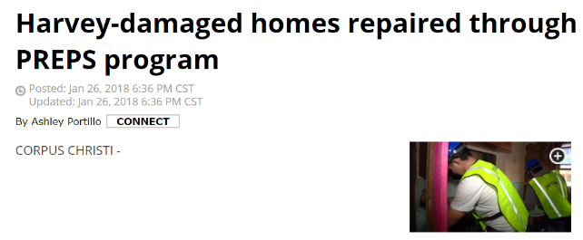
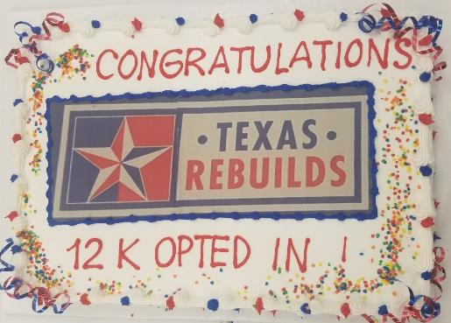
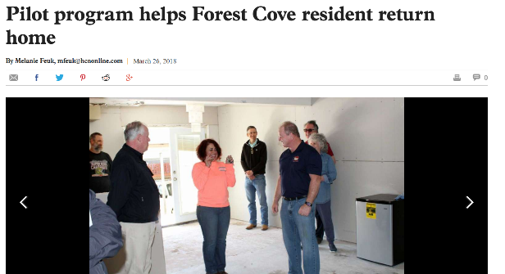
Celebrate the Wins / Focus on What Matters

Slide 26
