Slide 1
LWIN
Louisiana Wireless Information Network
System Management & Maintenance Update
May 1, 2013
Department of Public Safety
Radio Communications
(225) 925-6036

Slide 2
Infrastructure Update

Slide 3
SYSTEM SUMMARY
119 Tower Sites in Full Operation
6 Operational Mobile Sites

Slide 4
Zone 1 Sites in Full Operation
Pan Am | Bridge City | Slidell | LaPlace | Abita Springs
Sheridan | Geismar | St. James | LaRose | BR Simulcast BR, Central, LSU, WBR
Hammond | Gray | Berwick | Baywood | Ramah
Sage Hill | Parker Road | Iberville | Livingston | Jackson
Greensburg | Superdome | South Baton Rouge | Pointe Coupee | Theriot
Paincourtville | Boothville | Mobile Units 94, 96, 97, 98, 99, 100

Slide 5
Zone 2 Sites in Full Operation
Northern Simulcast Gretna, Gallera, NO East | Southern Simulcast St. Rosalie, Venice/Reggio | Kenner | Airport | Buras
Lafitte | Port Fourchon | Bayou Gauche | Hahnville | Wilmer
Blond | Montegut

Slide 6
Zone 3 Sites in Full Operation
Clearwater | Monroe | Winnfield | Delhi | Chopin
Dry Prong | Hagewood | Farmerville | Minden | Natchitoches
Bastrop | Greenwood | Ruston | Hineston | Ashland
Vivian | Newellton | Noble | Transylvania | Alexandria
Avoyelles | Bellevue | Bernice | Calhoun | Columbia
Ferriday | Homer | Jena | Jonesboro | Mansfield
Many | Marion | Oak Grove | Plain Dealing | Ringgold
Sentell | Tallulah | Wheeling | Shreveport | West Monroe
Chase | Keachi | Coushatta | Shongaloo | Sibley
Vick | Calvin | Arcadia

Slide 7
Zone 4 Sites in Full Operation
Abbeville | Acadia | Arsene Lebleu | DeQuincy | Dry Creek
Jeanerette | Jennings | Johnson Bayou | Lafayette | Lake Charles
Leesville | Merryville | Opelousas | Parks | Rockefeller
Rosepine | Scott | Sulphur | Vermillion | Ville Platte
Vinton | Cravens | Hicks | Hornbeck | Oakdale
Roseland

Slide 8
Channel Summary
Total Channels (119 Tower Sites and 6 Mobile Sites) – 1143
Total Active Channels – 1090
1054 Channels on 119 Sites
36 Channels on 6 Mobile Sites
Repeaters Pending Licenses – 53

Slide 9
System Statistics

Slide 10
Subscribers
7.13
Upgrade

Slide 11
Push to Talk
7.13
Upgrade

Slide 12
Busies
Hurricane Isaac X10
34,885 Busies

Slide 13
Top 3 Sites – Voice Busy
April 1 to April 30
1. Montegut
2. Roseland
3. Kenner

Slide 14
Subscriber Statistics

Slide 15
Subscriber Statistics
Security Groups/Agencies
182/427
Talkgroups
5,485
Users
70,136

Slide 16
Agencies Added Last 3 Months
Shreveport City Marshal Woodworth Fire Department Flatwoods Volunteer Fire Dept. Texarkana Arkansas Police Dept. Jeanerette Fire Dept. West Hancock Fire Rescue Ball Vol Fire Dept. Court of Appeal, First Circuit Monroe Regional Airport Vernon Parish Fire District

Slide 17
System Coverage

Slide 18
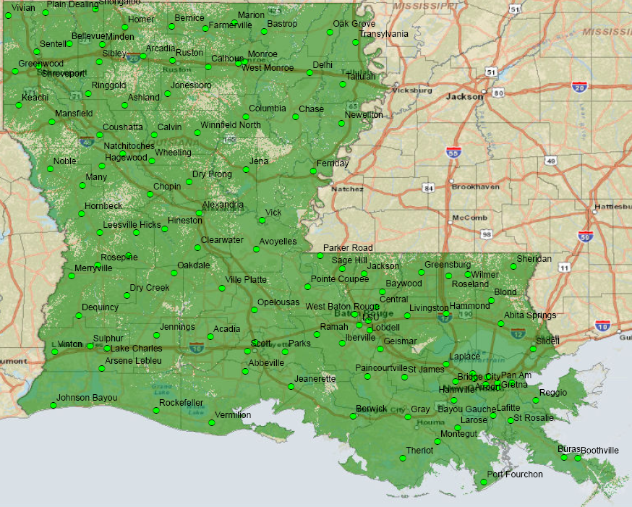
Present Coverage

Slide 19
Thank You!

