Slide 1
THREAT AND HAZARD IDENTIFICATION
AND RISK ASSESSMENT

Slide 2
THIRA
…methodologies exist to understand, qualify, and quantify risk. These methodologies most often focus on a single threat or hazard type and a small area or fixed facility assessment to geographic areas as large as cities and states and the full spectrum of threats and hazards. The specificity gained by complex probabilistic modeling and analysis is lost when trying to apply the results across complex landscape of prevention, protection, mitigation, response, and recovery….

Slide 3
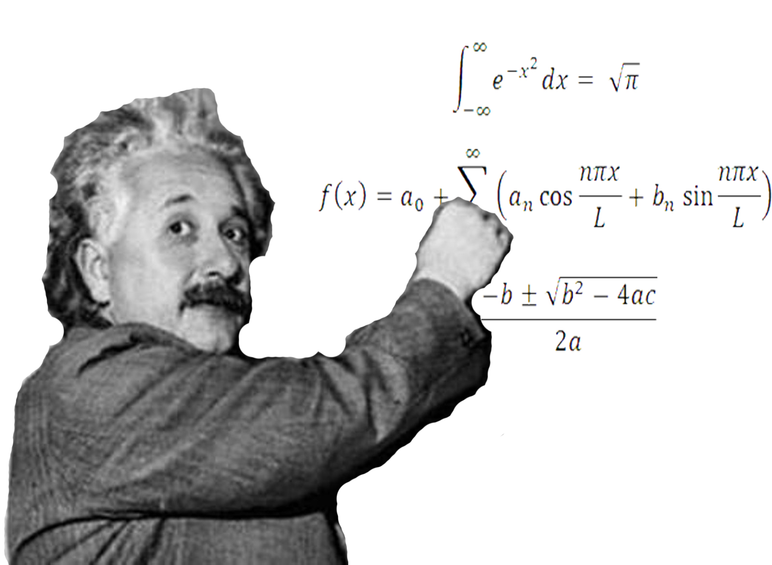
IN OTHER WORDS:
Notes:
Complicated

Slide 4
1 + 1 = 2
Notes:
We’re going to make it simplified, easy, and understandable.

Slide 5
THIRA
What is it?
What does it do?
How can I use it?
Notes:
THIRA is the Threat and Hazard Identification and Risk Assessment – a tool that provides a comprehensive approach for identifying threats and hazards in your area, assessing their risks and associated impacts, and setting a goal to accomplish your mission.
The THIRA will help guide your planning, training, and exercise programs.

Slide 6
COMPONENTS
Core Capabilities and Desired Outcomes
Threats and Hazards
Estimated Impacts
Capability Targets
Apply Results
Notes:
Overview

Slide 7
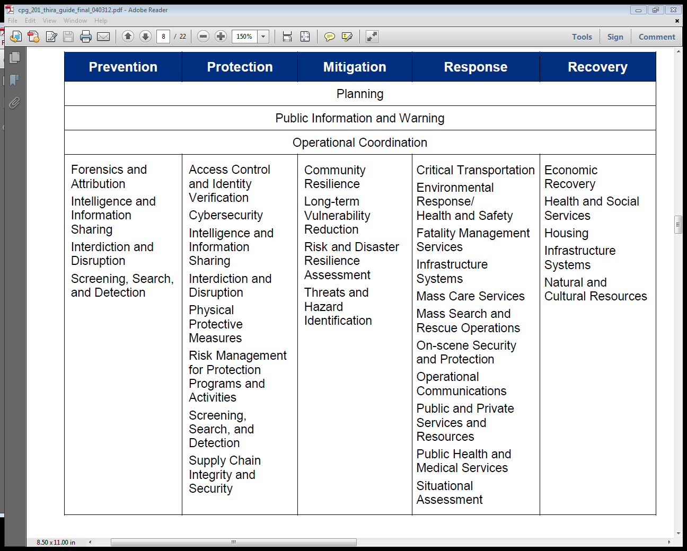
CORE CAPABILITIES
Notes:
Overview. Do not discuss each CC, just select one or two and discuss the Desired Outcomes

Slide 8
CORE CAPABILITIES
Core Capabilities
Notes:
Overview. Do not discuss each CC, just select one or two and discuss the Desired Outcomes

Slide 9
DESIRED OUTCOMES
Endstate of the Core Capability
What is it you want to accomplish?
Simple or complex
Notes:
The desired outcomes are your definitions of the Core Capabilities. They are the goals you are setting in place in order to reach, complete, or accomplish the core capabilities. It can be a simple, one sentence statement or it can be a full paragraph.

Slide 10
DESIRED OUTCOMES
Point A
Point B
Notes:
The desired outcomes are your definitions of the Core Capabilities. They are the goals you are setting in place in order to reach, complete, or accomplish the core capabilities. It can be a simple, one sentence statement or it can be a full paragraph.

Slide 11
THREATS AND HAZARDS
Identification and Determination
HIRA
Historical Data
WebEOC
Notes:
Discuss how to identify Threats and Hazards. Discuss giving them context (personalizing them to your particular area). Want to create low probability / high risk scenarios.

Slide 12
ESTIMATED IMPACTS
Core
Capabilities
Notes:
Discuss how to identify Threats and Hazards. Discuss giving them context (personalizing them to your particular area). Want to create low probability / high risk scenarios.

Slide 13
ESTIMATED IMPACTS
Core Capability
Threats and Hazards
Notes:
How will the Threat alter your ability to reach your desired income of your core capability? Apply a threat from the audience (flooding) to a core capability discussed on slide 7.

Slide 14
CAPABILITY TARGETS
Core
Capability Target
Capabilities
Notes:
Discuss how to identify Threats and Hazards. Discuss giving them context (personalizing them to your particular area). Want to create low probability / high risk scenarios.

Slide 15
THIRA
Breakfast
Core Capability
Serve Breakfast to your family on Saturday morning
Desired Outcome
Provide a wholesome and nutritious meal
Threat or Hazard
No food in the pantry
Estimated Impact
Your kids go hungry
Capability Target
Have a plan in place to shop for groceries by Friday night

Slide 16
THIRA
Dam Scenario
Core Capability
Desired Outcome
Threat or Hazard
Estimated Impact
Capability Target
Notes:
Obtain an actual threat from the group. Use 2 or 3 core capabilities and complete the THIRA.

Slide 17
THIRA
Building planning scenarios
Utilizing for exercises and training
Notes:
Explain how the THIRA can be used in planning and exercises.

Slide 18
THIRA
Questions?
scott.vankeuren@la.gov
225-926-3633
Notes:
Explain how the THIRA can be used in planning and exercises.

