Slide 1

Ebola Virus Disease (EVD) Update
And Influenza Preparedness
Jimmy Guidry, MD - DHH
January 20, 2015

Slide 2
Agenda Topics
Ebola Status Update: What has changed in West Africa that impacts EVD planning for US?
First Responder Update
Flu Season Update

Slide 3

Status of Ebola Outbreak in West Africa
The western region of Sierra Leone is experiencing intense Ebola transmission.
The case rates have declined in Liberia and the country plans to reopen schools in February 2015.

Slide 4
Impact on Screening for International Travelers
Mandatory screenings and monitoring will remain in place for travelers from Liberia, Guinea, and Sierra Leone.
Effective January 6, 2015 mandatory airport entry screening for people entering the United States from Mali was discontinued

Slide 5
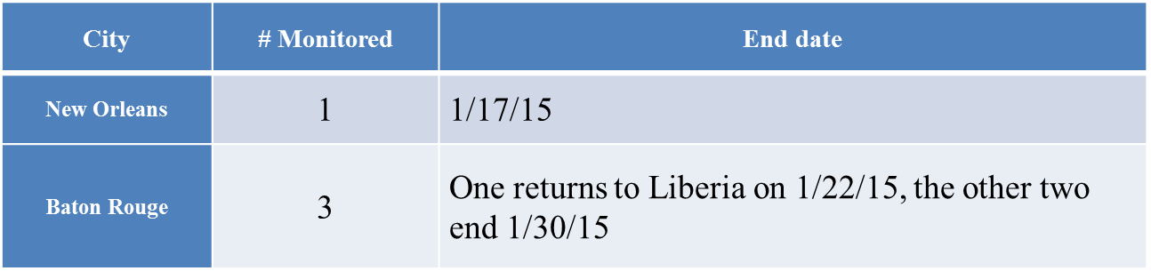
What is LA actively monitoring?

Slide 6
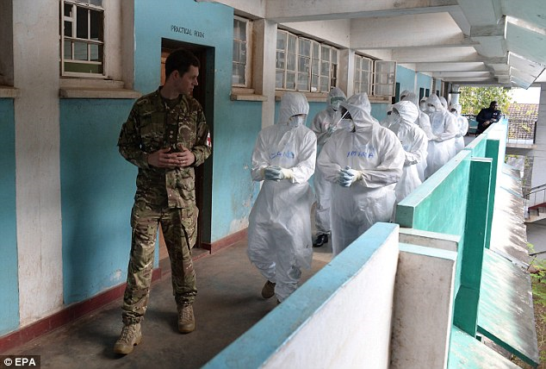
Returning Soldiers
World Health Organization is investigating reported cases of Ebola in Mosul in ISIS militants.
U.S. soldiers returning to the United States from West Africa will undergo 21-day monitoring periods on designated U.S. bases in Washington, Texas, North Carolina, and Virginia.

Slide 7

Ebola Virus Disease Updates
Several aid organizations continue to advise their returning volunteers to avoid flying through JFK and Newark airports due to strict mandatory quarantine policies in New York and New Jersey.

Slide 8

Ebola Virus Disease Update
Due to the sudden increase in demand for personal protective equipment (PPE), the U.S. supply chain is experiencing delays in filling orders for some of the PPE recommended by CDC in October 2014.
Available Resource: ViralProtec
Local LA provider with PAPRs and PPE
JimWemett@aol.com
585-967-1111

Slide 9
First Responder Update

Slide 10
EVD Transmission
The virus that causes Ebola is not airborne
Ebola is spread by close contact with an infected person.
Ebola is spread through direct contact with:
  blood or body fluids (such as saliva, sweat, semen, stool or urine) of an infected person or animal, or
  through contact with objects that have been contaminated with the blood or other body fluids of an infected person.

Slide 11
EVD Symptoms
The incubation period ranges from 2 to 21 days (most commonly 8-10 days)
Early symptoms include sudden fever, chills, and muscle aches.
Nausea, vomiting, chest pain, sore throat, abdominal pain, and diarrhea may follow.
Symptoms become increasingly severe mental confusion, bleeding inside and outside the body, shock, and multi-organ failure.

Slide 12
EVD Case Definition
Person Under Investigation (PUI)
Clinical criteria, which includes fever and additional symptoms such as severe headache, muscle pain, vomiting, diarrhea, abdominal pain, or unexplained hemorrhage;
AND Epidemiologic risk factors within the incubation period:
Contact with blood or other body fluids or human remains of a patient known to have or suspected to have EVD
Residence or travel in an area where EVD transmission is active
Direct handling of bats, rodents, or primates from disease - endemic areas.

Slide 13
EVD Treatment
Standard treatment for Ebola is limited to supportive therapy.
No currently licensed antivirals or vaccines
Experimental trials:
  ZMapp
  Brincidofovir - Doctors Without Borders says a clinical trial of Brincidofovir is under way at one of its Ebola treatment facilities in Liberia, with initial results expected in February.
  Favipiravir - Trials of the drug Favipiravir are under way at two treatment centers in Guinea, with initial results expected in late March. (Sources: AP, Reuters)
  Vaccine - Johnson & Johnson has started clinical trials of a candidate Ebola vaccine, making it the third to enter this stage of testing. (Source: Reuters)

Slide 14
Legal Definitions
Quarantine (confinement): non-symptomatic; person exposed to the disease; confined for the duration of the incubation period which is 21 days for Ebola, with close monitoring.
Isolation: symptomatic with the disease; and in isolated setting usually in a medical setting (hospital).

Slide 15
Recommendations for EMS, Medical First Responders, Firefighters and
Law Enforcement Personnel

Slide 16
Patient Assessment
Address scene safety:
  If 9-1-1 call takers / dispatch advise that the patient is suspected of having Ebola, put on appropriate PPE (Gloves, Gown, Eye protection, Facemask) before entering the scene
  Keep the patient separated from other persons as much as possible

Slide 17
Patient Assessment (Con’t)
Consider the symptoms and risk factors of Ebola:
  Fever (CDC no longer clarifying minimum temperature as of January 2, 2015 guidance), and
  Additional symptoms such as severe headache, muscle pain, vomiting, diarrhea, abdominal pain, or unexplained hemorrhage.
If the patient has these symptoms of Ebola, then ask about risk factors within the past 3 weeks :
  Contact with blood or body fluids of a patient known to have or suspected to have Ebola;
  Residence/travel to a country with an Ebola outbreak
  Direct handling of bats or nonhuman primates from disease-endemic areas

Slide 18
Patient Transport
No Risk Factors
Proceed with normal patient care and transport
Suspected Ebola
Ensure all personnel are using proper PPE
Notify receiving hospital prior to arrival of suspected case
Call the Louisiana Office of Public Health 24 hour hotline immediately
Limit activities, especially during transport, that can increase the risk of exposure to infectious material

Slide 19
24-Hour Hotline
To discuss a possible exposure, request laboratory testing, or report a suspected case, contact the Louisiana Office of Public Health immediately at 504-568-8313 or after 4:30 p.m. weekdays and weekends 800-256-2748.

Slide 20
EMS Protocol Modification
EMS Medical Protocols should be modified by the agency medical director to include the following:
If the EMS Practitioner suspects the patient has Ebola (by using the CDC criteria detailed on previous slides):
  ensure proper PPE is utilized
  contact the OPH hotline immediately, prior to transport if possible, at 800-256-2748 for guidance

Slide 21
EVD Additional Resources
CDC Guidance For Pre-Hospital Responders:
http://www.cdc.gov/vhf/ebola/hcp/interim-guidance-emergency-medical-services-systems-911-public-safety-answering-points-management-patients-known-suspected-united-states.html
EMS Checklist For Ebola
http://www.cdc.gov/vhf/ebola/pdf/ems-checklist-ebola-preparedness.pdf
http://www.cdc.gov/vhf/ebola/index.html
Algorithm for EMS and 911 Public Safety Answering Points
http://www.cdc.gov/vhf/ebola/pdf/ems-911-patients-with-possible-ebola.pdf

Slide 22
EVD Additional Resources
CDC
http://www.cdc.gov/vhf/ebola/index.html
DHH
http://www.dhh.state.la.us/index.cfm/page/1974
Questions or Training Assistance:
Bureau of Emergency Medical Services
225-925-7200
BEMS@LA.GOV

Slide 23
Seasonal Influenza (Flu)
UPDATE

Slide 24
National Influenza Updates
Influenza is high across most of the country with flu illnesses, hospitalizations, and deaths elevated.
Influenza is now widespread in 42 states.
Most(>90%) of the virus is H3N2, which is a serious form of influenza.
Influenza spreads every year, but the timing, severity, and length of the season usually varies from one season to another.

Slide 25
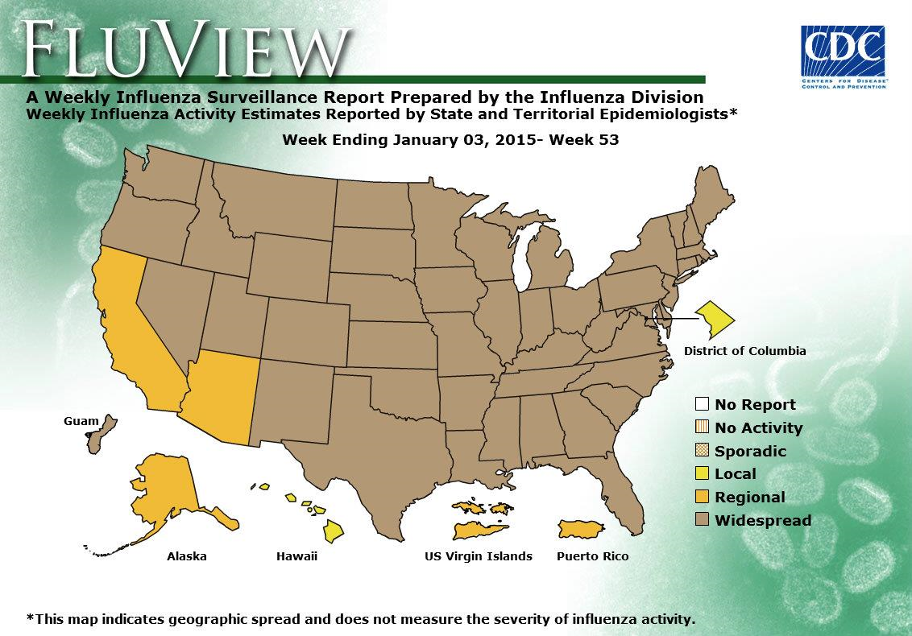
National Influenza Update

Slide 26
Louisiana Influenza Update
Louisiana has seen widespread influenza activity since December 1, 2014.
There has been >350,000 flu cases and >3,500 influenza hospital visits in Louisiana.
7% of doctor/hospital visits are due to flu-like symptoms.
Several flu outbreaks in nursing homes have required strict control measures.

Slide 27
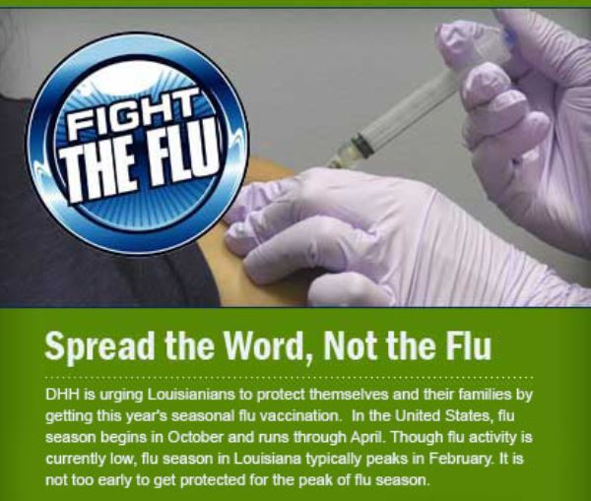
Louisiana’s Fight the Flu
The State has been involved in an extensive communication campaign encouraging the flu vaccine and healthy habits that protect against the flu.

Slide 28
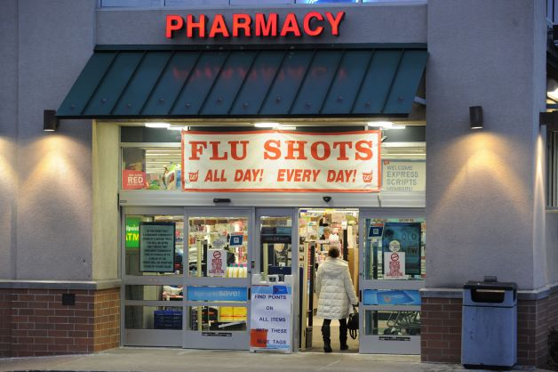
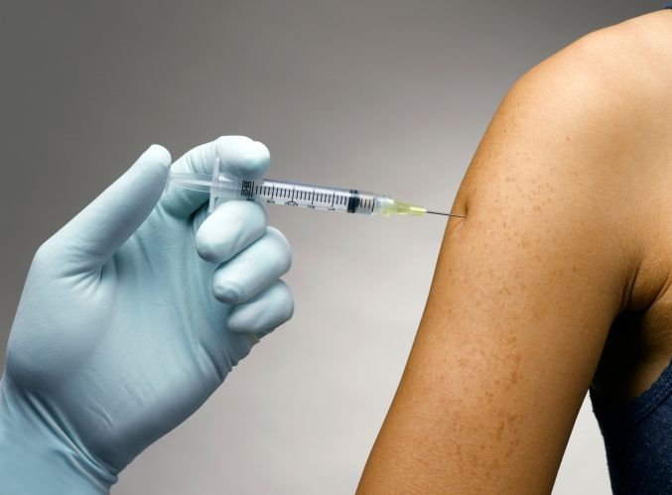
Influenza Vaccine Update
The influenza vaccine is the best protection against the flu.
The circulating H3N2 has “drifted” since the vaccine was produced; making the vaccine less effective NOT ineffective.
A flu vaccine is readily available from your healthcare provider or local community pharmacy.

Slide 29
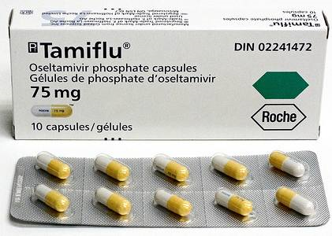
Influenza Antivirals Update
Antivirals are recommended for anyone with high-risk conditions.
Antivirals do not “cure” the flu, but shorten the duration and severity of the illness.
Studies show antivirals work best when started within 48 hours of symptom onset.

Slide 30
Continuity of Operations (COOP)
COOP ensures to provision of essential services during emergency situations.
A severe influenza season can reduce your staff by 20-30% for several weeks.
Basic services, such as law enforcement, emergency response, utilities, transportation, and healthcare could be disrupted.

Slide 31

Importance of COOP
Ensure that your COOP plan is updated and accurate, to ensure delivery of essential services that your community relies on.

Slide 32
Questions?

