Slide 1
Louisiana Voluntary Organizations Active in Disaster (VOAD)
The mission of Louisiana Voluntary Organizations Active in Disaster (Louisiana VOAD) is to enhance the effectiveness of service providers and stakeholders who help communities prepare for, respond to, and recover from disasters, with the overall purpose of lessening the impact of disasters on Louisianans.
Louisiana VOAD accomplishes its mission by
serving as a forum for the sharing of knowledge and resources
raising awareness among providers & stakeholders about best practices in providing services throughout the disaster cycle
advocating for sound public policies that support its mission and purpose
sponsoring activities that strengthen local coalitions
serving a coordinating role in statewide response and recovery efforts
Cooperation | Communication | Coordination | Collaboration

Slide 2
Donations Management
Louisiana VOAD is tasked to assist in the coordination of solicited and unsolicited donations during an activation of the State EOC. Rules to abide by:
Cash rules
Used clothing is rarely useful
Confirm what is needed before taking action
Donate through a trusted organization
Make sure logistics are covered

Slide 3
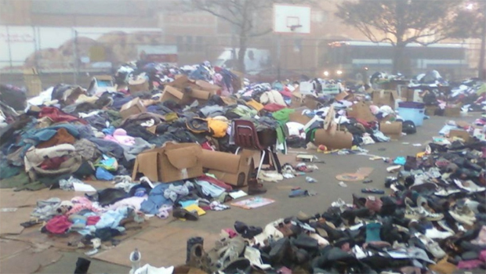
Unsolicited Donations Can Actually Cost Money and Valuable Time

Slide 4
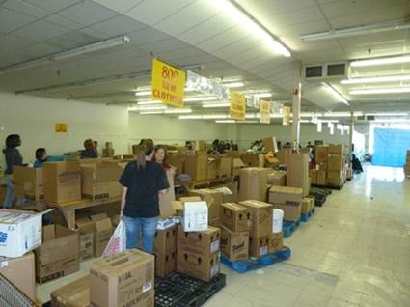
Solicited Donations and a Management Plan Assist in Recovery Efforts

Slide 5
How Businesses Can Engage
Businesses can provide a wide range of needed products and services during emergency and recovery operations. These donations may be tax deductible and promote corporate social responsibility.
Financial contributions can be used to purchase needed goods and supplies
Corporate volunteers
Donate requested products and services like bottled water, cleaning and medical supplies, building materials, loaned equipment, and donated transportation or warehouse space

Slide 6
Questions?
Contact Info:
Jessica Vermilyea
Louisiana VOAD Manager Consultant
Director, Upbring Disaster Response
504.376.9121 mobile
vermilyea.jessica@gmail.com
www.lavoad.org | www.upbring.org

