Slide 1
#SMEM: Social Media and Emergency Managers
Christina Stephens
2013 GOHSEP Directors Conference

Slide 2
Social Media 101
The term “social media” typically refers to any Internet-based service that allows users to share information with each other.

Slide 3
Social Media 101

Slide 4
SocMe Market share
More than a billion monthly active users worldwide as of December 2012;
618 million daily active users on average in December 2012;
Two-thirds of online adults say they use Facebook;
Women are more likely than men to be Facebook users.
Source: Pew Internet & American Life Project / Facebook.com

Slide 5
SocMe Market share
There are more than 200 million active Twitter users and they send more than 340 million tweets per day;
16 percent of Internet users use Twitter;
People younger than 50 are most likely to use Twitter;
Those 18-29 years old are most likely to Twitter;
People who live in cities or urban areas are more likely to be on Twitter.
Source: Pew Internet & American Life Project / Twitter.com

Slide 6
Internet Usage in America
As of November 2012, 81 percent of all Americans 18 years of age and older use the Internet.
The most recent statistics for American teens (ages 12 to 17) shows that as of July 2011, 95 percent used the Internet and 77 percent owned a cell phone.
Source: Pew Internet & American Life Project

Slide 7
Internet Usage in America
As of August 2012, 69 percent of online adults use social networking sites.
67 percent of online adults say they use Facebook
16 percent of online adults say they use Twitter
Source: Pew Internet & American Life Project

Slide 8
Mobile Internet Usage
2012 was the tipping point for smartphone usage in America, where more people are buying smartphones when compared to traditional cellular phones.
Source: Pew Internet & American Life Project

Slide 9
Mobile Internet Usage
Almost half of all adult Americans (45 percent) own a smartphone and 66 percent of Americans aged 18 to 29 have smartphones.
In total, 55 percent of adult cell phone users use their smartphones to access the Internet and 17 percent use their phones as their main tool to access the Internet.
Source: Pew Internet & American Life Project

Slide 10
PRACTICES: Integrating #SMEM into response

Slide 11
Why Social Media is Great
Quick and easy to use
Public can amplify your message
People share information with responders

Slide 12
Why Social Media is Bad
Quick and easy to use
Public can amplify your message
People share information with responders

Slide 13
Responsibility for SocMe
Social Media should fall under ESF-15 – Public Affairs with a PIO monitoring and responding;
If there is no PIO, then delegate responsibility to someone you would trust to speak on behalf of the agency.

Slide 14
Responsibility for SocMe
Don’t try to reinvent the wheel: use existing messaging from press releases and talking points.
Make sure what is being said on social media matches what is being said elsewhere.

Slide 15
Social Media Content
Rule of thumb: Only post information from official sources.
Do not speculate.
Quash rumors by monitoring “chatter” on sites.

Slide 16
Social Media Content
Spend time helping people, acknowledge those with complaints, avoid “trolls.”
Posts with pictures/graphics are more likely to be shared on Facebook.

Slide 17
Monitoring / Mining
Social media is a two-way street. You push information to the public and they share information back.
Designate search terms on Twitter (hashtags) to monitor public messages.

Slide 18
Location of SocMe Manager
Some social media monitoring can be done off-site.
Ultimate authority should rest with someone who is embedded at the EOC most of the time to get “ground truth.”

Slide 19
Smartphone Quick Tips
Don’t just save phone numbers in your contacts, bookmark URLs in your smartphone browser.
Purchase an extra smartphone battery or cell phone car charger to keep charged during power outages.

Slide 20
Smartphone Quick Tips
Cell phone users can get updates from Twitter without creating an account using “Fast Follow,” which allows you to sign up to have tweets texted to a phone. Text messaging rates will apply.
To fast follow: Text follow [username] to 40404
For example, if you text “follow GOHSEP” to 40404, you will be text subscribed to all Twitter updates from GOHSEP.
Can cancel these alerts by texting “STOP” to 40404

Slide 21
EXAMPLES: #SMEM in action

Slide 22
State Resources
Louisiana Emergency Info Websites:
Gohsep.la.gov
Getagameplan.org
Emergency.louisiana.gov
GOHSEP also has an app for Apple iPhones, which can be downloaded at getagameplan.org

Slide 23
GOHSEP on Social Media
You can “like” GOHSEP on Facebook at facebook.com/gohsep and you can follow @GOHSEP on Twitter.
GOHSEP is also on YouTube and Flickr.

Slide 24
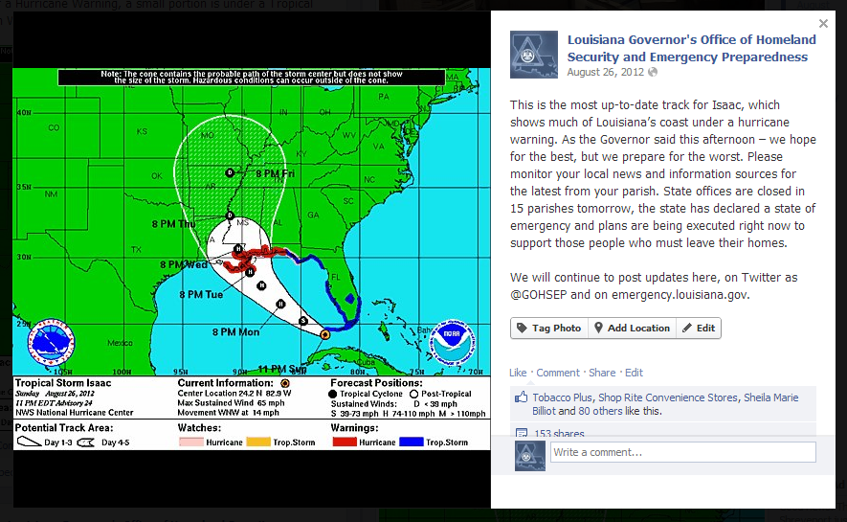
Hurricane Isaac
Warning people on Facebook before Isaac made landfall

Slide 25
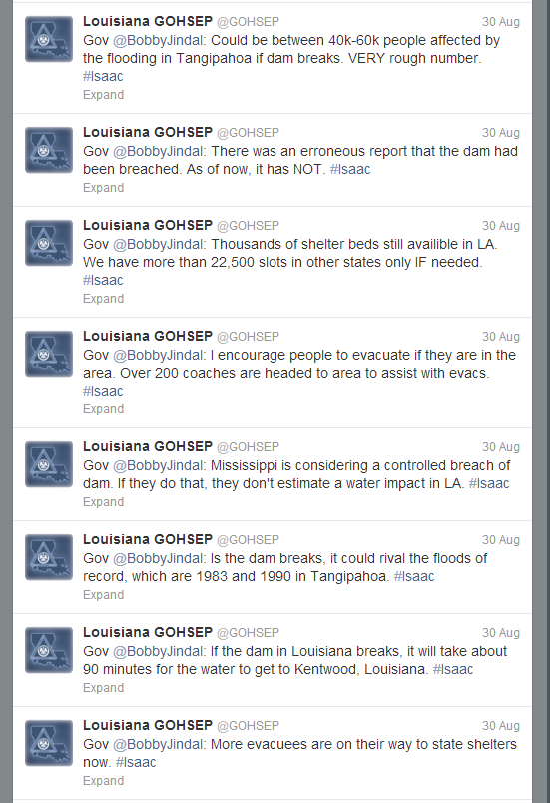
Hurricane Isaac
“Covering” Governor Jindal’s press conferences on Twitter

Slide 26
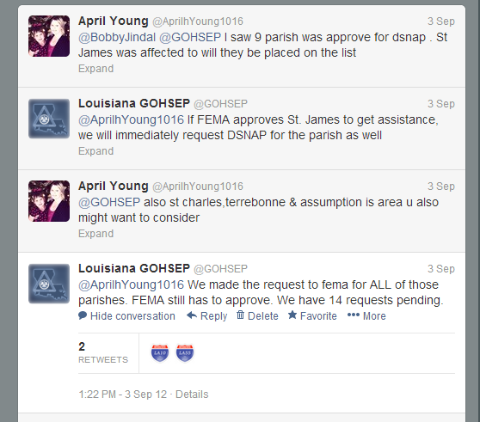
Hurricane Isaac
Answering questions from the public on Twitter

Slide 27
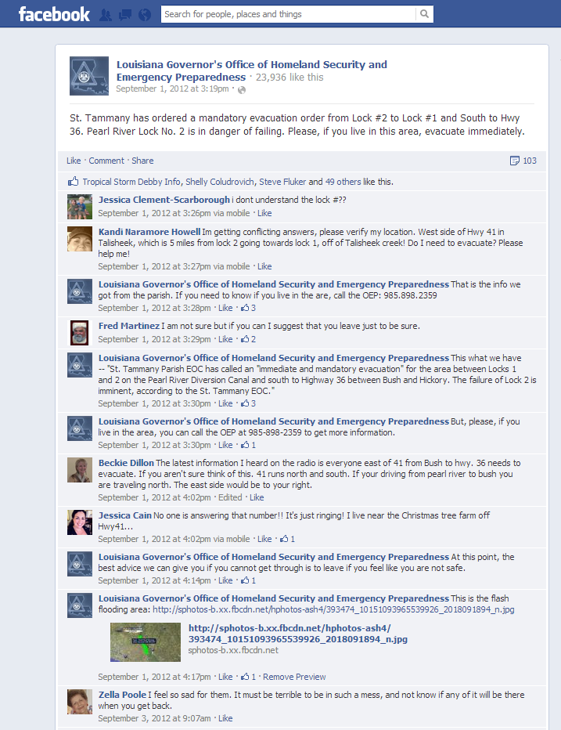
Hurricane Isaac
On September 1, when a lock on the Pearl River was in danger of failing because of flooding, GOHSEP used Facebook to answer questions from residents who did not know if they should evacuate.

Slide 28
Local Examples
Assumption Parish: Bayou Corne Sinkhole

Slide 29
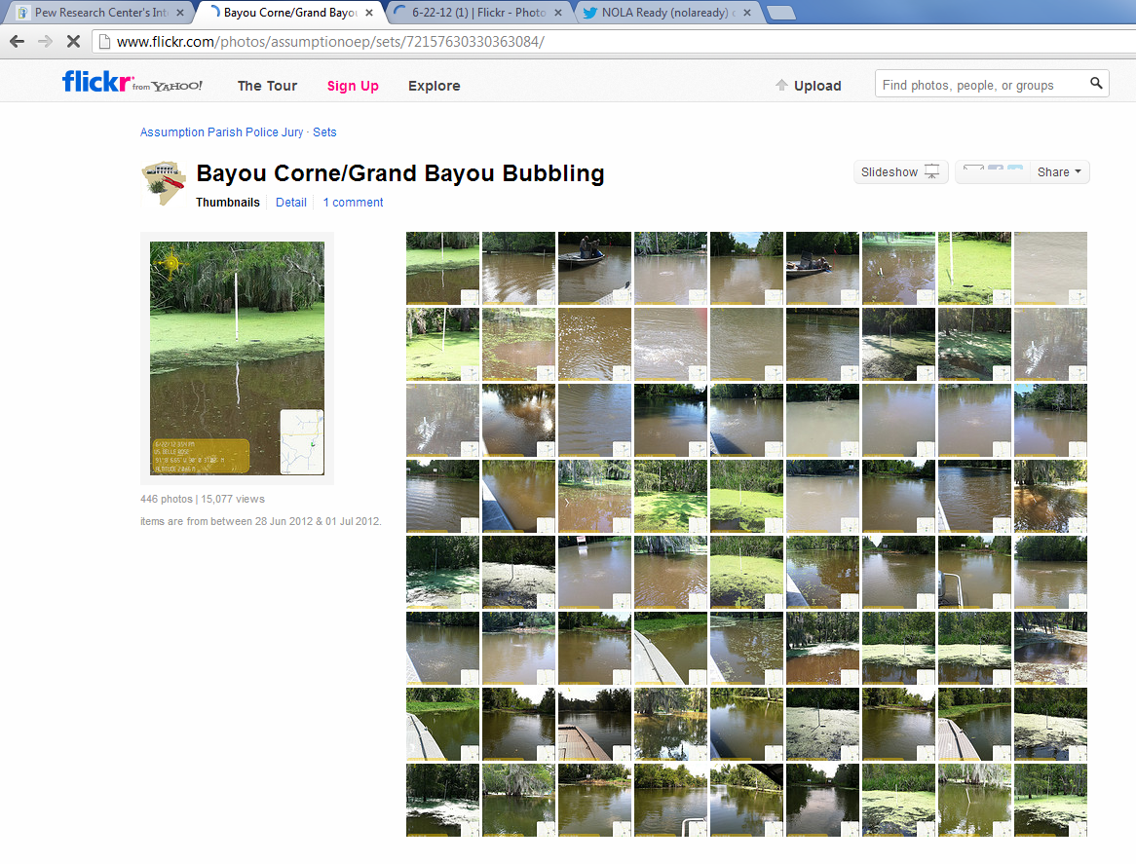
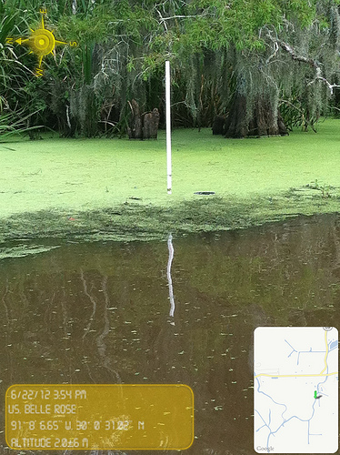
Local Examples
Assumption Parish: Bayou Corne Sinkhole

Slide 30
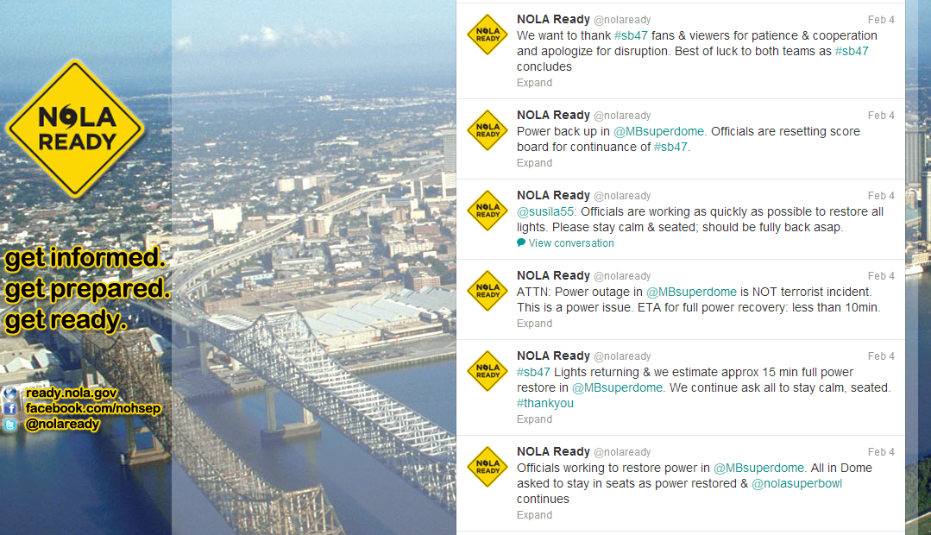
Local Examples
City of New Orleans: NOLA Ready

Slide 31
Local Examples
City of New Orleans: NOLA Ready

Slide 32
MEDIA: #SMEM vs. #Traditional

Slide 33
Bridging to Traditional Media
Social media should enhance
— not replace — your relationships with traditional media outlets like radio and television stations and newspapers.

Slide 34
Bridging to Traditional Media
Media outlets and reporters will “follow” government agencies to get information in real time.
Reporters also will share your information with their followers, amplifying your page and message.

Slide 35
Bridging to Traditional Media
Most reporters are active on social media and use it to promote their stories or report facts immediately.
Media outlets are not afraid to “break” news on social media outlets like Twitter and Facebook.

Slide 36
Bridging to Traditional Media
Free social media services can also allow media to “self select” which areas they want to cover.
This allows you to reach members of the media without having a PIO interact with them and to track who is covering you.

Slide 37
Bridging to Traditional Media
Reporters use social media to give themselves legitimacy and to validate that they are on the scene.

Slide 38
QUESTIONS NOW?
QUESTIONS LATER:
Christina.Stephens@la.gov
@CEStephens

