Slide 1
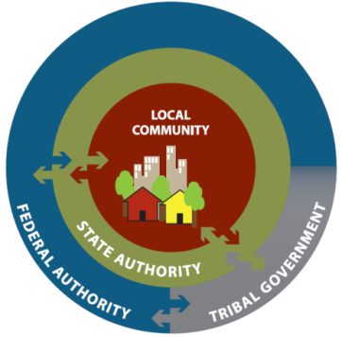
http://www.fema.gov/pdf/recoveryframework/ndrf.pdf

Slide 2
Recovery Continuum

Slide 3
NDRF Core Principles
Individual and Family Empowerment
Leadership and Local Primacy
Pre-Disaster Recovery Planning
Partnerships and Inclusiveness
Public Information
Unity of Effort
Timeliness and Flexibility
Resilience and Sustainability
Psychological and Emotional Recovery

Slide 4
Interagency Coordination

Slide 5
Recovery Support Functions
Community Planning and Capacity Building
Economic
Health and Social Services
Housing
Infrastructure
Natural and Cultural Resources

Slide 6
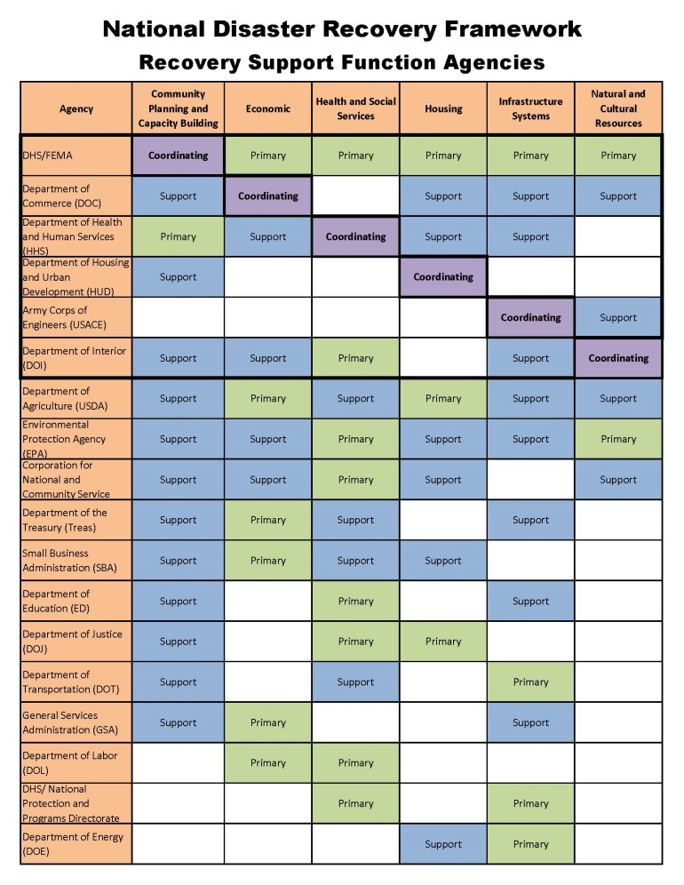
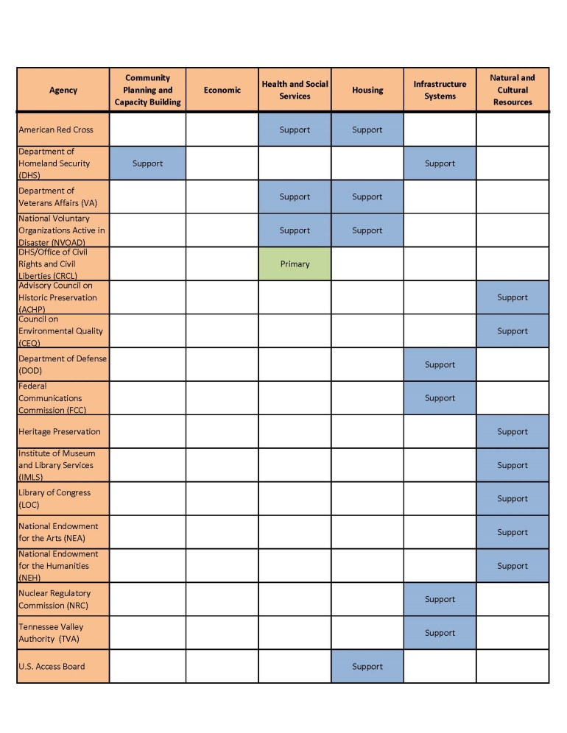
Recovery Support Functions

Slide 7
Types of Federal Recovery Support
Promote inclusiveness
Advise on community managed (pre-) recovery efforts
Support capacity-building
Incorporate mitigation, sustainability, and resilience-building measures
Assist in coordination with federal/regional and private sector stakeholders

Slide 8
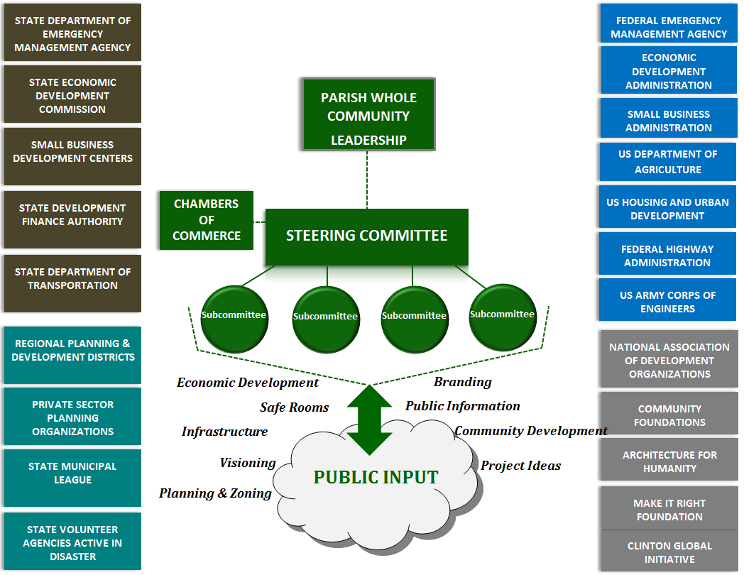

Slide 9
Recovery Continuum

Slide 11
Aggregate Data: Recovery Mission Area
States and territories generally reported having low capability levels in the Recovery-specific core capabilities

Slide 12
Aggregate Data: Recovery Mission Area
Moreover, States and territories reported lower capability levels in Recovery than every other mission area across all POETE elements

Slide 13
Resilience & Sustainability

Slide 14
Questions & Comments
wayne.rickard@fema.dhs.gov

