Slide 1

LWIN + Interoperability Program
E. Carroll W. Carroll Tensas Jackson Sabine Winn Natchitoches Grant LaSalle Vernon Rapides Avoyelles Catahoula Terrebonne LaFourche

Slide 2
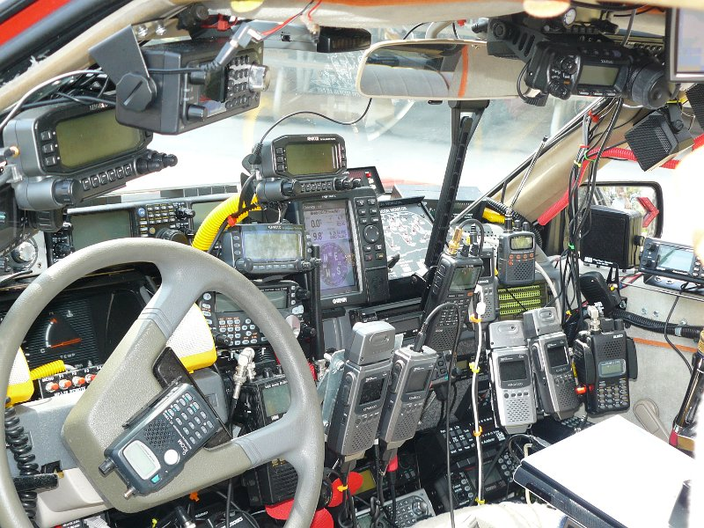
INTEROPERABILITY
Notes:
So given human factors built this image of interoperability, how do we ensure a different and sustained path forward. Interoperability is so much more than just our ability to communicate via LWIN/ Radio. What does your ESF 2 of tomorrow look like?

Slide 3
Statewide Interoperability Executive Subcommittee
Region 1 Representative | Jeb Tate, Jefferson Parish Emergency Management
Region 2 Representative | Billie Giroir, West Feliciana Parish Sheriff’s Office
Region 3 Representative | Conrad Baker, St John Sheriff’s Office
Region 4 Representative | Stacey Blanchard, St. Martin Sheriff’s Office
Region 5 Representative | Richard McGuire, Calcasieu 911
Region 6 Representative | Sonya Wiley-Gremillion, Rapides 911/OHSEP
Region 7 Representative | Major Doyle Dempsey, Bossier Parish Sheriff’s Office
Region 8 Representative | Sean Christian, Ouachita OHSEP
Region 9 Representative | Robert Seal, St. Tammany Parish Sheriff’s Office
Notes:
http://GOHSEP.la.gov/SIEC
Members are located there as well as way to contact them. Be sure to coordinate with your RICs (Regional Interoperability Committees and/or your Regional representative on the SIEC. They can provide and bring your questions to the SIEC meeting.

Slide 4
LWIN Today - Statewide Coverage
95% Portable On-Street +
95% In-Building Coverage in the (9) Metropolitan Areas of the State
135 tower sites
Four (4) mobile tower sites
Two (2) mobile repeater sites
Four (4) mobile satellite dishes
Six (6) generators on wheels
Four (4) masters sites
Monthly average of over 12 million Push To Talks (PTTs)
96,438 user devices

Slide 5
SIEC / LWIN Ongoing Projects
As funding becomes available, the SIEC authorized the following priorities:
  Addressing LWIN coverage gaps
  Increasing capacity
  Redundant/Backup communications
    Ethernet / Fiber
      Currently reviewing options for master sites with OTM/vendors
Upgrade of LWIN Software, Consoles and STR repeaters
  $15.8 million total project costs
    $11.4 million for software and console replacement and
    $1.2 million for (44) repeaters to change from STRs to GTRs
    Budget Request in FY 18/19 for $3.2 million for remaining (137) STRs
Notes:
For more information on Strategic Goals and Initiatives of SIEC regarding Interoperable Radio Communications, go to:
http://gohsep.la.gov/SIEC

Slide 6
Emergency Support Function (ESF) – 2
Co-lead or Primary Agencies
  Governor’s Office of Homeland Security and Emergency Preparedness (GOHSEP)
  Louisiana State Police
  Louisiana National Guard
Agencies request support through WebEOC during emergencies or disasters
Notes:
3 Ways to request Statewide Interop talkgroups:
1. WebEOC, 2. Written (Email/Fax ICS 205), 3. Verbal (Time sensitive ONLY) Contact ESF-2
SIEC Policy 007 – Network Coordination Policy
http://GOHSEP.la.gov/SIEC

Slide 7

Common Operating Picture
Unified Communications should be thorough, integrated and interoperable in order to achieve a Common Operating Picture, ensuring access to and exchange of mission critical information and intelligence across the OHSEP enterprise, anywhere, anytime.

Slide 8

Notes:
Human Factor can fix our issue too!
MITIGATE –An Incident Radio Communications Plan (ICS 205) would solve some of this. Individual talkgroup capacity is very robost, channels on each tower, limited. But better planning, communications and training will allow us to realize the benefits of the LWIN and Interoperable program, through pre-planning and incident coordinated planning.
Training, …next slide.

Slide 9
Training
What are your Communication Training Needs?
  Mutual Aid/ Parish Interoperability Committees (PIC)
  Regional Interoperability Committee (RIC)
  Agency Outreach + Training
  LWIN Interoperability Quick Reference

Slide 10
State Exercise - Communications
Regional 205’s
Parish LWIN Roll Call: Regional Coordinators
Regional LWIN Roll Call and SitReps: GOHSEP
Situation Reports
Suggestions?
Notes:
Regional 205’s created
Parish Roll Call on determined talkgroup
Situation Reports: SitReps, WebEOC, GIS Data
Dispatch: Monitoring *Reg # CoordTalk?
Submit After Action~ Communications
Exercise not finalized, any suggestions?

Slide 11
Statewide Point of Contact
for Interoperability
Ami Clouatre Johnson
Interoperability Program Manager
Governor's Office of Homeland Security
and Emergency Preparedness
(225) 461-6932 - cell | Ami.Johnson@la.gov

Slide 12
Questions?
E. Carroll W. Carroll Tensas Jackson Sabine Winn Natchitoches Grant LaSalle Vernon Rapides Avoyelles Catahoula Terrebonne LaFourche

