Slide 1
Introduction to LAHM
(LouisianaHM.com)

Slide 2

Purpose
Provides transparency to YOU, as a Subgrantee.
Helps expedite the process.
Reduces paperwork.
Reduces redundant requests for documentation.
Makes for a more efficient and effective process.

Slide 3
Introduction
LAHM is an online grants management tool for the State of Louisiana Hazard Mitigation Grant Program.
Provides capabilities for managing programs exclusively online from the Request For Assistance (RFA) through Closeout.

Slide 4
System users
Subgrantees
GOHSEP Staff
Document Review
Finance
FEMA

Slide 5
System overview
Request For Assistance (RFA)
Application
Appeal Request
Amendment Request
Quarterly Reporting
Reimbursement Request
Advance Request
Closeout Request

Slide 6
HMGP cycle

Slide 7
System overview
(Continued . . . )

Slide 8
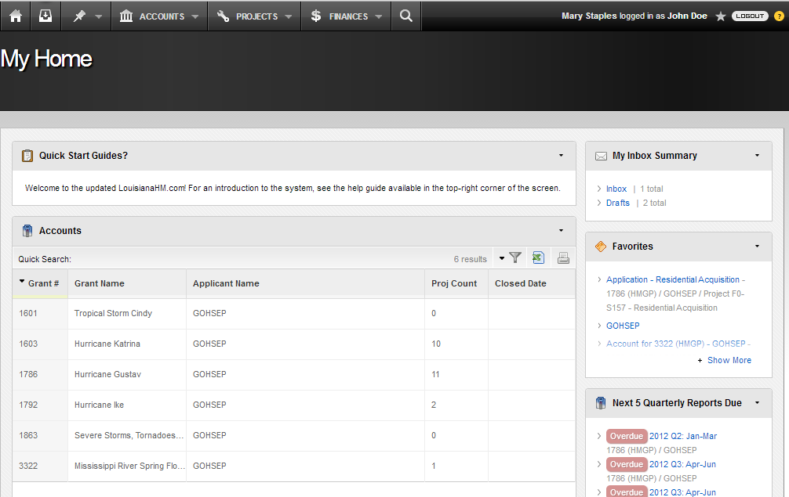
My Home

Slide 9
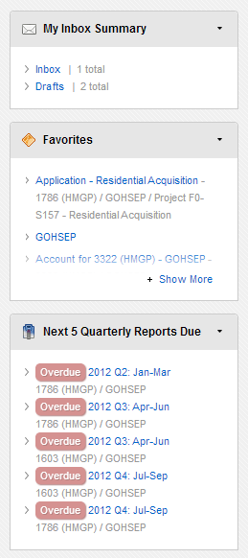
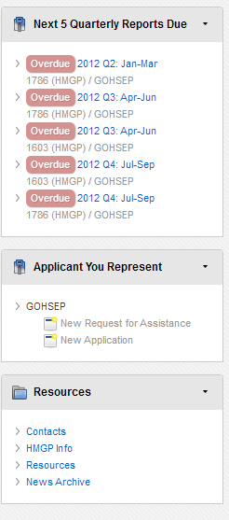
My Home

Slide 10
Request for Assistance (RFA)

Slide 11
Application workflow

Slide 12
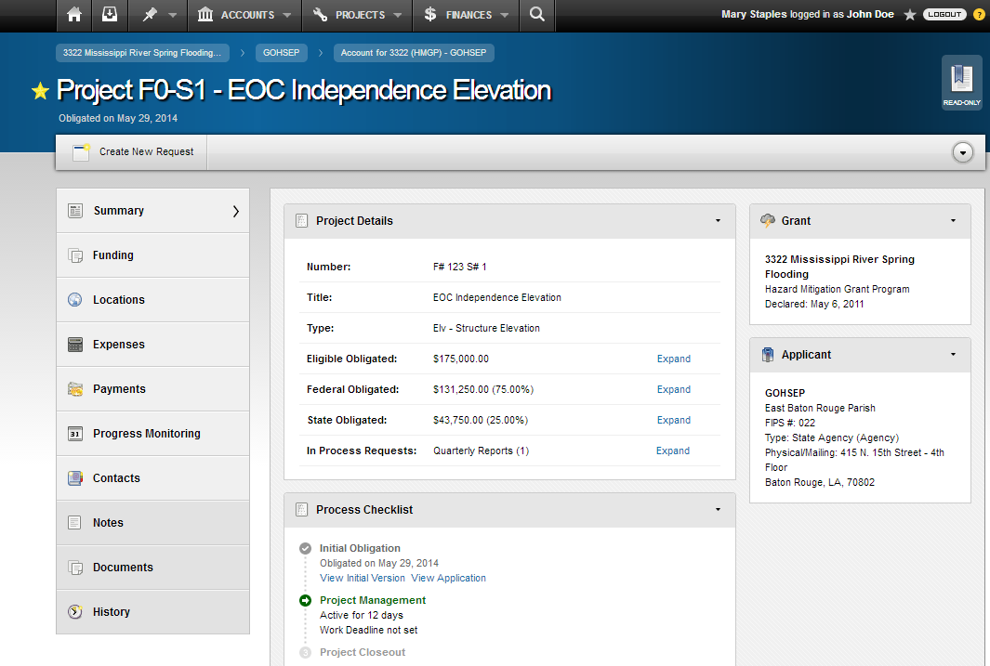
My Home

Slide 13
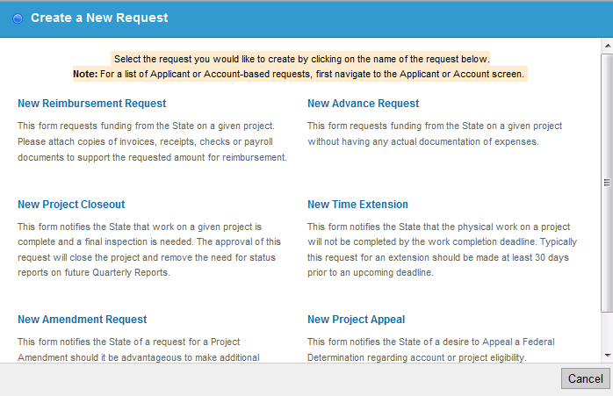
Create a new request

Slide 14
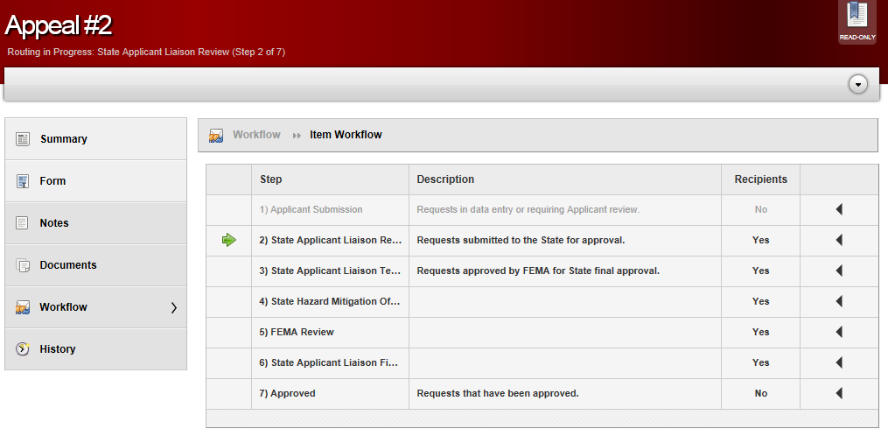
Appeal request

Slide 15
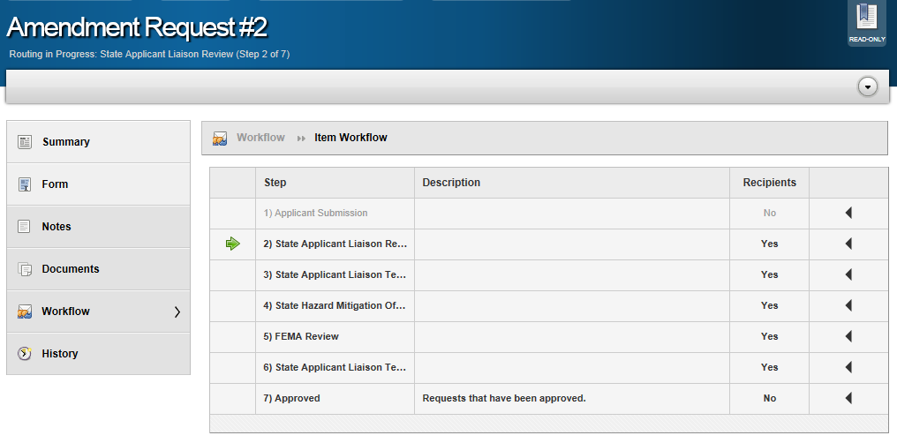
Amendment request

Slide 16
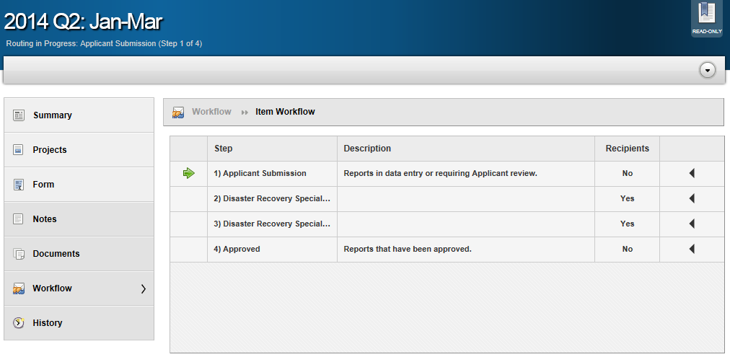
Quarterly report

Slide 17
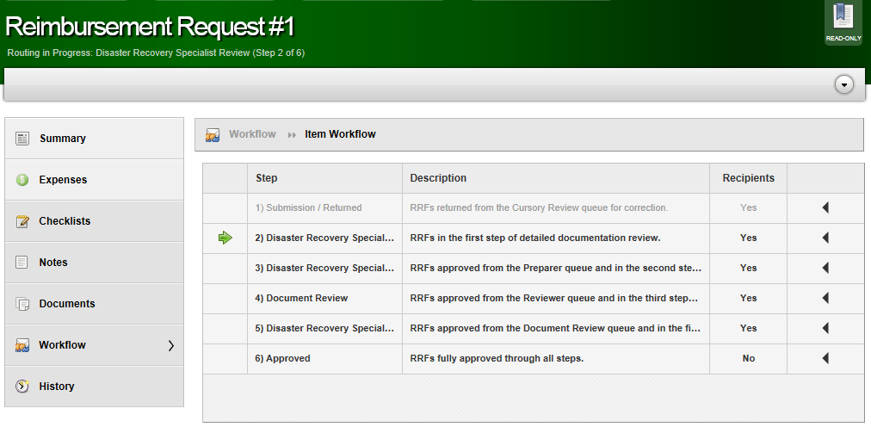
Reimbursement request

Slide 18
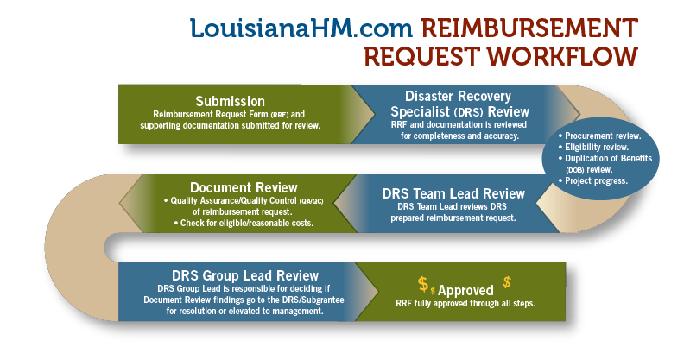

Slide 25
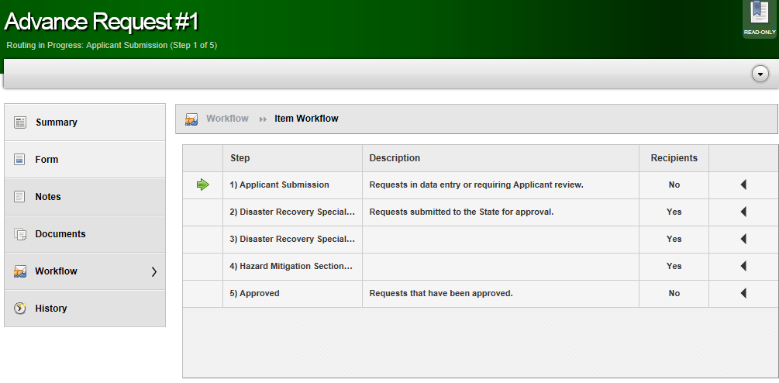
Advance request

Slide 26
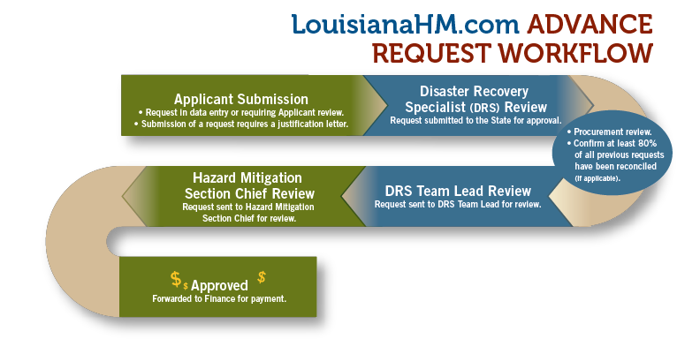

Slide 32
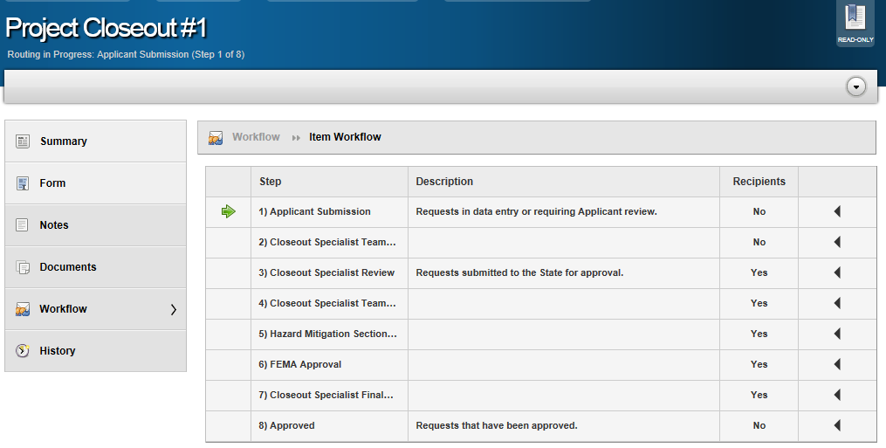
Closeout request

Slide 33
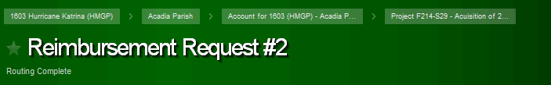
Breadcrumbs
Breadcrumbs
  Grant
  Applicant
  Account
  Project
Title of the item
Workflow step

Slide 34
Contact
Casey Tingle
casey.tingle@la.gov
Jeffrey Giering
jeffrey.giering@la.gov
Tenesha Wilson
tenesha.wilson@la.gov

Slide 35
Questions?

