Slide 1
Lieutenant Kelly Feet
Operations Lieutenant at JESTC
HMEP Program Manager
Kelly.feet@la.gov
Notes:
Good afternoon everyone.
My name is Kelly Feet and I am the Operations Lieutenant at the Louisiana State Police’s Joint Emergency Services Training Center / HMEP grant supervisor.
I would like to start by thanking Christina for giving me a chance to present our program to you.
In 2008, I was transferred to JESTC to manage the HMEP grant and re-develop the HazMat training program.
Prior to that, I was a trainer at the LSP Training Academy where I created training programs and trained cadets, troopers, and other law enforcement officers.
When I took over the grant, I learned that there were two sides to the grant; training and planning.
The planning portion is designed to support Commodity Flow Studies, Exercises, and Emergency Planning.
I had two LEPC’s request over $60,000 each for CFS’s and Emergency Planning. Louisiana has 64 LEPC’s. How far can you stretch your budget when CFS’s cost $60k per LEPC.
When I saw what they received for their money, I decided to show first responders how to conduct their own studies at minimal costs.

Slide 2
Training Academy
Scenario Training
Driver Training
Firearms Ranges
Off Road Training
Staff Development Center
Hazardous Materials Training
Shoot Houses

Slide 4
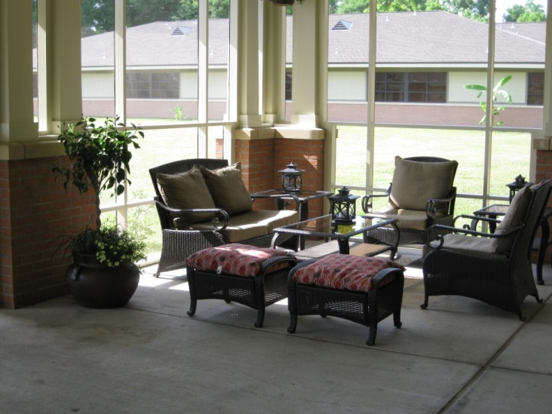
Staff Development Center
Lounge Area
Covered / Enclosed Veranda

Slide 5
Staff Development Center
3 Classrooms
50 Person Classroom
30 Person Classroom
15 Person Classroom
1 Computer Lab
4 Work Stations
Open Access
Printer

Slide 6
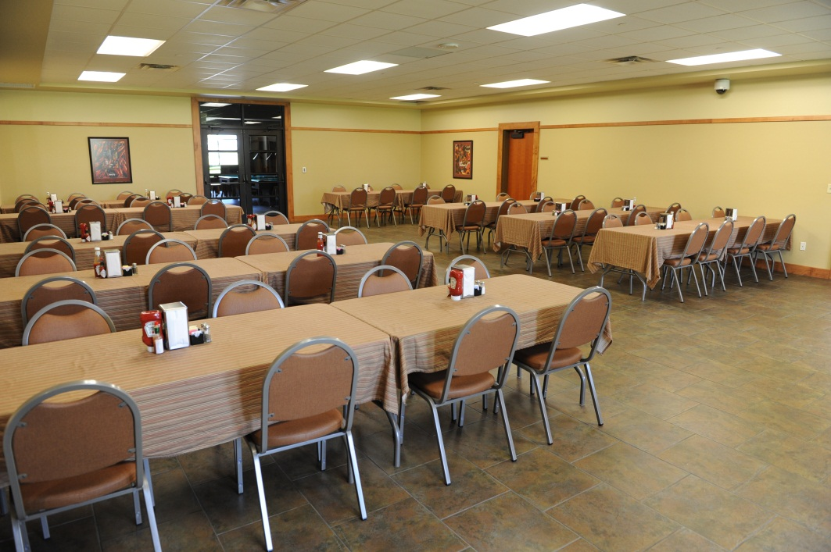
Staff Development Center Dining Hall
53 Over Night Rooms
2 VIP Suites
Wifi Access
Exercise Room
Free Washers and Dryers
On-Site Dining Facility
Recreation Room

Slide 7
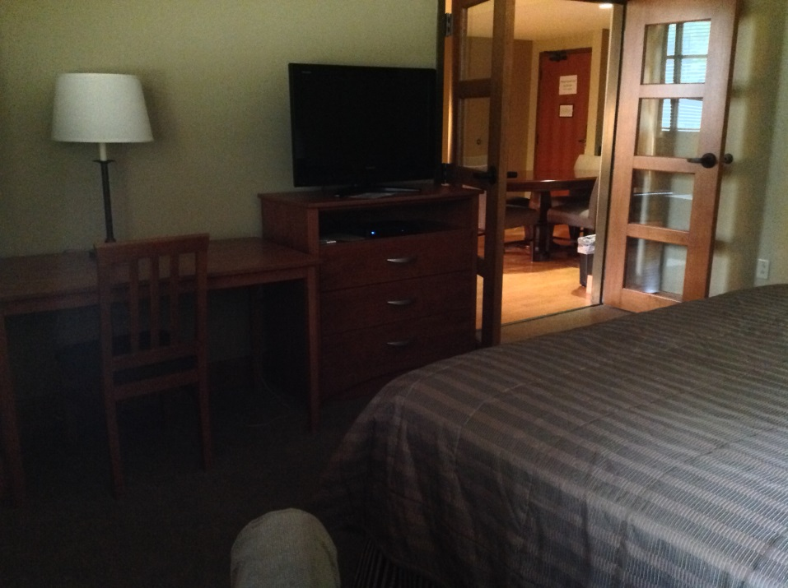
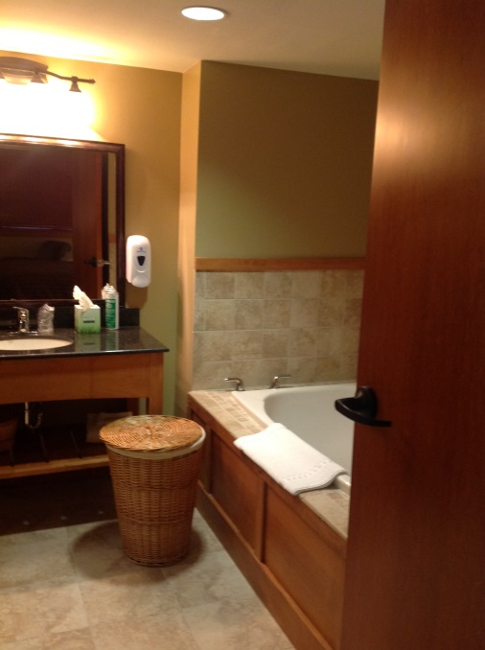
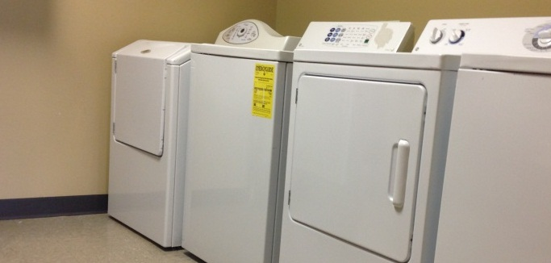
SDC Over Night Rooms with
Hotel comfort and amenities

Slide 8
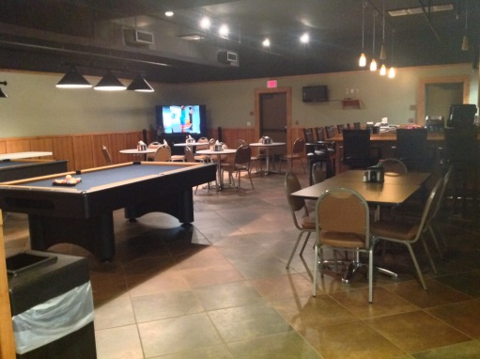
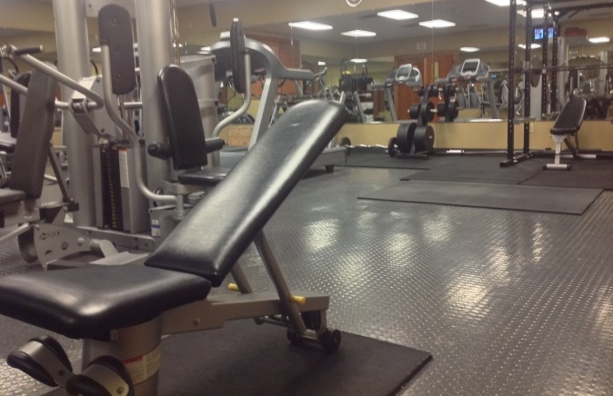
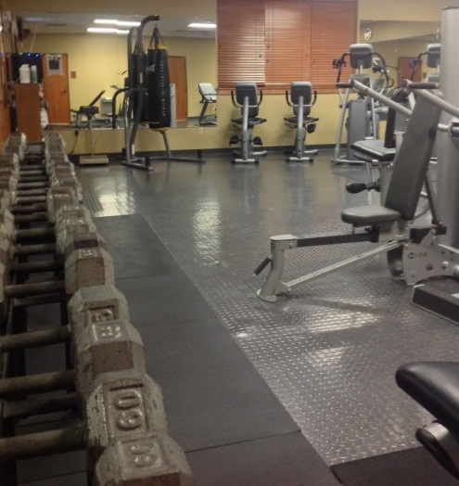
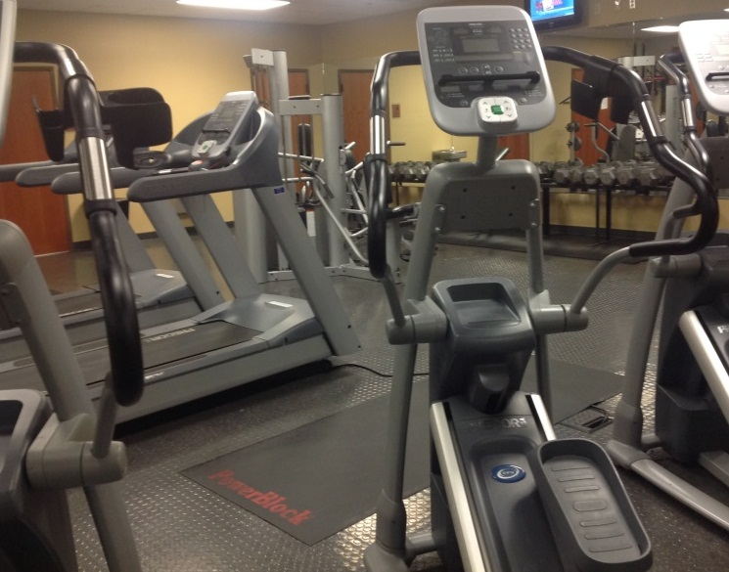
After Hours Activities
Game Room
Exercise Room

Slide 9
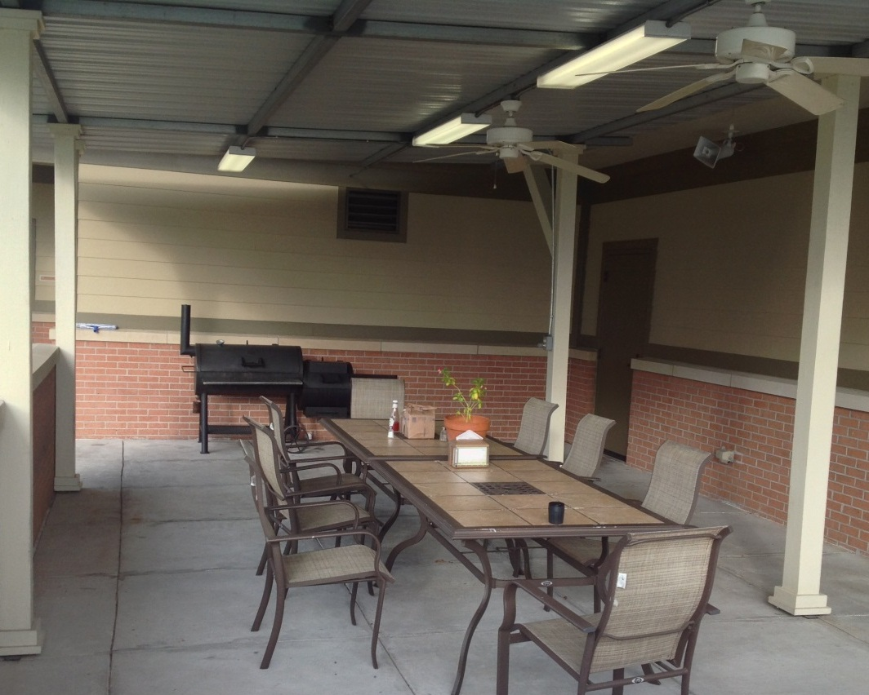
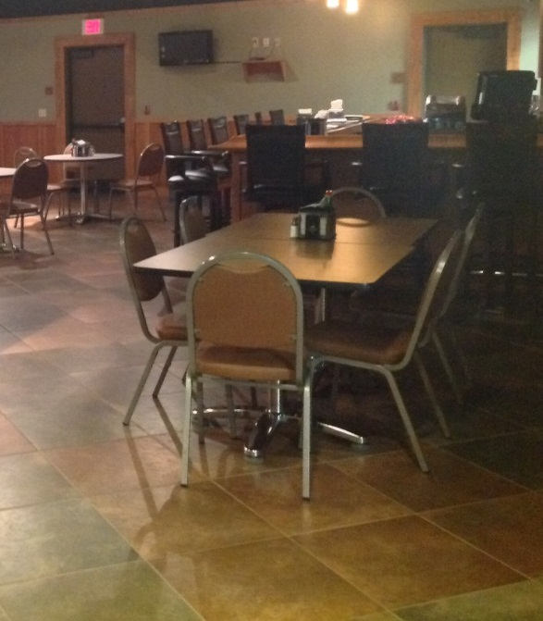
SDC Patio and Grill / Lounge Area
Louisiana Cookouts
Boiled Seafood
Grilled Steaks
Black Iron Pot Meals

Slide 10
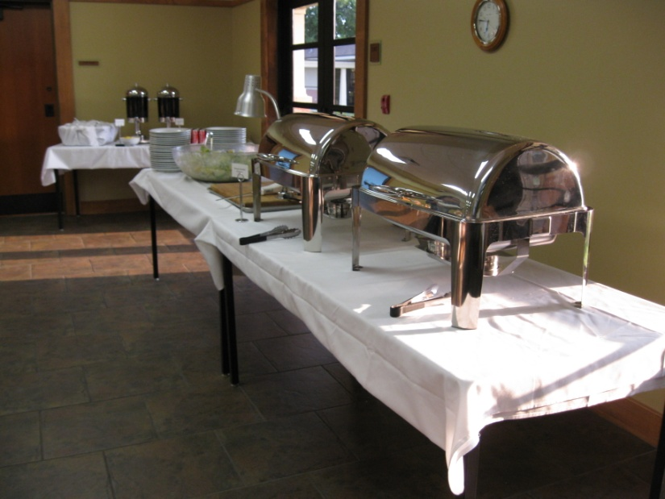
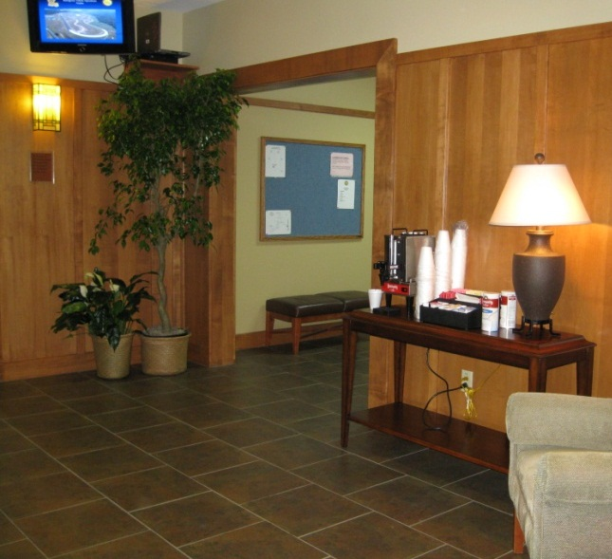
Full Service Kitchen
Catering Set-ups
Coffee Services
Snacks
Deserts

Slide 11
Emergency Vehicle Operations Center Classroom
Audio Visual Support
Seating for 50 Students
Break Out Room

Slide 12
Emergency Vehicle Operations Center Driving Track
Multiple Surfaces
Concrete
Asphalt
Dirt
Straight Away
Multi Lanes
S Curves
Apex Training
1.8 Mile Outer Track

Slide 13
EVOC City Grid
Intersections
Traffic Control Towers
T-Box
90⁰ Turns
Stop Signs
Street Signs
Red Light

Slide 14
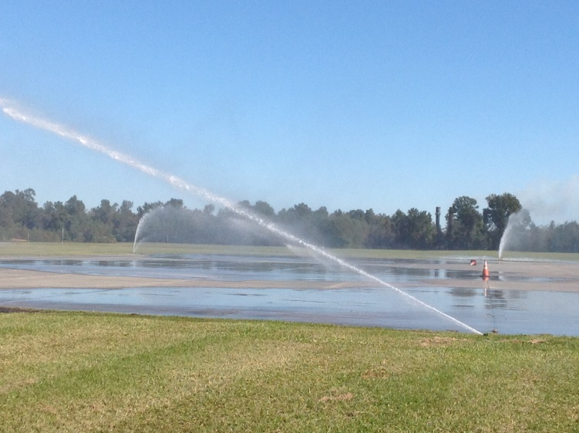
EVOC Skid Pan Training Area
180’ x 300’
Water Saturation System
Safety Run Off Areas

Slide 15
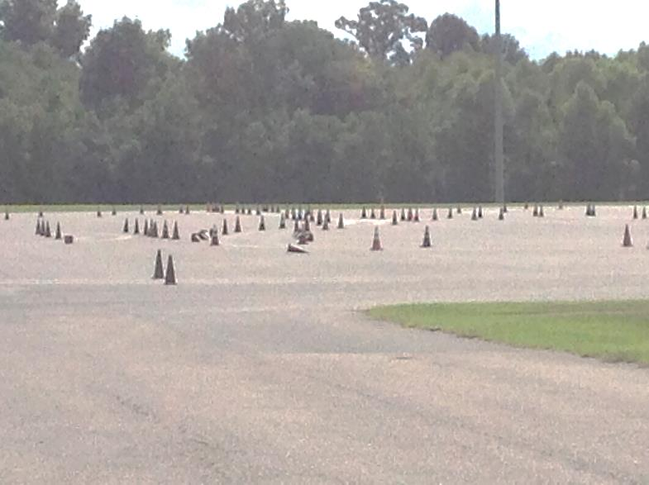
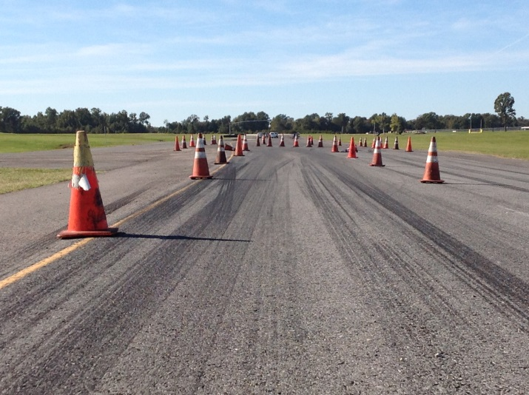
EVOC Skills Pad
450’ X 600’
Traffic Cones
Pre-marked Courses
Delineators
Stadium
Lights

Slide 16
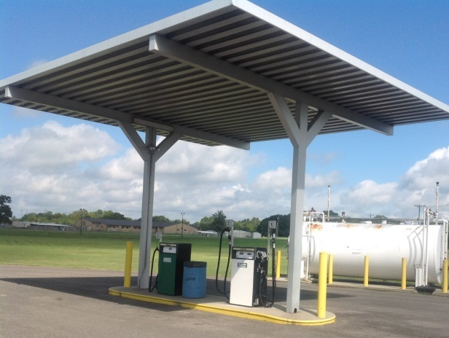
EVOC Support Buildings
Garage
Full Time Mechanic
Vehicle Retrieval System
Fueling Station

Slide 17
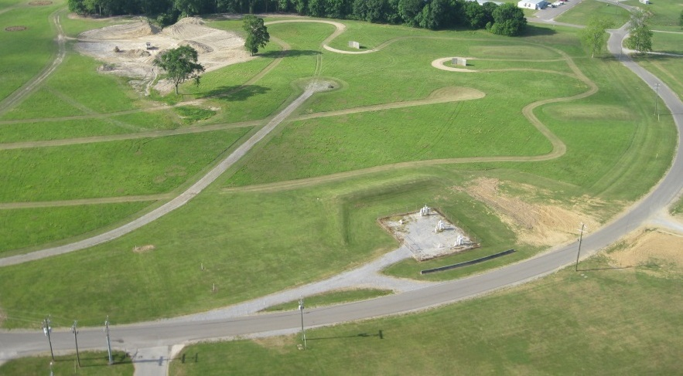
Off Road Driving Track

Slide 18
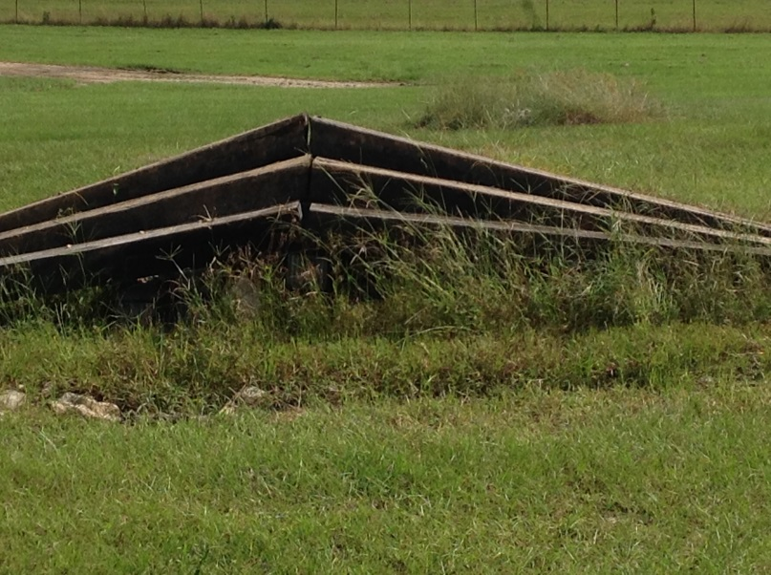
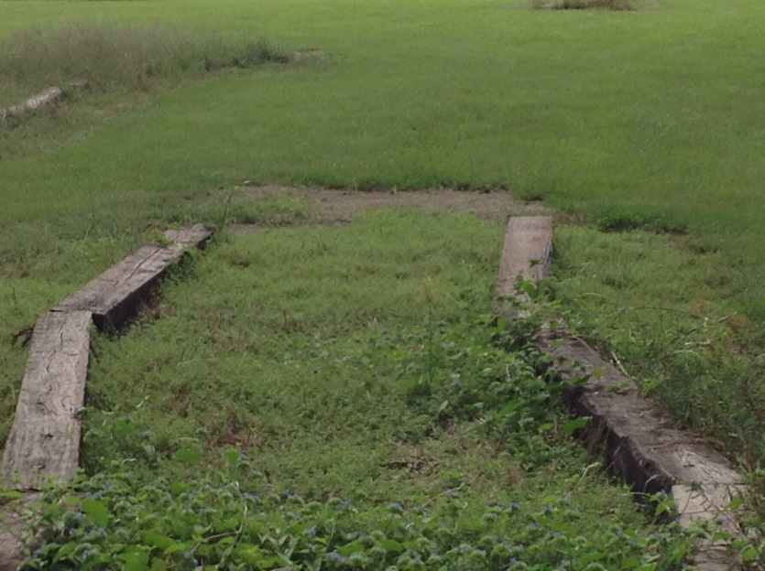
Off Road Obstacles

Slide 19
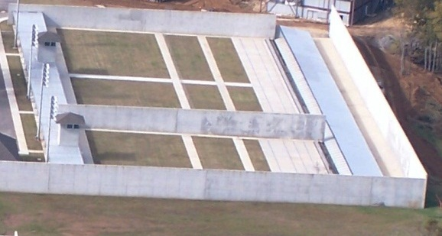
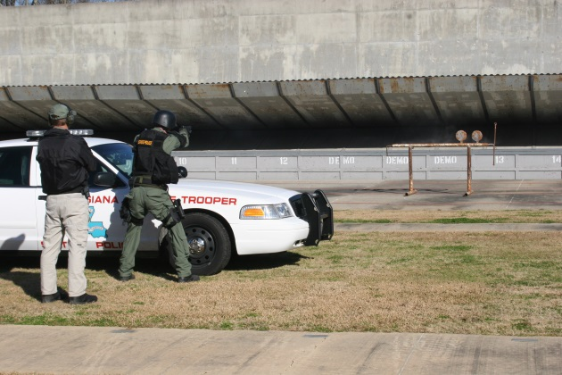
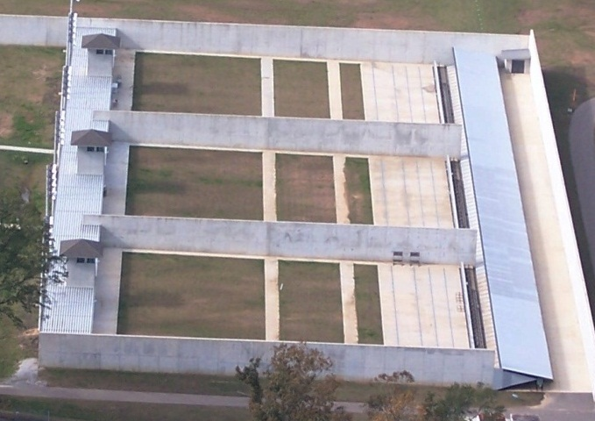
Firearms Training Ranges
1 x 50 Point Range
4 x 25 Point Ranges
Labeled in Meters and Yards
50, 25, 15, & 7 Yard Barricades
Concrete Shooting Positions
Turning Targets
Running Man System
Ammunition Vault At Each Range Tower
Covered Area At The 50 Yard Line

Slide 20
Weapons Cleaning Room
Gun Cleaning Tank
Cleaning Tools
Rubber Flooring
Stainless Counter Tops

Slide 21
Rifle Range
Berms at the 50 Yard Line and Each 100 Yard Increment
Turning Targets
Running Man System
Safety Gates and Flags
Up to 600 Yard Firing Position
Covered Position and Control Tower With a Vault at the 300 Yard Line

Slide 22
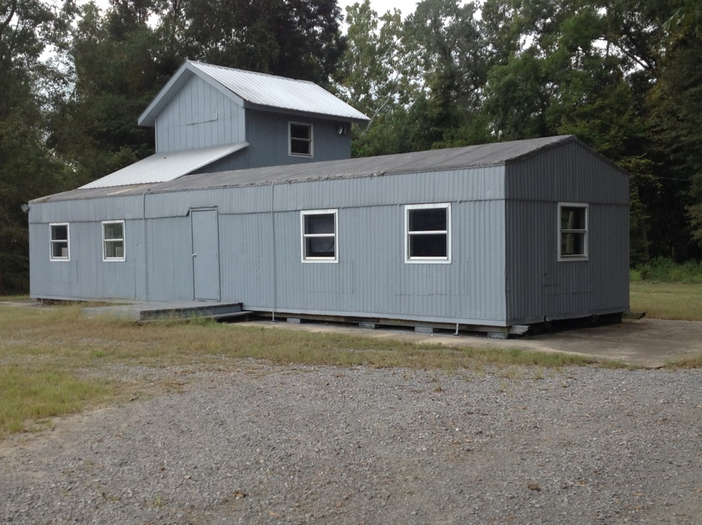
Scenario Training
Secure Trails for Patrols and Land Navigation

Slide 23
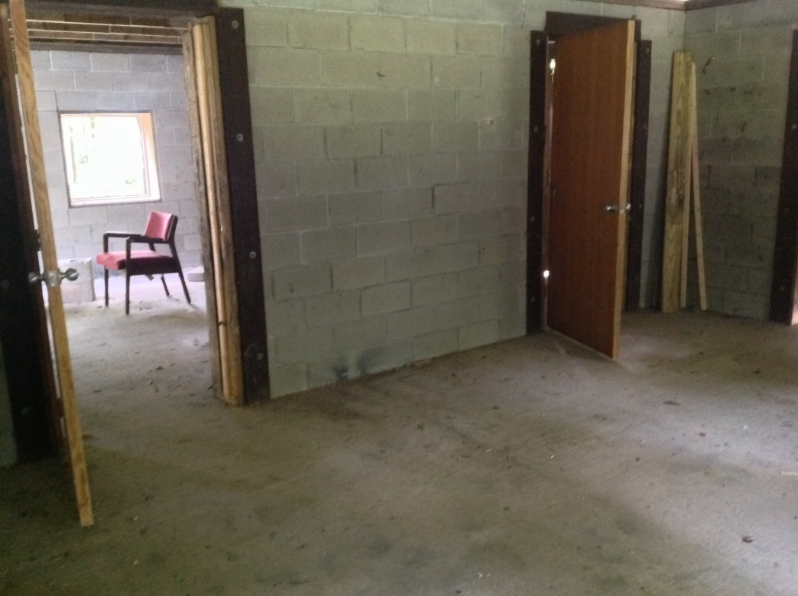
Explosives Breaching House

Slide 24
Less Lethal Training House
3 Entry Points
Center Cat Walk
Furniture
Covered

Slide 25
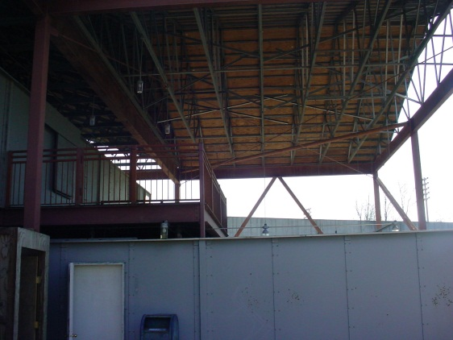
Two Story Live-Fire Shoot House
Exhaust System
Long and Short Halls
Multiple Entry Points
Sliding Walls
Interior and Exterior Stairs
Observation Deck

Slide 26
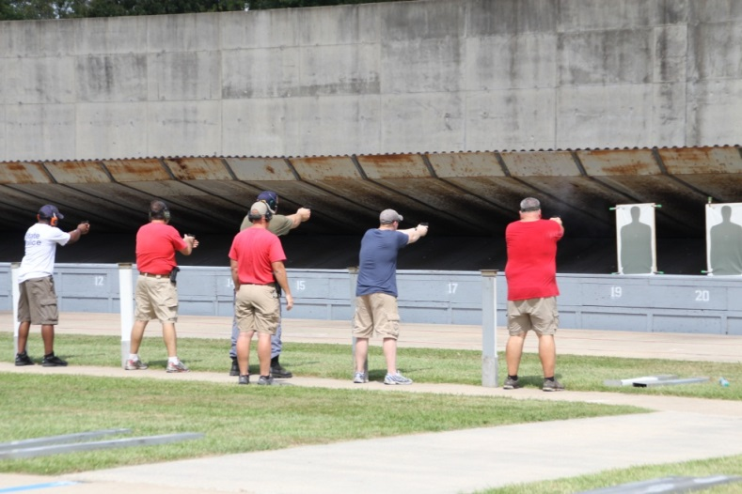
Range Support
Barricades
Turning Targets
Running Man System
Various Obstacles
Vehicles
Steel Targets

Slide 27
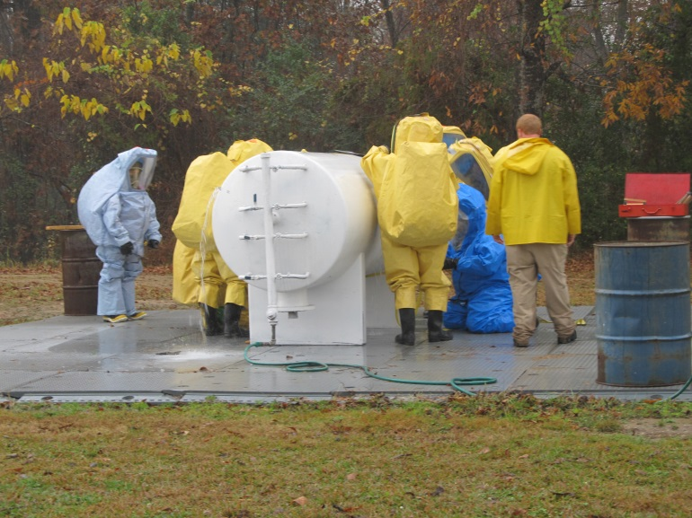
Hazardous Materials Training
Leaking Props
Patch Kits
Level A and B suits
Self Contained Breathing Apparatus

Slide 28
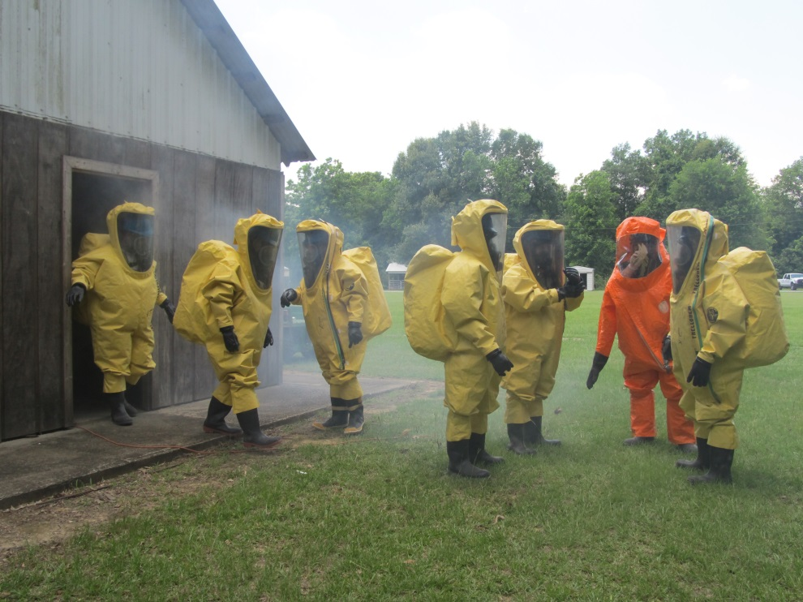
Smoke House / Confined Spaces
Maze
Tunnels
Scenarios

Slide 29
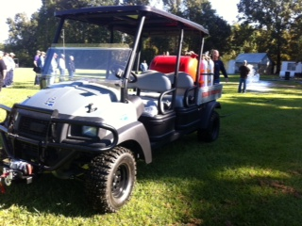
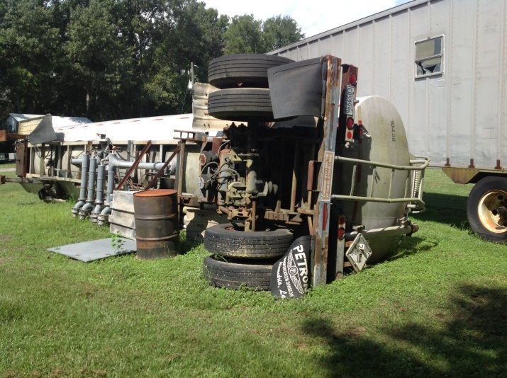
Scenario Training

Slide 30
Train Derailment / Leaking Valve Kits

Slide 31
HMEP Grant Coordinator
Hazardous Materials Transportation Training and Planning
40 Hour Technician Class
8 Hour Refresher
8 Hour Awareness
1st Responder School last full week of March
ICS / NIMS Training
Commodity Flow Training

Slide 32
How to Register
How to Log in
How to Begin Survey
How to View Survey
How to Create Shortcut on Desktop
How to Sync Survey

Slide 33
The next few slides will show you what you can do with the information when exported to excel

Slide 34
Notes:
You can then save it as an excel or number file and create your own charts.
This chart shows the types of containers that were recorded.

Slide 35
Notes:
This chart shows if the vehicle were straight trucks, single trailer, or multiple trailer.

Slide 36
Notes:
This chart shows the different classes that passed our study. As you can see, a large majority of trucks did not have placards. This included box trucks, gravel trucks, service trucks, etc…

Slide 37
Notes:
This study was only two hours long. You can see how it can be useful to show you the busiest times.

Slide 38
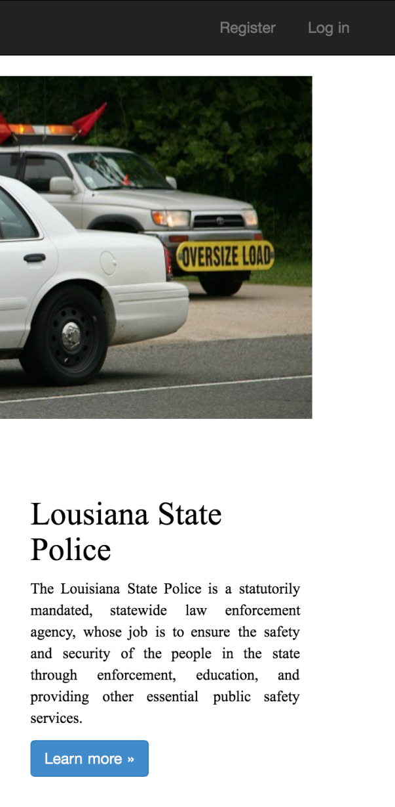
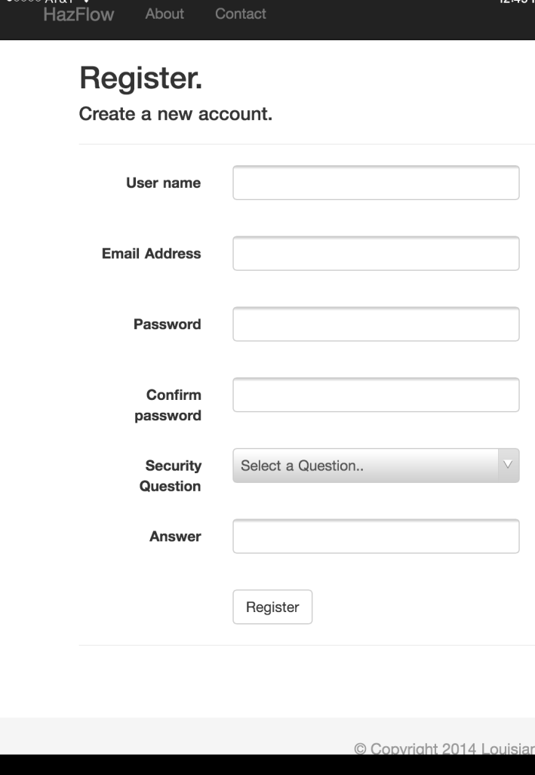
How to get started…
1. Go to the website
https://hazflow.sdmi.lsu.edu/
Click on Register
Create Log in User Name and Password
Wait for approval to use the site
Notes:
How do I collect this information?
Go to the Hazflow website, register / log in, and start your survey.
Minimal kilo bytes of data usage to conduct a study.
Uses data to set up, to send information, and to research. Does not use data to record each vehicle.

Slide 39
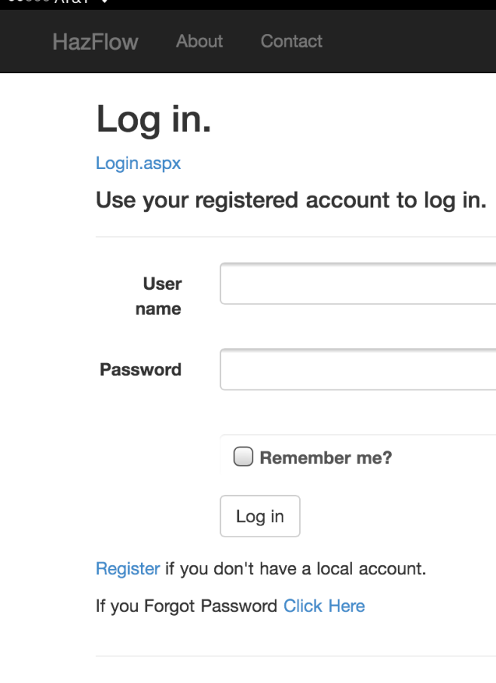
How to begin survey…
1. Go to the website
https://hazflow.sdmi.lsu.edu/
Click on Log In
Enter user name and password
Click Log In

Slide 40
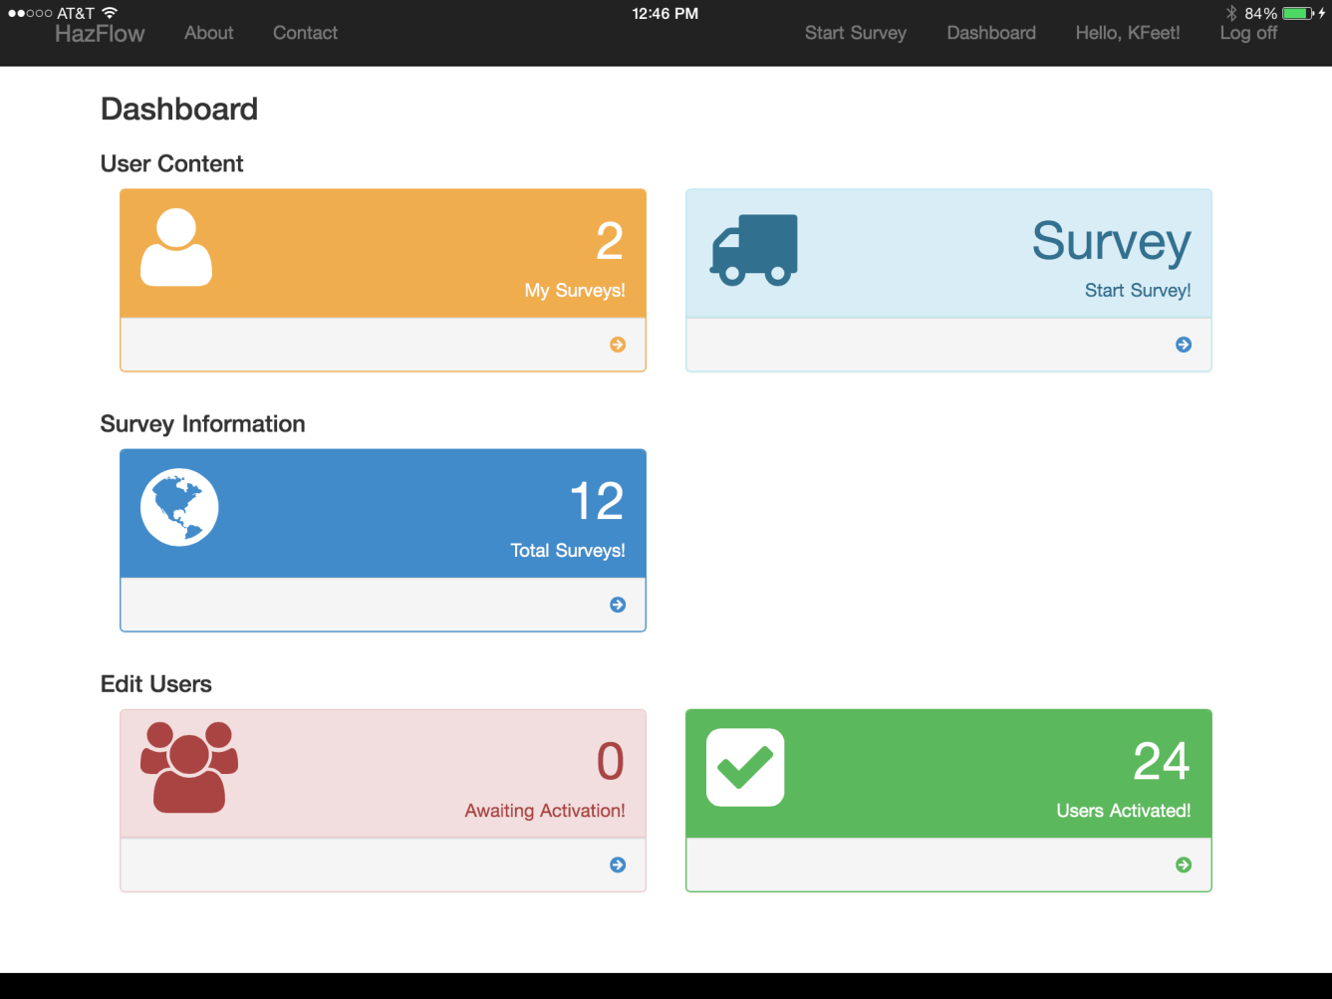
Beginning Survey Continued…
1. Click on one of the Start Survey buttons

Slide 41
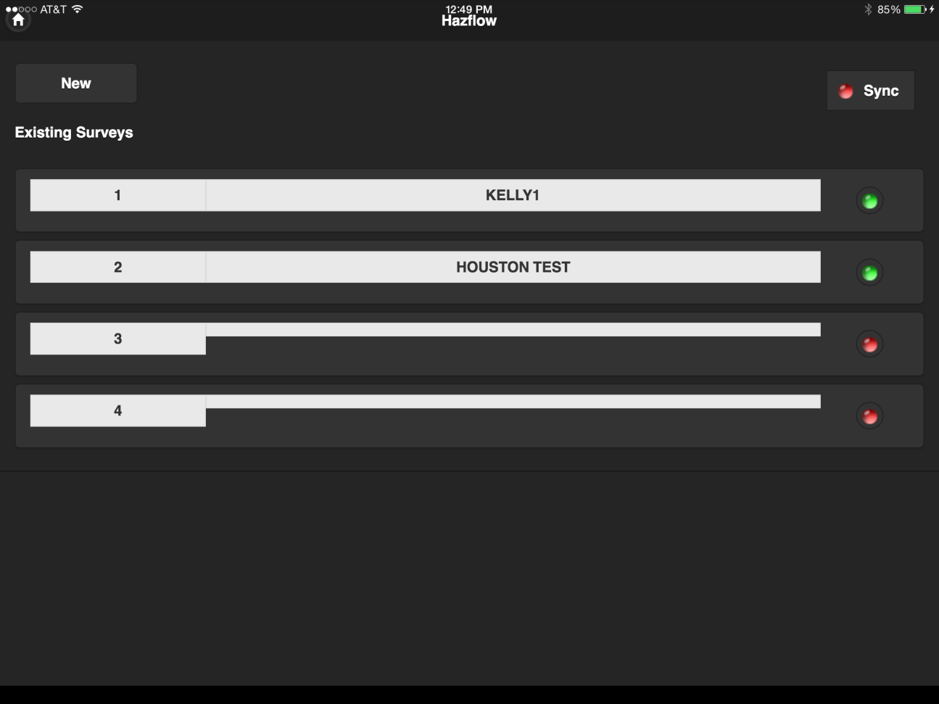
Beginning Survey Continued…
Click on New or select a prepared survey

Slide 42
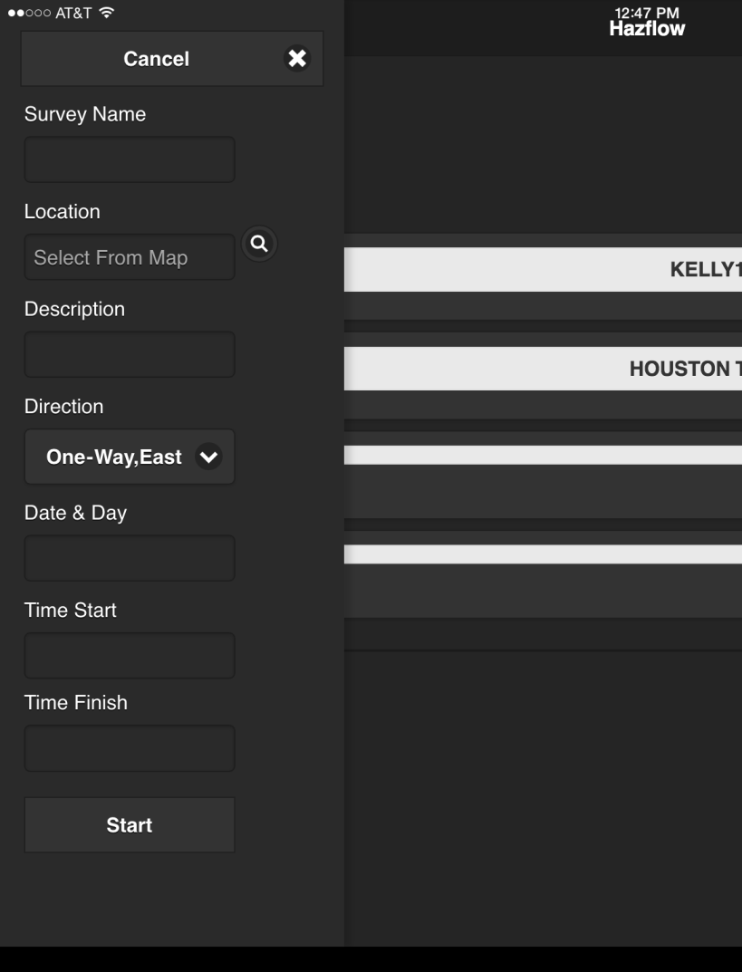
Beginning Survey Continued…
Enter Location Information
Survey Name / Department Conducting Survey
Location
Click on the magnifying glass to locate you on the map
Click use this point or tap the map to choose exact location
Location Description
Specific Name of Location
Traffic Direction
Date & Day
Time Start
Time Finish
Click Start to begin
1
2
3
4
5
6
7
8

Slide 43
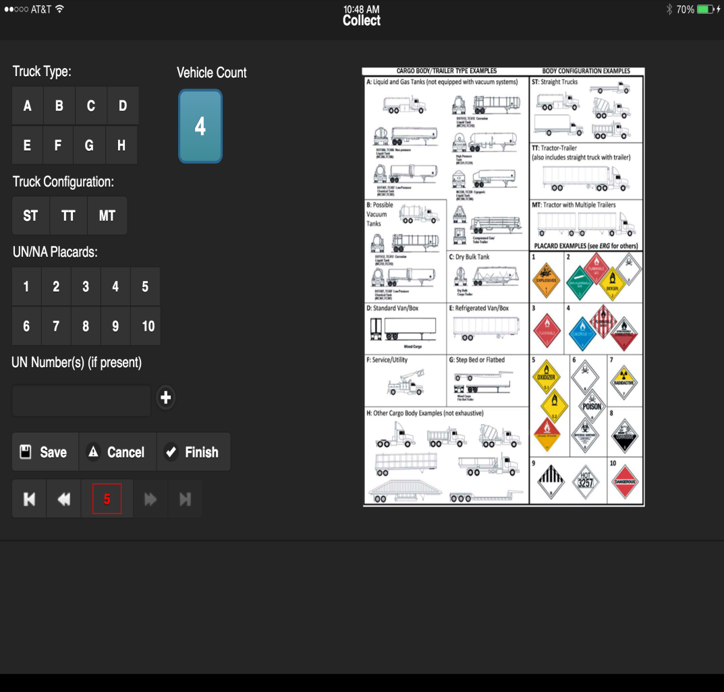
How to record vehicles…
Select truck type
Ex. A = Tank Truck
Select trailer configuration
Ex. TT = Tractor Trailer
Select UN Placard Number
Small number at the bottom center of the placard
Select UN Number
4 digits in the middle of the placard
If you type in a UN number you must click the + button to send it to the spread sheet
Click Save

Slide 44
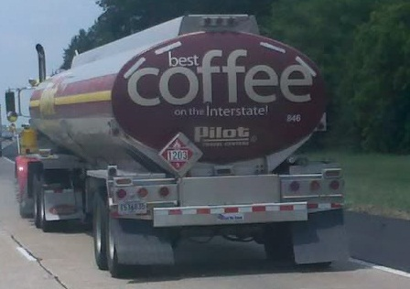
Truck Type A - Tanker
Truck Configuration TT – Tractor Trailer
UN/NA Placard Class 3 - Flammable
UN Number 1203 + (button)
Save

Slide 45
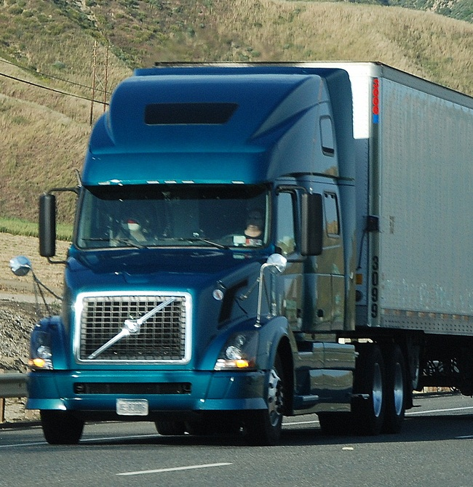
Truck Type D – Standard Van
Truck Configuration TT – Tractor Trailer
UN/NA Placard Leave Blank
UN Number Leave Blank
Save
Non-Placarded vehicles only require 3 clicks
1 – Truck Type
2 – Configuration
3 - Save

Slide 46
Continue counting…
Each time you click save, the program will clear the selections and prepare to receive the next vehicle.
You will have to manually delete the UN number between vehicles

Slide 47
How to edit…
Counter Box
Click the arrow buttons at the bottom of the screen to return to the vehicle you would like to edit
Or, you can tap on the counter box and go to the vehicle you would like to edit (See next slide)
Edit Buttons

Slide 48
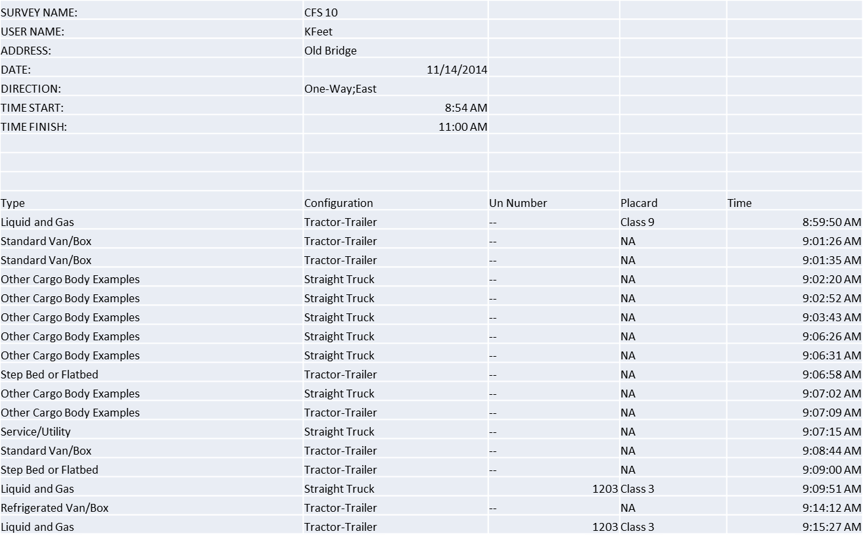

Slide 49
How to finish
Click finish
Click the Home button on the next screen
If you are connected to the internet, the program will upload the information to the map
If you are not connected, wait until you get to a wifi connection to sync your survey

Slide 50
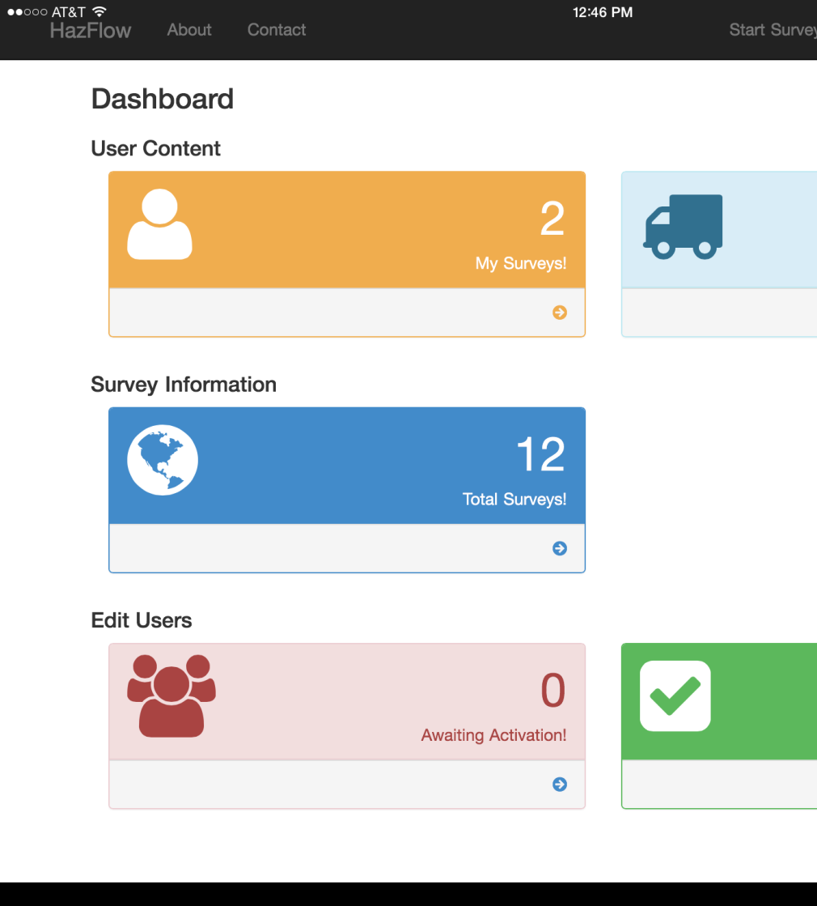
How to sync
Go back to the dashboard
Click on My Surveys or Total Surveys
Notes:
The Dashboard shows several boxes.
This view is the administrator’s view. Normal view will not have the Edit User’s box and the User’s Activated box.
User Content
My Survey - Records and groups your surveys
Start Survey
Allows you to begin a new survey
Survey Information
Moderators can see all surveys conducted
Users will only have access to their studies
Edit Users
Awaiting Activation - Notifies the Administrator of pending users
Users Activated – Allows the Administrator to manage users and moderators
If you use volunteers, you can send me an e-mail to remove them once the study is over
Tap / Click start survey when you are ready to begin

Slide 51
How to sync continued…
Click on Sync to sync all surveys or click on the red button to sync a specific survey
Syncing will upload the survey to the map and allow moderators to download the report
Notes:
After clicking start survey, you will see your previous surveys and will be allowed to edit your surveys or begin a new survey.
You have to start the survey while you are on-line so the system can log you in. If you lose your connection or turn off your web access, you can continue your study and sync when you get to the wifi.
The red dots indicate studies done off line. When you get on-line or to a wifi hot spot, you can click on sync to send your study to the website and post it on the map.
Click on New when you are ready to begin a new survey.

Slide 52
How to view report
Go back to the dashboard
Click on My Surveys or Total Surveys
Notes:
The Dashboard shows several boxes.
This view is the administrator’s view. Normal view will not have the Edit User’s box and the User’s Activated box.
User Content
My Survey - Records and groups your surveys
Start Survey
Allows you to begin a new survey
Survey Information
Moderators can see all surveys conducted
Users will only have access to their studies
Edit Users
Awaiting Activation - Notifies the Administrator of pending users
Users Activated – Allows the Administrator to manage users and moderators
If you use volunteers, you can send me an e-mail to remove them once the study is over
Tap / Click start survey when you are ready to begin

Slide 53
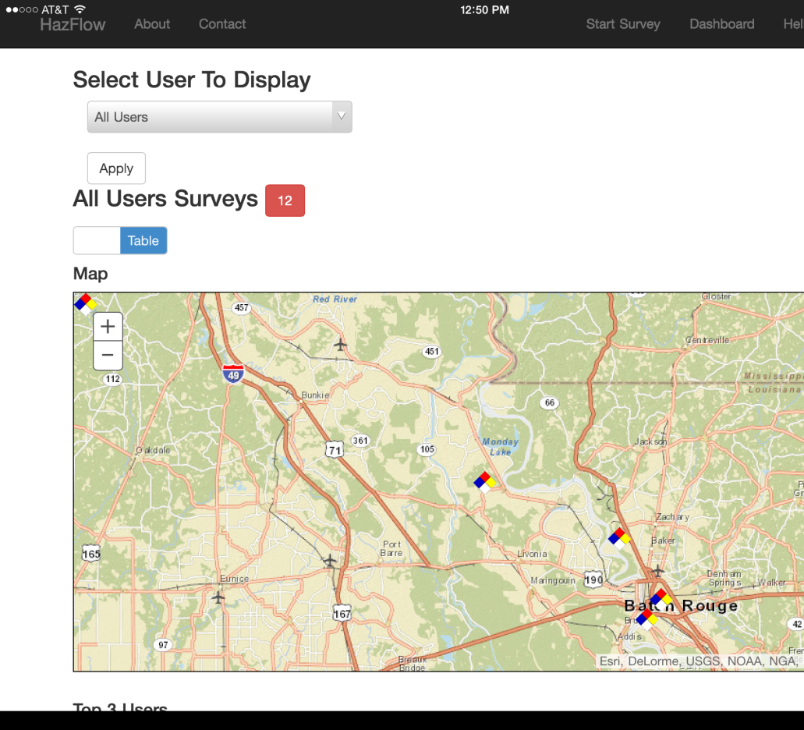
How to view report continued…
Click on the icon near the desired location on the map or click on table to get to the table view
Notes:
Once the surveys are done, the Moderator can view the completed studies in the table or map mode
Map mode – posts a pin for each study that is recorded and uploaded
To switch to table mode, tap / click the table button

Slide 54
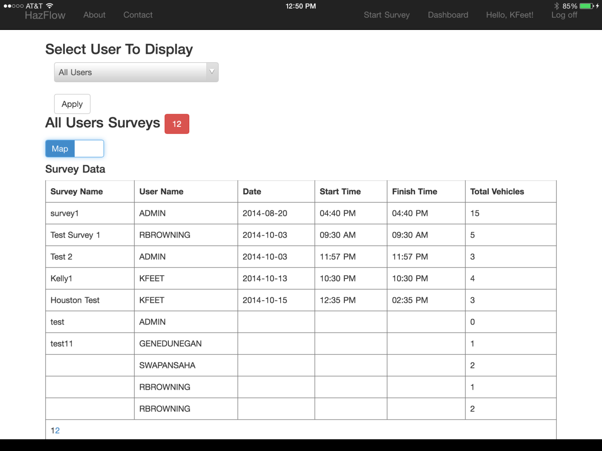
How to view report continued…
Click on the survey you would like to view
Notes:
Moderator can view studies in a table mode
To select a study, tap or click on the survey name
To return to the map mode, tap / click on the Map button
Table is sorted by date and time of survey
The easiest way to identify your survey is by using a specific Survey / Group Name from the first step

Slide 55
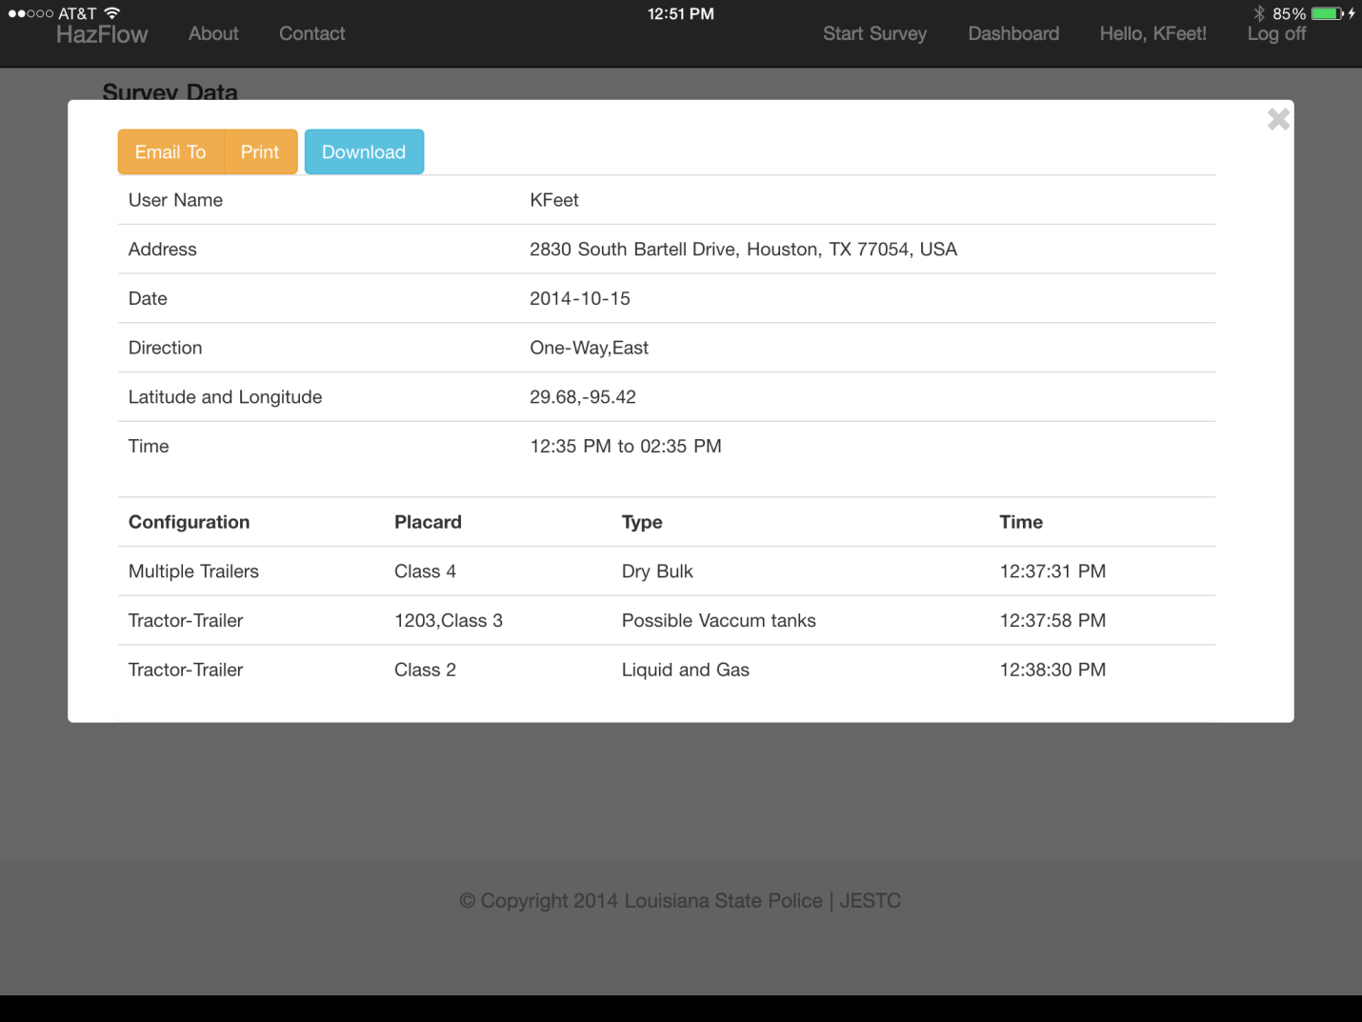
How to view report continued…
Select Download
Notes:
To send to excel, tap / click on download.
To email, tap / click email to
To print, tap / click print

Slide 56
Export to Excel to save
SURVEY NAME: | JESTC 1
USER NAME: | KFeet
ADDRESS: | JESTC
DATE: | 11/10/2014
DIRECTION: | One-Way;East
TIME START: | 1:00 PM
TIME FINISH: | 3:00 PM
Type | Configuration | Class | UN | Time
Liquid and Gas | Tractor-Trailer | Class 3 | 1203 | 1:15:39 PM
Other Cargo Body Examples | Straight Truck | NA |  | 1:16:07 PM
Step Bed or Flatbed | Tractor-Trailer | NA |  | 1:16:20 PM
Liquid and Gas | Straight Truck | Class 3 | 1203 | 1:16:36 PM
Standard Van/Box | Multiple Trailers | NA |  | 1:16:48 PM
Refrigerated Van/Box | Tractor-Trailer | NA |  | 1:17:20 PM
Service/Utility | Straight Truck | NA |  | 1:17:29 PM
Liquid and Gas | Tractor-Trailer | Class 3 | 1203 | 1:17:41 PM
Dry Bulk | Tractor-Trailer | NA |  | 1:17:57 PM
Service/Utility | Straight Truck | NA |  | 1:18:11 PM
Liquid and Gas | Tractor-Trailer | Class 9 | 1985 | 1:18:39 PM
Notes:
Export to excel and select save as excel to keep the formatting

Slide 57
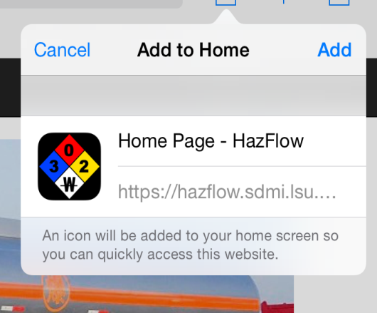
(1) Forward Button
How to send icon to home screen…
1. Pull up the site
Click on the forward button
Click add to home screen button
3. Click Add button
(2) Add to Home Screen
(3) Add Button

Slide 58
Commodity Flow Study Class
2 Day Course
CFS Definition
Study of Hazardous Materials stored or transported through your jurisdiction
Benefits of a CFS
Identifies required training and equipment
Helps properly prepare for pending emergencies
How to conduct a CFS
Identify traffic study locations
Identify resources to gather additional information
Physically conduct a CFS

Slide 59
Computer Aided Management Emergency Operations
3 Day Class
CAMEO
Linked to the Emergency Response Guide Book
Identifies Placards and Chemicals
Identifies characteristics of the chemicals
ALOHA
Allows you to create plumes for chemical releases
MARPLOT
Allows you to create emergency plans on maps
Allows you to plot the plumes on a map

Slide 60
Contact Information
Kelly Feet
Kelly.feet@la.gov
225-658-7210

