Slide 1


Slide 2

Disaster Recovery + Resilience
Governor's Office of Homeland Security & Emergency Preparedness

Slide 3
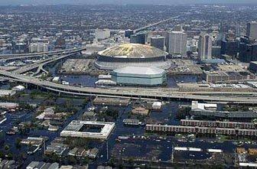

3
Louisiana is the “most
disaster-prone State in the Nation.”
(TWO YEARS RUNNING)

Slide 4
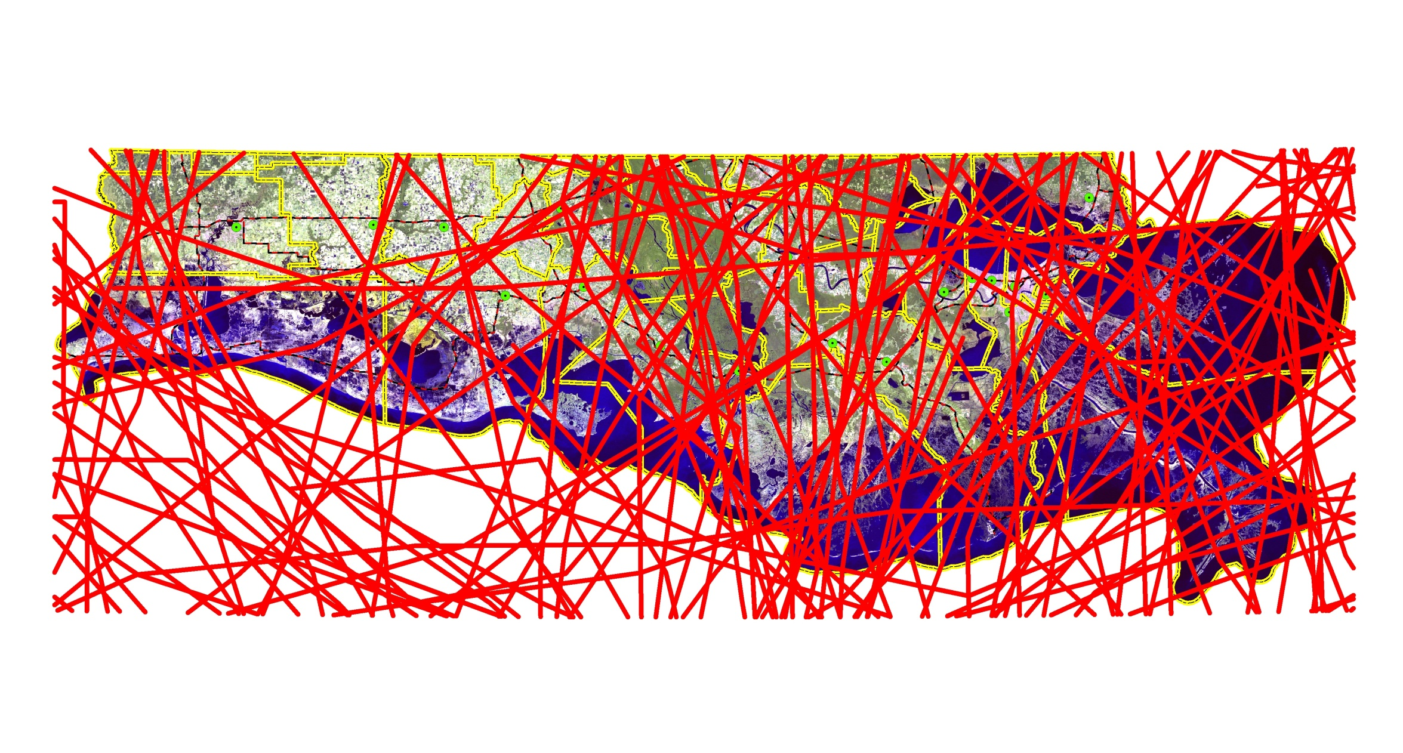
Louisiana coast
A Vulnerable Area for Storms
4
Jeff
Davis
Acadia
St
Martin
Livingston
Saint
Tammany
Calcasieu
Iberville
Ascension
St
John
Iberia
Lafayette
St
James
Cameron
Jefferson
St Bernard
St Charles
Vermilion
Assumption
St Mary
Lafourche
Plaquemines
Terrebonne
All Atlantic Basin Tropical Systems
National Hurricane Center 1850 - 2007
Notes:
4

Slide 5
5
Top U.S. disasters by cost
EVENT YEAR FEMA FUNDING
Hurricane Katrina (LA Only) 2005 $43 billion
Attack on America (NY,PA,VA) 2001 $9 billion
Northridge Earthquake (CA) 1994 $7 billion
Hurricane Rita (LA,TX) 2005 $3.8 billion
Hurricane Ivan (AL,FL,GA,LA,MS,NJ,NY,NC,PA,TN,WV) 2004 $2.4 billion
Hurricane Georges (AL,FL,LA,MS,PR,VI) 1998 $2.25 billion
Hurricane Wilma (FL) 2005 $2.1 billion
Hurricane Charley (FL,SC) 2004 $1.89 billion
Hurricane Andrew (FL,LA) 1992 $1.8 billion
Hurricane Frances (FL,GA,NY,NC,OH,PA,SC) 2004 $1.77 billion
SANDY 2012 ??????

Slide 6
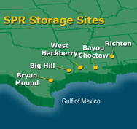
Strategic petroleum reserve
National ranking: 1st
6
National Security
Interest:
High

Slide 7
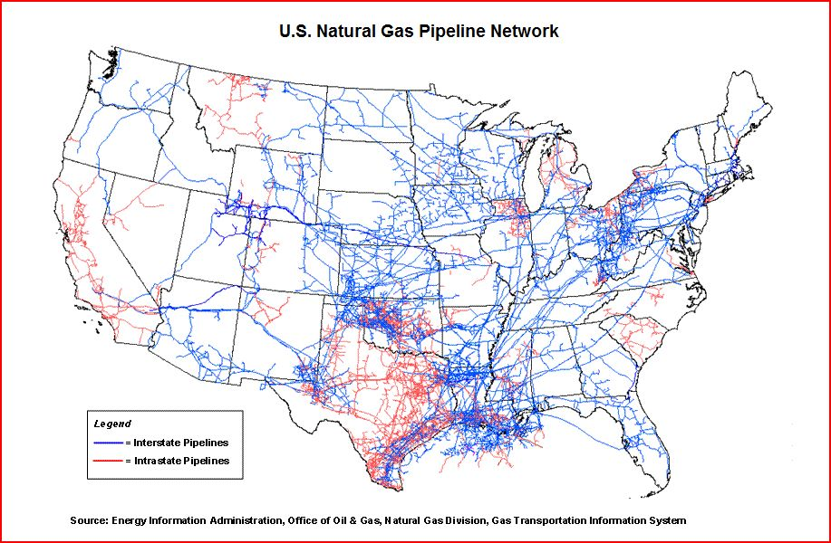
Gas transmission pipelines
National ranking: 1st
7
National Security
Interest:
High

Slide 8
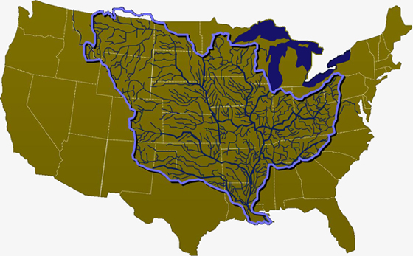
Ports + waterways
National ranking: 1st
8
National Security
Interest:
High

Slide 9
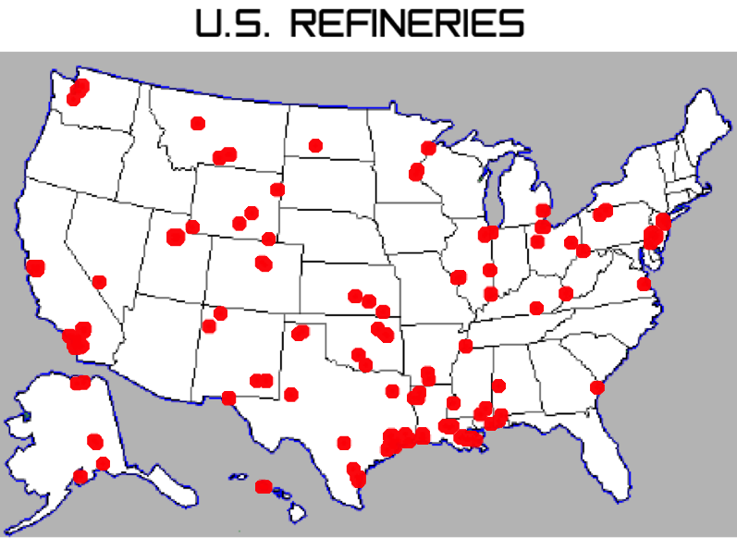
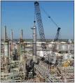
Petroleum refining + chemical products
National ranking: 2nd
9
National Security
Interest:
High

Slide 10
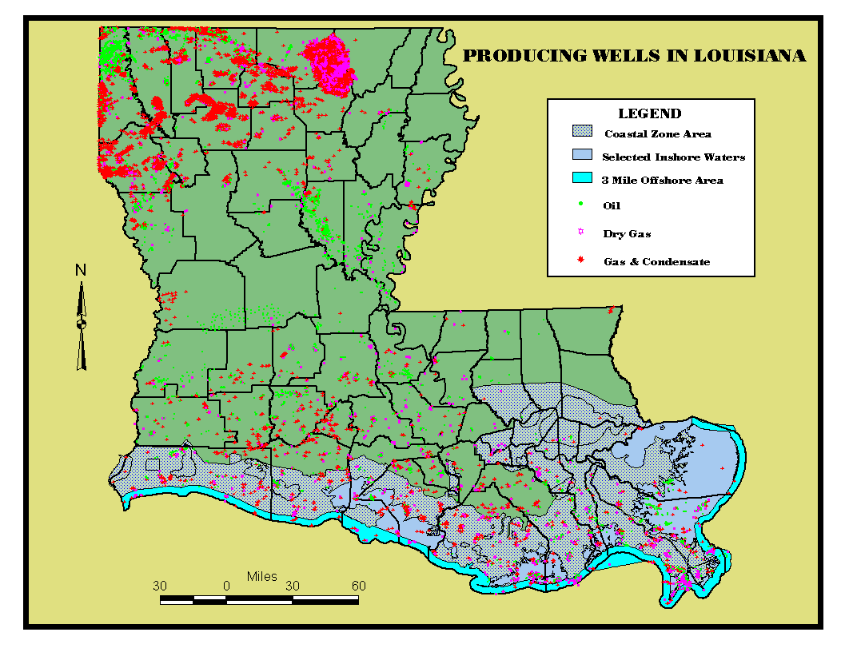
Oil/gas exploration + production
National ranking: 4th
10
National Security
Interest:
High

Slide 11
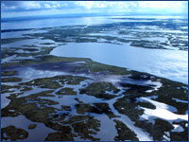
Coastal restoration + wetland management
National ranking: 1st
11
National Security
Interest:
High

Slide 12
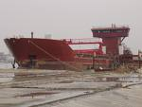

Ship fabrication
National ranking: 4th
12
National Security
Interest:
Medium

Slide 13

NASA – Space station program
National ranking: 3rd
13
National Security
Interest:
High

Slide 14

Mission
14
  “To lead and support Louisiana in preparation for, response to, and recovery from, all emergencies and disasters.”

Slide 15
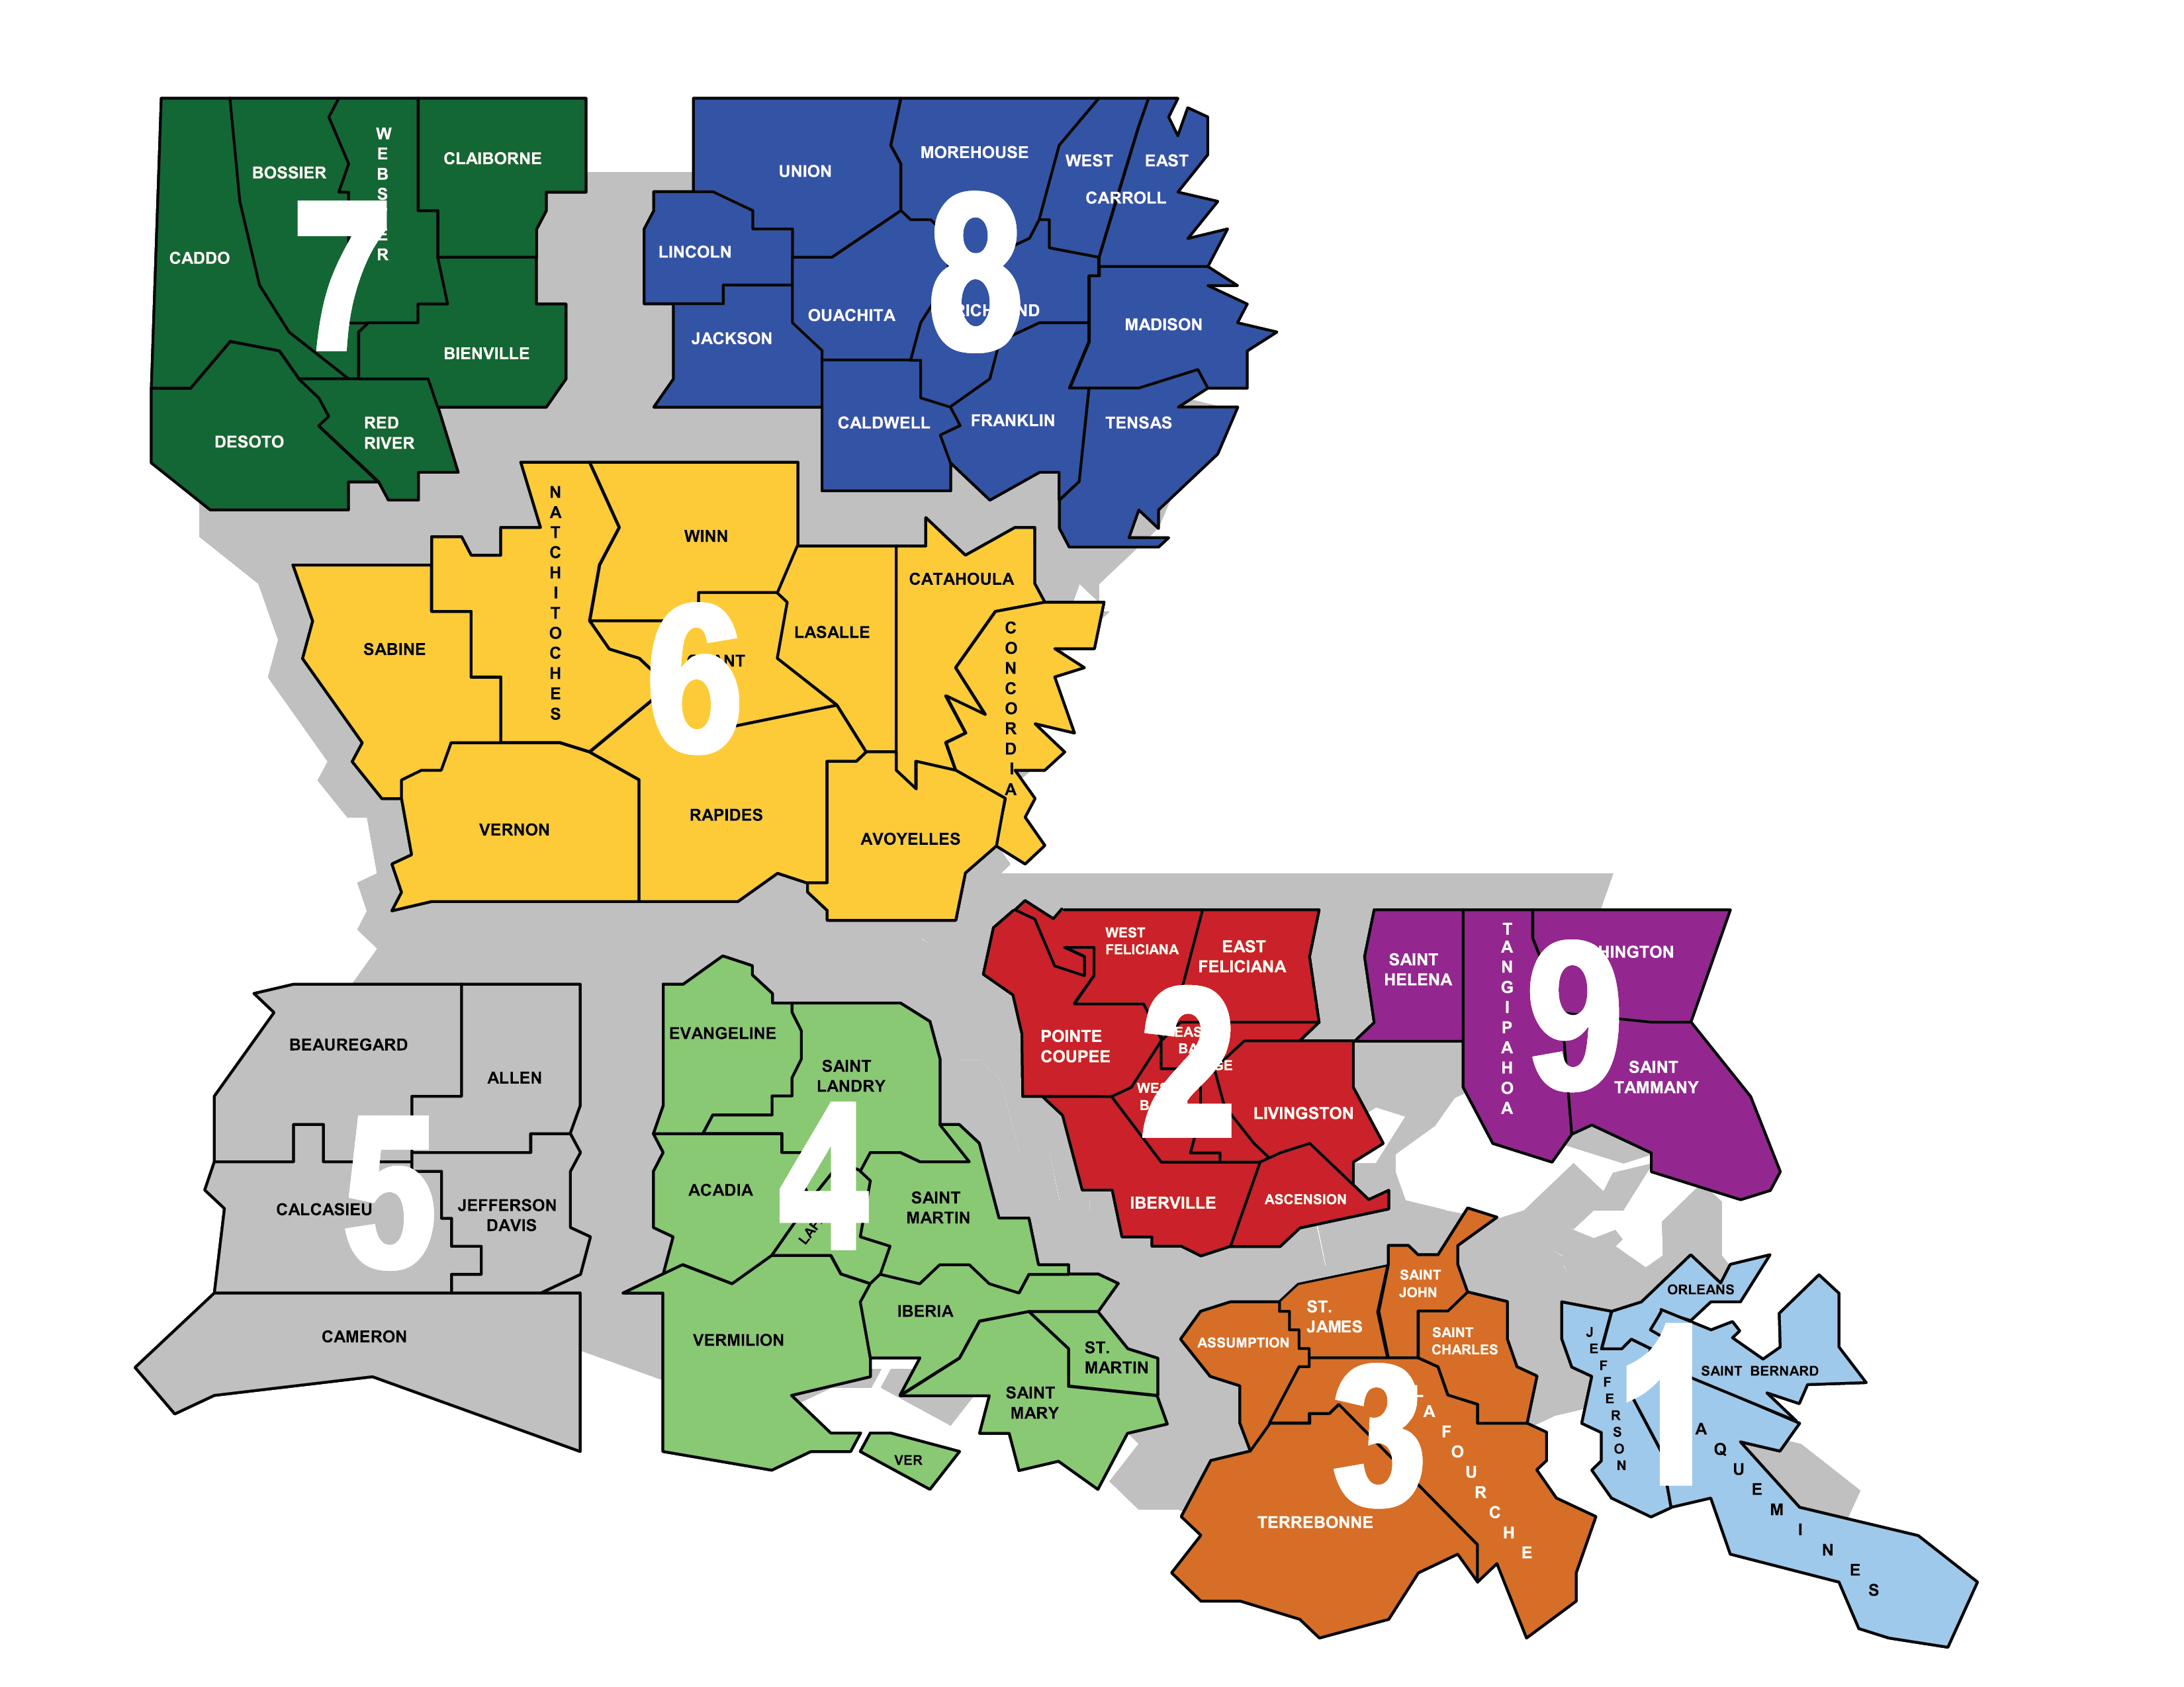
GOHSEP regions
15

Slide 16
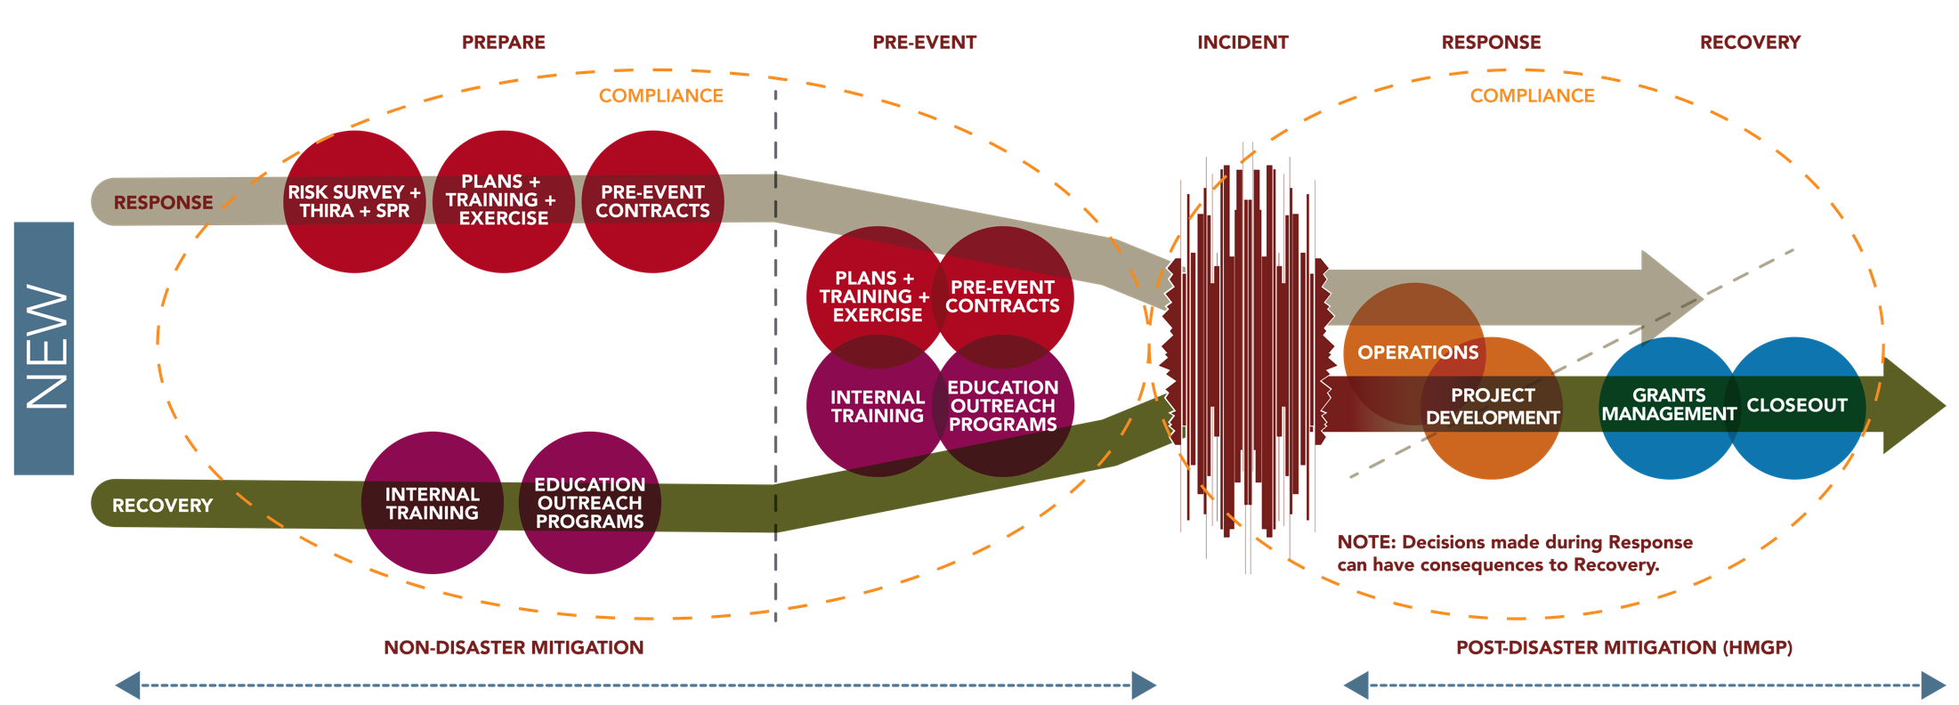
Disaster Life Cycle
16

Slide 17

Emergency public information
Louisiana Hurricane Emergency Preparedness Guides.
GOHSEP Apple iPhone & iPad Apps.
Public service announcements via TV, radio, web and print media to include the Critter Plan series.
Donna Douglas

Slide 18
18
www.ohsep.louisiana.gov/plans/eopindex.htm

Slide 19
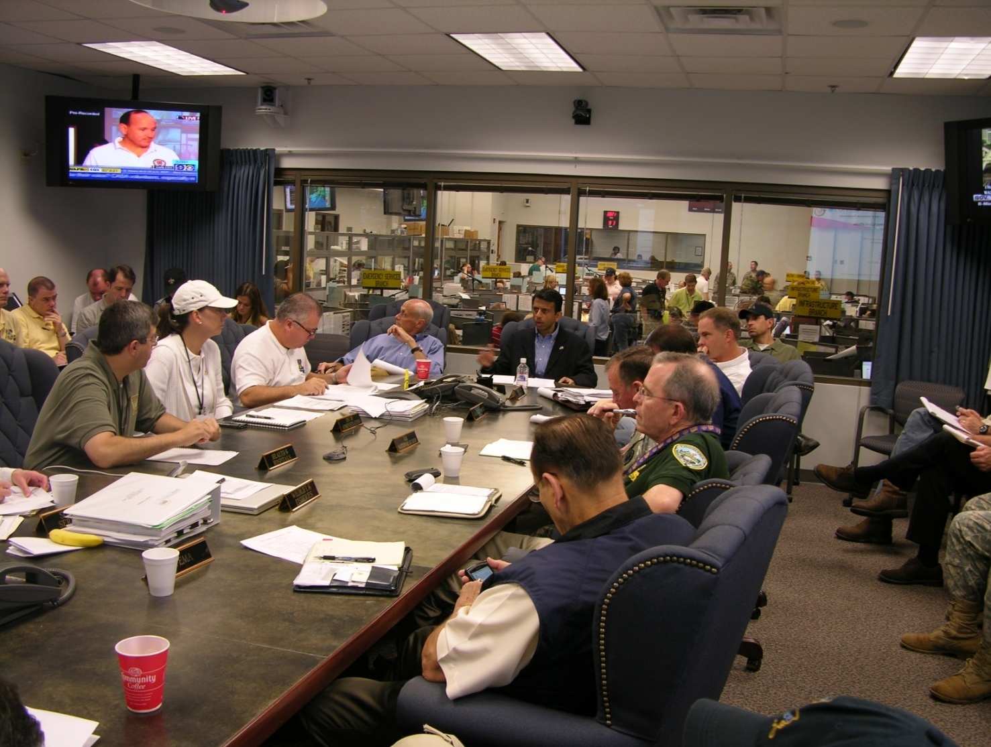
GOHSEP management structure during activation
19
GOHSEP operates under the Unified Command Group (UCG) during activation for all major disasters.

Slide 20

Emergency action levels
Level I: In progress - response activities required
Incident requiring full augmentation of EOC with all ESFs, supporting organizations & FEMA.
Level II: Event in progress - major impact
Incident requiring full augmentation of EOC with all ESFs, supporting organizations & FEMA as needed.
I
II
III
Level III: Potential or actual threat
Incident requiring activation of CAT with potential augmentation from selected ESFs.
Level IV: Normal operations
Staffing is in accordance with authorized manning levels and may include the CAT.
IV

Slide 21
Stafford Act (Continued . . . )
Major grant programs:
  Public Assistance (PA) - $14.3 Billion
  Individual Assistance (IA)
  Hazard Mitigation (HM) - $2 Billion

Slide 22
RECOVERY OVERVIEW
Louisiana open disasters
Disaster | Period | No. of Applicants | Project Worksheets | Obligated Federal $
Winter Flooding - 4102 | 1/8/2013-1/17/13 | 33 | 86 | $6,293,502
Isaac – 4080 | 8/26/12 – 9/10/12 | 520 | 119 | $124,242,161
TS Lee – 4041 | 9/1/11 – 9/5/11 | 46 | 89 | $8,234,673
Miss River – 4015 | 4/252/11 – 7/7/11 | 117 | 157 | $10,382,016
2009 NW Flood – 1863 | 10/29/09 – 11/3/09 | 46 | 351 | $9,177,733
Ike - 1792 | 9/11/08 – 11/11/08 | 342 | 1,671 | $233,817,042
Gustav - 1786 | 9/1/08 – 9/11/08 | 975 | 7,028 | $744,328,689
2006 Floods - 1668 | 10/16/06 – 11/8/06 | 63 | 413 | $15,124,026
Rita - 1607 | 9/23/05 – 11/1/05 | 798 | 4,607 | $799,271,774
Katrina - 1603 | 8/29/05 – 11/1/05 | 1,535 | 19,744 | $12,415,179,850
TOTAL |  | 4,475 | 34,266 | $14,366,051,466

Slide 23
Recovery responsibilities
23
Public Assistance (PA) grant program – $14 billion+
Hazard Mitigation (HM) grant program – $2 billion+
  Interact with FEMA on program and policy issues.
  Accountable for funds disbursed to all Applicants.
  Provide technical advice and support to Applicants.
  Provide support to Applicants for damage assessments.
  Maintain compliance with Federal grant management requirements.

Slide 24
Hazard mitigation funding
Open Disaster Declarations | Disaster Funding Levels
DR-1603 (Katrina) | $1,722,818,666
DR-1607 (Rita) | $137,903,000
DR-1786 (Gustav) | $225,071,189
DR-1792 (Ike) | $545,014,258
DR-1863 (Severe Storms, Tornadoes, and Flooding) | $895,384
DR-4015 (Flooding) | $2,026,125
DR-4041 (Tropical Storm Lee) | $900,000
Dr-4080 (Isaac) | $63,732,027
DR-4102 (Severe Storms and Flooding) | $439,621
Total | $2,698,800,270

Slide 25
Long-Term Recovery

Slide 26
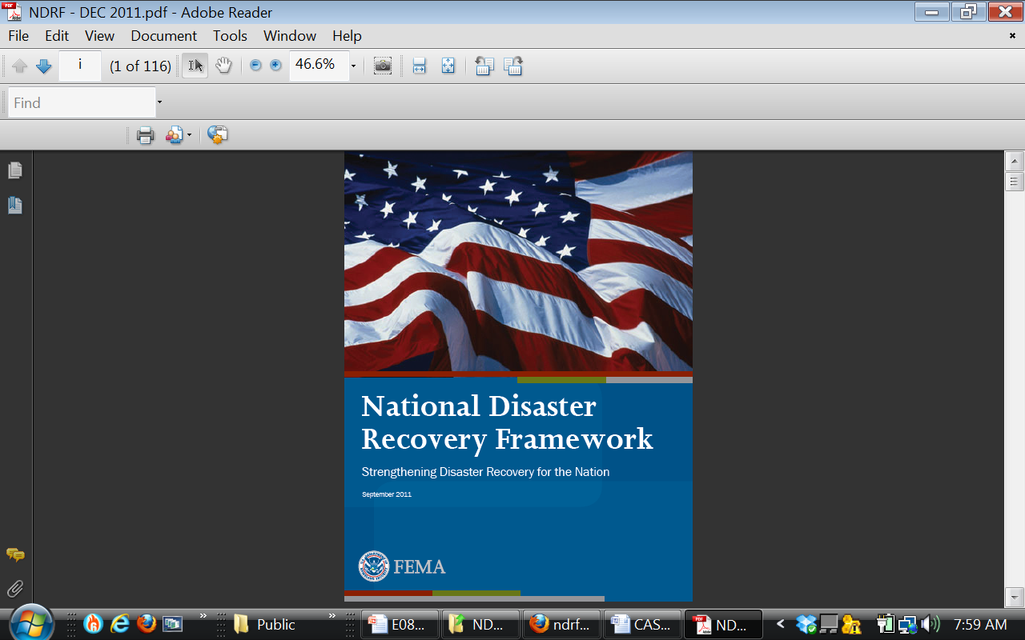
National Disaster Recovery Framework
“a scalable, flexible, and adaptable framework coordinating structures to align key roles and responsibilities, linking local, State, Tribal and Federal governments, the private sector, and voluntary, faith-based and community organizations that play vital roles in recovery”
** Post-Katrina Emergency Management Reform Act of 2006
** Presidential Policy Directive (PDD-8)

Slide 27
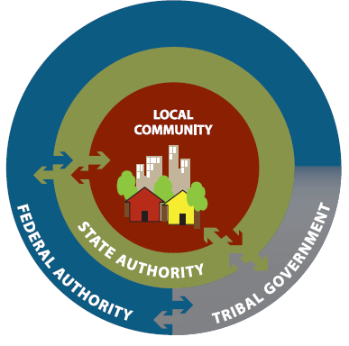
Defines roles + responsibilities
Individuals + Family
Private Sector – Business Community
Critical Infrastructure Owners + Operators
Non-Profit Sector
Local Government
State Government
Tribal Nations
Federal Government

Slide 28
Biggert-Waters Flood Insurance Reform Act of 2012

Slide 29
Why reform the NFIP?
Flooding is the most frequent, destructive, expensive disaster type in the US;
  This is the primary reason that flood is an excluded peril in most property casualty policies.
An unintended consequence of the NFIP is the subsidy of risk behavior, using public funds.
Between 1978 and 2013, 108 significant claims events for the resulted in 1,030,309 claims filed paying policy holders $42,289,635,243.53 (average $41,045.58).
Notes:
Source:
FEMA, 2013
Questions About the Biggert-Waters Flood Insurance Reform Act of 2012
http://www.fema.gov/flood-insurance-reform-act-2012

Slide 30

What does BW-12 do?
BW-12 extends the National Flood Insurance Program (NFIP) for five years and requires significant reform in the following NFIP major components:
  Flood insurance;
  Flood hazard mapping;
  Grants; and
  Floodplain management.
Notes:
Source:
FEMA, 2013
Questions About the Biggert-Waters Flood Insurance Reform Act of 2012
http://www.fema.gov/flood-insurance-reform-act-2012

Slide 31
Flood insurance
Removes subsidized rates for certain classes of structures:
  Jan, 2013 – Non-Primary Residences
  Oct, 2013 – Business Properties, 1-4 Residences SRL Properties, Properties where claims have exceeded fair market value, Properties with no/lapsed insurance, and Properties purchased after BW-12
  Late 2014 – actuarial rate phase in for all other (at 20% per year increase)
Notes:
Source:
The Association of State Floodplain Managers, 2012
2012 NFIP Reform Act Summary of Contents. Print.

Slide 32
Flood insurance (Continued . . . )
Allows for rate increases on subsidized of 25% annually until actuarial rates are achieved.
Increases the limit for annual rate increases within a given risk classification from 10% to 20%.
Notes:
Source:
The Association of State Floodplain Managers, 2012
2012 NFIP Reform Act Summary of Contents. Print.

Slide 33
Flood insurance (Continued . . . )
Allows for installment payment.
Allows for private insurance.
Allows for State sponsored mediation and requires NFIP participation.
Notes:
Source:
The Association of State Floodplain Managers, 2012
2012 NFIP Reform Act Summary of Contents. Print.

Slide 34
Effects on Louisiana
Louisiana has 481,354 NFIP policies.
  82,000 are subsidized.

Slide 35

QUESTIONS + ANSWERS

