Slide 1
New WebEOC SITREP Process

Slide 2
Why Is an Update Needed?
Make the board easier to read and use
Larger text; easily-defined sections
Better guide the user through the reporting process
Better communicate needed information
Reduce recurring errors from past events
Duplication of SITREP entries
Blank updates
Take advantage of more modern code (development)
Better look and design
More customization for our users

Slide 3
SITREP Board View
Like the new Contacts Manager and POD Status Log, the new SITREP board has a simplified header.
Any headings, names, and labels are subject to change.

Slide 4
Header Section
The board name and incident name can be found on the left side of the board header.

Slide 5
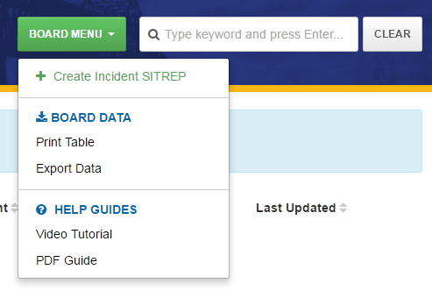
Header Section
On the right side is the Board Menu button and the search feature.
All board-level actions, export options, and help guides are available here.
Click the “Create Incident SITREP” option to begin your SITREP. This link will not be available if a SITREP has already been created for your position.

Slide 6
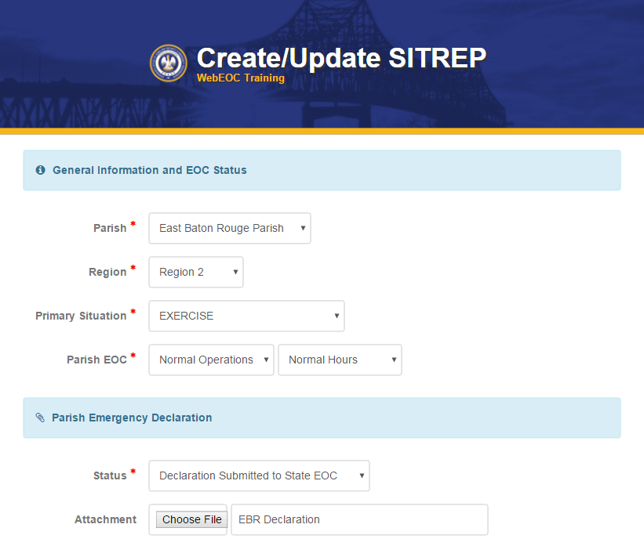
Creating a SITREP: General Info/EOC Status
The SITREP input is broken down into sections. Required fields are marked with a red asterisk.
Your parish name will be populated automatically.
The “Primary Situation” allows you to mark which specific event type is impacting your parish.
Parishes will report EOC activation and staffing.

Slide 7
Creating a SITREP: Declaration/Attachment
You can also upload your emergency declaration and set your declaration status. You can give a custom name to the attachment, similar to the uploads in the File Library.
This is the only attachment in this SITREP. Other attachments can be added to the File Library.

Slide 8
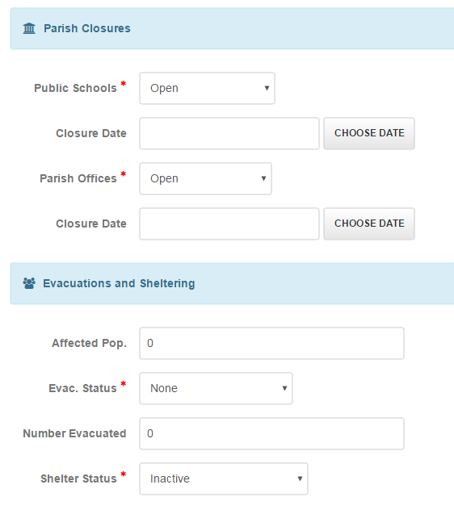
Creating a SITREP: Closures and Evacuations
Next is the parish closures section. Closures, early dismissals, and delays can be selected here, along with the affected dates.
Below, evacuation and sheltering statuses and evacuation numbers can be updated.

Slide 9
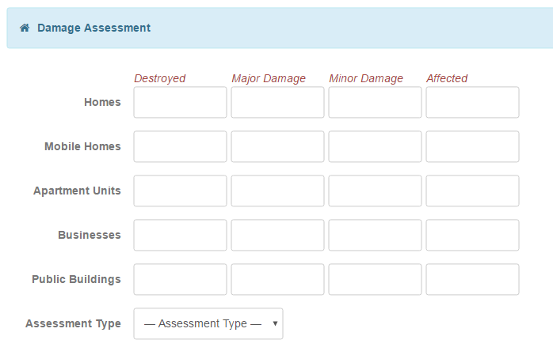
Creating a SITREP: Damage Assessment

Slide 10
Creating a SITREP: Damage Assessment
The damage assessment table allows parishes to record the number and type of structures that have been destroyed, damaged, or affected.
Parishes can mark the assessment totals as Pre-Impact Estimate, Estimate, or Actual.
If no information is entered in a cell, it will default to zero.

Slide 11
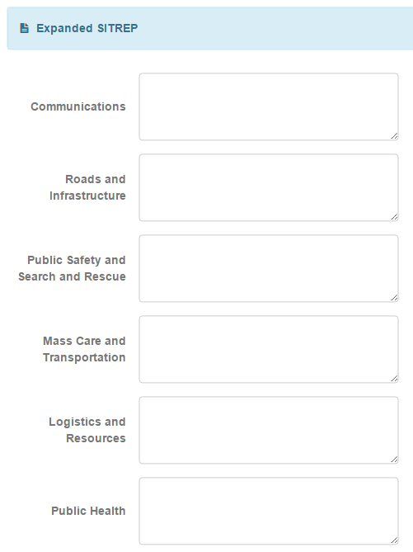
Creating a SITREP: Detailed Reports
The expanded SITREP section allows the parish to report various issues separately, rather than reporting all details into one text field.

Slide 12
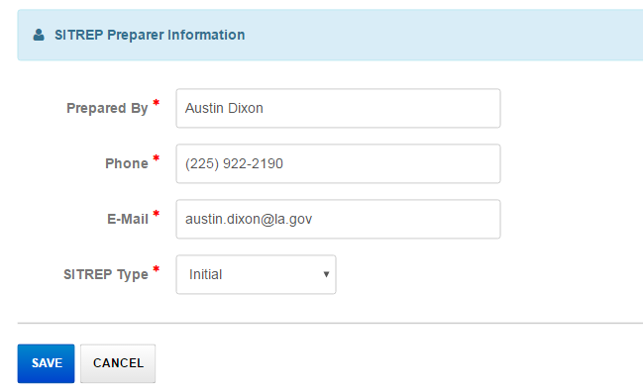
Creating a SITREP: Preparer Info
Preparer information is added in the last section. The SITREP type can be marked as initial, update, or final. An initial or final SITREP will be marked as such on the main view. Click Save to submit your SITREP.

Slide 13
Updating Your SITREP
Once your parish has created a SITREP, you can update it by clicking the pencil icon to the left of your entry. Parishes can only edit their own entry.

Slide 14
Viewing Your SITREP
To view a SITREP, click the folder icon to the far left of an entry. SITREPs can be viewed by all WebEOC users.

Slide 15
Additional Notes
Parish and state agency SITREPs will be listed together on a single board. A clickable filter will allow users to view only parish or only state agency SITREPs, if desired.
Parishes will be able to print and save a copy of their current SITREP in the details view. All SITREP updates can be printed and saved as well.

Slide 16
Contact Information
While the new SITREP board and process is nearly complete, we’re still open to any suggestions from parishes before a final change is made in WebEOC.
For SITREP-related questions:
Jason Lachney
Section Chief, Operations
(225) 358-5412
jason.lachney@la.gov
For WebEOC-related questions:
Austin Dixon
WebEOC Administrator
(225) 922-2190
austin.dixon@la.gov

Slide 17
Questions?

