Slide 1


Local and State Needs

Slide 2
Survey of Local Needs
Preparedness Examples:
  Sand, Pumps, Catering, Food, Water, Hotels, Waste, Light Plants, Barricades, Wrap Around Services, Debris Removal & Monitoring, Planning and Fuel
Mitigation Examples:
  Wind Retrofits, Safe Rooms, Generators (Lease & Buy)
  Source: Livingston Parish OHSEP and Terrebonne Parish OHSEP

Slide 3

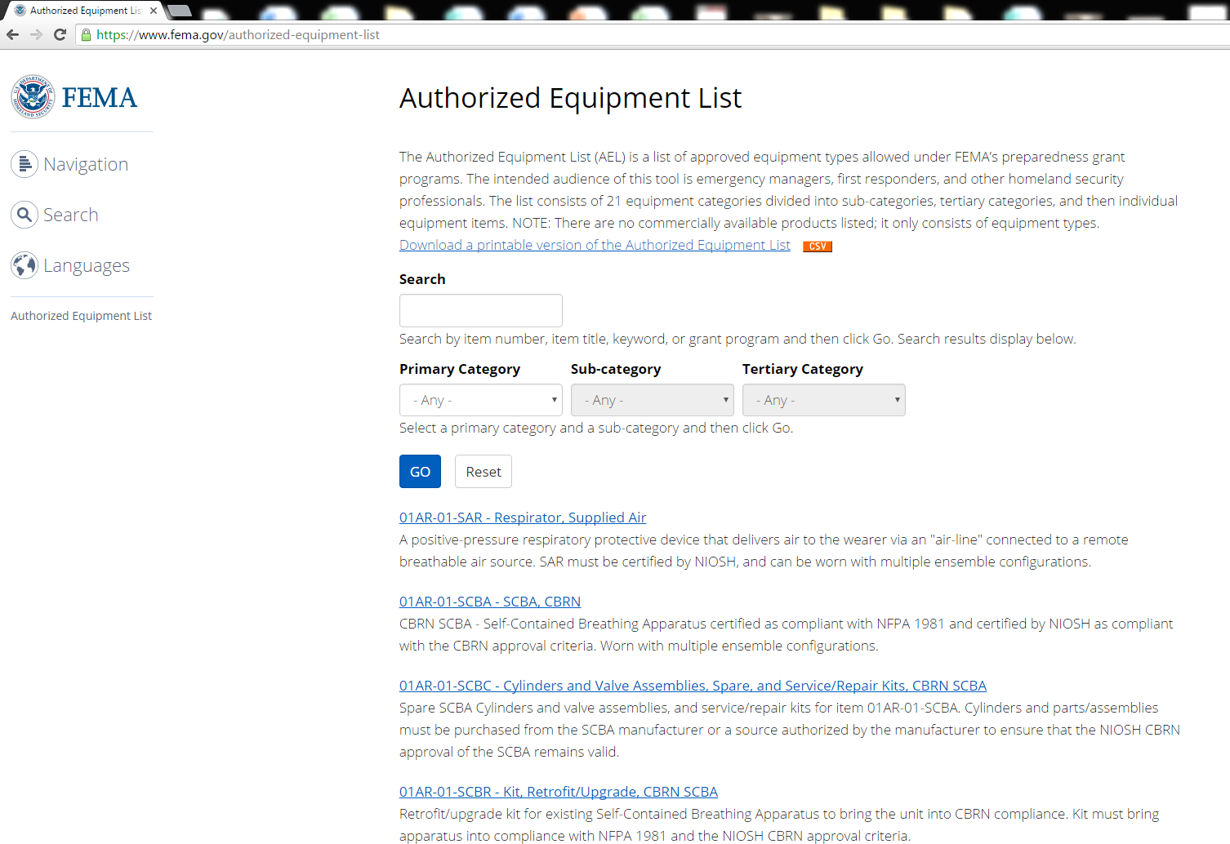
Authorized Equipment List

Slide 4
AEL Samples
Source: GOHSEP Homeland Security Grants

Slide 5
Top State Commodities
Source: GOHSEP Operations

