Slide 1
LWIN
Louisiana Wireless Information Network
February 20, 2013
Department of Public Safety
Radio Communications
(225) 925-6036

Slide 2
Jeya Selvaratnam Jeya@DPS.LA.GOV 225-925 4017

Slide 3
What is LWIN?
Land Mobile Radio (LMR) network
P25 Digital 700 – 800 MHz
Trunked
Ability to talk from one end of the state to the other
Notes:
More complicated, more equipment, but better

Slide 4
Governance Act 797 (SB788)
Statewide Interoperability Executive Committee (SIEC)
Oversees LWIN
Department of Public Safety
Identify and implement interoperability solutions
Address critical interoperability issues relating to public safety and emergency response, including communications, spectrum, networks, equipment, training, and other areas as needs are identified

Slide 5
SIEC Members
5 State Representatives
Deputy Director of Interoperability, or designee -
Chairman, Pat Santos
Commissioner of the Division of Administration, or designee
Adjutant General of the Louisiana National Guard, or designee
Deputy Secretary of the Department of Public Safety and Corrections, Public Safety Services, or designee
Executive Director of the Governor’s Office of Indian Affairs, or designee

Slide 6
SIEC Members
6 Local Agency Representatives
President of the Louisiana Sheriffs Association, or designee
President of the Louisiana Association of Chiefs of Police, or designee
President of the Louisiana Fire Chiefs Association, or designee
Chair of the Regional Parish Homeland Security and Emergency Preparedness Directors Committee, or designee
Association of Public Safety Communications Officials, or designee
Louisiana Ambulance Alliance, or designee

Slide 7
SIEC Members
9 Local Representatives
Region 1 Ken Hughes
Region 2 Billie Giror
Region 3 Eric Deroche
Region 4 Lee Hebert
Region 5 Sheriff Douglas Hebert III
Region 6 Sonya Wiley-Gremillion
Region 7 William Edge
Region 8 Artice Dowdey
Region 9 Merrick Tassin

Slide 8
Infrastructure Update

Slide 9
SYSTEM SUMMARY
119 Tower Sites in Full Operation
6 Operational Mobile Sites

Slide 10
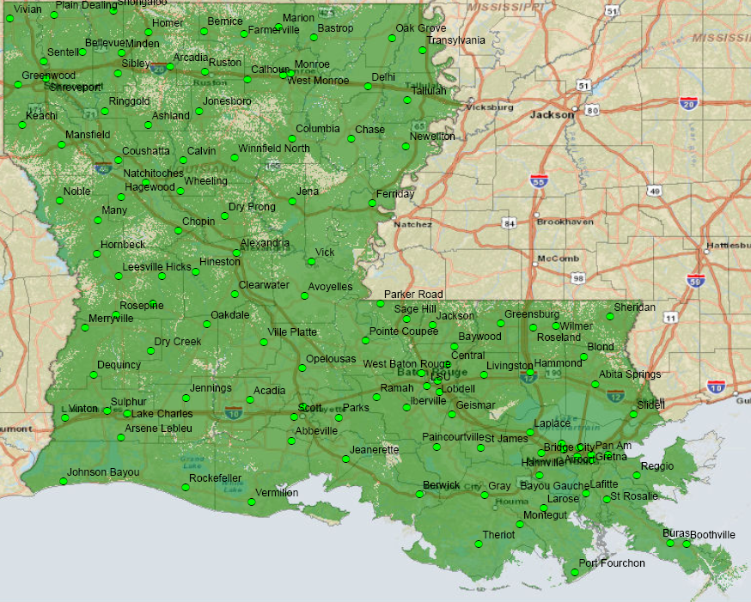

Slide 11
SYSTEM SUMMARY: 119 INSTALLED SITES
119 Sites in Full Operation
2008 58 Operational sites
2009 87 Operational sites
2010 104 Operational sites
2011 112 Operational sites
2012 119 Operational sites
6 Operational Mobile Sites

Slide 12
Channel Summary
Total Channels (119 Tower Sites and 6 Mobile Sites) – 1142
Total Active Channels – 1084
1048 Channels on 119 Sites
36 Channels on 6 Mobile Sites
Repeaters Pending Licenses – 58

Slide 13
System Statistics

Slide 14
Subscribers

Slide 15
Subscribers 2008 to 2012

Slide 16
Push to Talk

Slide 17
Push to Talk 2008 to 2012

Slide 18
Busies
Hurricane Isaac X10
34,885 Busies

Slide 19
Busies 2008 to 2012

Slide 20
Subscriber Statistics

Slide 21
Subscriber Statistics
Security Groups/Agencies
182/427
Talkgroups
5,453
Users
69,805

Slide 22
System Coverage

Slide 23
Present Coverage

Slide 24
Thank You!

