Slide 1
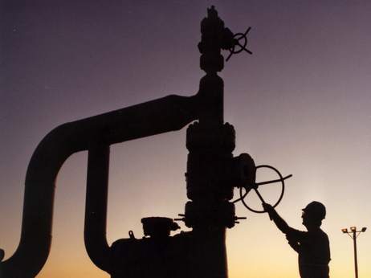

United States
Strategic Petroleum Reserve
James Kelley, CEM
Manager, Emergency Preparedness

Slide 2
Presentation Outline
I. SPR Mission and Management
SPR Design & Development
SPR Stockpiling Sites
SPR Operations & Readiness
V. SPR Drawdown Policy & Capabilities
Notes:
The focus of my briefing today will be to provide –
A brief overview of the U.S. Oil Reserve
A description of the U.S. Policy governing the use of the Reserve
A description of the U.S.’s Salt Storage Technology
And considerations in developing a Strategic Oil Reserve Program

Slide 3
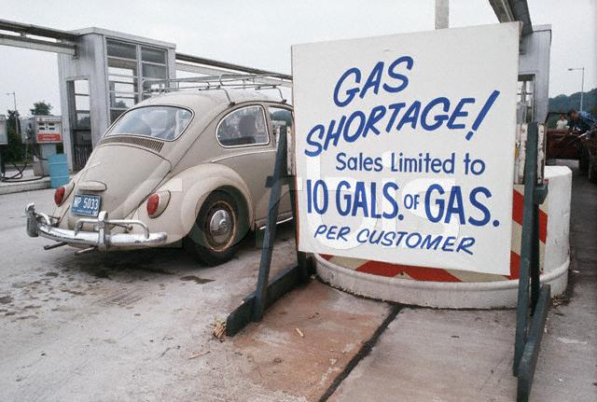

Strategic Petroleum Reserve
Established by U.S. Law:
Energy Policy & Conservation Act (EPCA)
December 1975
Mission:
To ensure U.S. Energy Security:
  To reduce the impacts of potential
  disruptions in U.S. petroleum supplies
  To carry out U.S. obligations under
  International Energy Program (Treaty)
Program Implementation:
  Managed By U.S. Dept of Energy
  Federally Owned & Financed
  No Industry Obligations
1973 Arab Oil Embargo
International Energy Program

Slide 4
Strategically Located for Distribution
Gulf Coast contains almost 50% of the U.S. refining capacity
Gulf Coast is place of entry for approx. 70% of U.S. Non-Canadian imports
SPR has both PIPELINE and MARINE distribution capabilities for max. flexibility

Slide 5
Salt Storage Technology
Lowest Cost Storage Technology:
  Drill wells into salt
  Solution mine storage cavities
Oil Storage in Salt Caverns:
  Proven Storage Technology
  Assured Containment
  Utmost Safety and Security
  Easy to get in and out
  Oil does not dissolve salt
  No Evaporation or Air Emissions
SALT

Slide 6
SPR Storage Cavern Design
230 m
Cavern Size & Shape
  10 Million Barrels
  (1.59 million m³)
  Cylindrical shape
  ~ 200 ft Diameter
  ~ 2000 ft Tall
Storage Depth
  Top >-2000 ft
  Bottom <-5000 ft
Two Wells/Cavern
Salt Dome
Notes:
The SPR caverns are designed to store large volumes 10 to 11 million barrels (2 million m³) each
The caverns are cylindrical in shape and taper slightly from top to bottom
The caverns are approximately 200 feet (61 m) in diameter and 2000 feet (610 m) high
The cavern roof is conical shaped for maximum oil withdrawal
Depending on the Salt Dome, SPR caverns are located between 2000 feet (610 m) and 5000 feet (1524 m) below the surface
After testing one, two and three well designs, the SPR standardized on two wells per cavern using one for water or brine and the other for oil.

Slide 7
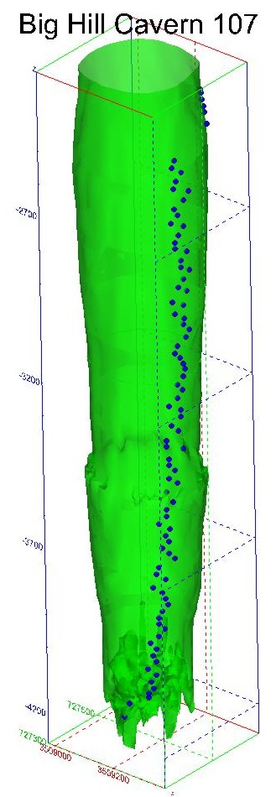

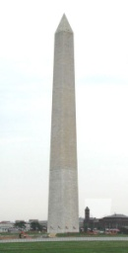
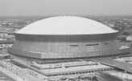
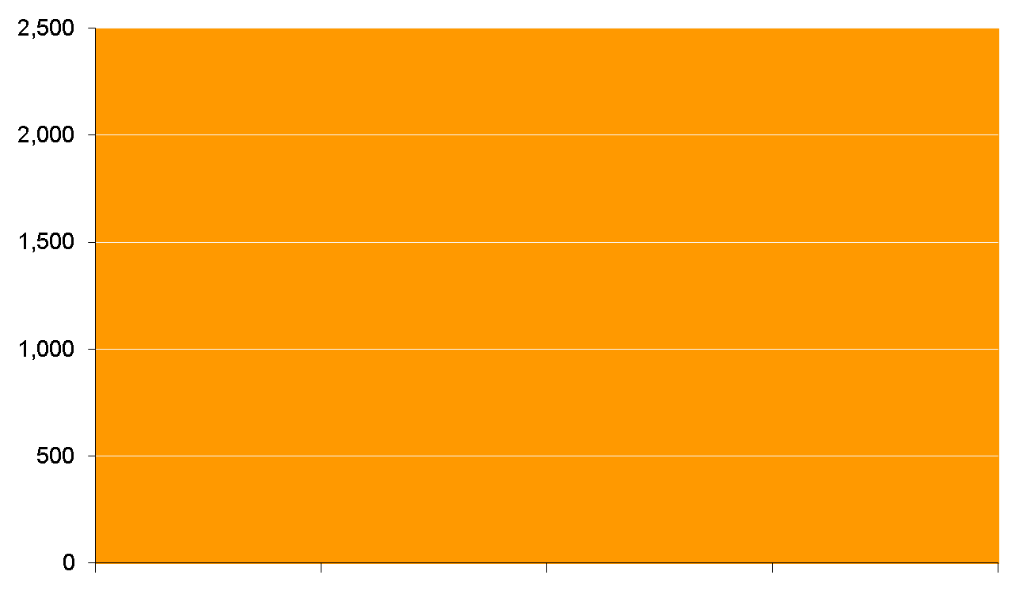
SPR Storage Cavern
Height Comparison
SPR Cavern
2,000 Ft
Eiffel Tower
1,050 Ft
Washington
Monument
555 Ft
New Orleans
Superdome
273 Ft
Notes:
This slide gives a different perspective

Slide 8
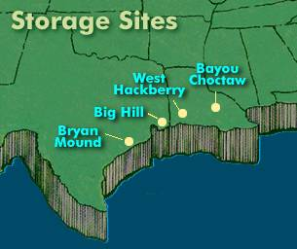
SPR Storage Facilities
SPR Oil Storage Sites:
Texas (2), Louisiana (2)
Storage Capacity:
727 Million Barrels
Current Inventory:
696 Million Barrels
(83 Days of Net U.S. Imports)
Drawdown Capability:
4.25 Million Barrels/Day
(50% of U.S. Import Rate)

Slide 9
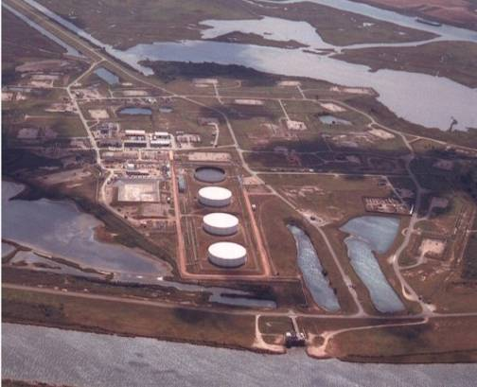
SPR Bryan Mound Site
Site Acquired: 1977
Location: Freeport, TX
Site Development:
Converted 4 Industry Caverns
Constructed 16 New Caverns
Completed 1986
Storage Capacity: 254 MMB
Drawdown Rate: 1,500 MB/D
Distribution Capability: 2,260 MB/D
Houston/Texas City Refiners
Freeport Refinery
Marine: 2 Terminals
SPR’s Largest Oil Storage Site
SPR’s Largest Single Cavern - 35 Million Barrels

Slide 10
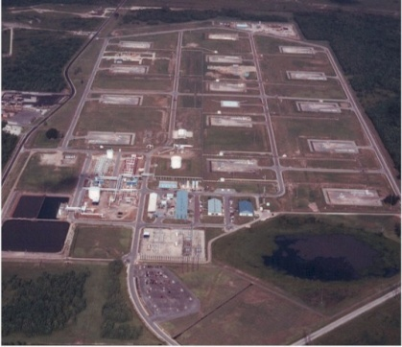
SPR Big Hill Site
Site Acquired: 1982
Location: Winnie, TX
Site Development:
Undeveloped Site
Constructed 14 New Caverns
Completed 1991
Storage Capacity: 171 MMB
Drawdown Rate: 1,100 MB/D
Distribution Capability: 2,825 MB/D*
Beaumont/Port Arthur Refiners
Shell Pipeline to Houston
MidValley Pipeline to Midwest
Marine: 2 Terminals
SPR’s “Award Winning” Site Design
Storm Surge Covered Site in Hurricane Ike in 2008
* Distribution capability of Big Hill and West Hackberry combined due to shared distribution system

Slide 11
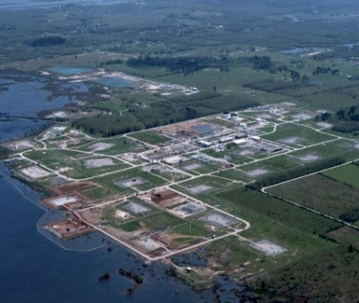
SPR West Hackberry Site
Site Acquired: 1977
Location: Hackberry, LA
Site Development:
Converted 5 Industry Caverns
Constructed 17 New Caverns
Completed 1988
Storage Capacity: 228 MMB
Drawdown Rate: 1,300 MB/D
Distribution Capability: 2,825 MB/D*
Beaumont/Port Arthur Refiners
Lake Charles Refiners
MidValley Pipeline to Midwest
Marine: 1 Terminal
Largest Number of Storage Caverns
Manages SPR Pipelines & Emergency Spill Response Program
* Distribution capability of Big Hill and West Hackberry combined due to shared distribution system

Slide 12
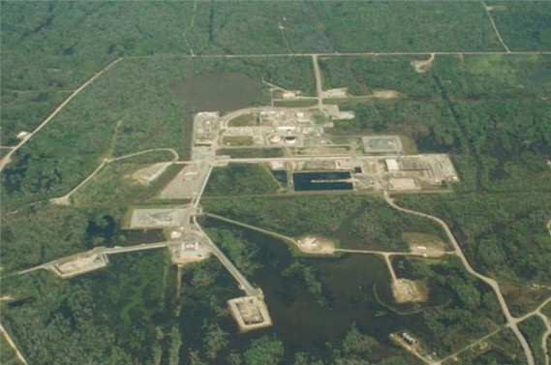
SPR Bayou Choctaw Site
Site Acquired: 1977
Location: Plaquemine, LA
Site Development:
Converted 5 Industry Caverns
Constructed 1 New Cavern
Completed 1987
Adding New Cavern in 2012
Storage Capacity: 74 MMB
Drawdown Rate: 515 MB/D
Distribution Capability: 1,170 MB/D
Mississippi River Refiners
Baton Rouge Refiners
Capline Pipeline to Midwest
Marine: 1 Terminal

Slide 13
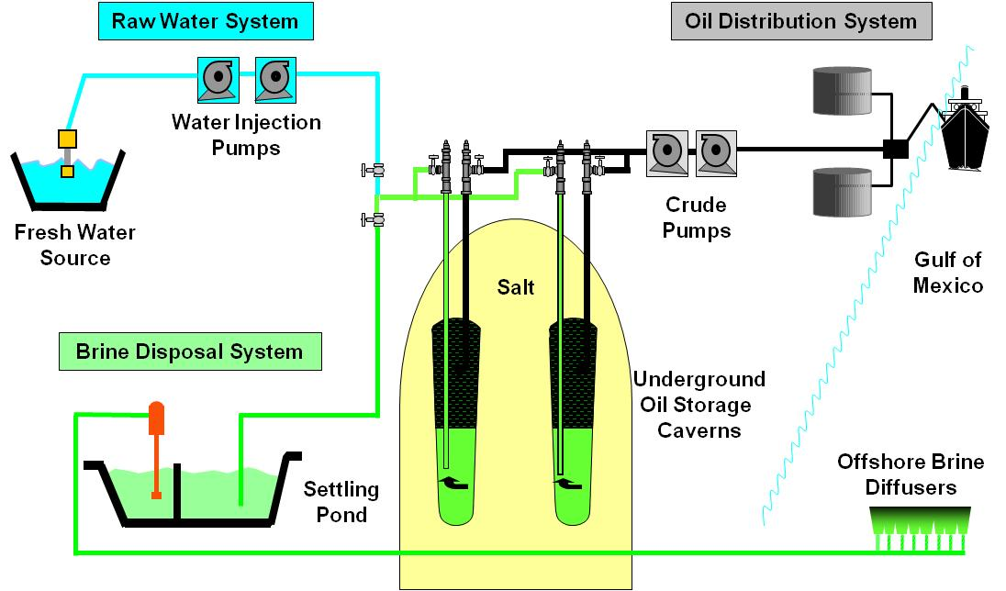
SPR Storage Operations
Notes:
STORAGE FACILITY OPERATIONS
All SPR storage sites operate with 3 fluid systems – oil, water, brine (or salt water) to receive and remove oil from storage.
Oil Storage operations
Oil is received at terminal
Oil is pumped via pipeline to SPR storage site
Oil is metered and injected into the storage caverns using high pressure pumps.
The oil forces (through displacement) salt water (brine) out of the cavern into a settling pond
The brine is pumped from the settling pond to the Gulf and disposed of offshore through an offshore diffuser
Oil Drawdown operations
Water is pumped from a water source (e.g. river channel) to the SPR storage site
The water is injected into the storage caverns using high pressure pumps.
The water forces (through displacement) the oil out of the cavern
The Oil is metered and pumped via pipeline to distribution terminals
The terminals receive, meter and deliver the oil to refiners via pipeline and marine vessels.

Slide 14
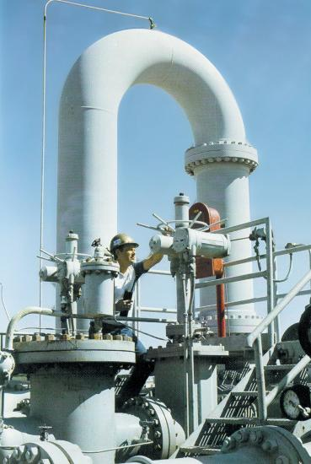
SPR System Readiness
Rapid Drawdown Capability Is Paramount!
  Most disruptions are short
  Being able to drawdown & distribute
  the inventory quickly is critical
Operational Readiness Is Important!
  Built systems with in-line spares, flexibility
  and made easy to repair
  Have formal plans & procedures for
  responding to potential crises
  Established sales process & release plans
  Periodic training & exercises

Slide 15
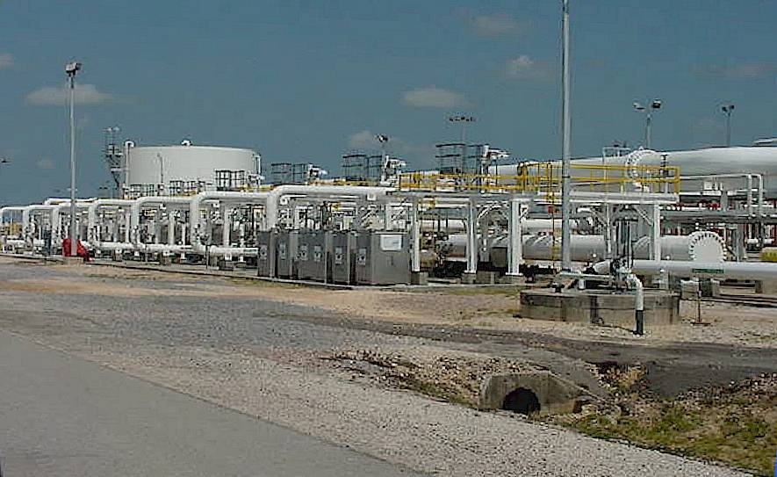
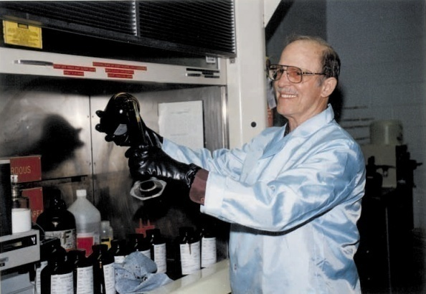

SPR Readiness Assurance
SPR Systems and Equipment
  Full drawdown test (STE) of SPR sites to demonstrate maximum drawdown capability
  Quarterly Drawdown Readiness Reviews to verify system & equipment readiness
SPR Inventory
  SPR crudes are degassed to maintain availability
  SPR crudes are sampled and tested to assure high product quality
SPR Personnel Training
    Regular personnel readiness and training exercises
    Full Simulated Drawdown Exercises (Bi-Annually)
    Operators proficiency maintained by Site Simulators

Slide 16
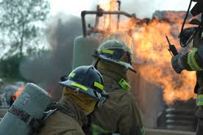
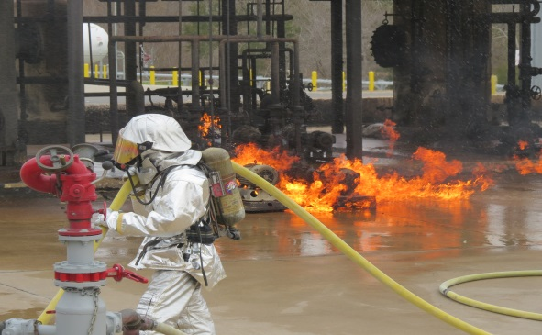

SPR Emergency Response
Emergency Response Team Training
  Initial Training Requirements
  ERT Academy
  Quarterly Training Requirements
  Medical Refresher Training
ICS Training
  100, 200, 700, 800 (all ERT & management staff)
  300 & 400 for management staff
  Position Specific
Annual Exercises & Inspection
    PREP
    No Notice (boom deployment)
    Operational Assessments
    COOP

Slide 17
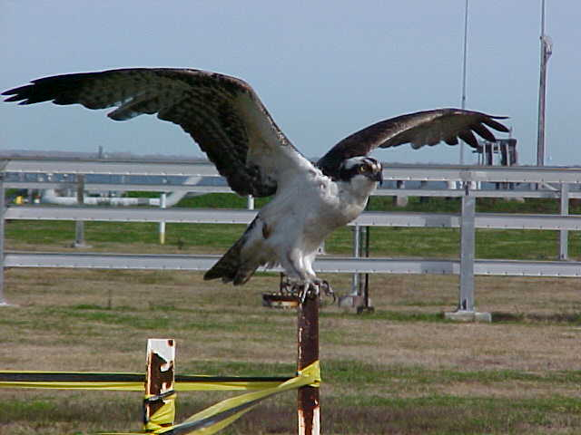
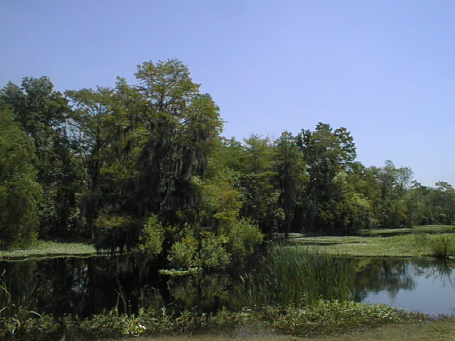
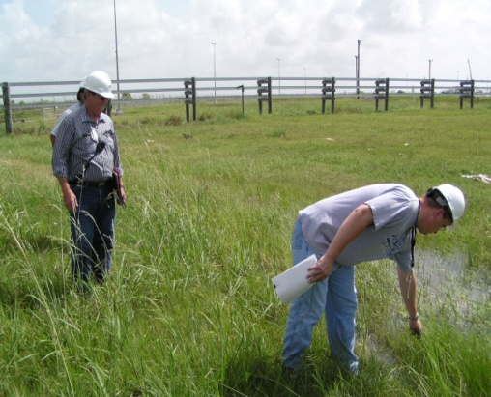
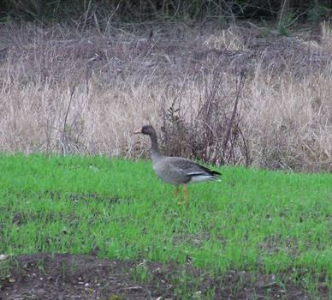
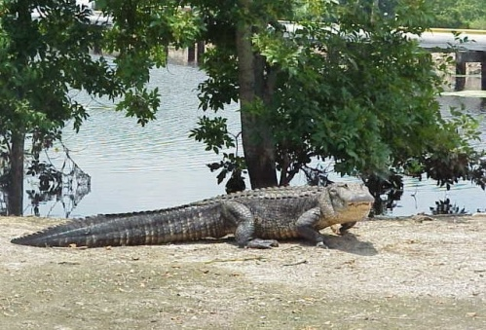
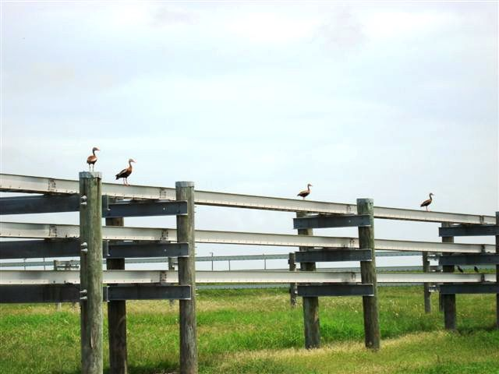
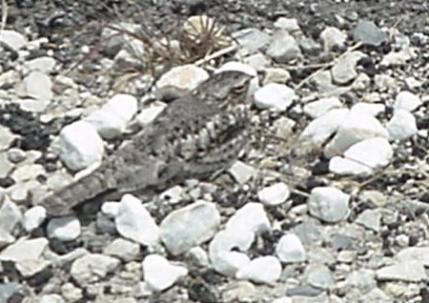
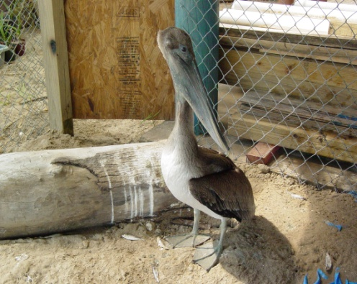
Environmental Responsibility
Protection & Preservation
of Wetlands and Wildlife
while providing
U.S. Energy Security
SPR has set aside nearly 80 Acres for Habitat Enhancement

Slide 18
SPR Distribution Capability
Pipeline Capabilities: 39 Refineries (Imports of >5 MMB/D)
Marine Capabilities: 5 Terminals (Capacity of 2.5 MMB/D)

Slide 19
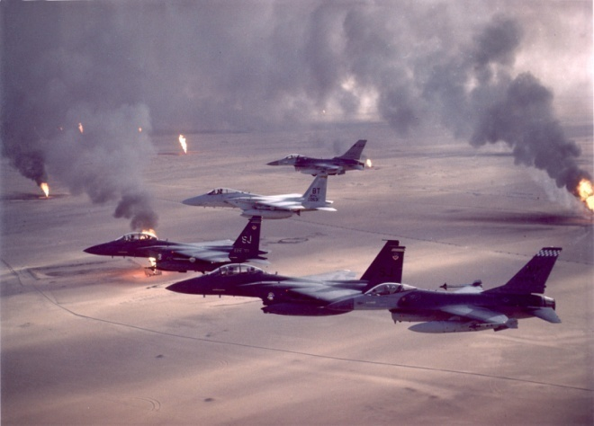
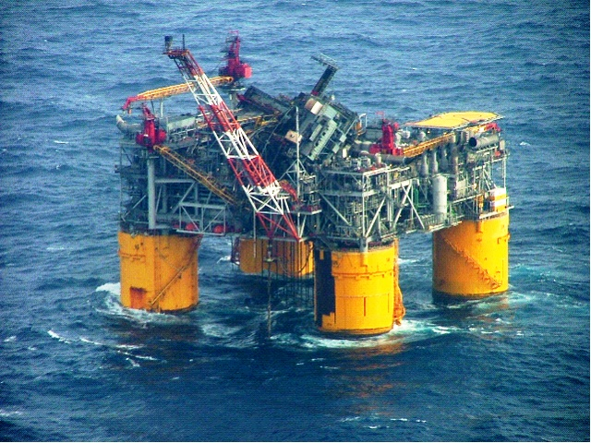
Prior SPR Oil Releases
SPR Drawdowns (IEA Actions):
  1991 Iraq War: 17.3 MMB
  2005 Hurricane Katrina: 11.0 MMB
  2011 Libya Situation: 30.6 MMB
SPR Test Sales:
  1985 Test Sale: 1.0 MMB
  1990 Test Sale: 3.9 MMB
  2014 Test Sale: 5.0 MMB
Emergency Exchanges (Loans):
  Seaway Emergency (1996): 1.0 MMB
  Ship Channel Closure (2000): 1.0 MMB
  Time Exchange 2000: 30 MMB
  Hurricane Ivan (2004): 5.4 MMB
  Hurricane Katrina (2005): 9.8 MMB
  Ship Channel Closures (2006): 1.6 MMB
  Hurricane Gustav/Ike (2008): 5.4 MMB
1991 Iraq War
2005 Hurricane Katrina
Notes:
18

Slide 20
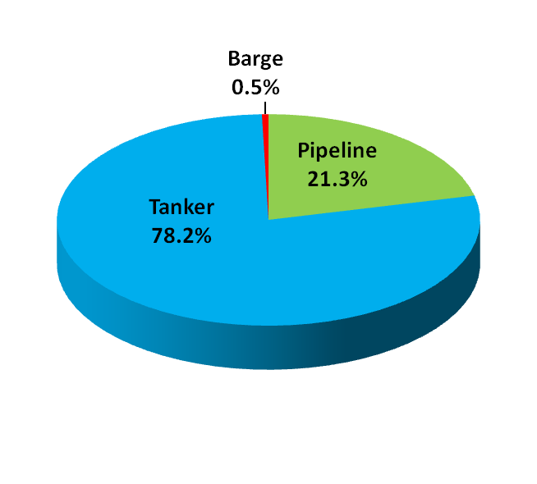
SPR Drawdown 2011
SPR Deliveries by Transportation Mode and Destination
79% of All Deliveries
were by
Marine Vessels
77% of All Deliveries
were within
U.S. Gulf Coast

Slide 21
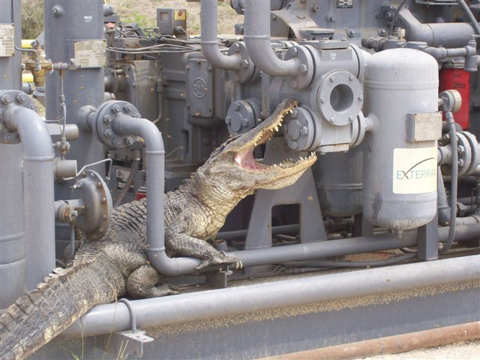
Thank You From
The U.S. SPR
Questions?

