Slide 1
L.W.I.N.
Louisiana Wireless
Information Network
System Management & Maintenance February 19, 2025
Department of Public Safety
Office of State Police
Mobility and Communication Services
(225) 925-6036

Slide 2

Infrastructure Update

Slide 3
SYSTEM SUMMARY
150 Total Tower Sites in Operation
6 Operational Mobile Sites

Slide 4
Zone 1:
43 Sites in Full Operation
Pan Am
Bridge City
Livonia
Laplace
St. Tammany Simulcast
Lacombe
Abita Springs
Waldheim
Pearl River
Covington
Slidell
Talisheek
Blond
Sheridan
Geismar
St. James
Larose
Gibson
BR Simulcast
BR
Central
LSU
WBR
Hammond
Gray
Berwick
Baywood
Ramah
Sage Hill
Parker Road
Iberville
Livingston
Jackson
Greensburg
Superdome
South Baton Rouge
Baldwin
Pointe Coupee
Theriot
Paincourtville
Boothville
Mobile Units
94
96
97
98
99
100
Denham Springs
Clinton
St. George

Slide 5
Zone 2:
18 Sites in Full Operation
N. Simulcast
Gretna
Galleria
NO East
Houma
Lafitte
Bayou Gauche
Hahnville
St. Rosalie
Kenner
Airport
Port Fourchon
Reggio
Montegut
Bourg
Buras
Wilmer
Grand Isle
Thibodeaux

Slide 6
Zone 3:
55 Sites in Full Operation
Clearwater
Monroe
Winnfield
Delhi
Chopin
Dry Prong
Hagewood
Bossier(City)
Farmerville
Minden
Natchitoches
Bastrop
Greenwood
Ruston
Hineston
Ashland
Vivian
Newellton
Noble
Transylvania
Alexandria
Avoyelles
Bellevue
Bernice
Calhoun
Columbia
Ferriday
Homer
Jena
Jonesboro
Mansfield
Many
Marion
Oak Grove
Plain Dealing
Ringgold
Sentell
Tallulah
Wheeling
Shreveport
West Monroe
Chase
Keachi
Coushatta
Shongaloo
Sibley
Vick
Calvin
Arcadia
Enterprise
Holloway
Chatham
Cypress/
Ouachita
Logansport
Pelican

Slide 7
Zone 4:
34 Sites in Full Operation
Abbeville
Acadia
Arsene LeBleu
DeQuincy
Dry Creek
Jeanerette
Jennings
Johnson Bayou
Lafayette
Lake Charles
Leesville
Merryville
Opelousas
Parks
Rockefeller
Rosepine
Scott
Sulphur
Vermillion
Ville Platte
Vinton
Craven
Hicks
Hornbeck
Oakdale
Roseland
E. Jennings
Anacoco
Oberlin
Moss Bluff
New Iberia
Eunice
Starks
Bell City
Calcasieu Jail

Slide 8
Channel Summary
Total Channels 1610
1559 Channels on 150 Sites
51 Channels on 6 Mobile Sites

Slide 9
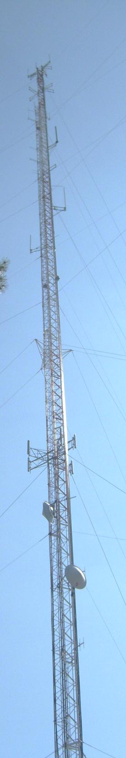
System
Statistics

Slide 10
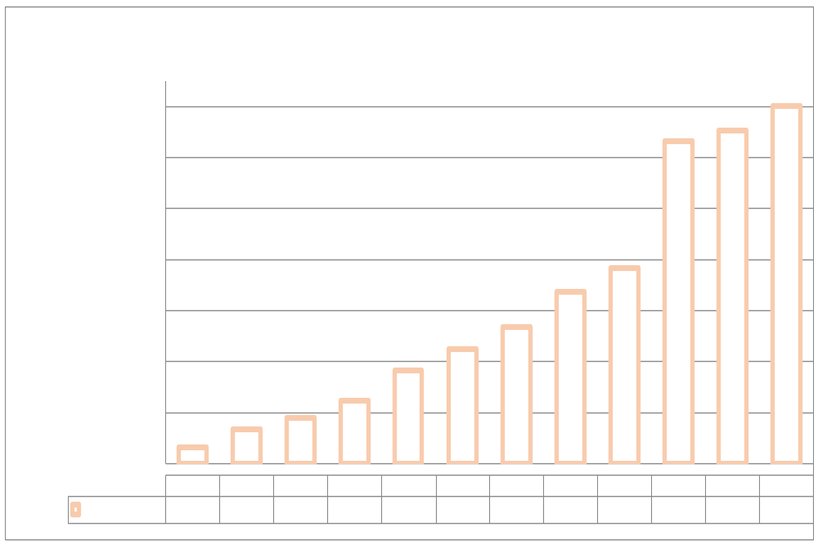
SUBSCRIBERS

Slide 11
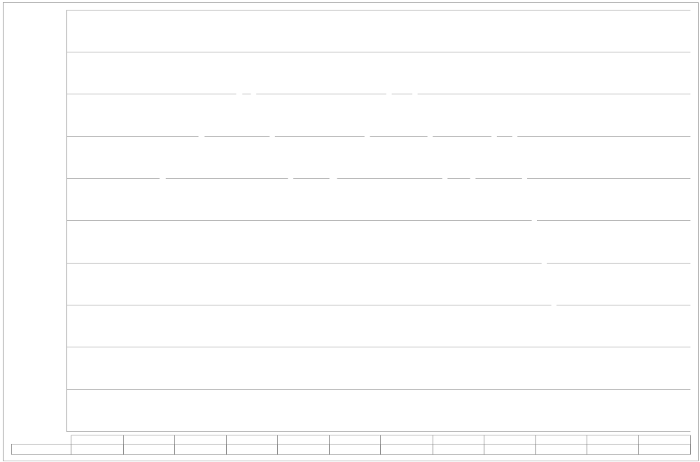
PUSH TO TALK

Slide 12
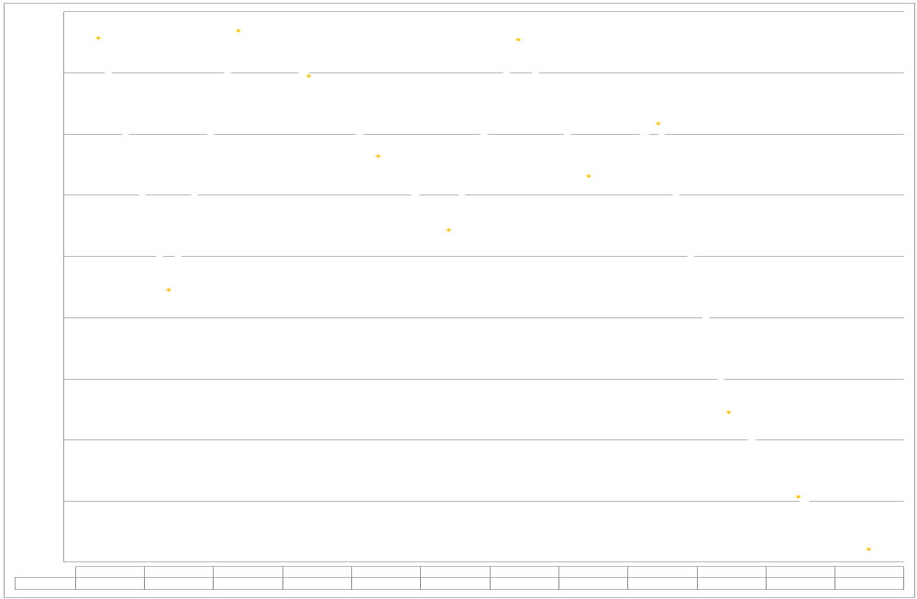
PUSH TO TALK PER DAY

Slide 13
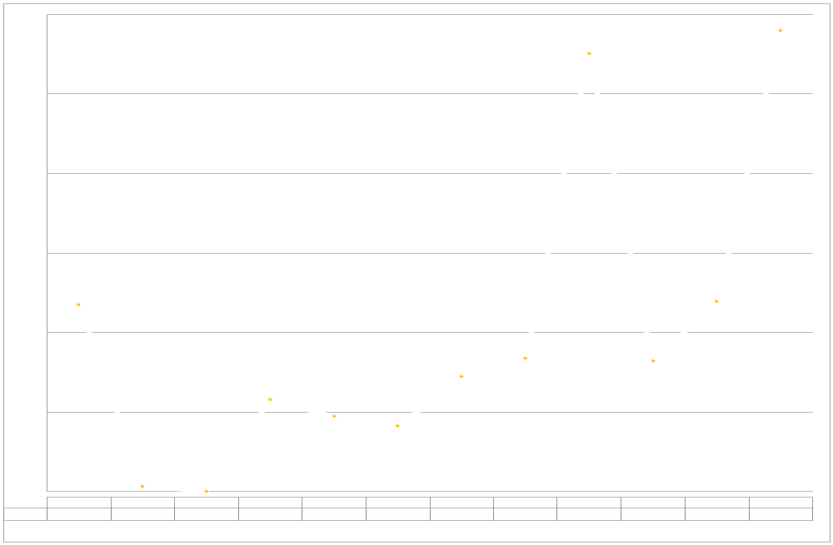
BUSIES

Slide 14

Top Busy Sites
Calcasieu Jail 143
Lafayette 110
Laplace 76

Slide 15
SITE OUTAGES
Arsene Lebleu | Ashland | Avoyelles | Baldwin | Bastrop
Bayou Gauche | Bell City | Bellevue | Berwick | Bossier
Bourg | Buras | Calvin | Chatham | Clearwater
Clinton | Cypress | Dequincy | East Jennings | Enterprise
Geismar | Hineston | Holloway | Homer | Jena
Jonesboro | Keachi | Lafayette | Many | Marion
Minden | Oak Grove | Opelousas | Plain Dealing | Ringgold
Rockefeller | Roseland | Scott | Sheridan | Shongaloo
Total Downtime: 4965 Hours

Slide 16
SITE OUTAGES
Shreveport | South Baton Rouge | St. James | Starks | Superdome
Tallulah | Theriot | Thibodeaux | Trailer 98 | Vermillion
Ville Platte | Wheeling | Winnfield North
Total Downtime: 4965 Hours

Slide 17
SITE OUTAGE DATA
69%

Slide 18
SYSTEM STATISTICS

Slide 19
Subscriber Statistics
Security Groups
192
Agencies
617
Talkgroups
6,642

Slide 20

Agencies Added Last 4 Months
Region 8 OHSEP
Governor’s office of intergovernmental affairs
USCG marine safety unit-
lake charles

Slide 21
SUPER BOWL 2025
The Superdome Site was expanded from 12 to 18 Channels.
Deployed Suit case site at Convention Center.
MCS & Motorola personnel provided support at multiple locations throughout NOLA and BTR LWIN Core.
During game day, the Superdome site had 10,052 voice calls with total duration of 23 Hours, 13 minutes and 39 seconds.
The Superdome site was affiliated with 315 radios, 32 talk groups and did not experience any busies.

Slide 22
System Coverage

Slide 23
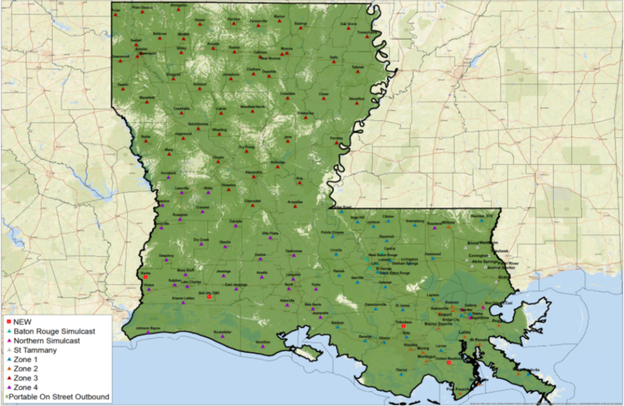
Present Coverage

Slide 24
Questions?

Slide 25
Ethernet Update

Slide 26
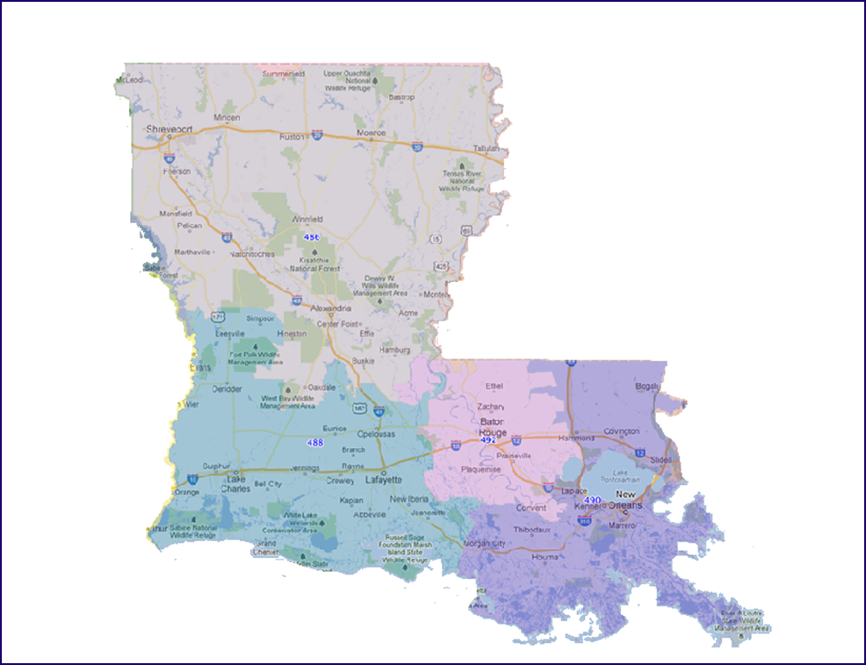
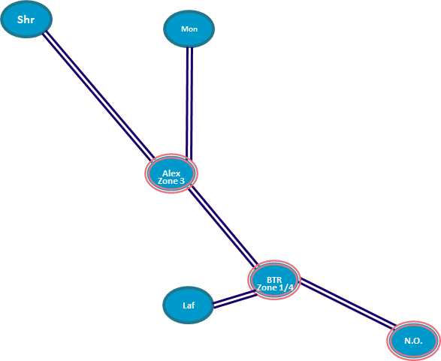
Existing Network

Slide 27
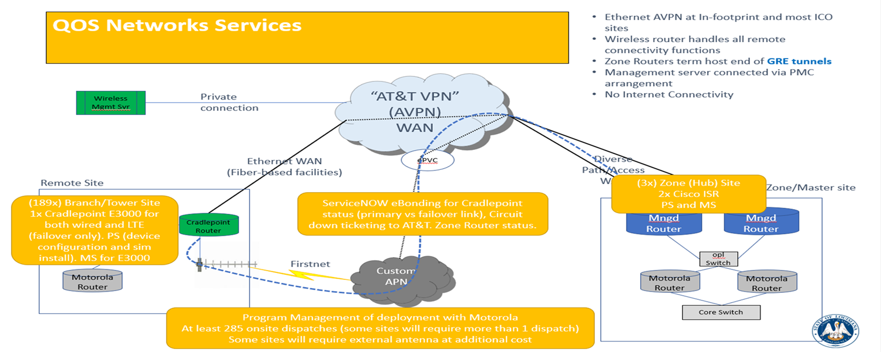
New LWIN Network

Slide 28
LWIN Circuit Update
LWIN Circuit Update
 |  | Circuits on Order | Circuits Delivered | Curcuits Pending Order | Cradlepoint Installed | External Antenna Installed | Program Curcuit Total | Sites cut over
Overview | Hubs | 8 | 8 | 0 | N/A | N/A | 8 | 8
 | Console | 34 | 27 | 29 | 25 | 11 | 63 | 19
 | Tower | 106 | 73 | 23 | 72 | 48 | 129 | 65
 | Total | 148 | 108 | 52 | 97 | 59 | 200 | 92

Slide 29
Thank You!

