Slide 1
Pre-Disaster Planning
No Notice Event Sheltering – USP
The purpose of this planning is to identify the current capacity of the American Red Cross Louisiana Region and State Partners to provide emergency sheltering support to Parishes in response to a No Notice incident.
Ensure alignment with the LA State Unified Sheltering Plan
USP is one mass care plan for Louisiana that’s applicable for all hazards regardless of size and scope
Defines roles and responsibilities of non profits and government at local, state and federal level
Establishes standards for shelters
Mass Care levels

Slide 2
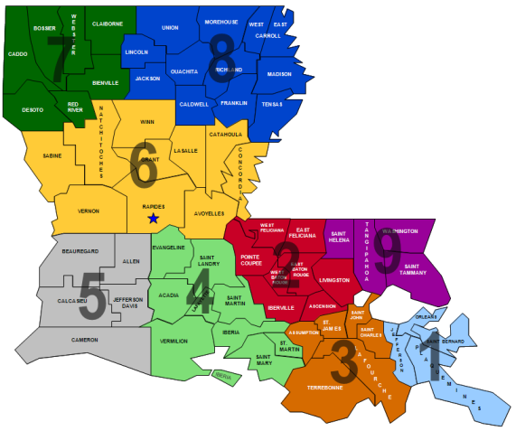
Planning Assumptions -Population
No Notice event would impact 20% of the total population
6.8% of the affected population will seek sheltering (based on National Standards)
Shelter facilities with a capacity of 350 was utilized to create a baseline for the number of facilities
Population based on Geographic areas
Scenario 1 – GOHSEP Regions 1,3,9
Scenario 2 – GOHSEP Regions 2,4,5
Scenario 3 – GOHSEP Regions 6,7,8

Slide 3
Shelter Population and Facility Planning Numbers
Planning Assumptions-Facility
 | Total Population | Affected Population | To Be Sheltered | Shelter Facilities Required (350 capacity)
Scenario 1 (Regions 1, 3,9) | 1,600,933 | 320,186 | 21,772 | 62
Scenario 2 (Regions 2,4,5) | 1,722,668 | 344,538 | 23,429 | 66
Scenario 3 (Regions 6,7,8) | 1,209,771 | 241,954 | 16,452 | 47
CONFIDENTIAL – For ARC Planning Purposes

Slide 4
Staffing Ratio
Planning Assumptions - Staffing
Initial Phase: 1 to 50
Sustained phase: 1 to 30
 | Initial Phase (E+72) | Sustained Phase (E+72-120)
350 Population Capacity | 7 staff/period | 14 staff/period
*This ratio does not include facility management or security
CONFIDENTIAL – For ARC Planning Purposes

Slide 5
ARC Workforce and Staffing Plan – Scenario 1
Planning Assumptions - Staffing
Scenario 1 | E+24 | E+48 | E+72 | E+96 | E+120
Red Cross Available Workforce | 99 | 128 | 556 | 942 | 1328
% of ARC Workforce to Total Workforce Requirement * | 22% | 29% | 64% | 108% | 150%
Number of ARC staff available to place in each required shelter based on planning assumptions. | 34 shelters - 2 ARC staff 28 shelters 1 ARC staff | All shelters - 2ARC staff per | All shelters - 9 ARC staff per | All shelters - 15 ARC staff per (7/8 per shift) | All shelters - 21 ARC staff per (10/11 per shift)
CONFIDENTIAL – For ARC Planning Purposes

