Slide 1
Pat Forbes, Executive Director
Louisiana Office of Community Development
GOHSEP Annual Conference
May 17, 2018

Slide 2
The Great Floods of 2016
The March and August flooding events impacted 193,000 families across 58 of the 64 parishes.
The 10 most impacted parishes, where 80 percent of the CDBG-DR funds must be spent, with housing as the primary focus:
Acadia Ouachita
Ascension St. Tammany
East Baton Rouge Tangipahoa
Lafayette Vermilion
Livingston Washington
May 17, 2018

Slide 3
The Great Floods of 2016
Homeowner and Renter Populations with
FEMA Verified Loss
March 2016
August 2016
DR-4263 - with FVL
Owners | 16,459 | 76%
Renters | 5,225 | 24%
(blank) | 1
Grand Total | 21,684
DR-4277 - with FVL
Owners | 67,664 | 75%
Renters | 23,009 | 25%
(blank) | 6
Grand Total | 90,679
May 17, 2018

Slide 4
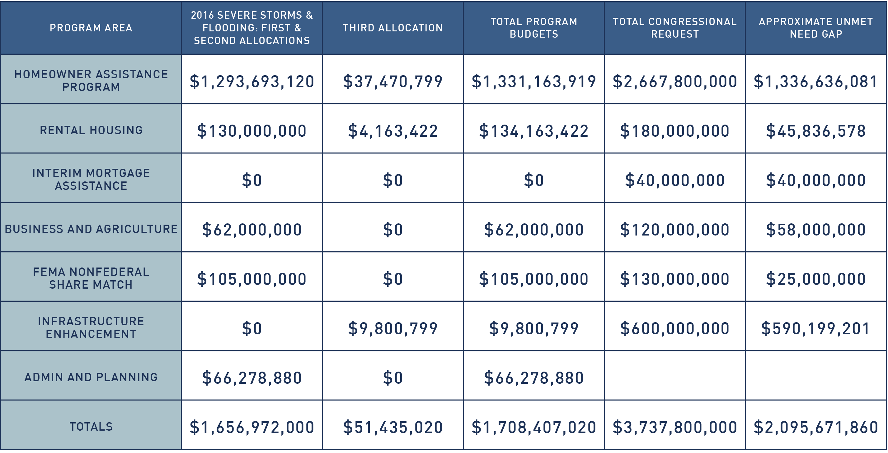
The Great Floods of 2016
Requested Disaster Assistance
May 17, 2018

Slide 5
Restore Homeowner Assistance Program
Solution 1
PROGRAM MANAGED
Solution 2
HOMEOWNER MANAGED
Solution 3
REIMBURSEMENT
May 17, 2018

Slide 6
Summary of Tiered Eligibility
All Phases: Major or Severe Damage ($8,000 or more of FEMA inspected real property damage or 1 foot or more of flood damage on the first floor).
Phase I: Low-to-moderate income, elderly or persons with disabilities, outside the floodplain. Phase II: Low-to-moderate income, elderly or persons with disabilities, inside the floodplain. Phase III: Reside within one of the 10 most impacted or distressed parishes, outside the floodplain, no priority due
to income.
Phase IV: Reside within one of the 10 most impacted or distressed parishes, inside the floodplain, no priority due to income. Phase V: All other parishes, inside and outside the floodplain. Phase VI: Reimbursement for homeowners who have completed the rebuilding process at the time they answer the survey or complete the application.
* The program has been expanded to include homeowners who had flood insurance and were otherwise eligible for Phase I – VI.
May 17, 2018

Slide 7
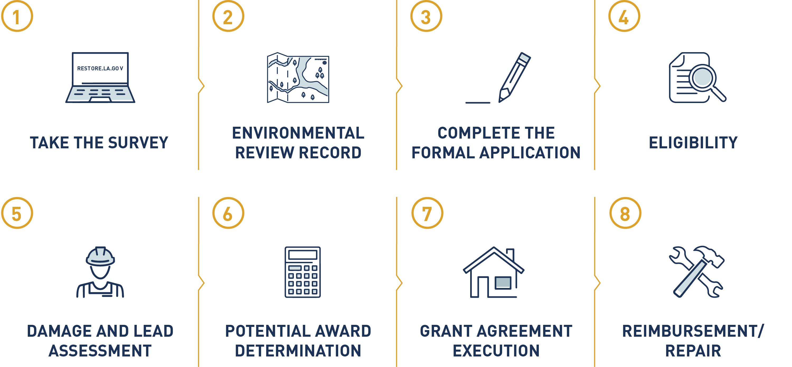
Restore Homeowner Program
May 17, 2018

Slide 8
Restoring Louisiana
49,820 homeowners have submitted surveys with 40,710 qualifying for the program.
Of the qualifying homeowners, 40,460 have been invited to apply.
30,880 of the invited applicants have submitted their application.
Grant awards have been offered to 10,740 homeowners with a total dollar amount of $284 million⁺.
May 17, 2018

Slide 9
Gov. Edwards Asks HUD for Quick Interpretation of Duplication of Benefits Fix in Bipartisan Budget Act of 2018
Bipartisan Budget Act of 2018: Congress made a partial fix to the Small Business Administration Duplication Of Benefits issue in the Bipartisan Budget Act of 2018, but it’s not clear if this applies to Restore.
SBA DOB: Many applicants who were approved for Small Business Administration loans to repair their homes—whether or not they used the loans—cannot receive assistance from Restore because the federal government considers the SBA loan to be a Duplication of Benefits.
Governor’s Letter: Gov. Edwards sent a letter on April 3, 2018, asking HUD to provide a timely interpretation of the Duplication of Benefits (DOB) language in the Bipartisan Budget Act of 2018.
May 17, 2018

Slide 10
Restore Homeowner Survey Deadline
Deadline: The deadline to complete the initial survey required for participation in the Restore Louisiana Homeowner Assistance Program is Friday, July 20, 2018.
NOTE: Deadline does not apply to homeowners who already submitted a survey or application.
IMPORTANT: Gov. Edwards has asked HUD for clarity on the SBA DOB issue. However, if HUD allows Restore to use the SBA fix, only homeowners who have already completed the survey will be considered. This is true for any future, potential program expansions, such as Solution 4 – Buyout/Acquisition and Increased Reimbursement for all Phases.
May 17, 2018

Slide 11
How To Complete The Survey
Homeowners can complete the survey at restore.la.gov or speak to a representative from 8 a.m. to 6 p.m. Mondays through Fridays at 866.735.2001.
Housing Assistance Centers in Lafayette, Hammond, Monroe and Baton Rouge are also open from 8 a.m. to 5 p.m. Mondays through Fridays. Program representatives are available to help homeowners complete surveys and applications, connect with case managers and provide overviews of options for repairs, reconstruction or reimbursement.
May 17, 2018

Slide 12
Restore Rental Programs
Neighborhood Landlord Program – $53.9 million: Construction loans for development of new residential housing units and restoration of flood-damaged units. Limited to seven or fewer units. Approved units to date: 318 units.
Multifamily Rental Gap Program – $22.5 million: Construction loans for development of new residential housing units and restoration of flood-damaged units to create long-term affordable rental housing stock. Must be multifamily property of at least 20 units. Approved units to date: 582 units.
Piggyback Program – $36.7 million: Gap financing for developments creating or preserving multifamily rental units with bond-financed conventional or FHA-Insured 1st mortgages, CDBG funds structured as soft 2nd mortgages) and equity from the sale of 4 percent Low-Income Housing Tax Credits. Anticipated units: 500.
Rapid Rehousing ($16 million) and Permanent Supportive Housing ($5 million) – Provides rental assistance and wrap-around services to vulnerable low and very-low income renters in order to prevent homelessness. Households with vouchers: 693
May 17, 2018

Slide 13
Restore Economic
Development Programs
Small Business Loan Program – $43 million: Partially forgivable loans range from $10,000 to $150,000. Loans can be used for working capital—such as rent, mortgage, utilities, non-owner employee wages and inventory—as well as for furniture and movable equipment. Approved applications to date: 178
Louisiana Farm Recovery Grant Program – $10 million: Grant assistance to farmers who had crop and/or livestock damage. Grants may be used for working capital expenses for the 2017 planting year related to the preparation, planting, management and harvesting of the 2017 crop. Closings to date: 241.
May 17, 2018
Notes:
Small Business Loan Program -- Eligible applicants are small businesses who:
Have 50 or fewer employees and a minimum annual gross revenue of $25,000.
Experienced either a physical or financial loss as a result of the flood events.
Farm Recovery Grant Program – 1, 065 applicants.

Slide 14
Restore Infrastructure Programs
FEMA PA Cost Share Match Program – $105 million: Provides grants to state agencies, local governments and non-profit organizations that are eligible for FEMA Public Assistance, in order to offset the burden of the 10 percent or 25 percent state and local match requirements. Applications to date: 1,684.
Watershed Modeling and Planning – $9.8 million: A statewide initiative to coordinate watershed planning at the local level, allowing best practices in future flood mitigation investments. This funding predates the $1.2 billion hazard mitigation grant recently awarded to Louisiana.
May 17, 2018

Slide 15
HUD Allocates $1.2 Billion to Louisiana for Hazard Mitigation
Bipartisan Budget Act of 2018: As one of the states that experienced a major Presidentially declared disaster since 2015 the U.S. Department of Housing and Urban Development awarded $1, 213,917 to Louisiana for mitigation activities.
Mitigation: These activities protect communities from predictable damage from future events. The majority of these funds must be spend in the “most-impacted” areas.
Watershed Council: In response to this allocation, Gov. John Bel Edwards appointed a steering committee comprised of leaders from OCD, GOHSEP, CPRA, DOTD and LDWF to ensure cohesive watershed planning and project implementation efforts across the state.
May 17, 2018

Slide 16
Louisiana Watershed-Based Floodplain Management Program
COOPERATING AGENCIES
OCD
CPRA
DOTD
LDWF
GOHSEP
INITIATIVES
MONITORING, MAPPING, AND MODELING WATERSHEDS
River Gauges and TopoBathy
H & H Models
Data Portal for Public Access
WATERSHED-BASED PROJECTS AND PROGRAMS
Watershed Improvements and Flood Storage
Waterway Restoration
Infrastructure Improvements
FEMA HAZARD MITIGATION GRANT PROGRAM LOCAL MATCH
Local HMGP Cost Share is 25% for both March and August flood events
BUYOUTS, ACQUISITIONS AND FLOOD EASEMENTS
Strategic Land Acquisition and Headwater Protection
Flood Easements to protect/enhance flood storage
Voluntary Buyouts
LARGE SCALE PROGRAMS AND PROJECTS
Already-identified programs and projects
Must be consistent with goals of Program and HUD
May 17, 2018

