Slide 2
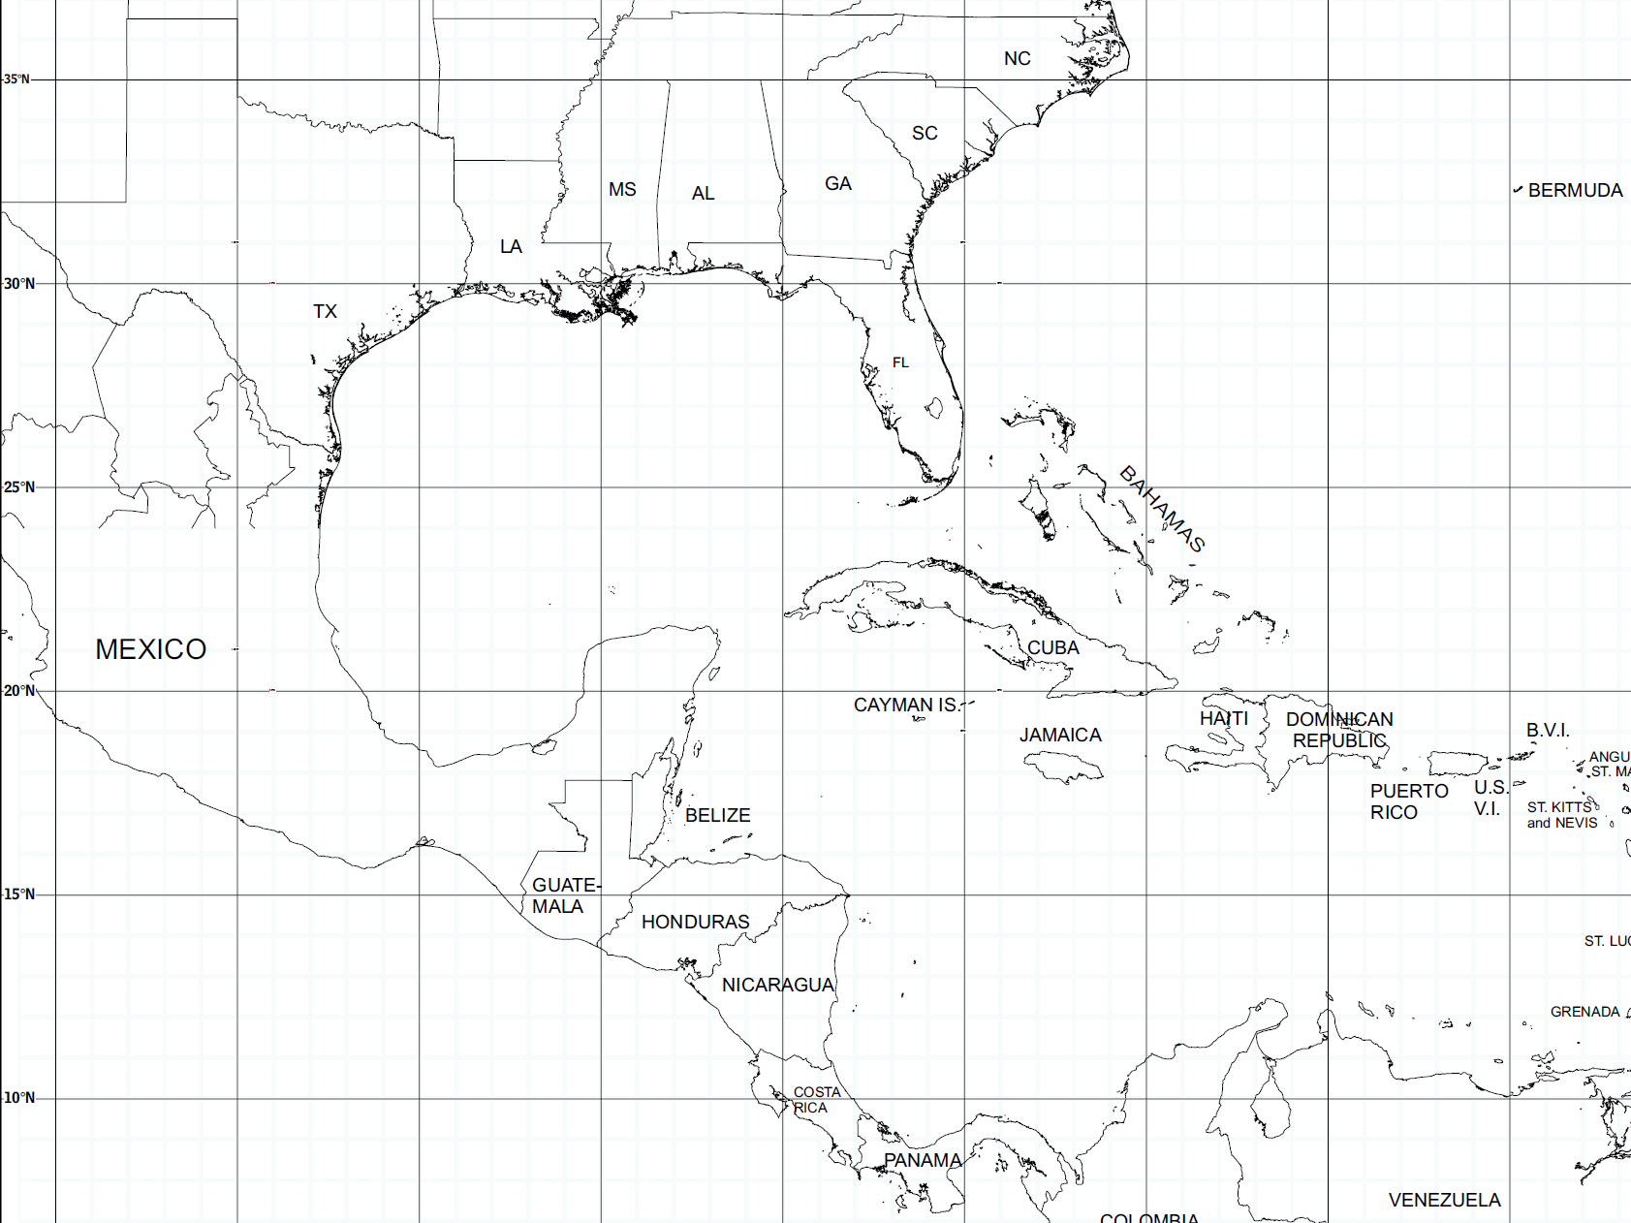
Comments
X
X
X
Opening

Slide 3
Storm Overview
Isaac began as a tropical wave on August 16th off the coast of Africa & was classified as a tropical storm on August 21st
Storm prediction models initially tracked the storm along the west coast of Florida & then northeast toward the Florida Panhandle - hurricane warnings were posted on August 25th for west coast of Florida
Isaac followed a more northwest track - Louisiana declares a State of Emergency on August 26th
The storm reached hurricane strength on August 28th as a Category 1

Slide 4
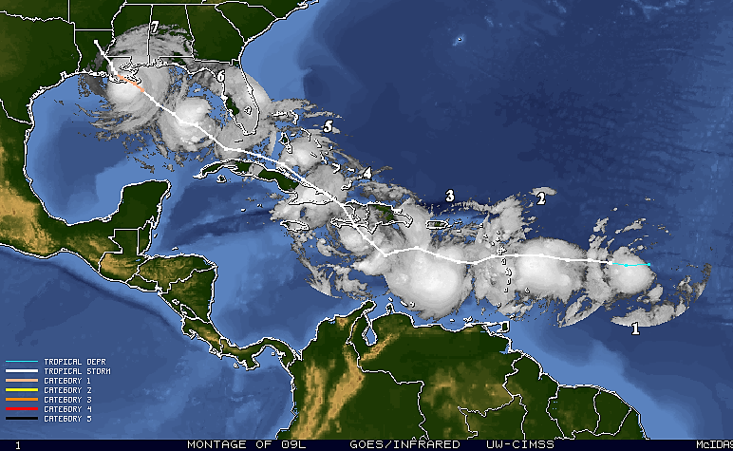
FL
Isaac Storm Track, August 21st - 29th

Slide 5
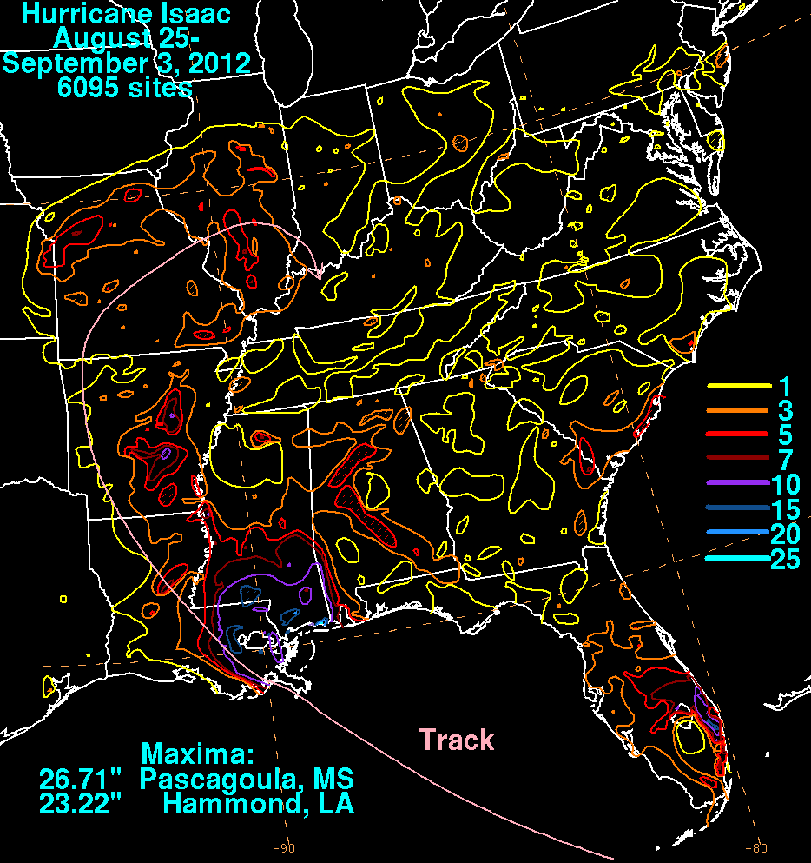
Storm Overview
First landfall occurs near mouth of the Mississippi River at 6:45 PM on August 28th
Isaac made a second landfall at 2:00 PM on August 29th at Port Fouchon
Total Storm Rainfall
August 25th - September 3rd

Slide 6
After Action
X
X
X
Review

Slide 7
After Action Review
The objective of the After Action Review (AAR) is to identify strengths, challenges, trends & lessons learned during Louisiana’s response to Hurricane Isaac
Six regional AARs were conducted by GOHSEP between October 15th & November 8th
Regions 1, 2, 3 & 9 conducted individual reviews & Regions 4, 5, 6 &, 7 & 8 conducted combined AARs
Local, state, federal & non-governmental entities were invited & present at all conferences

Slide 8
Areas to Sustain
Activation of local, state, federal & non-governmental entities that expedited coordination & response operations for Hurricane Isaac
GOHSEP coordination conference calls from the Response phase through the event’s Recovery phase
Expanded use of social media by response agencies that has increased the ability to provide public information on storm conditions, alerts & protective actions
Regional Coordinators & liaisons played a vital role in assisting local officials to coordinate activities

Slide 9
Areas for Improvement
Response plans must be revised with a focus on the predicted storm effects rather than just the category of the storm
Flexibility needs to be added to response plans to accommodate for situations where a storm develops quickly or the track changes
Additional WebEOC training is necessary for local & state personnel
A current “Request Status” function needs to be added to WebEOC’s capability

Slide 10
Areas for Improvement
Local officials need to be notified & coordinated with prior to the release of public warnings or any state actions taking place within their jurisdictions
Social media has become a key tool for emergency public information & warning - all stakeholders need to ensure that plans & procedures reflect the utilization of this resource
Mass care plans need to be revised to address the increasing level of medical support for all shelters & affected populations

Slide 11
Areas for Improvement
Increased coordination is needed between state & local officials regarding decisions to open PODs, the commodities necessary for each site & where the POD will be located
Improved coordination & planning is needed between state & local agencies regarding DSNAP operations with special attention paid to security, staffing & operational flow of the sites
Local & state officials should work with FEMA & GSA to develop a list of facilities that meet the criteria for a Disaster Recovery Center

Slide 12
Comments
X
X
X
Closing

Slide 14
Hurricane
Governor’s Office of Homeland Security & Emergency Preparedness
ssac
After Action Review

