Slide 1
Office of Inspector General (OIG)

Slide 2
Overview
Establishment of DHS-OIG
OIG mission
OIG organization
Audit selection and findings

Slide 3
Overview (Continued . . . )
OIG audit strategy
OIG and DHS commitments
To report allegations

Slide 4
Establishment of DHS-OIG
Homeland Security Act of 2002, Inspector General Act of 1978, as amended
Inspector General Reform Act of 2008

Slide 5
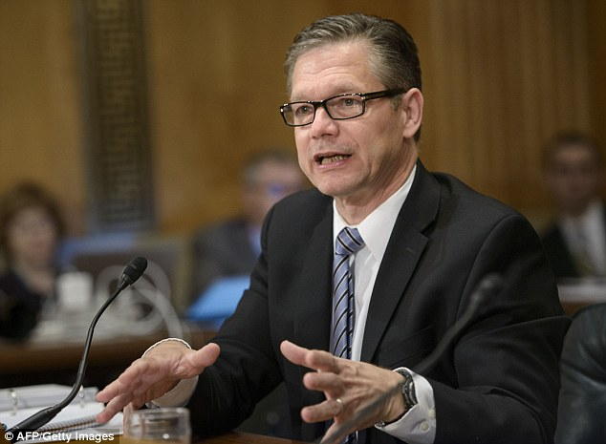
Establishment of DHS-OIG (Continued . . . )
Inspector General is appointed by the President, subject to Senate confirmation.
Directly reports to both
the Secretary of
Homeland Security
and Congress.

Slide 6
OIG mission
An independent and objective inspection, audit and investigative body, which . . .

Slide 7
OIG mission (Continued . . . )
Offers recommendations for improving the economy, efficiency and effectiveness of department operations and activities; and . . .

Slide 8




OIG mission (Continued . . . )
Deters, identifies and addresses fraud, waste and abuse in DHS programs and operations.

Slide 9
OIG organization
Inspector General
John Roth
Chief of Staff
Counsel to the IG
External Affairs
Deputy Inspector General
Assistant Inspectors General
Audits
Investigations
Management
Inspections
Integrity + Quality
Oversight
Emergency Management
Oversight
Information Technology
Audits

Slide 10

Emergency Management Oversight (EMO) mission
To provide an aggressive and ongoing audit effort designed to ensure that disaster relief funds are spent appropriately, while identifying fraud, waste and abuse as early as possible.

Slide 11
EMO mission (Continued . . . )
EMO keeps Congress, the Secretary, the Administrator of FEMA and others fully informed . . .

Slide 12
EMO mission (Continued . . . )
. . . and also addresses problems relating to . . .
  Disaster operations and
  Assistance programs and
  Progress regarding corrective actions.

Slide 13
EMO mission (Continued . . . )
EMO’s focus is weighted heavily toward prevention (including reviewing internal controls) and monitoring and advising DHS and FEMA officials on contracts, grants and purchase transactions before they are approved..

Slide 14
EMO mission (Continued . . . )
This allows EMO to stay current on all disaster relief operations and provide on-the-spot advice on internal controls and precedent setting decisions.

Slide 15
EMO organization
Assistant Inspector
General
John Kelly
Assistant Deputy
Inspector General
VACANT
Assistant Deputy
Inspector General
Tonda Hadley
Central Regional
Office - South
Central Regional
Office - North
National Capital
Regional Office
Eastern Regional
Office - South
Western Regional
Office
Gulf Coast
Regional Office
Eastern Regional
Office – North
New Orleans
Field Office
Puerto Rico
Field Office

Slide 16
EMO audit selection
Current or potential dollar magnitude.
Requests from congressional, FEMA or State officials.
Reports of allegations of impropriety.

Slide 17
Audit objectives
To determine whether:
Recipients/Subrecipients accounted for and expended FEMA grant funds according to Federal regulations and FEMA guidelines.

Slide 18
Top ten (10) audit findings + issues
CO’s Oversight – Not Sufficient to Ensure Performance.
No Basis for the Award.
Ineligible Expenses.
No clear Definition of Req’d Services or Perf. Standards.
Perform Cost Analysis.
Follow Procurement Standards.
Excessive Billings.
Inadequate Supporting Documentation.
Interest Earned – Not Remitted.
Insufficient Contract Monitoring.

Slide 19
Other audit findings
Questionable costs;
Ineligible contract method;
Contract awarded without competition;
Ceiling price not included;

Slide 20
Other audit findings (Continued . . . )
Project-by-project accounting of eligible costs not followed;
Billings not reconciled; and
Contractual deficiencies.

Slide 21
Appendix A
Office of Inspector General, Audit Tips for Managing Disaster-Related Project Costs (DHS-OIG)

Slide 22
EMO capping reports
FY 2012 – Audited $1.25 billion
  59 Grant audits issued
    $415.6 million in potential monetary benefits
  187 Recommendations in 54 reports
    $267.9 million in questioned costs
    $147.7 million in unused funds

Slide 23
EMO capping reports (Continued . . . )
FY 2013 – Audited $1.28 billion
  59 Grant audits issued
    $307.8 million in potential monetary benefits
  261 Recommendations in 54 reports
    $266.2 million in questioned costs
    $41.6 million in unused funds

Slide 24
EMO capping reports (Continued . . . )
FY 2014 – Audited $3.44 billion
  61 Grant, program and operations audits issued
    $1 billion in potential monetary benefits
  159 Recommendations in 61 reports
    49 grant audits
    12 program audits

Slide 25
EMO capping reports (Continued . . . )
FY 2014 – Recommendations
  $971.7 million in 140 recommendations in 49 grant audits (includes $812 from one HMGP audit)
  $29.3 million in 19 recommendations for 12 program audits

Slide 26
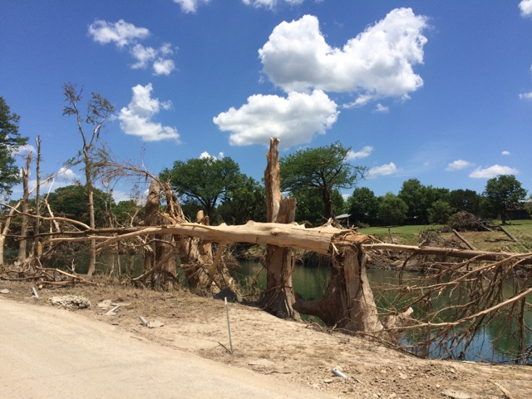
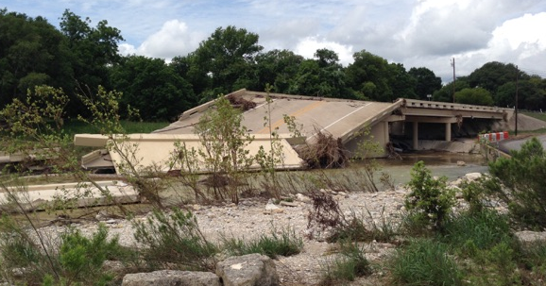
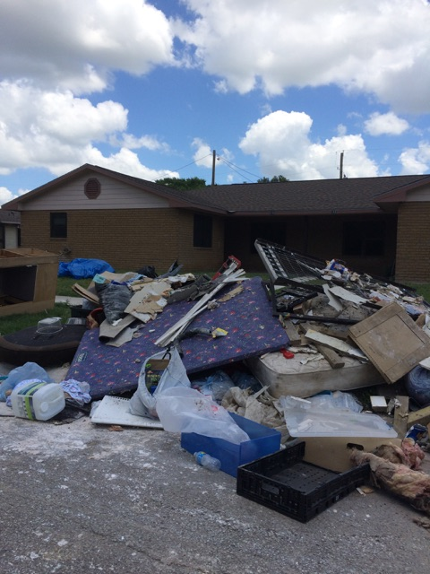
EMO current audit strategy
EMOT
Capacity
Early warning
Traditional

Slide 27

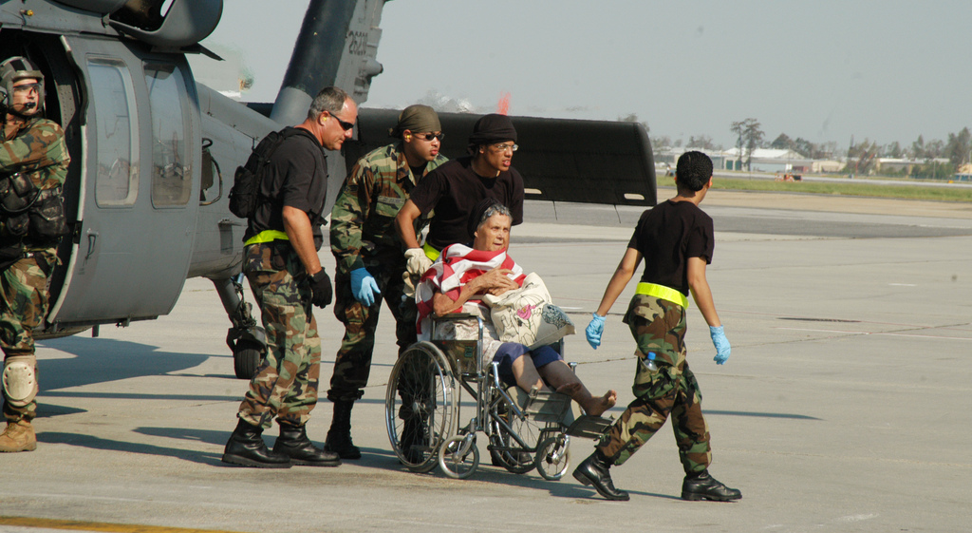
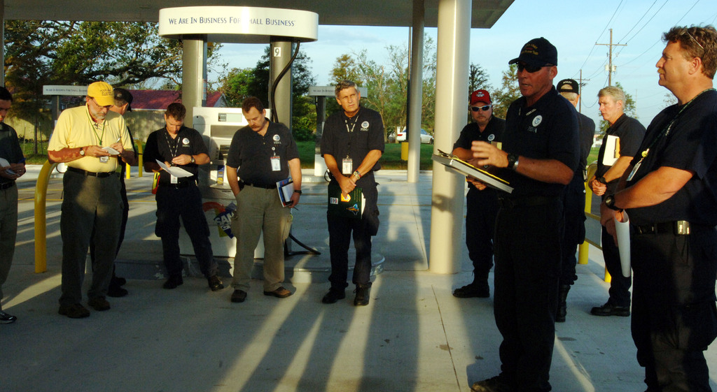
Emergency management oversight team (EMOT)
Essentially first responders.
Provide an objective and independent observation of national disaster-related activities.

Slide 28
Emergency management oversight team (EMOT) (Continued . . . )
Detect and prevent fraud, waste and abuse.
Coordinate with other Federal agencies, State and local audit organizations, as well as the Government Accountability Office.

Slide 29
EMOT in-brief
EMOT is a team that can be rapidly assembled and deployed to a significant event to primarily perform proactive oversight activities when directed by the AIG.

Slide 30
EMOT in-brief (Continued . . . )
Team size, composition and deployment periods may vary depending on the event and specific objectives.
EMOT is NOT a Public Assistance centric activity.

Slide 31
EMOT oversight activities
Passive Oversight
Monitor response and recovery reporting.
Attend meetings, VTC/Conference Calls.
Random contacts.

Slide 32
EMOT oversight activities (Continued . . . )
Active Oversight
Field observations
Conduct interviews
Evaluate targeted activities

Slide 33
EMOT deployments
Louisiana
New York/New Jersey
Oklahoma
Colorado
California
Washington
Michigan
Texas
South Carolina

Slide 34
EMO capacity + early warning audits
  ID areas where Subrecipients (Applicants) may need additional technical assistance or monitoring to ensure compliance with Federal regulations and FEMA guidelines.

Slide 35
EMO capacity + early warning audits (Continued . . . )
  Gives Subrecipients (Applicants) an opportunity to correct noncompliance before they spend the majority of their grant funding.

Slide 36
EMO capacity + early warning audits (Continued . . . )
  Allows the opportunity to supplement deficient documentation or locate missing records.

Slide 37

OIG commitments to DHS
Conduct our work thoroughly, objectively, considering DHS perspectives and minimizing disruptions of DHS work.

Slide 38
OIG commitments to DHS (Continued . . . )
Keep DHS advised of our findings on a timely basis.

Slide 39
DHS commitments to OIG
Keep OIG up to date on current matters and events.
Respond promptly to OIG requests for information.

Slide 40
OIG + DHS shared commitments
Common goal: achieving DHS Missions
Professionalism and mutual respect.
Open communication.
Avoid surprises.
Cooperatively identify areas for OIG work.

Slide 41
Disaster fraud hotline
To report fraud, waste or abuse, or allegations of mismanagement involving disaster relief operations, you can:
  Call the Disaster Fraud Hotline at 1-866-720-5721
  Fax the Disaster Fraud Hotline at 1-225-334-4707

Slide 42
Disaster fraud hotline (Continued . . . )
  Email: disaster@leo.gov
  Or write:
  National Center for Disaster Fraud
Baton Rouge, LA 70821-4909

Slide 43

OIG contacts
Judy Martinez
EMOT Coordinator
Office of Emergency Management Oversight
  (225) 454-1251
  judy.martinez@oig.dhs.gov

