Slide 1
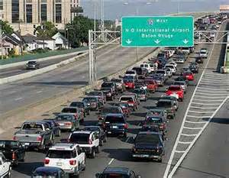
Take a walk on the Outside!

Slide 2
Let’s start walking!
Employees (Family, pets, medication , location)
Business Operations
Evacuation Plans (hotel research)
Re-entry planning (Law Enforcement Partnerships)
Power of the Brand (Radio, TV, Social Media)
Employee Response Team program
Open First!!!!!!!!

Slide 3
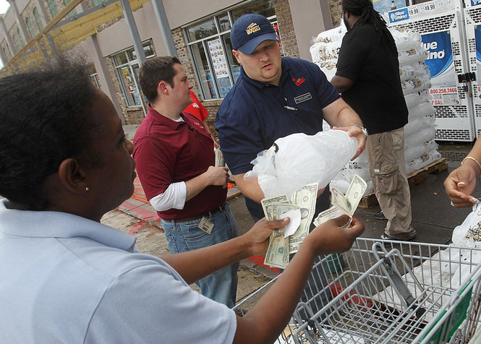
Dedication

Slide 4
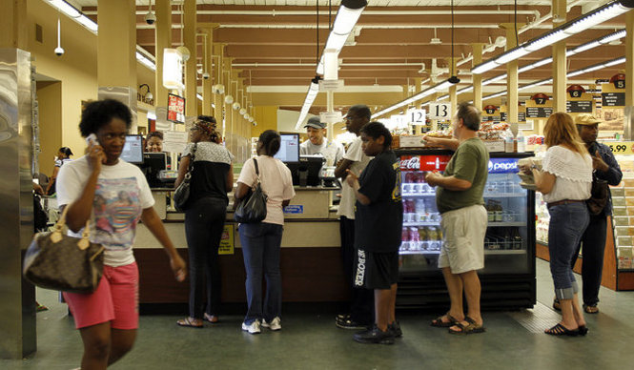
All Smiles!

Slide 5
Communications
Wireless Critical Infrastructure
Connectivity 4+ hours
Connectivity Ranking System (home tower example)

Slide 6
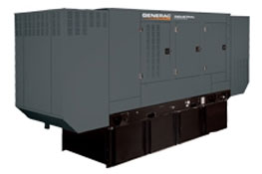
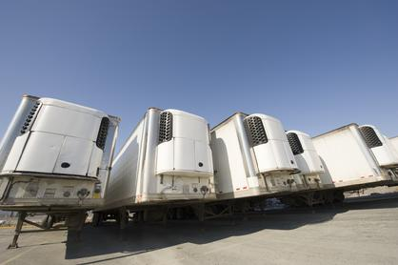
Generator Backup Program
All Stores on backup generator will have a reefer unit available

Slide 7
Fuel Capabilities
Pre-Storm commitment from Wag-a-Pak, fuel truck
2 Rouses employees HazMat certified
Access to reporting database pre/post event
http://sonris-www.dnr.state.la.us/fuel_stations/mapstations.jsp
Option to set up remote fuel station at pre-selected locations

Slide 8
Employee Response Team
Overview- provide stores with volunteer employee assistance before, during and after a natural disaster. Primary function of the program is to provide assistance to store supervision in preparing a store for reopening as soon as possible after an emergency.
Hand picked by store management
Strict requirements for participating employees

Slide 9
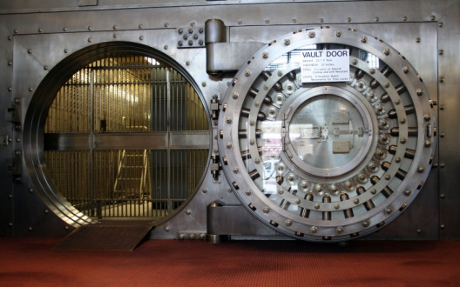
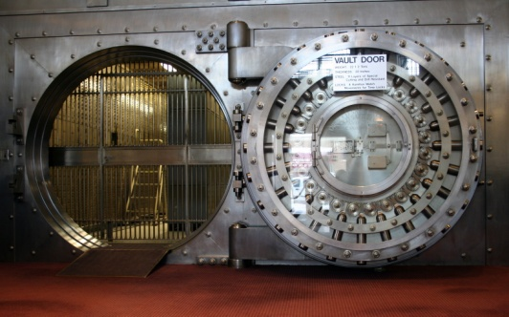
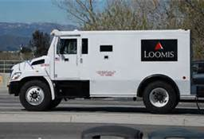
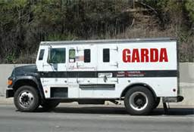
Cash is King!

Slide 10
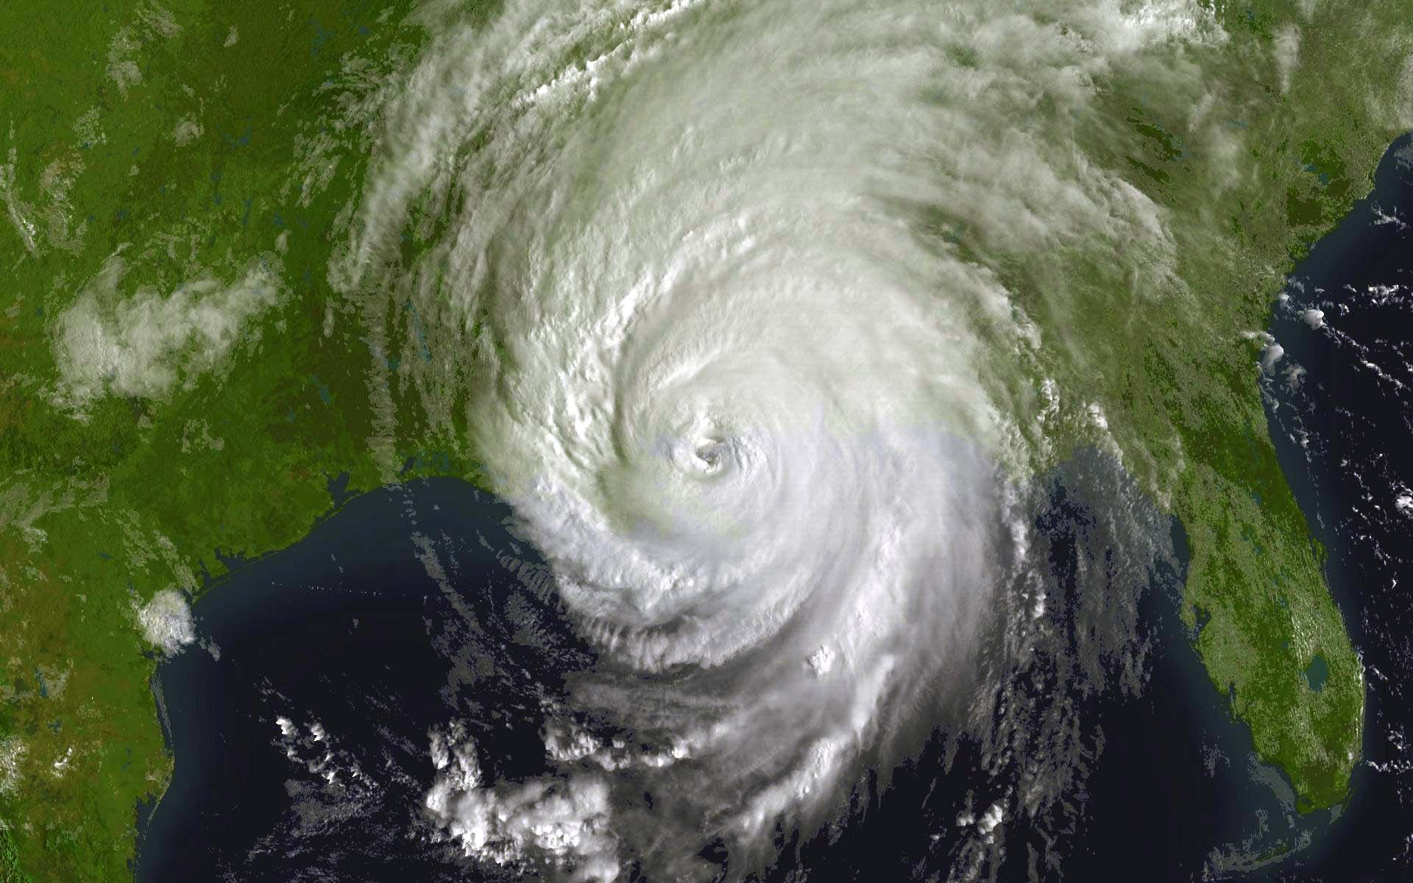
Take a walk on the outside!

