Slide 1
Louisiana Business Emergency Operations Center (LA BEOC)
Portal Technology

Slide 2

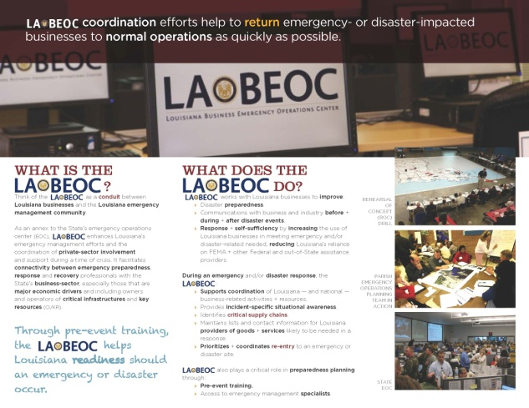



Slide 3
Mission Statement
To support disaster management in Louisiana by developing an accurate understanding of economic impacts to critical infrastructures and major economic drivers, as well as facilitating the coordination of businesses and volunteer organizations with the public sector through enhanced resource and information management.
Through the LA BEOC, the State of Louisiana will improve disaster preparedness and response, reduce reliance on FEMA and other federal assistance, thereby maximizing business, industry, and economic stabilization, returning the business environment to normal operations as quickly as possible.

Slide 4
Public-private partnership . . .
An outlet for the private sector to:
  PROVIDE information
  OBTAIN information

Slide 5
. . . Public-private partnership
An opportunity for businesses to:
  Support the State when traditional resources are exhausted.
  Help one another through the network of associations.
Speed + Networking + Flexibility

Slide 6
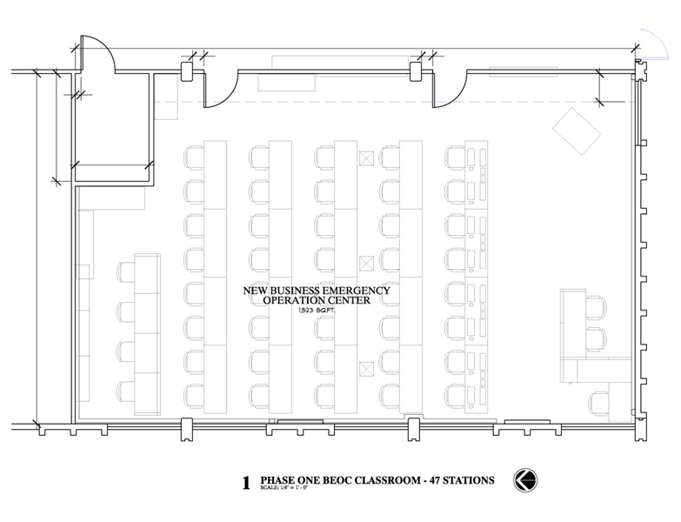

Slide 7
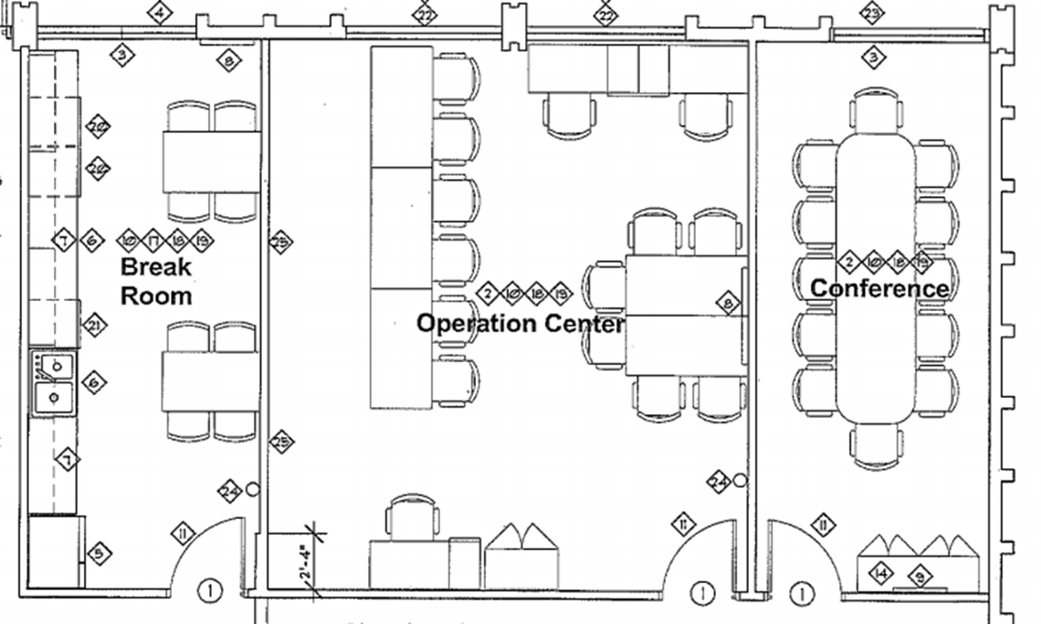

Slide 8
Military or 24 hour Time
Conversion Chart
Civilian Time (AM) | 24 Hour Time |  | Civilian time (PM) | 24 Hour Time
12 AM | 0000 |  | 12 PM | 1200
1 AM | 0100 |  | 1 PM | 1300
2 AM | 0200 |  | 2 PM | 1400
3 AM | 0300 |  | 3 PM | 1500
4 AM | 0400 |  | 4 PM | 1600
5 AM | 0500 |  | 5 PM | 1700
6 AM | 0600 |  | 6 PM | 1800
7 AM | 0700 |  | 7 PM | 1900
8 AM | 0800 |  | 8 PM | 2100
9 AM | 0900 |  | 9 PM | 2100
10 AM | 1000 |  | 10 PM | 2200
11 AM | 1100 |  | 11 PM | 2300

Slide 9
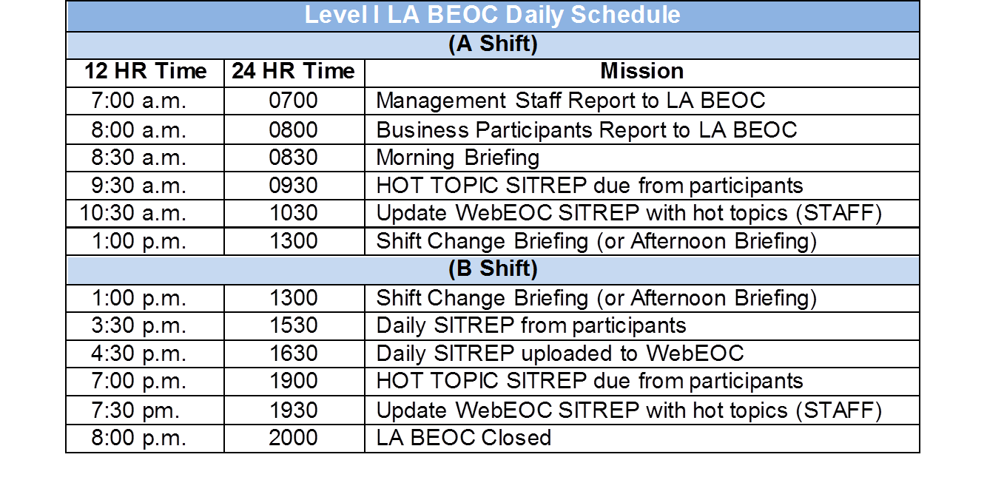
“Battle Rhythm”

Slide 10

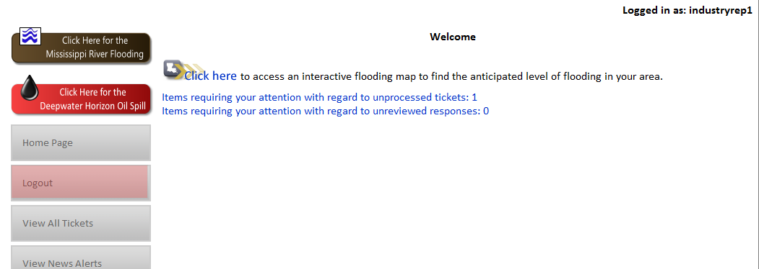
Website home page

Slide 11

Website home page

Slide 12

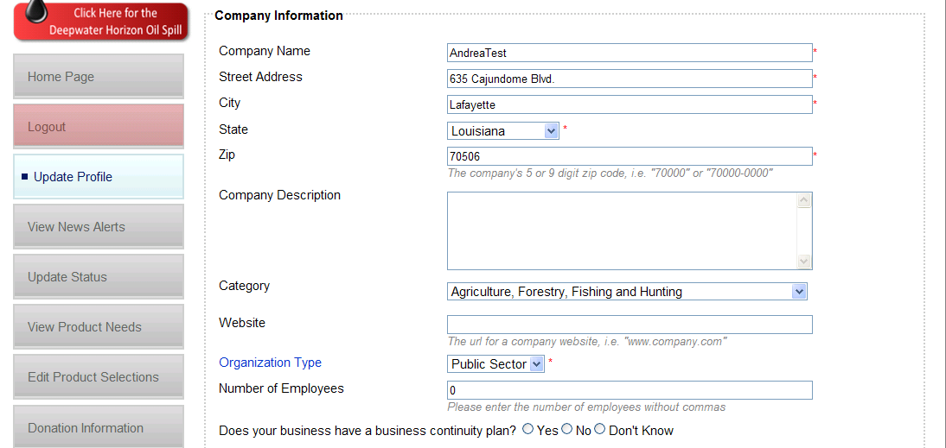
Company registration . . .

Slide 13

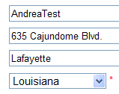
Company registration . . .

Slide 14
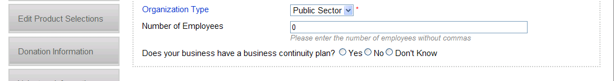
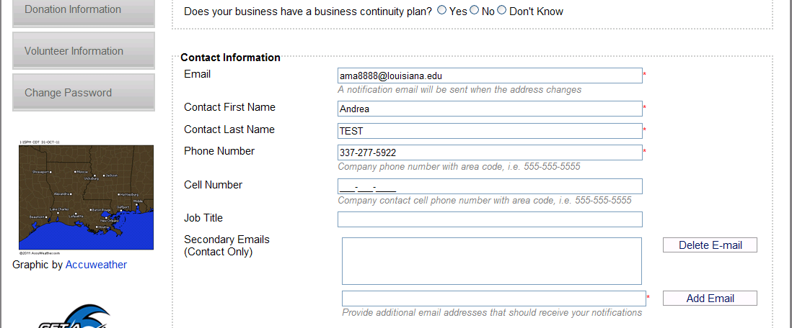
. . . Company registration
. . . Company registration . . .

Slide 15
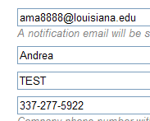
. . . Company registration
. . . Company registration . . .

Slide 16
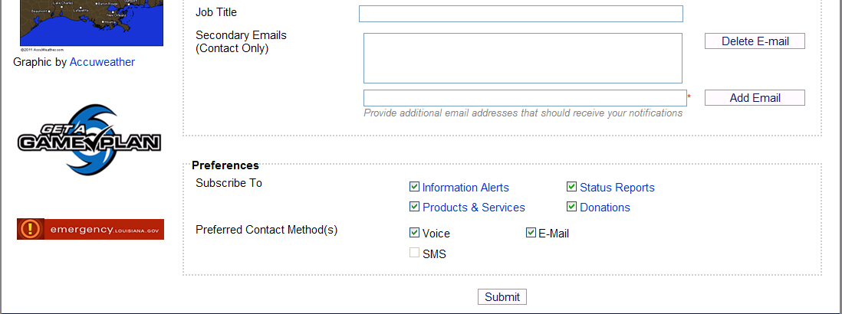
. . . Company registration
. . . Company registration

Slide 17

. . . Company registration
. . . Company registration

Slide 18

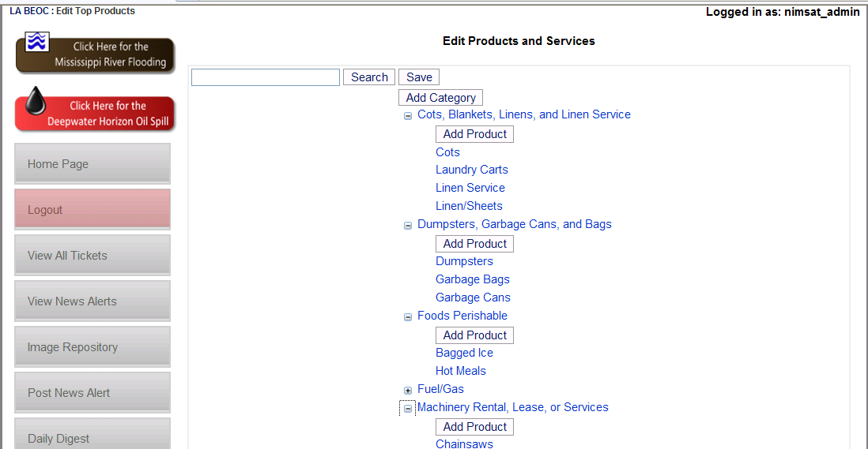
Register product/services

Slide 19

Register product/services

Slide 20
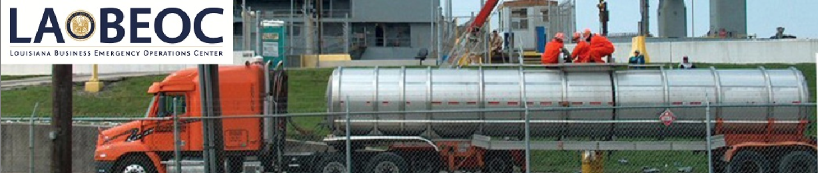
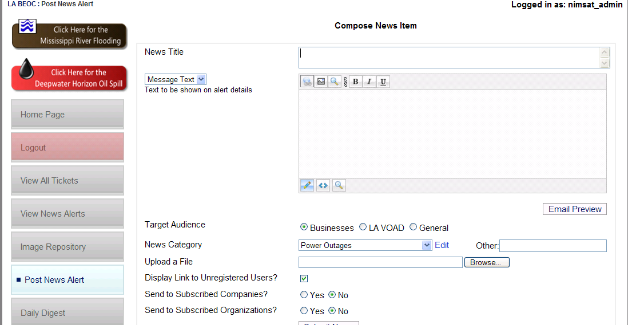
Information sharing – post news alert

Slide 21

Information sharing – post news alert

Slide 22
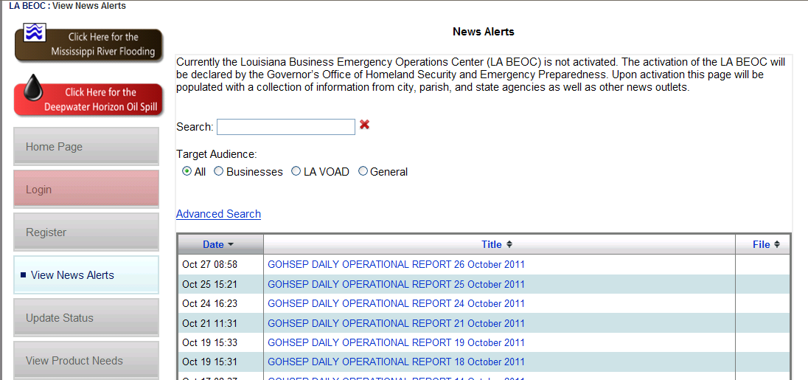
Information sharing – view news alert

Slide 23
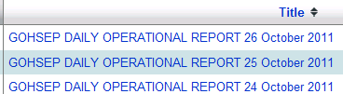
Information sharing – view news alert

Slide 24
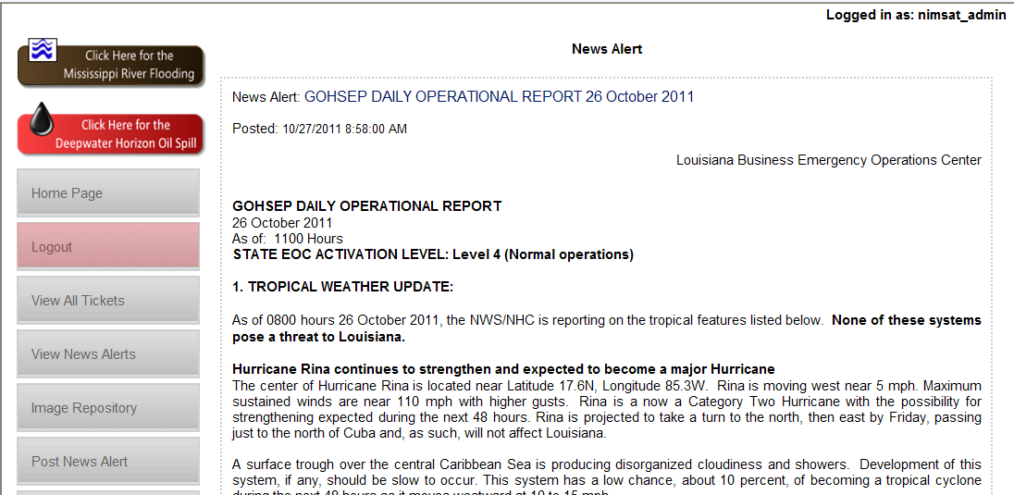
Information sharing – view alerts on portal

Slide 25

Information sharing – view alerts on portal

Slide 26
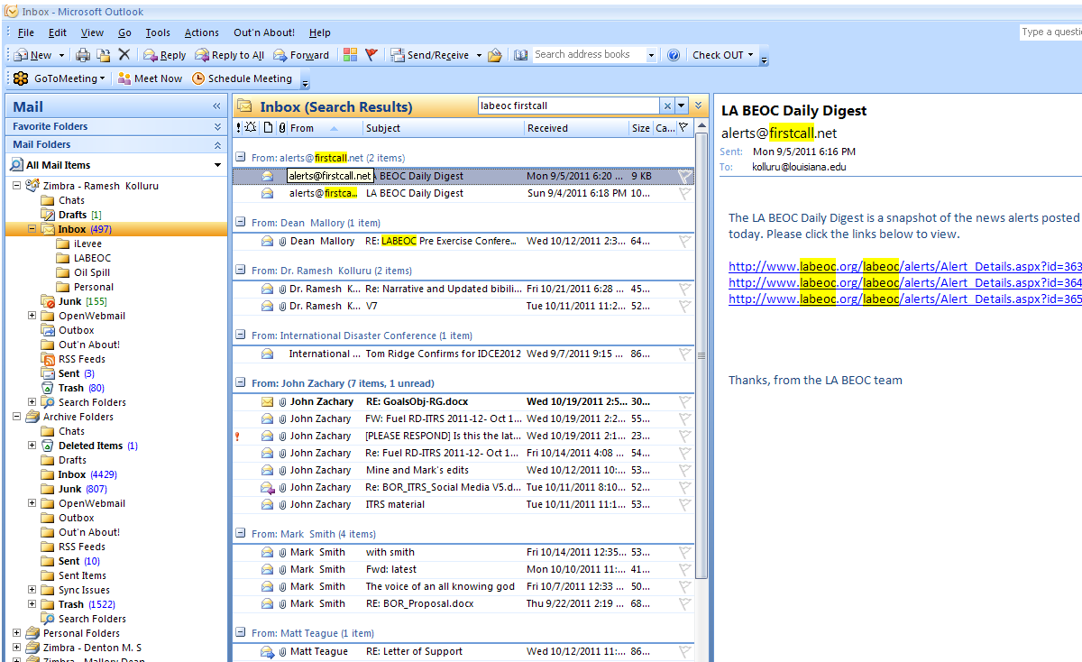

Information sharing – email + SMS messages

Slide 27
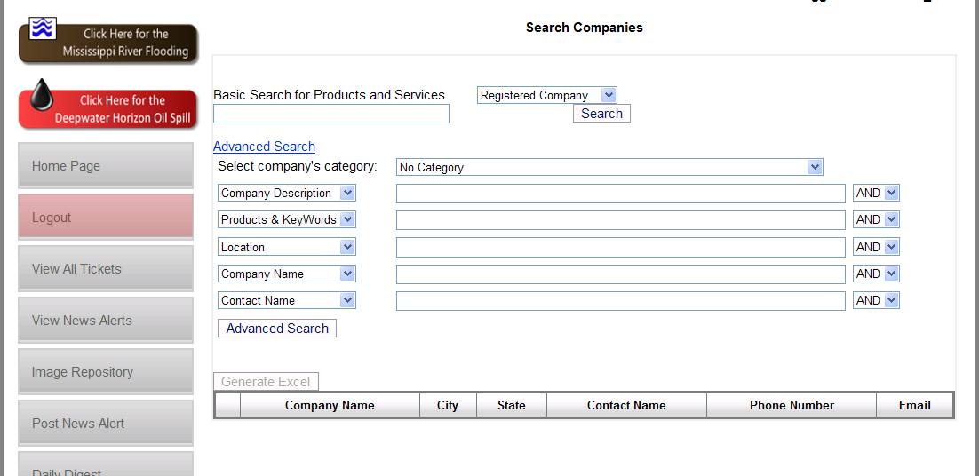
Product + services - search companies

Slide 28
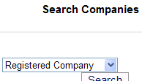
Product + services - search companies

Slide 29
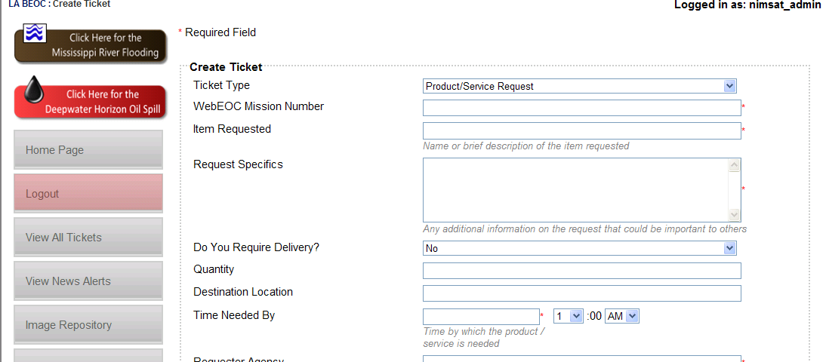
Product + services – create ticket

Slide 30
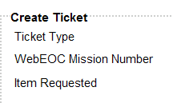
Product + services – create ticket

Slide 31
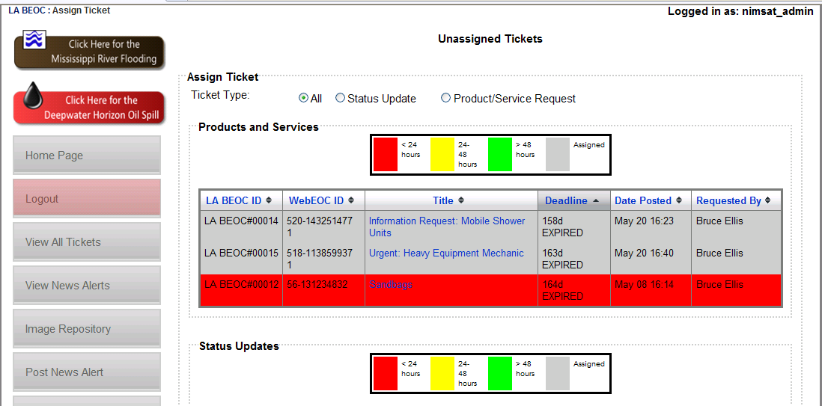
Product + services – assign ticket

Slide 32

Product + services – assign ticket

Slide 33
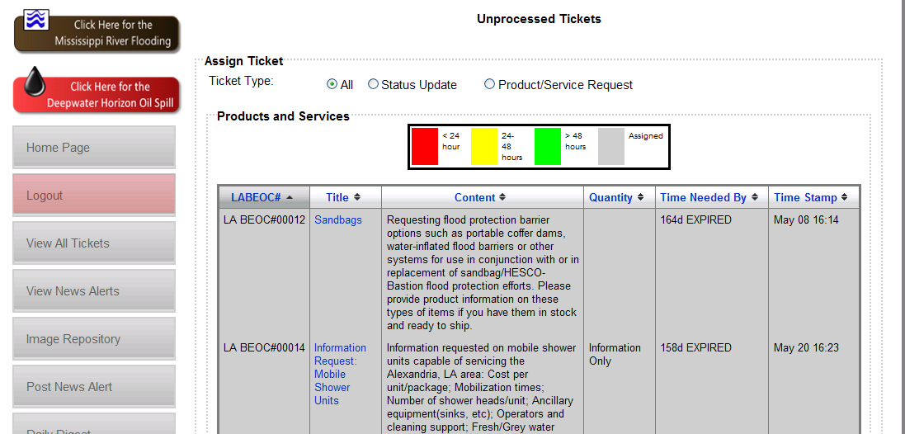
Product + services – process ticket

Slide 34

Product + services – process ticket

Slide 35
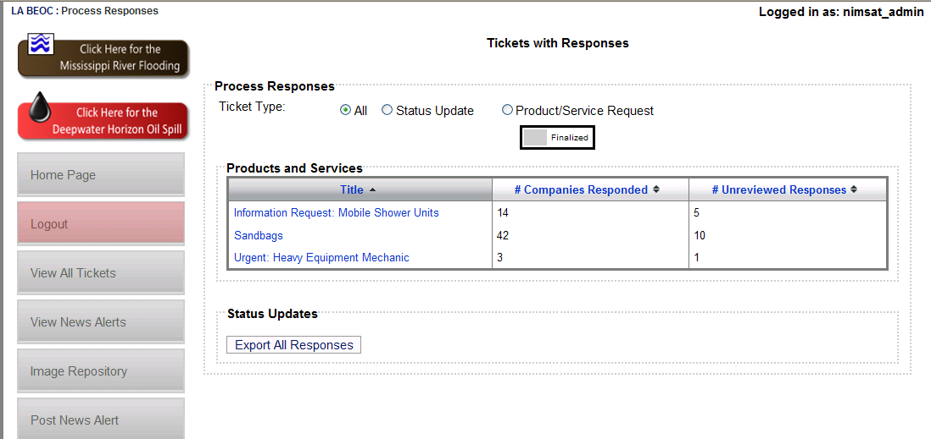
Product + services – process responses

Slide 36

Product + services – process responses

Slide 37
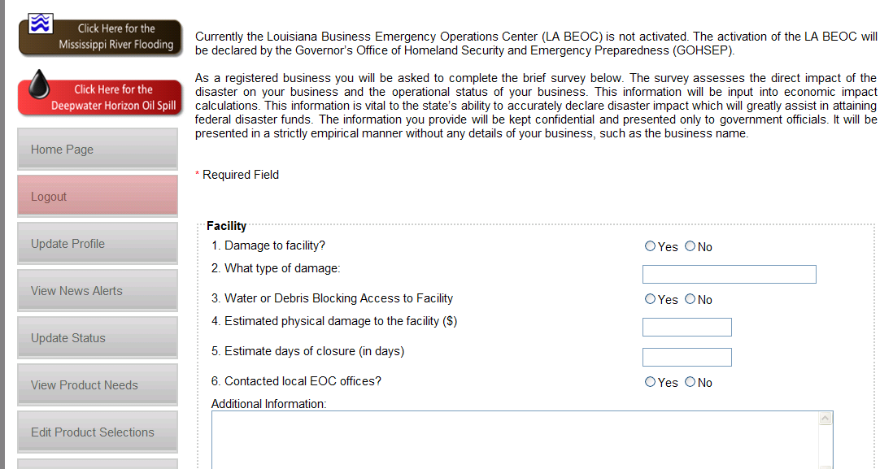
Economic impacts – status update . . .

Slide 38

Economic impacts – status update . . .

Slide 39
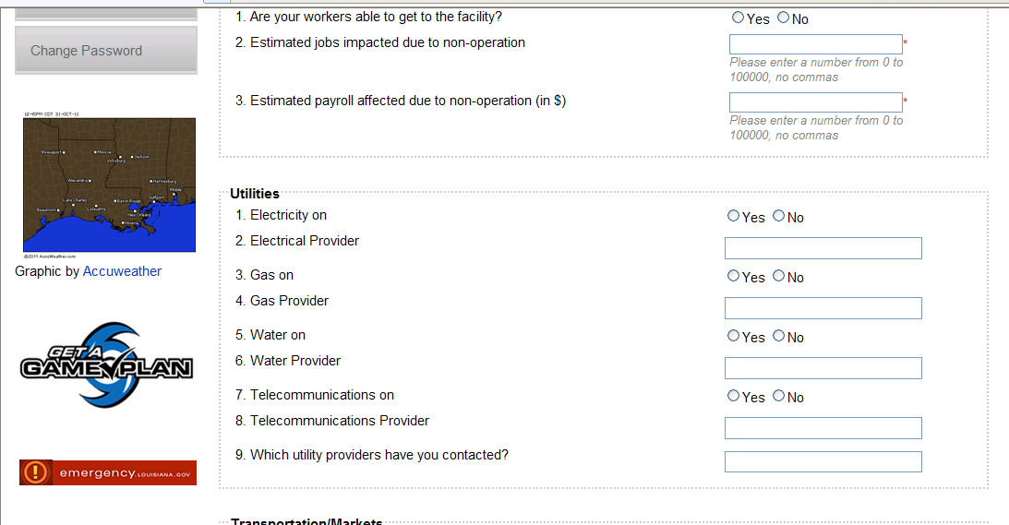
. . . Economic impacts – status update

Slide 40

. . . Economic impacts – status update

Slide 41
Situational Awareness - Economic impacts – Status Map

Slide 42
State
Agency
Assets
LEGEND
Private Sector
ESF
Contracts
Rents
etc.
Status Feedback
Business
EOC
Request for Support
Virtual BEOC
State
Operations
Federal
Assistance
Parish
EOC
Parish
Assets
EMAC
State
To State
Assets
Contracts
Rents
etc.
Intrastate
Mutual
Aid

Slide 43
Example of LA BEOC in Action

Slide 44
Hurricane Isaac – Lafourche Parish 08/30/2012
SEOC receives WebEOC request for Levee/Flood Support
  22:14:18 Potential four mile levee breach a Bayou Bouef Levee System – need sandbags & equipment
  22:49:32 Report Immediate Mandatory Evacuation for Kraemer, LA

Slide 45
Hurricane Isaac – Lafourche Parish 08/30/2012
ESF 16 & ESF 13 Tasking
Sandbag Operational Issues
LA BEOC Activity
Mission complete 08:00:26 08/31/2012

Slide 46
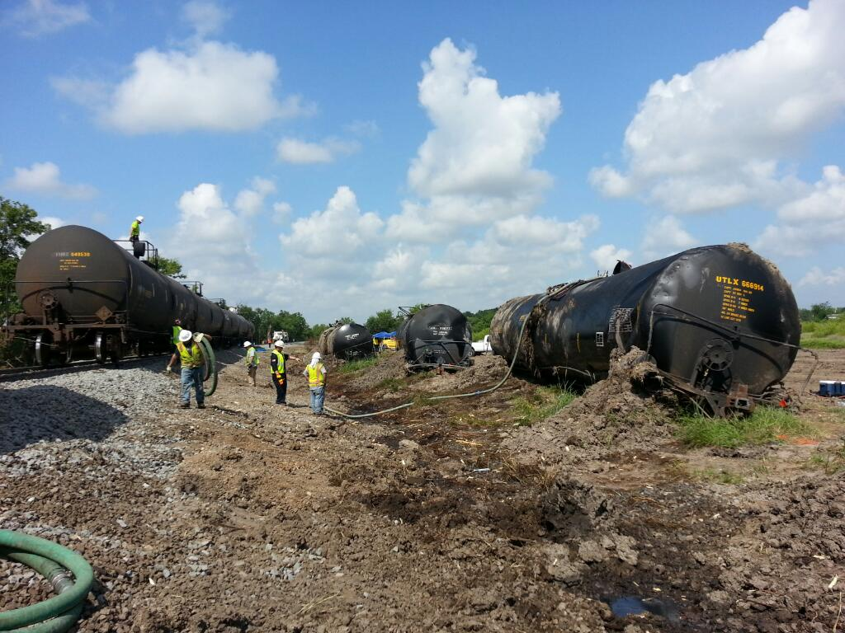
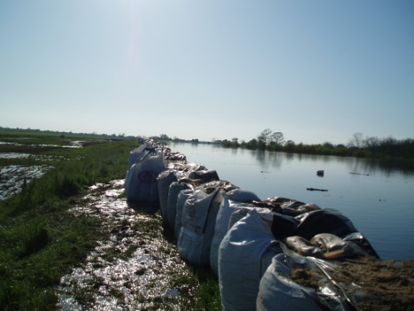
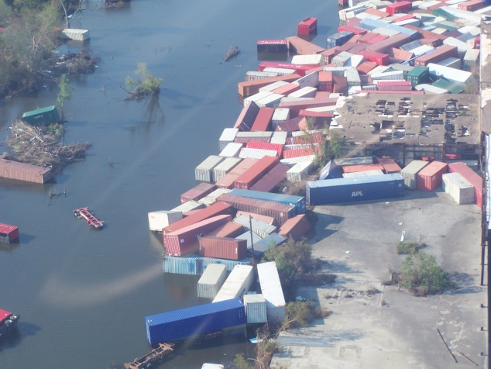
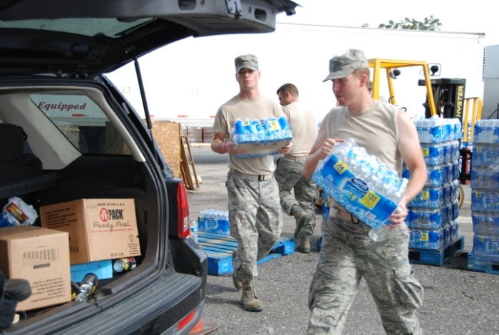
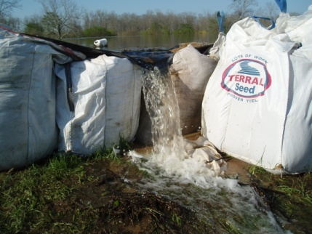
Speed + Efficiency + Impact

Slide 47
New Added Features

Slide 48
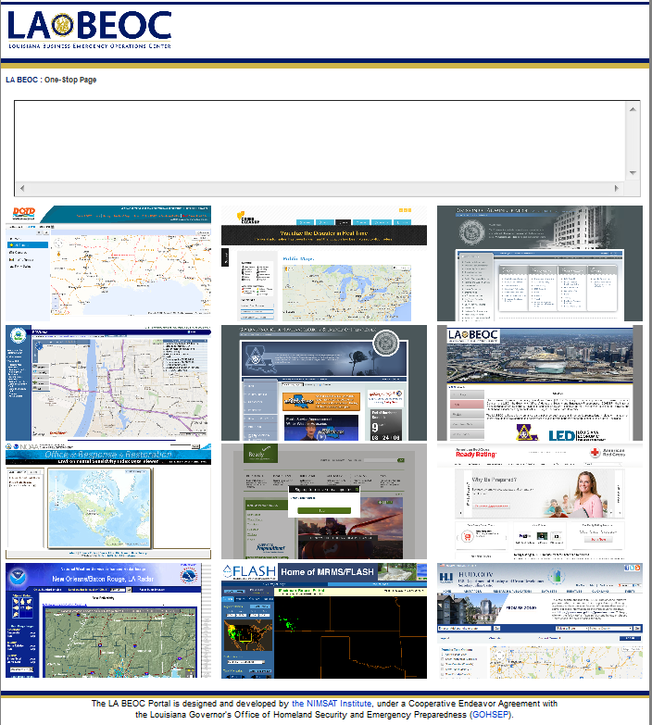

Slide 49


Slide 50
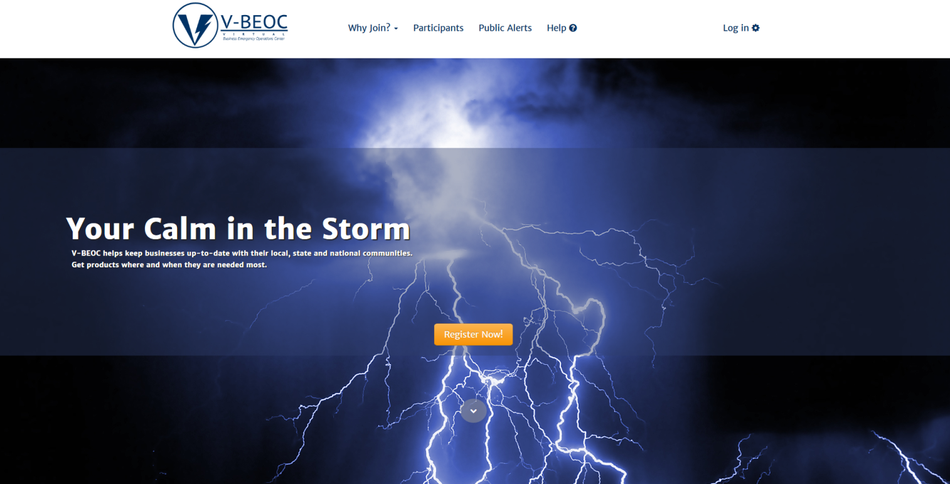
LA BEOC Virtual BETA Platform

Slide 51
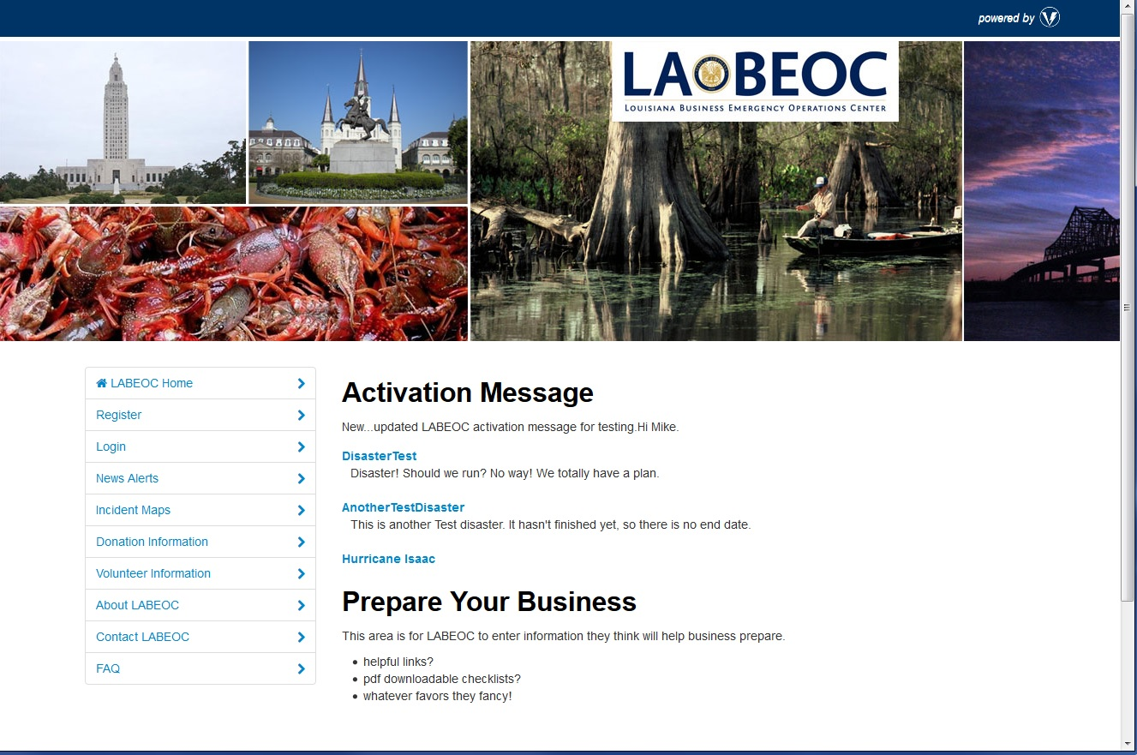

Slide 52
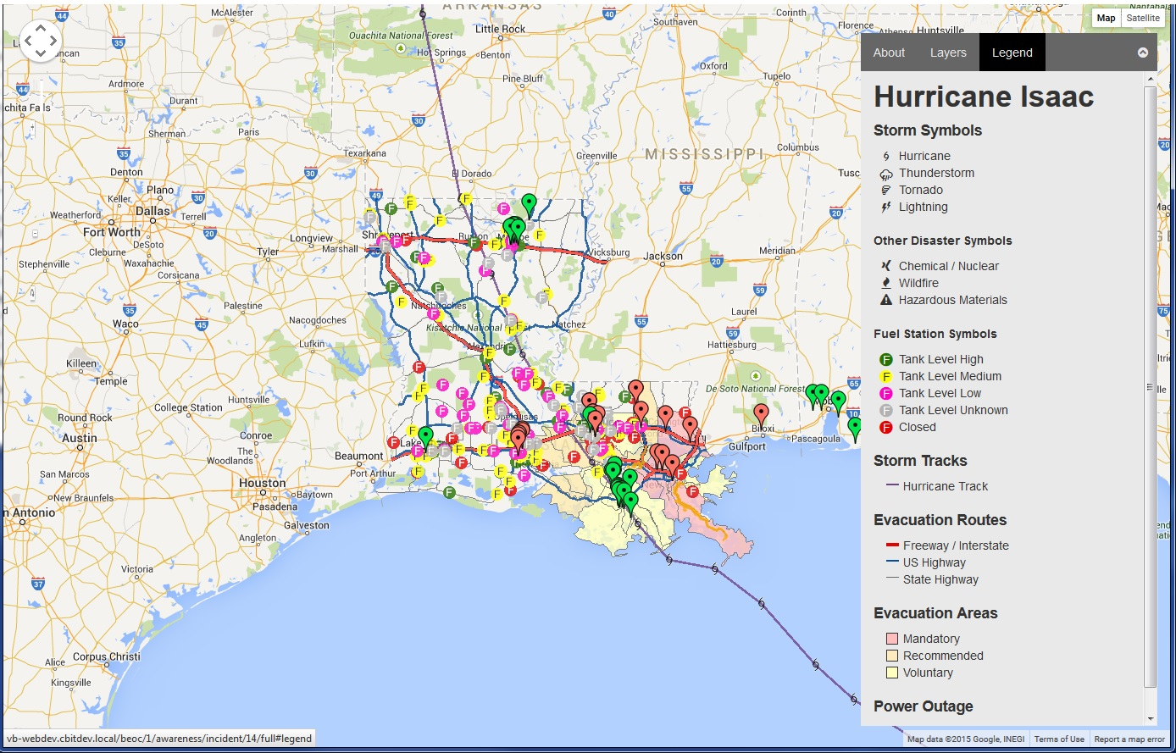

Slide 53
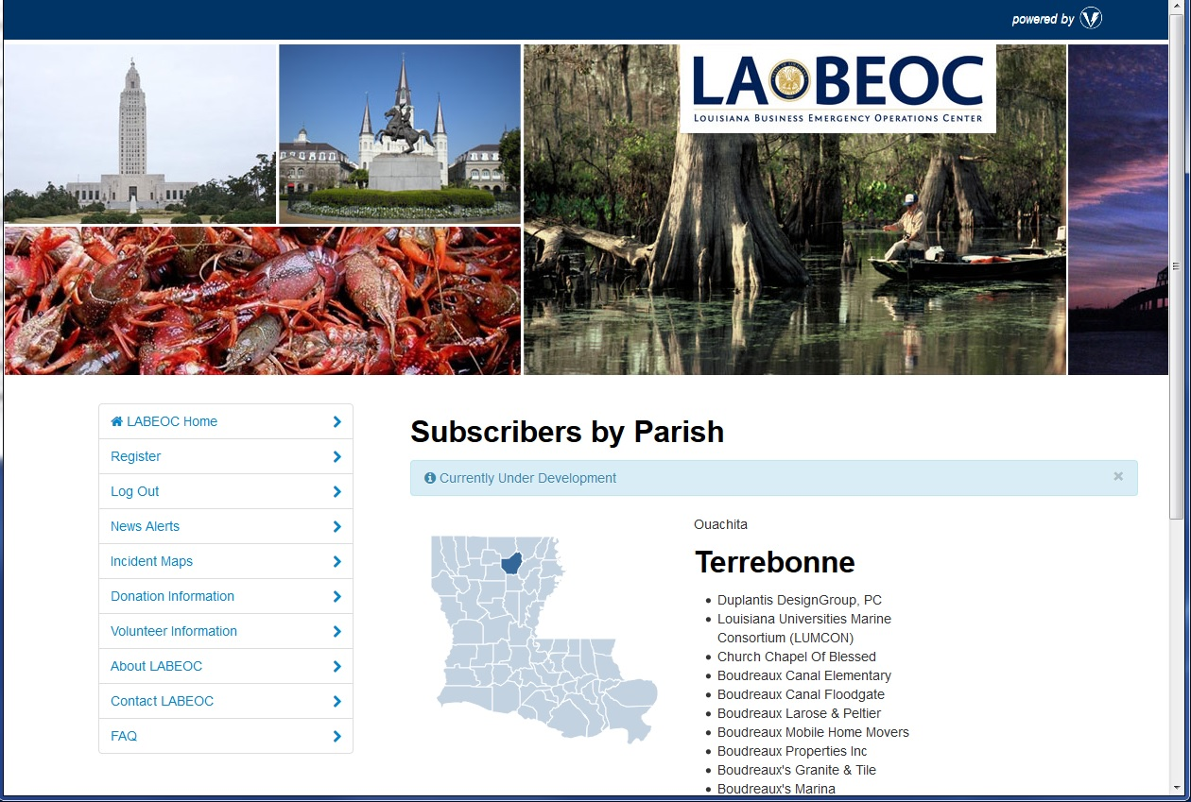

Slide 54
Training Available
IS-660: Introduction to Public-Private Partnerships
IS-662: Improving Preparedness and Resilience through Public-Private Partnerships

Slide 55
Future Portal Improvements
Requirement and Design Phase Survey
  Open for Business Application
  Community Forum
  Enhanced GIS and Crowdsourcing Capabilities
  Business-to-Business Portal
  Other:
    PDA Tool
    Re-Entry
    Single Point Sign On

Slide 56
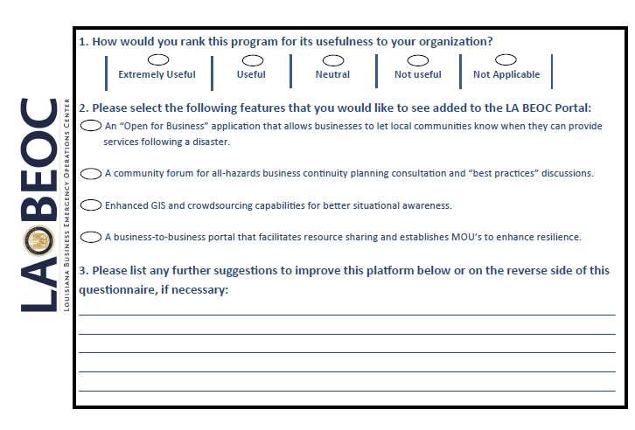

Slide 57
For more information . . .
Email us at:
  info@labeoc.org

