Slide 1
Notes:
Kay (30-45 sec.)

Slide 2
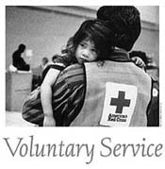
Fundamental Principles
Notes:
Kay (3 min)

Slide 3
Mission: Prevent and Alleviate Human Suffering in the face of Emergencies
Vision: Build Community Resilience
PREPARE
RESPOND
RECOVER
Save lives, reduce injuries, and improve capability of non-profit social services sector.
Increase presence and relevance to lead in provision of mass care and reunification services
Address unmet needs and increase resiliency in military and civilian communities
Witnessed events - 15-25% improvement - Cardiac, Arrest, Choking, Drowning, Home Fires, Natural Disasters and Blood Transfusions
Convene Social Services - mobile feeding, food banks, home health care, mental health care, para-transportation, etc.
2000+ US communities and military facilities worldwide
Respond to greater than 50% of
all Single Family House Fires
Increase financial assistance per family by 10%
Provide mass care services to 500,000 people simultaneously
Preferred provider of emergency support and reunification services to military and civilian populations
Always – Convener, case work and financial assistance
When funds allow – expand direct assistance, grant assistance and build resiliency
Notes:
Kay– (4-6 min)
Before we go into details on structure, I wanted to talk about our purpose in doing this.
It all starts with the mission—”To prevent and alleviate human suffering in the face of emergencies.” It’s why we’re here.
What is the world we are trying to build beyond 2017?
It’s a world where the mission can truly thrive as we are able to apply our growth in fundraising dollars to an expanded reach in service delivery.
By 2017, we will be an organization that—
Shows increased participation across the entire disaster cycle—prepare, respond and recover;
Increases its presence in more than 2,000 U.S. communities and military facilities worldwide;
Responds to more emergencies with more resources for those affected, boosting financial assistance per family by 10 percent; and
Focuses on lifesaving outcomes as well as outputs, with a 15 – 25 percent improvement in preventing cardiac arrest, choking and drowning, responding to home fires and natural disasters and collecting blood.

Slide 4
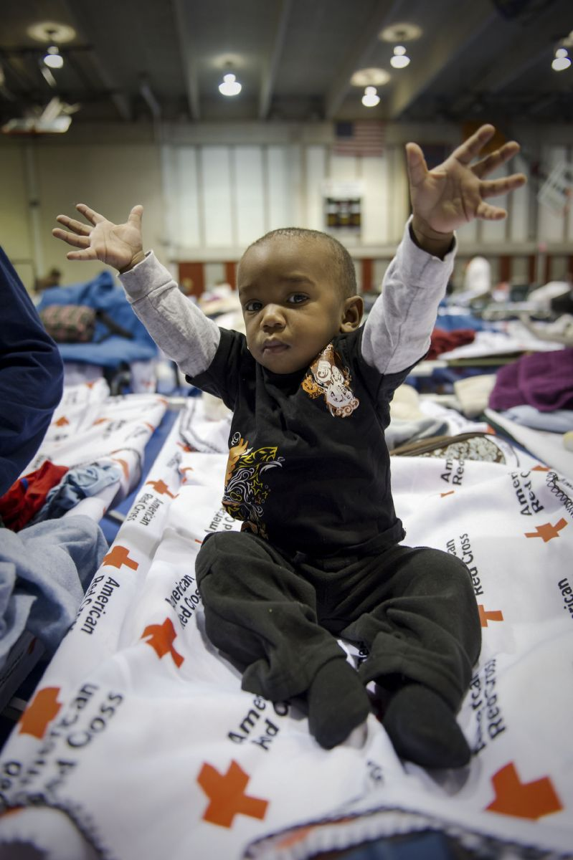
American Red Cross Sheltering
Align with government and
Non-government partners
to ensure
Parish
OEPs
State of Louisiana
Red Cross
Standards & expertise
Trained shelter volunteers
Food
Cots/Blankets
Shelter Owners
Units of Local Government
Schools
Churches
Private facilities
Safe, Secure & Sanitary
Shelter
Notes:
Bruce– (2 min)
Here is one of the more common ways you think of the American Red Cross and as it relates to your line of work.
For large disasters you expect to see us opening and assisting with shelters, operating our ERV’s delivering meals to residents who’s homes have been damaged and are cleaning up, and we do this

Slide 5
Louisiana Region
Disaster Response Incident Map
FY14
Claiborne
Union
Morehouse
20
33
West
Carroll
Bossier
5
9
East
Carroll
Caddo
Webster
Lincoln
4
16
11
13
129
Ouachita
Richland
Bienville
69
7
Madison
3
Jackson
6
Responses to Home Fires and other small disasters during FY 14
FY15 Goal—respond to all fires within 2 hours of notification.
Anticipate increase in home fire responses.
7
De Soto
Red River
Caldwell
Franklin
Tensas
6
7
Winn
4
6
5
13
Natchitoches
Catahoula
17
La Salle
2
Sabine
Grant
6
Concordia
2
16
16
Vernon
Rapides
11
80
Avoyelles
18
West
Feliciana
East
Feliciana
Washington
14
7
St.
Helena
34
Beauregard
Allen
Evangeline
34
Pointe
Coupee
15
13
8
East
Baton
Rouge
Tangipahoa
16
11
St. Landry
West
Baton
Rouge
Livingston
120
St. Tammany
23
286
56
60
Calcasieu
Jefferson Davis
Acadia
17
19
St. Martin
Iberville
Ascension
118
Lafayette
16
St.
John
10
46
31
238
St.
James
Orleans
18
Iberia
13
St.
Charles
Cameron
Vermilion
Assumption
18
26
St. Martin
150
St. Bernard
2
11
St. Mary
16
18
10
26
Jefferson
Lafourche
29
Plaquemines
Terrebonne
4
32
Notes:
5
5
Bruce– (2 min)
Our staff have been and are continuing to work with the fire departments in your parish to ensure efficient notification of home fires. We know that some notification process are working more smoothly than others. We have had success in several parishes of being added as a contact and SOP for their 911 dispatch system after a residential fire has occurred and FD has responded. If this is something your parish may be able to
Most responses are handled by volunteers.

Slide 6
Home Fire Preparedness Campaign
Campaign Objectives
Save Lives • Reduce Injuries • Build Resilient Communities
NATIONAL GOAL
25% reduction in home fire deaths and injuries in 5 years
Notes:
In so many cases fire deaths are avoidable if proper preparedness measures are in place. The Red Cross and partners will collaborate to support increased home fire preparedness and prevention in communities across the country. Nationally, the campaign aims to reduce home fire deaths and injuries by 25% within 5 years.

Slide 7
Acadiana

Slide 8
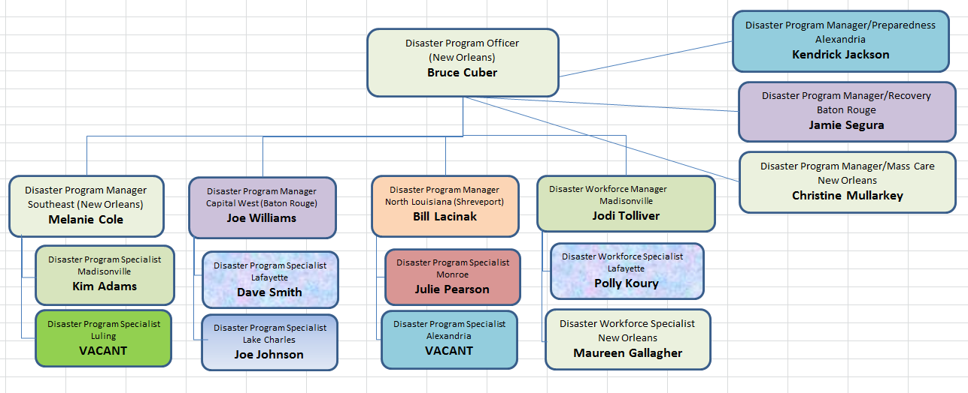
Louisiana Disaster Cycle Services
Notes:
This is our Disaster Cycle Services team in Louisiana—we have 16 paid staff members (including myself) and an army of volunteers.

Slide 9
Questions:

Slide 10
Bruce G. Cuber
Regional Disaster Programs Officer
American Red Cross
Louisiana Region
504-342-5297 c
Bruce.Cuber@redcross.org

