Slide 1
Obtaining and Maintaining Insurance as part of Receiving FEMA Public Assistance

Slide 2
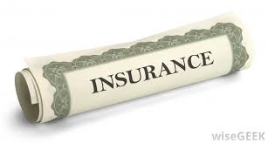
Obtain and Maintain
As a condition for receiving Public Assistance for permanent work, you must Obtain and Maintain insurance to cover your facility for the hazard that caused the damage.

Slide 3
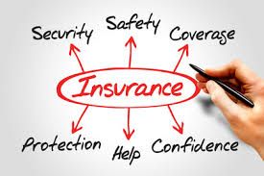
Obtain and Maintain (O&M)
This insurance should be:
OBTAIN = at least the amount of eligible damages.
MAINTAIN = for the life of the item requiring insurance

Slide 4
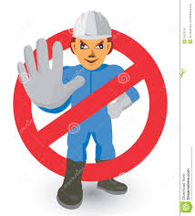
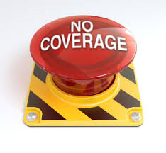
Obtain and Maintain
Failure to Obtain and Maintain the proper amount(s) and type of insurance will cause that facility to not be eligible for assistance in a future disaster.

Slide 5
Obtain and Maintain
O&M
Adjustments to the Obtain and Maintain requirement for a facility are possible by obtaining an Insurance Commissioner’s Certification (ICC).

Slide 6
Obtain and Maintain
ICC
The La. State insurance commissioner has established criteria based off market conditions where applicants can obtain this certification if these criteria are met.
Applicants may apply for this certification from the Louisiana Insurance Commissioner through GOHSEP.

Slide 7
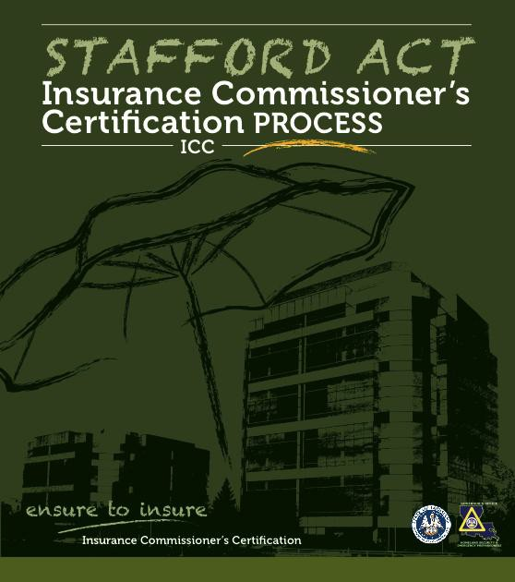
Obtain and Maintain
Randall Hart
GOHSEP
Problem Resolution Officer/Insurance
225-376-5330
Randall.Hart@la.gov

Slide 8
Obtain and Maintain
ICC
An ICC is only good until the next disaster. If an applicant receives damages in a subsequent disaster, the applicant must “re-certify” for an updated ICC.

