Slide 1

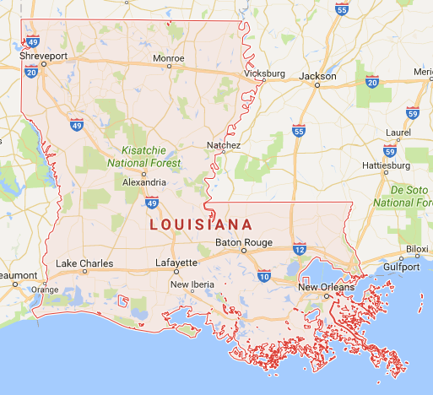
“Research for a Reason”
Michael Dunaway
Director, NIMSAT
UL Lafayette
16 January 2018
UL Lafayette

Slide 2


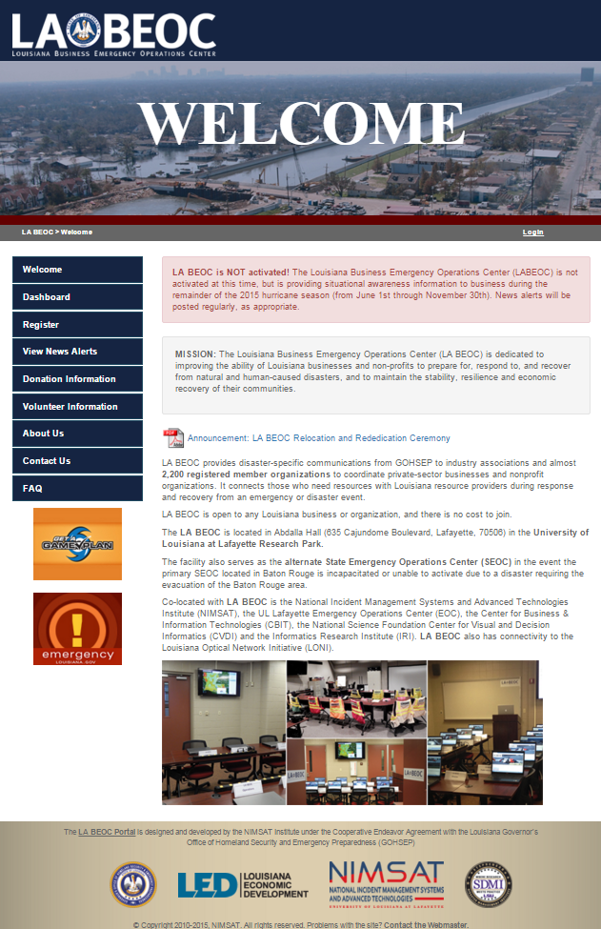
A Public / Private Sector Partnership
and Information-Sharing Portal to:
    Establish Situational Awareness across public and private sectors
    Support State disaster recovery when public resources are exhausted
  And a resource to enable businesses to
    PROVIDE information
    OBTAIN information
    Identify REQUIREMENTS
    Provide RESOURCES
www.labeoc.org

Slide 3
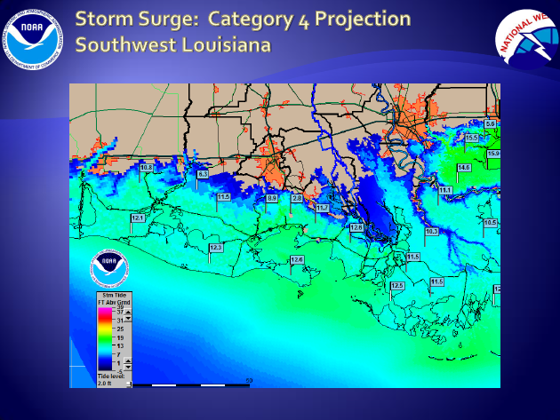
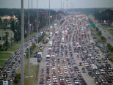

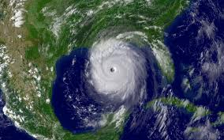
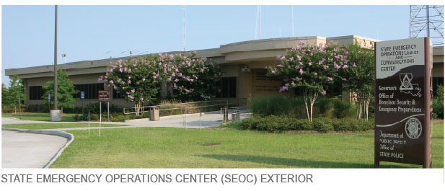
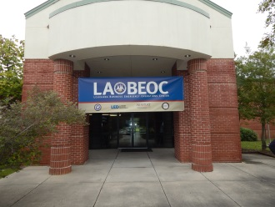
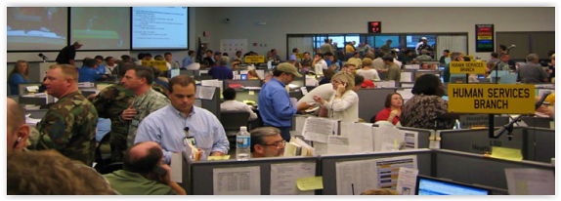
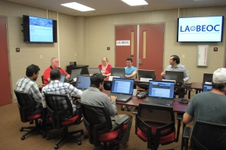
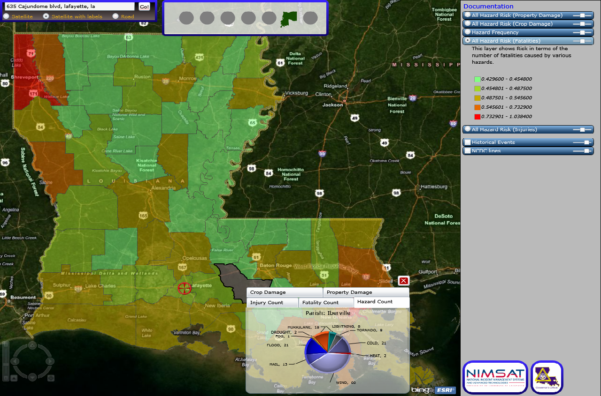

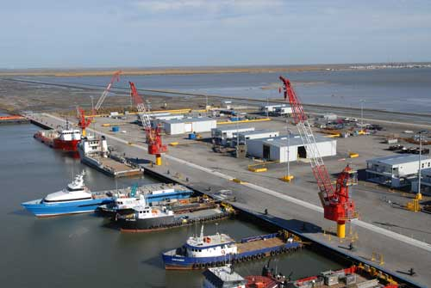
State EOC / LA BEOC Activation and Coordination
Louisiana State
Emergency Operations Center
Abdalla Hall
UL Research Park
Information and Data Flow
SEOC to BEOC
Situational Awareness
Contracts and Donations
State Private Sector
Entities and Resources

Slide 4
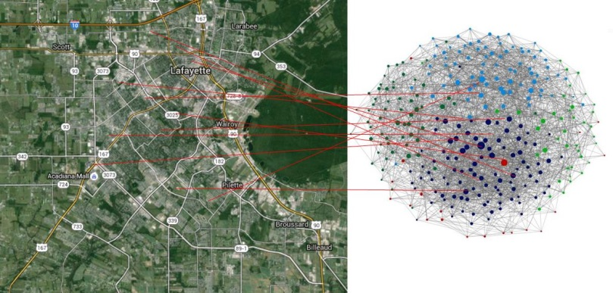
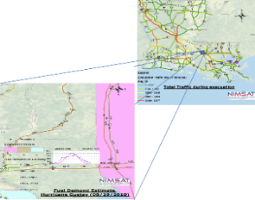
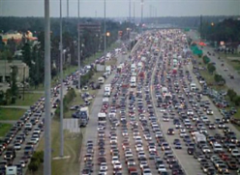
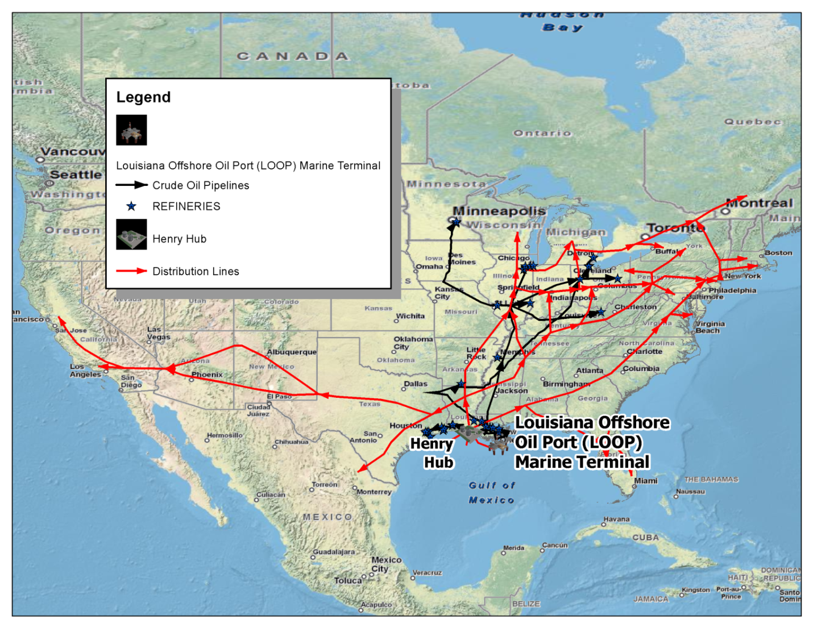
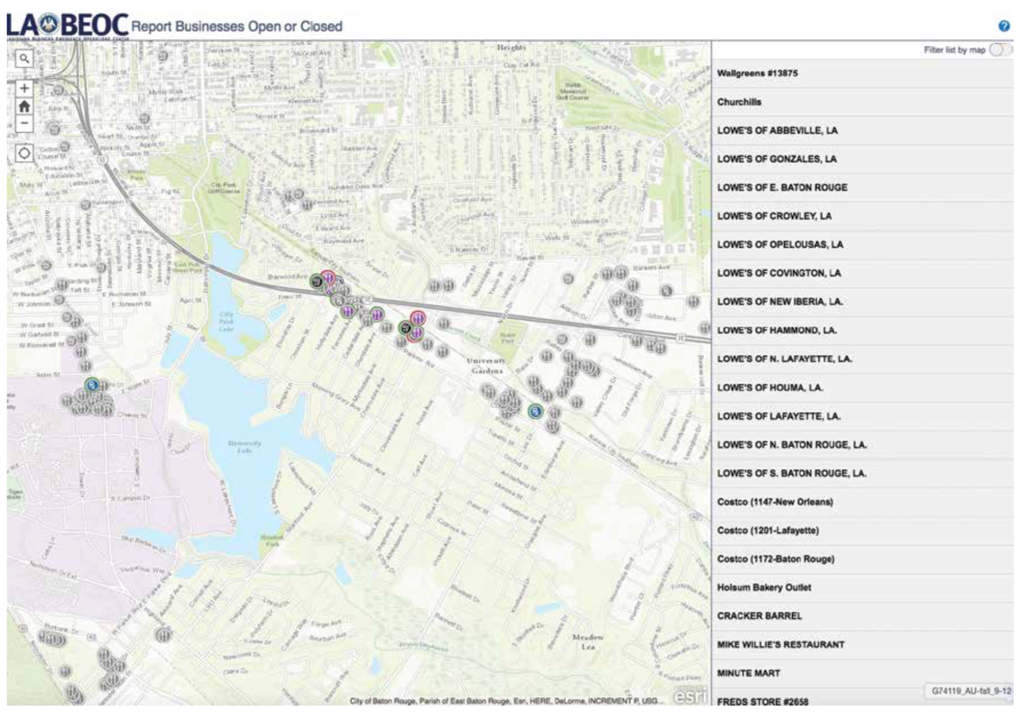
“Research for a Reason”
Supply Chain Interdependency Analysis
Human Geography Mapping of Crisis Leadership Networks
Fuel Demand & Supply Prediction for Regional Evacuation
Points of Distribution (POD)
location optimization
Consequence Analysis of Natural Gas Pipeline Disruptions
Louisiana Hazard Information Portal
LABEOC Open for Business App piloted during DR-4277-LA

Slide 5


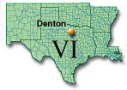


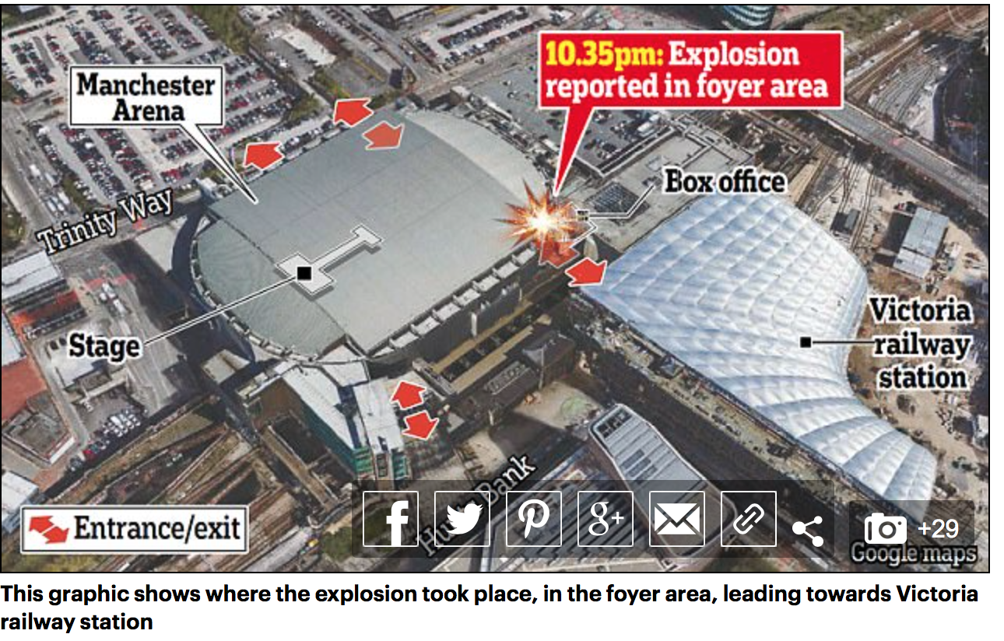
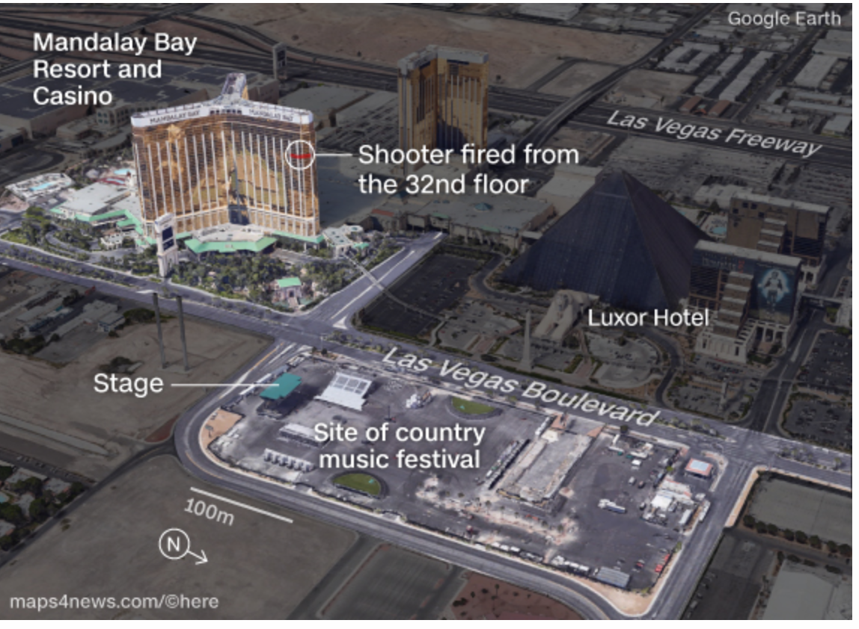
Initiatives in Public-Private Partnerships
National Business EOC / FEMA Headquarters
FEMA Region Six Private Sector Office
NDRF/RSF Implementation Study
Regional BEOC Pilot
Cajundome Mass Casualty
Incident Exercise

Slide 6




NIST / GCTC Smart Public Safety Research
Alameda / San Francisco, CA AI-based Emergency Preparedness
Conover, NC GEO Fencing Predictive Policing Solutions
Denton, TX / UNT / PSU Deployable Communications & Incident Command
Fairfax County, VA / GMU Multi-Team Coordination & Analysis
Lafayette, LA / UL Lafayette Louisiana Business Emergency Operations Center
Las Vegas, NV IoT for Preparing Underserved Communities
Montgomery County, MD Safe Community Awareness and Alerting Network
Nashville, TN Integrated Analytics & Scheduling of First Responders
Newport News / VA Beach, VA Storm Sense Inundation and Flood Prediction Modeling
North Central Texas COG Smart Emergency Response System
Orlando, FL Video Analytics for Public Safety during Special Events
Ronart / Santa Rosa, CA Advanced Flood Warning & Environmental Awareness
San Francisco, CA Mobile Micro-Grids for Disaster Resilience
Washington, DC Cyber City Education & Awareness Platform
Genoa / Milan / Torino, Italy Open Platform for Smart City Disaster Prevention
Taichung City, Taiwan Community Traffic Control for Disaster Response
Wakayama / Nagano / Miyagi NerveNet Regional Resilience IoT Platform
Prefectures, Japan

Slide 7


Michael Dunaway, PhD
Informatics Research Institute
University of Louisiana at Lafayette
mdunaway@louisiana.edu
337.482.0615
www.labeoc.org

