Slide 1
Louisiana Public Safety Broadband/FirstNet Overview
January 21 – 22, 2015

Slide 2
What is FirstNet?
The Middle Class Tax Relief and Job Creation Act of 2012 created the First Responder Network Authority (FirstNet) as an independent authority within the National Telecommunications and Information Administration (NTIA) to provide emergency responders with their first nationwide, high-speed, broadband network dedicated to public safety.

Slide 3
FirstNet Focus
The First Responder Network Authority shall hold the single public safety wireless license (700MHz, or band class 14) and take all actions necessary to ensure the building, deployment, and operation of the Nationwide Public Safety Broadband Network (NPSBN).

Slide 4
Middle Class Tax Relief and Job Creation Act of 2012
State Planning Funds: Up to $135 million State and Local Implementation Grant program (SLIGP) is provided by the NTIA to help State planning efforts in support of FirstNet consultation
Opt In/Out Provision: States have the opportunity to opt-out of the nationwide build-out and develop its own interoperable system with FCC approval

Slide 5
Nationwide Public Safety Broadband Network
The NSPBN is the name of the planned 4G LTE mobile data network for the nations' first responder community.
Not for public use
Band Class 14 (700MHz)
Mission Critical Standards: Designed to be reliable, functional, safe and secure, and provide optimal levels of operational capability at all times.

Slide 6
Funding
Planning and Implementation funding is provided through the spectrum auctions
Funds are available until Sept. 30, 2022; revert to the Treasury for deficit reduction after
By law, the network is to be self sustaining upon expending $7 Billion
Phase | Funds | Purpose
Planning | $135 Million | Grants to assist States/Territories with planning & implementation. Requires 20% match
 | $7 Billion | $2 Billion provided up front to start planning, designing and early implementation
Implementation |  | Remaining $5 Billion to be provided from spectrum auctions; used to complete network build out
Sustainment | Ongoing | Network User Fee: Fee from each entity including public safety or secondary user that uses the Network Lease Fee for Network Capacity: Fee for agreement between the FirstNet and secondary user to permit secondary access Lease Fee for Network Equipment/Infrastructure: Fee for entity that seeks access or use of antennas, towers, etc. constructed or owned by FirstNet

Slide 7
Responsibilities of FirstNet by Law
Consultation
Commercial Infrastructure
Management
Contracts
Standards
Cybersecurity
Certified Equipment List
PSAPs
RFPs
Rural
Prohibition on Consumer Service
FirstNet CANNOT offer, provide, or market commercial telecommunications or information services directly to consumers

Slide 9
Louisiana FirstNet/SLIGP Structure
State Point of Contact (SPOC): Col. Mike Edmonson (Appointed by the Governor)
SLIGP Grant Recipient: Office of State Police
Grant Administrator: GOHSEP
(80% Federal/ 20% State Match)
Federal share: $1.9M
State share: $480K
Total: 2.4M
SIEC Broadband Subcommittee
Chairman: Adam White, DPS/LSP
Christina Dayries, GOHSEP
Neal Underwood, DOA/OTS
Ricky Edwards, Louisiana Sheriffs Association
Aaron Miller, New Orleans
William Daniel, Baton Rouge

Slide 10
Louisiana FirstNet/SLIGP Structure
SLIGP Staffing:
Allison McLeary, Program Manager
Jeya Selvaratnam, Technology Consultant
Vacant, Outreach Coordinator
Travis Johnson, Technology Specialist

Slide 11
State and Local Planning Consultation Topics
Construction of a core network and any RAN build-out
Placement of towers
Coverage areas of the network, whether at the regional, state, tribal, or local levels
Adequacy of hardening, security, reliability, and resiliency requirements
Assignment of priority to local users
Assignment of priority and selection of entities seeking access to or use of the nationwide interoperable public safety broadband network and training needs of local users.

Slide 12
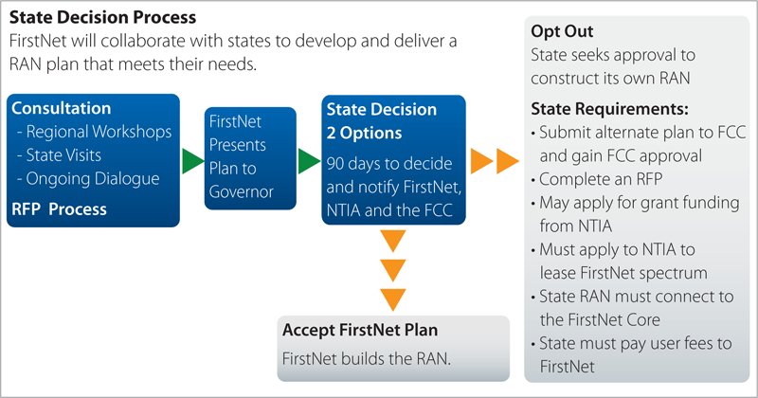

Slide 13
State Plan
Cost
Interoperability
Coverage
Funding
Security
Technology
Management
QOS
Timeline

Slide 14
Licensing FirstNet Spectrum
If the state plan is not approved, the construction, operation and maintenance of the state RAN will proceed in accordance with the FirstNet plan.
If a state receives approval to build its own RAN, the state then must apply to NTIA to lease spectrum capacity from FirstNet.

Slide 15
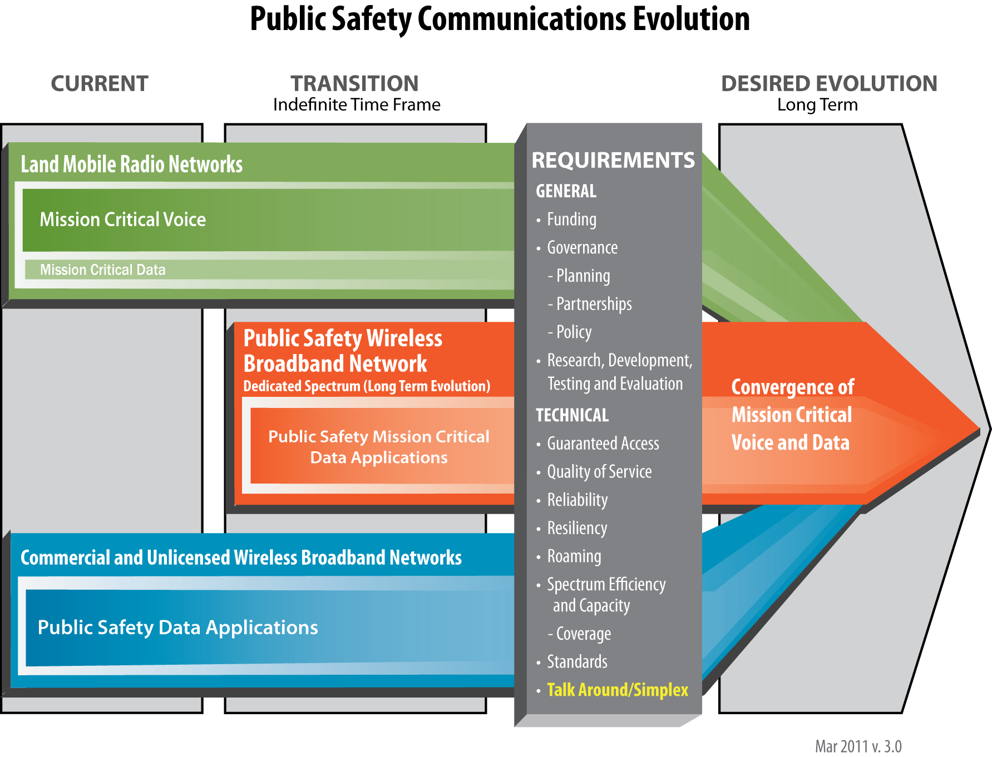

Slide 20
Future Outreach
Presentations:
Parish level meetings
Association groups
Conferences
Louisiana FirstNet Consultation
Developed:
Louisiana FirstNet website
Twitter Account
Email Address

Slide 21
Questions?

