Slide 1
Project Management

Slide 2
Purpose
To make Subgrantees aware of the scope + contracts + cost reasonableness of procuring Project Management + Architectural/Engineering (A/E) services so that they can receive/keep the maximum Federal dollars.

Slide 3
Authorities
44 Code of Federal Regulations (CFR) Part 206
Hazard Mitigation Assistance (HMA) Unified Guidance July 12, 2013
OMB Circular 133
FEMA 322 – Public Assistance Guide July 2007

Slide 4
Acronyms
A/E Architectural/Engineering
CA Construction Administration
CEF Cost Estimating Format
CM Construction Management
FIPS Federal Information Processing System
FP+C Louisiana Office of Facility Planning + Control
GA Grant Administration

Slide 5
Acronyms (Continued . . . )
HMA Hazard Mitigation Assistance
PM Project Manager/Management
RFI Request for Information
RFP Request for Proposal
RFQ Request for Qualifications
SOV Schedule of Values
SOW Scope of Work

Slide 6
3 things to be aware of
Project vs. construction management vs. grants administration.
Reasonable fee curves for Architectural/Engineering (A/E) services?
Cost analysis.

Slide 7
Project vs. Construction Management vs. Grants Administration

Slide 8
Project Management (PM)
Define
The oversight of an eligible project from the design phase to the completion of the work. (Source: Disaster Assistance Policy [DAP] 9525.6)

Slide 9
Project Management (PM)
Define (Continued . . . )
Eligible PM activities are those activities that the Subgrantee would have performed in the absence of Federal funding.

Slide 10
PM activities
Direct management of projects in the concept + design stages.
Procurement activities for architectural/engineering services + performance of work.

Slide 11
PM activities (Continued . . . )
Review + approval of the project design.
Oversight of project work by both A/E and construction contractors.

Slide 12
Grants Administration (GA)
Define
Activities necessary to apply for, administer and closeout a grant.

Slide 13
GA activities
Application process.
Reimbursement activities.
Quarterly Report preparation.
Grant reconciliation activities.

Slide 14
Construction Management (CM)
Define
Also known as Construction Administration (CA)/Construction Management (CM), usually performed by the A/E contractor/firm as part
of their basic services during the phase of construction.

Slide 15
CA/CM activities
Preparation of construction documents, based on final design, for procurement of bids.
Bid tab analysis + recommendation.

Slide 16
CA/CM activities (Continued . . . )
Periodic supervision of construction:
  Such as weekly progress meetings + processing contractor’s pay applications + respond to requests for information (RFI) + preparation of change orders (as necessary) + etc.

Slide 17

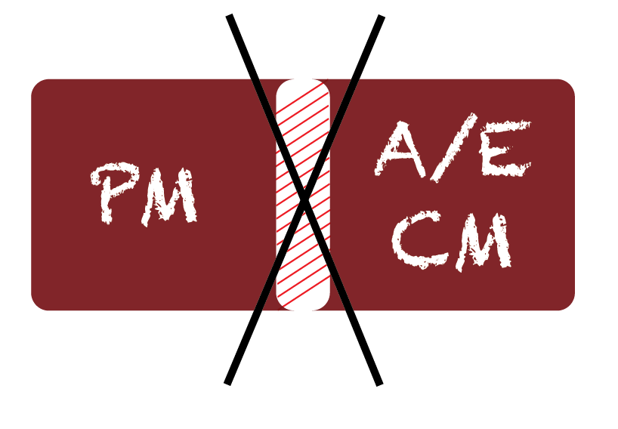
Do NOT overlap PM + CA/CM

Slide 18
Where overlap may occur . . .
Construction oversight
Procurement Activities
  Construction Contract
Kickoff meeting
Quarterly Reports
Schedule work plan + budget
Other

Slide 19
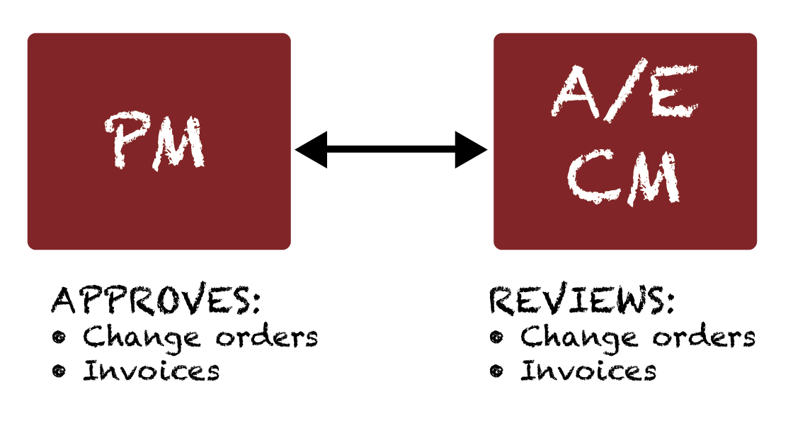
For example . . .

Slide 20
How to avoid overlap
Clearly distinguish roles and responsibilities for activities that have the same title but not the same work.
Well-defined contracts.
Other.

Slide 21
Overlap can lead to . . .
Request for an explanation.
  Requires distinct narrative separating two (2) activities under the same category.
Withholding/de-obligation of funds.

Slide 22
Reasonable fee curves for A/E services?

Slide 23


2 fee curves
FEMA fee curves A + B.
Louisiana Office of Facility Planning + Control (FP&C) curve.

Slide 24

Curves A + B
Curve A - Above average complexity.
Curve B - Average complexity.

Slide 25
Curve A
Applies to projects of above-average complexity and nonstandard design:
  Airports with extensive terminal facilities.
  Water + wastewater + industrial waste treatment plants.
  Hospitals + schools + office buildings.
  Power plants.
  Highway + railway tunnels.
  Pumping stations.
  Incinerators.
  Complicated waterfront + marine terminal facilities.

Slide 26
Curve A (Continued . . . )
CURVE A. COMPENSATION FOR BASIC SERVICES EXPRESSED AS A PERCENTAGE OF CONSTRUCTION COST FOR PROJECTS OF ABOVE-AVERAGE COMPLEXITY AND NON-STANDARD DESIGN

Slide 27
Curve B
Applies to projects of average complexity:
  Industrial buildings + warehouses + garages + hangars + comparable structures.
  Bridges + other structures of conventional design.
  Simple waterfront facilities.
  Roads + streets.
  Conventional levees +
  floodwalls + retaining walls.
  Small dams.
  Storm sewers + drains.
  Sanitary sewers.
  Water distribution lines.
  Irrigation works (except pumping plants).
  Airports (except as classified for Curve A).

Slide 28
Curve B (Continued . . . )
CURVE B. COMPENSATION FOR BASIC SERVICE EXPRESSED AS A PERCENTAGE OF CONSTRUCTION COST FOR PROJECTS OF AVERAGE COMPLEXITY

Slide 29
FP&C Fee Curve
Simple
Average
Medium complex
Complex

Slide 30
Fee curve adjustments
Other FP&C factors
Adjustment for renovations.
Repetitive or duplicative work.
Prefabricated building.
Multiple projects in a single contract:
  Fee based on sum of the projects.
Segregate projects:
  Fee based on respective portions.

Slide 31
Fee adjustment (FP&C)
Change in project value: Pre-bid
Typically no adjustment for small project cost change.
Large changes in project cost may warrant fee adjustment:
  Change in scope-based cost.
  Original estimate significantly under or over valued.

Slide 32
Fee adjustment
Change orders
A/E fee adjustments are appropriate based on changes in costs during construction.
  A/E fee adjustments are eligible for FEMA reimbursement provided the change order is deemed eligible by FEMA.
  Cost overruns may be the responsibility of the Subgrantee based upon availability of funds.

Slide 33

Fee adjustment
FP&C change order guidance
Change orders resulting from errors + omissions . . .
  Generally do not warrant
  fee adjustment.

Slide 34
What to look for when reviewing a contract

Slide 35
PM contracts
Procurement:
  Must be procured through a request for proposal (RFP) with two (2) or more bids.
Contract should include:
  Schedule (start + end date).
  Budget (include a not to exceed clause).
  Scope of work (SOW).
  Payment schedule.

Slide 36
A/E contracts
Procurement:
  Procured through a request for qualifications (RFQ).
    BEST PRACTICE: Specify in the RFQ that fees will be based on FEMA or FP&C curve.

Slide 37
A/E contracts (continued . . .)
Contract should include:
  Schedule (start + end date).
  SOW.
  Milestones/payment schedule.
  Additional services.
    May require cost analysis to determine reasonableness.

Slide 38
Cost Analysis

Slide 39
  What is procurement?
Process of acquiring (buying, purchasing, renting/leasing) goods + services.

Slide 40
  How is procurement regulated?
44 CFR 13.36
Promotes equal opportunity.
Promotes cost-effective acquisition.

Slide 41
Why is procurement important?
FEMA must hold Grantees and Subgrantees accountable for non-compliance with Federal procurement practices.
May disallow all or part of contracts that are NOT in compliance.
Subject to de-obligation of Federal funds.

Slide 42
What is a cost analysis?
A Subgrantee’s demonstration that the cost of an acquisition is reasonable:
  It is the “story” of a Subgrantee’s procurement.
  An analytical explanation of why the procurement decisions were reasonable.

Slide 43
Why must a cost analysis be performed?
Because it is REQUIRED by 44 CFR 13.36 (f)(1).

Slide 44
When is a cost analysis required?
If procuring with Federal funds, cost analysis must be performed:
  Non-competitive procurement.
  Sole source contract.
  For all scope alignments.
  For all contract amendments.
  For all change orders.

Slide 45
What is “cost reasonableness”?
A cost that is both fair + equitable for the type of work performed. (OMB A-87)

Slide 46
How is cost reasonableness determined?
Using comparisons, which might include:
  Historic data for cost of similar work.
  Average costs for similar work in the same market.
  Catalogs.
  Internet.

Slide 47
How is cost reasonableness determined? (Continued . . . )
Using cost comparisons, which might include:
  Published unit costs from nationally – or industry – recognized cost standards like RSMeans, BNi Costbooks, Marshal & Swift and others.

Slide 48
How complex does a cost analysis need to be?
The method + degree of analysis depends on the facts surrounding each procurement.

Slide 49
Is a specific format required?
No specific format is required.
A sample cost analysis has been provided that follows the process outlined in this presentation.

Slide 50
Cost analysis process: 9 key steps
1. Identify the who, what, when, where and why:
  Person preparing analysis and date prepared.
  Grantee/Subgrantee and Federal Information Processing System (FIPS)/Applicant ID number.

Slide 51
Cost analysis process (Continued . . . )
  1. Identify the who, what, when, where and why: (Continued . . . )
  Project title.
  Address and facility being analyzed (if applicable).

Slide 52
Cost analysis process (Continued . . . )
  1. Identify the who, what, when, where and why: (Continued . . . )
  Project numbers and amendments.
  Cost analyzed (using contracts, estimates, invoices, etc.).

Slide 53
Cost analysis process (Continued . . . )
2. Describe the party requesting the cost analysis and intended purpose:
  Include relevant background information.
3. Describe the key points of the cost analysis:
  Define the costs expended by the Subgrantee that require cost analysis.

Slide 54
Cost analysis process (Continued . . . )
4. Define the type of procurement:
  Describe intention to acquire. Break down how much individual parts of the project will cost (lump sum, unit price, etc.).
  Explain how those costs correspond with the project’s cost.

Slide 55
Cost analysis process (Continued . . . )
5. Identify the methods to justify the cost estimation:
  There are many different methods of comparison that can be used to establish cost reasonableness including, but not limited to, pre-disaster price for similar work or average cost for similar work in the same market.

Slide 56
Cost analysis process (Continued . . . )
6. Explain the ways in which the selected comparables are alike:
  Adjust the data to account for any relevant differences such as:
    Inflation/time value of money (Consumer price index [CPI]).
    Price volatility and raw materials.
  Compare adjusted costs with the project costs.

Slide 57
Cost analysis process (Continued . . . )
7. Conclusion:
  Is the cost reasonable or not?
  If the project cost is within 10% of the adjusted cost then it is reasonable.

Slide 58
Cost analysis process (Continued . . . )
8. Recommendation (if applicable):
  If the cost is determined to be reasonable, and depending on what purpose the cost analysis is being performed for, make a recommendation about the desired outcome.

Slide 59
Cost analysis process (Continued . . . )
9. Last but not least, provide references and citations to document all cost analyses.
Back up! Back up! Back up!

Slide 60
Proper procurement can minimize cost analysis requirements
Procuring properly does not eliminate the need for cost analysis, but . . .
  GOHSEP/FEMA may view a properly procured contract with an adequate number of responses as sufficient.

Slide 61
Sole source/ non-competitive procurement

Slide 62
What about sole source or non-competitive procurement?
Cost analysis is still required.
To be approved, must meet the specific requirements in 44 CFR 13.36(d)(4)(i) A-D.

Slide 63
What about sole source or non-competitive procurement? (Continued . . . )
Sole source/non-competitive cost analysis are difficult:
  Acceptability is determined on a case-by-case basis by GOHSEP/FEMA.
  Compelling narrative required.
  Previous transactions from sole source vendor may be the only option.

Slide 64
Contact
Jeffrey Giering
jeffrey.giering@la.gov
Unmesh Kirtikar
unmesh.kirtikar@la.gov
Tenesha Wilson
tenesha.wilson@la.gov

Slide 65
Questions?

Slide 66
For more information + to download materials from today’s seminar:
gohsep.la.gov/outreach.aspx

