Slide 2
Louisiana State Citizen Corps Council

Slide 3
Mission of Citizen Corp
The mission of the Citizen Corps program is to harness the power of every individual through educating, training and volunteer service.

Slide 4
Citizen Corp
The cornerstone of any successful Citizen Corps program is our attention to detail and our complete commitment to the Safety of the Program.
Safety Training is Good Training
Instructors who are responsible for teaching the program must focus on and be familiar with the mission of the Citizen Corps Program.

Slide 5
Citizen Corp
The cornerstone of any successful Citizen Corps program is our attention to detail and our complete commitment to the Safety of the Program.
Safety Training is Good Training
Instructors who are responsible for teaching the program must focus on and be familiar with the mission of the Citizen Corps Program.

Slide 6
Duties of Local Citizen Corps Councils
Local Citizen Corps Councils: Promote and strengthen the Citizen Corps programs at the community level, such as Volunteers in Police Service programs, CERT teams, Medical Reserve Corps units, and Neighborhood Watch groups;
Provide opportunities for special skills and interests;
Develop targeted outreach for the community, including special needs groups;

Slide 7
State Advocates
The Citizen Corp Program elected state advocates to represent each program that is offered.
Advocates assist communities who are interested in starting a Citizen Corp program in their community.
These advocates will provide knowledge and support where it is necessary.

Slide 8
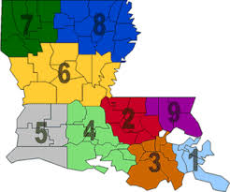
Louisiana Citizens Corps Council

Slide 9
State Citizen Corp Board
The board has recently adopted a set of by-laws on how the board will continue in the future due to lack of state funding.
Funding for projects will be put aside by the Governors Office of Homeland Security to fund special trainings and events.

Slide 10
State Citizen Corp Board
Membership list will be based on 2014 applications for new and old members. Those who do not update will be dropped from current list.
All members are required to complete Louisiana Ethic Training.

Slide 11
Citizen Corps Initiatives 2014
Sponsor Community Emergency Response Train The Trainer to be held May14-16 at OEP Office in Lake Charles.
State Citizen Corp Safety Expo
June a CERT camp to be held in Bunkie, LA for students.

Slide 12
Calcasieu Parish
Angela Jouett
Calcasieu Parish Medical Reserve Corps
The Calcasieu Medical Reserve Corps is funded locally by the Calcasieu Parish Police Jury.

Slide 13
The mission of the MRC is to establish teams of local volunteer medical and public health professionals who can contribute their skills and expertise throughout the year and during times of community need.

Slide 14
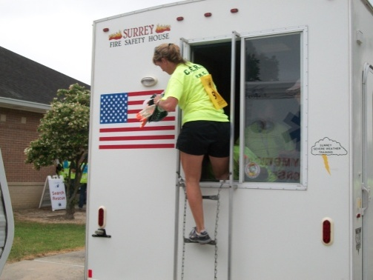
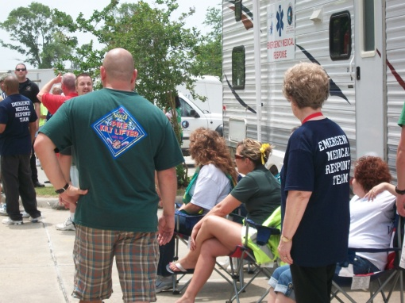
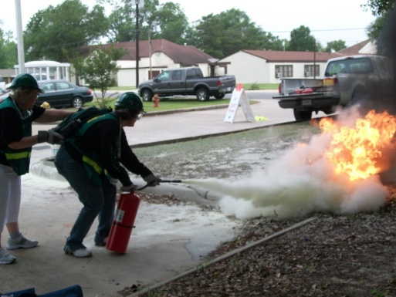
How Can an MRC Benefit Your Community
Resiliency not as reliant on state and national resources
Bolster public health and emergency response infrastructures
Information sharing between partner organizations

Slide 15
Medical Support We Provide
Crisis Counseling
Assist in Shelters
Triage
First Aid
Patient Tracking
Evacuation Triage
Mass Immunizations
Vaccinations
Medical Hotlines
Emergency Medical Services
Mental Health

Slide 16
Non-Medical Support We Provide
Forms and Information Distribution
Orientation
Education
Registration
Data Collection
Administrative
Clerical
Translators
Security
Transportation

Slide 17
Lt. Lafate Elliott Day, Jr.
Lafourche Parish Sheriff’s Office

Slide 18
Assists Law Enforcement Agencies
Reserves (various levels of training and assistance)
Can be set-up by individual agencies to meet their needs and expectations.
Explorers (Career Oriented Training and hands on assistance)
Pools resources and assists with manpower needs
Becomes a bridge between the public and the agency.

Slide 19
John Lane Assistant Chief Training Officer
Shreveport Fire Academy

Slide 20
Fire Corps is managed by Nation Volunteer Fire Council
Members of the Fire Corps represent every major fire service organization in the nation.
Supported by the United States Fire Administration and is funded through the Federal Emergency Management Agency and Citizen Corps.

Slide 21
Fire Corps is managed by Nation Volunteer Fire Council
Together these organizations work to create valuable resources and foster programs that will bring community members into local fire and emergency service departments to assist them with non-emergency tasks.
The foundation of their national initiative is to help local fire/EMS departments.

Slide 22
Timothy S. Gauthreau Jr.
Jefferson Parish Emergency Management

Slide 23
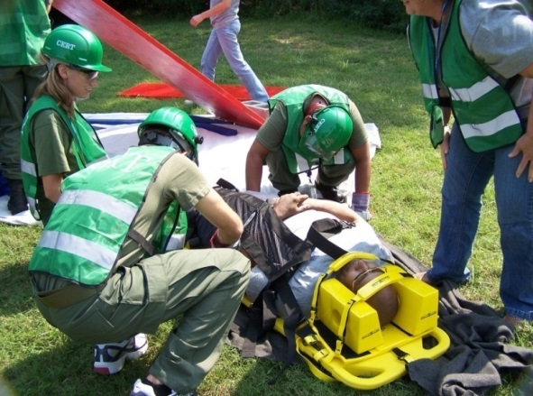
What is CERT?
Community Emergency Response Team (CERT) program educates people about disaster preparedness for hazards that may impact their area and trains them in basic disaster response skills, such as fire safety, light search and rescue, team organization, and disaster medical operations.

Slide 24
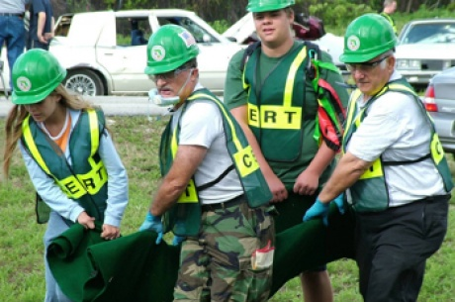
What Do We Do?
Using the training learned in the classroom and during exercises, CERT members can assist others in their neighborhood or workplace following an event when professional responders are not immediately available to help.

Slide 25
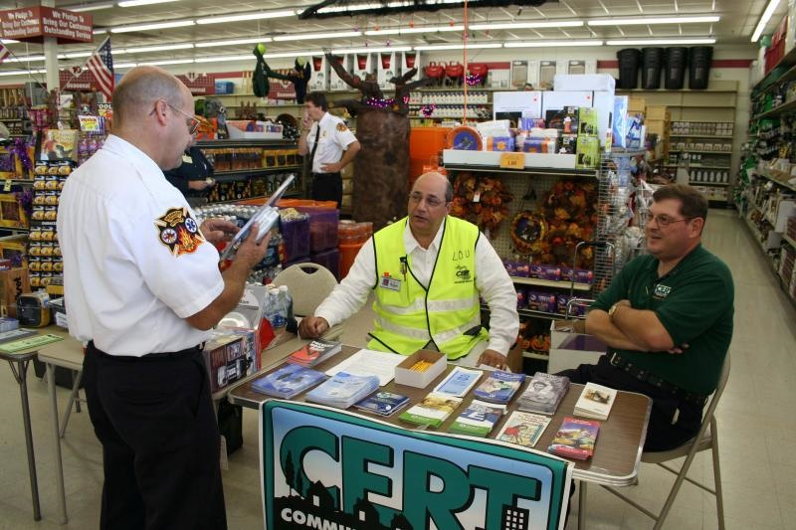
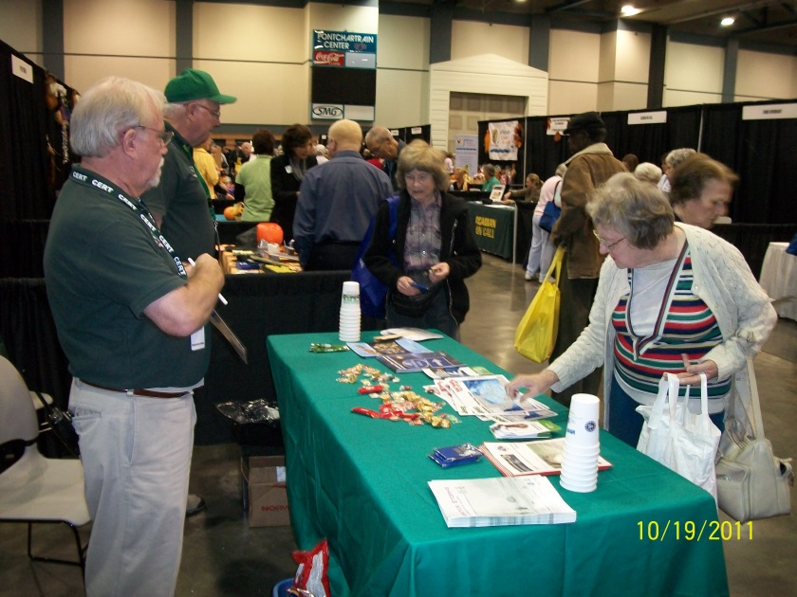
Non Emergency Roles
CERT members are also encouraged to support emergency response agencies by taking a more active role in emergency preparedness projects in their community.

Slide 26
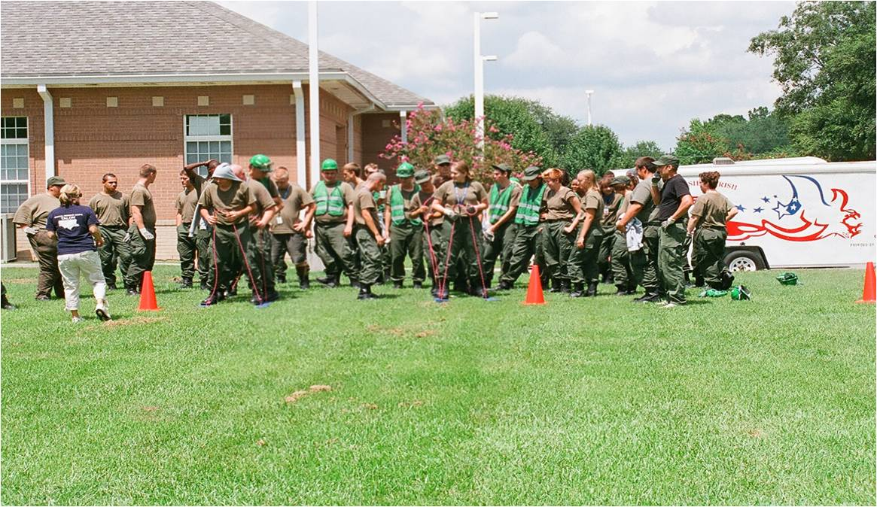
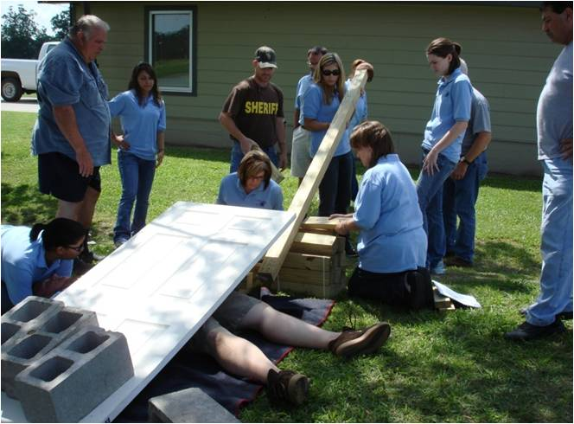

Slide 27
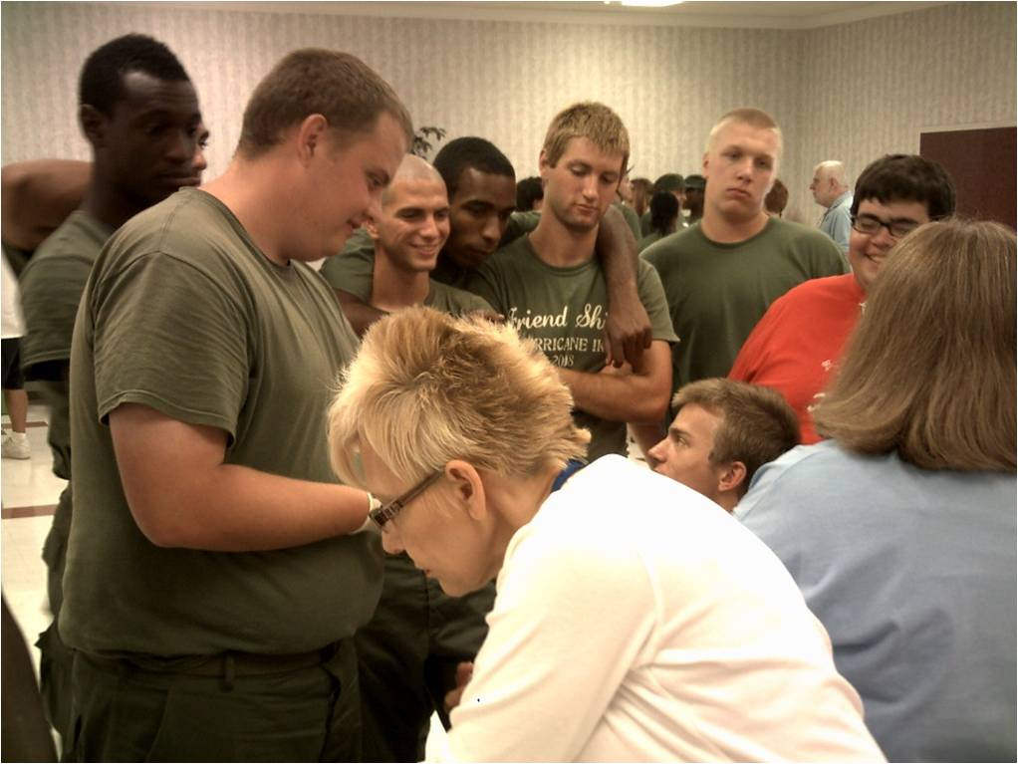
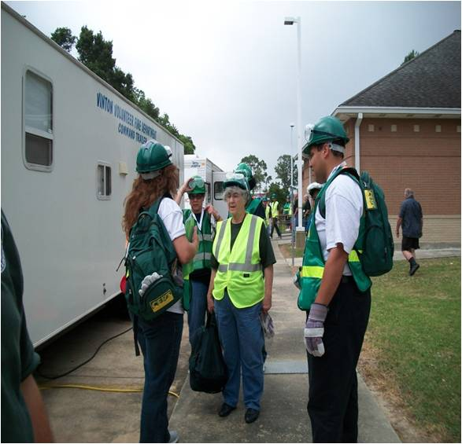

Slide 28
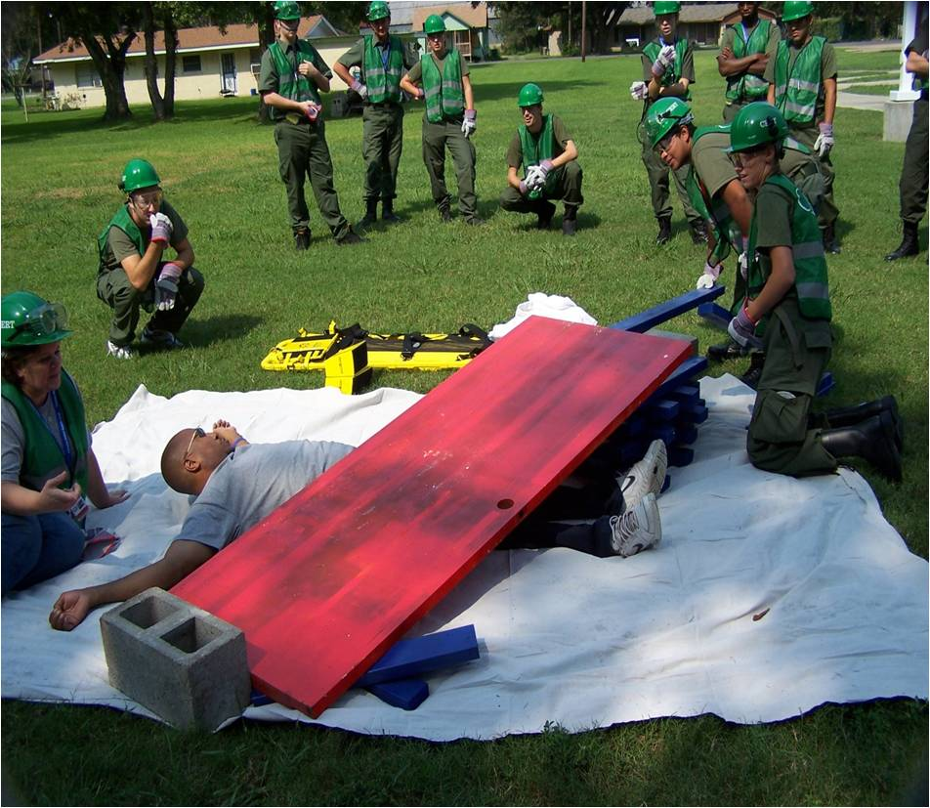

Slide 29
Upcoming Citizen Corp Sponsored Events
Cert Train the Trainer
Lake Charles
May 14-16, 2014
Teen CERT
Bunkie
June 23-27, 2014
Safety Town Expo
Lake Charles
July 26, 2014
Registrations will be sent out soon!

Slide 30
ARM YOURSELF:
ACTIVATE
RESPOND
MAKE A DIFFERENCE

Slide 31
Our Contact Info:
Angela Jouett -Calcasieu Medical Reserve Corps Coordinator and State Advocate for Citizen Corps
Tel. (337) 656-0839
ajouett@cppj.net
Lt. Lafate Elliott Day, Jr. -Lafourche Parish Sheriff’s Office
Tel. (985) 532-4327
Lafate-day@lpso.net
Timothy S. Gautreau Jr.- Jefferson Parish Emergency Management
Tel. (504) 349-5360
tgautreau@jeffparish.net
John Lane - ASST. Chief Training Officer
Tel. (318) 673-6766
John.lane@shreveportla.gov

