Slide 1
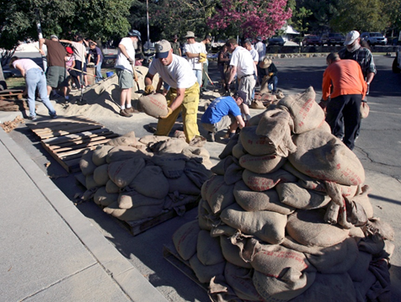
Public Assistance Grant Program
Donated Resources

Slide 2
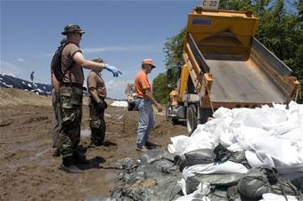
Donated Resources
Third party donated resources may be eligible to offset the non-Federal portion of the cost for emergency work.
Donated Resources are:
volunteer labor
donated equipment
donated materials
Notes:
The applicant is required to buy insurance in the amount of the eligible damages for flood and general hazards. Mention in future diasters the importance of obligating/deobligating.

Slide 3
FEMA Policy DAP 9525.2
Provides guidance as to when an applicant may be eligible to apply credit for the use of volunteers and donation in performing emergency work
Identifies eligible components of work
Calculation of Volunteer Value

Slide 4
DAP 9525.2 Eligibility of Donated Resources
The work must be authorized and documented by a local public official
Work must apply to emergency work organized by an eligible applicant. Examples include:
Debris Removal
Search and Rescue
Sheltering
Filing and Placing Sandbags

Slide 5
DAP 9525.2 Components of Work
Volunteer Labor: The rate charged for labor should be the same rate ordinarily paid for similar work with the applicant’s organization.
Donated Equipment: Shall be reimbursed at the FEMA Equipment Rate.
Donated Materials is based on the current commercial rate. Federal Donations may not be included.

Slide 6
DAP 9525.2 Calculation of Volunteer Value
Applicant must document all of the hours of volunteers, donated equipment hours, and costs of equipment to determine a total project cost.
The total credit is limited to the local cost share of emergency project worksheets.

Slide 7
Documentation of Volunteer Efforts
Local Governments are encouraged:
To establish ESF #6 to manage volunteers
Register and Document your volunteers
Track Name, Hours worked, location, and worked performed.

Slide 8
Documentation of Volunteer Efforts, cont.
Use of FEMA Force Account Labor form to document costs.
FEMA will typically develop a hourly rate for laborers
Use of the FEMA Force Account Equipment form and the FEMA equipment rates
Use of the FEMA Force Account Material form

Slide 9
Limitations
Donations credit is capped at the non federal share of emergency work.
Reasonable logistical support is an eligible cost
Donated Resources from another Federal grant or federally funded are not eligible

Slide 10
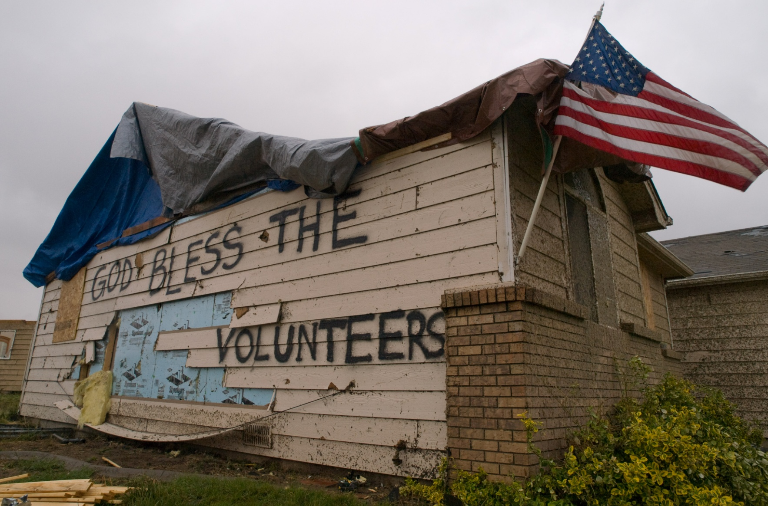
QUESTIONS?

