Slide 1
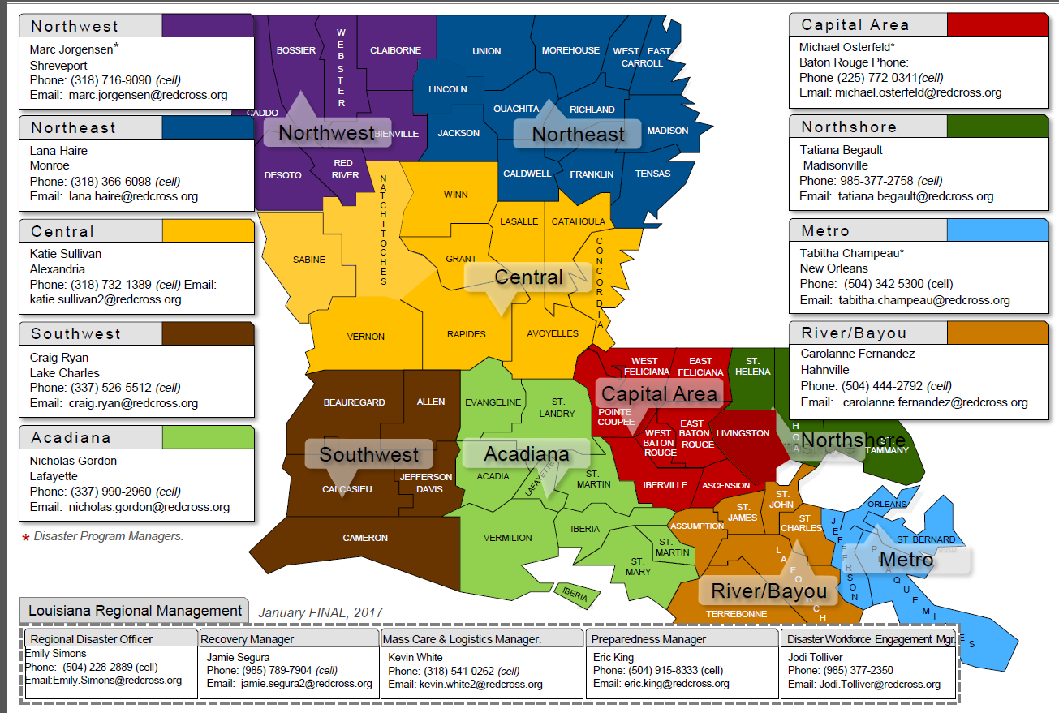
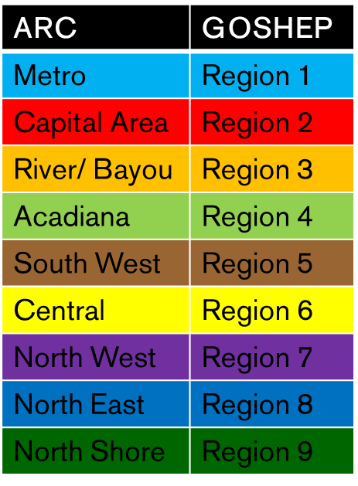
Red Cross Service Areas

Slide 2
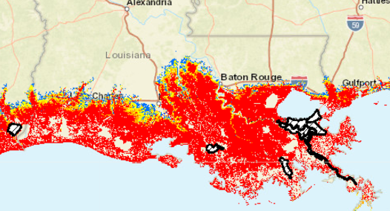
Region One Red Cross Sheltering
ARC does not participate in pre-landfall sheltering efforts that are within the Category Four Storm Surge or below

Slide 3
Region On Point-to-Point Shelters (Red = Red Cross Managed)
Parish From | Parish To | Shelter | Notified At | Open At | M/S/I/SS
St. Bernard | Region 6/ Alexandria | NSU-PE Majors Bldg | H-72 | H-52 | M
St. John | Region 8/ Monroe | Henrietta Johnson Rec Center | H-72 | H-40 | M
St. John | Region 8/ Monroe | Liller Marbles Rec Center | H-72 | H-40 | M
St. John | Region 8/ Monroe | Saul Adler Rec Center | H-72 | H-40 | M
St. John | Region 8/ Monroe | Thomas Jason Lingo Center | H-72 | H-40 | M
Plaquemine | Region 8/ Monroe | West Monroe Sports Complex | H-72 | H-40 | M
St. James | Region 9/ Madisonville | Amite Westside Magnet |  | H-9 | I
St. Charles | Region 9/ Madisonville | Hammond High School |  | H-6 | I
Terrebonne | Region 8/ Monroe | Monroe Civic Center |  |  | I

Slide 4
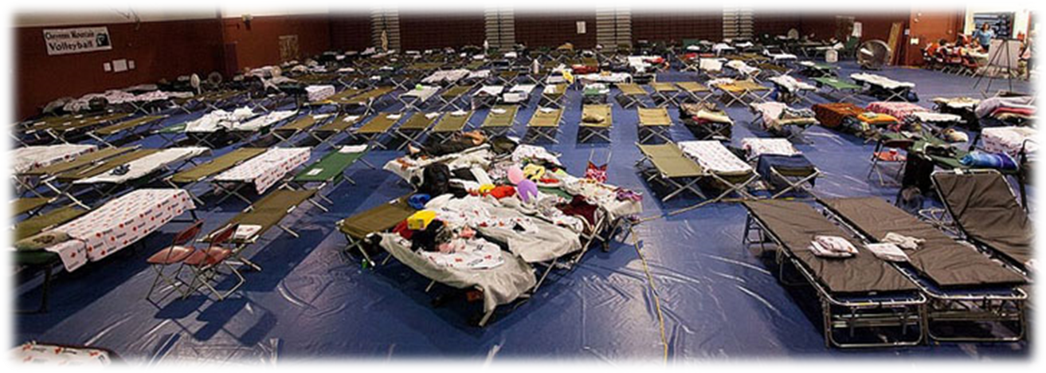
Sheltering
Shelter Management
”Operating a Shelter Checklist” Self-Study V.1.0 2017.08.30

Slide 8
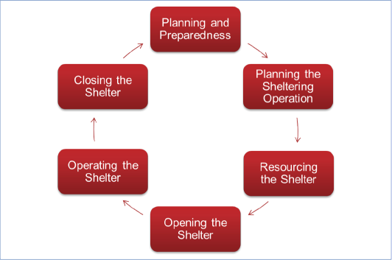

Slide 9
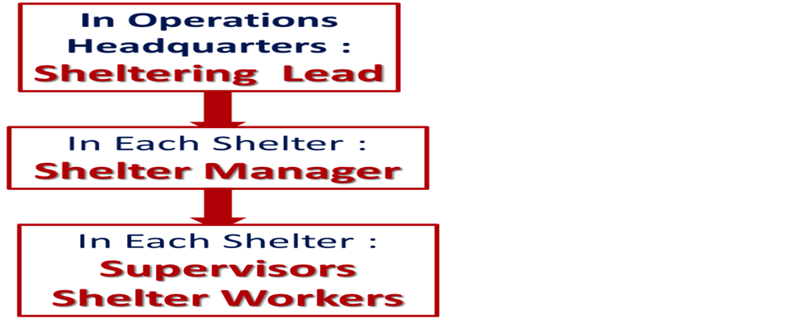

Slide 10
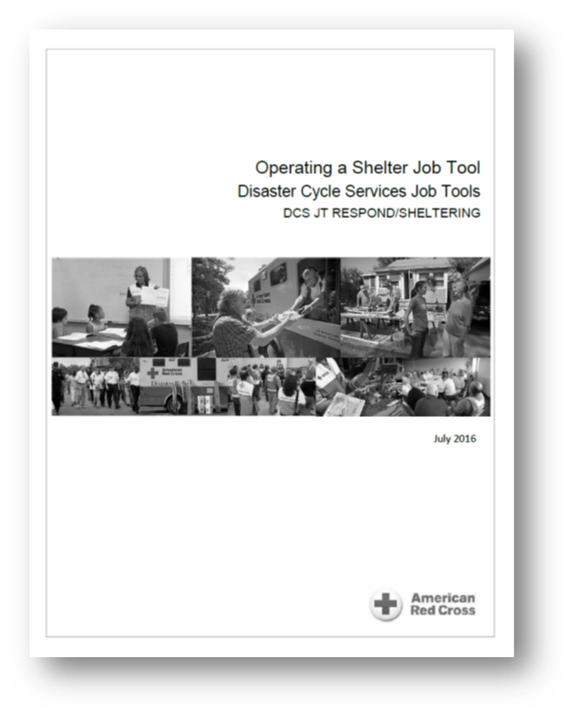
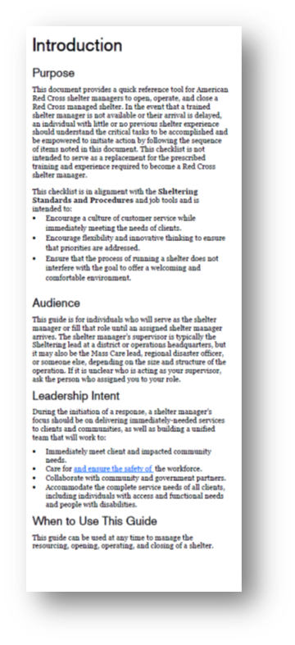
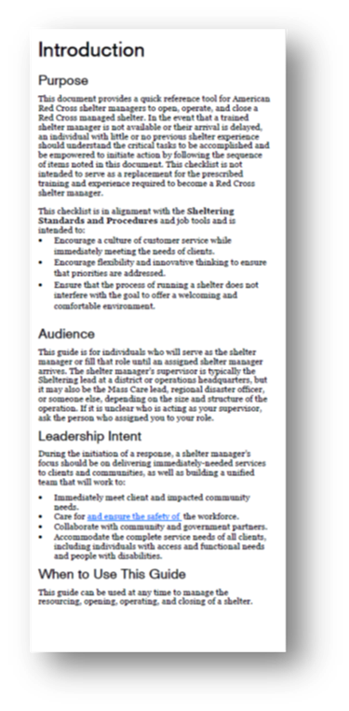

Slide 11
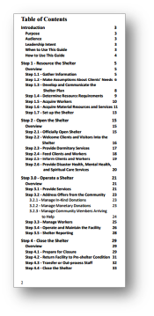
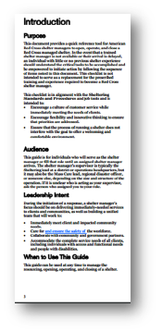
Operating a Shelter Job Tool

Slide 12
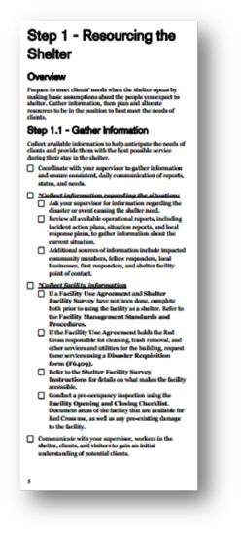
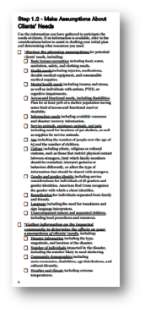

Slide 13
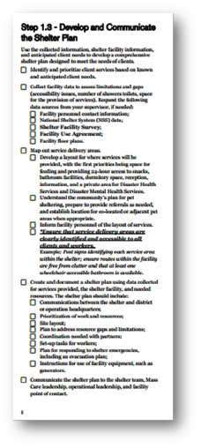
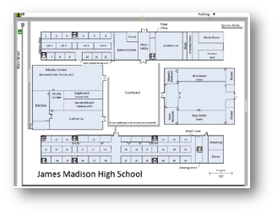
Notes:
Now we begin to develop and communicate our shelter plan.
The shelter manager makes an initial plan for the shelter. The manager will: map out the areas where services will be provided, making sure that all service delivery areas are clearly identified and fully accessible.
The plan will include: how the shelter will communicate with their district or headquarters, what tasks and resources need to be prioritized and how gaps will be addressed, the layout of services, partner coordination, an emergency plan in case there is an emergency within the shelter, instructions for using any specialized equipment in the shelter such as generators, and initial start up tasks for workers.
Once the plan is drafted, it will be communicated to all of the workers in the shelter, the facility point of contact, and leadership at the operation headquarters.

Slide 14
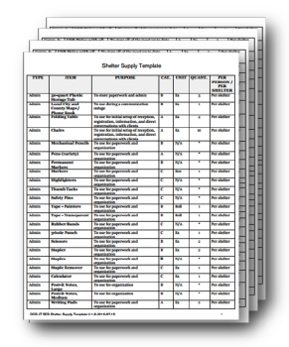
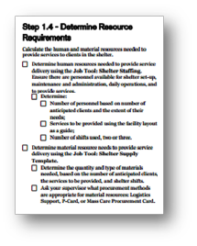
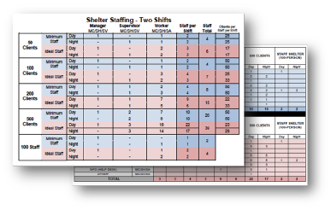
Notes:
Page nine directs the manager to two tools available to use in determining the personnel and material needs in a shelter, the Shelter Staffing Tool and the Shelter Supply Template.

Slide 15
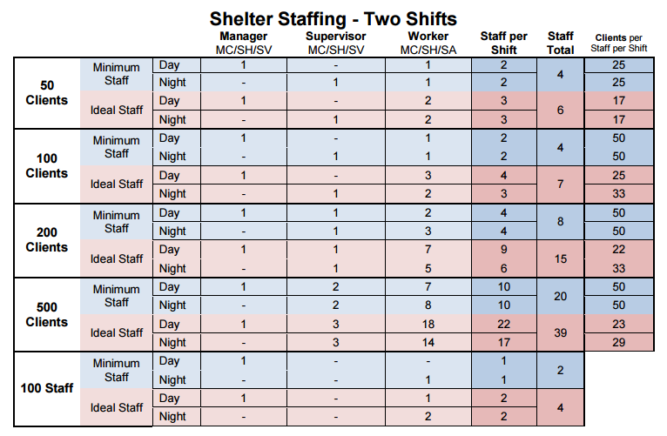
Shelter Staffing

Slide 16
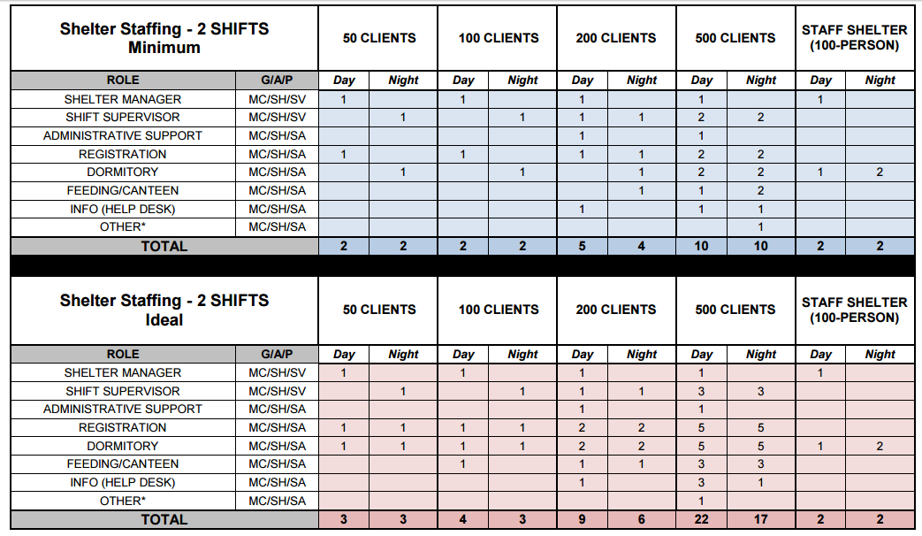
Shelter Staffing

Slide 17
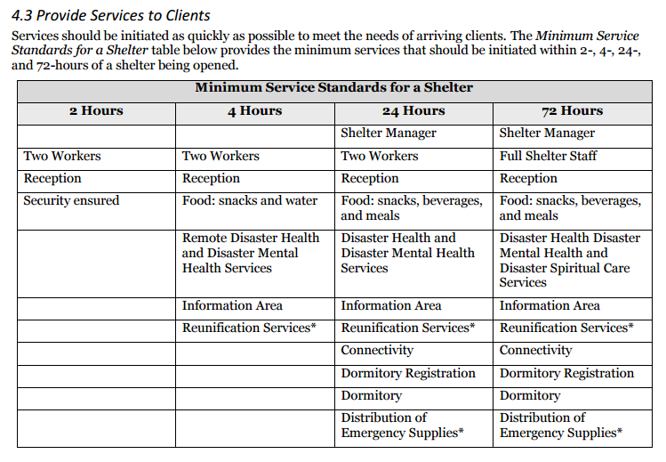
Minimum Service Standards for a Shelter

Slide 18
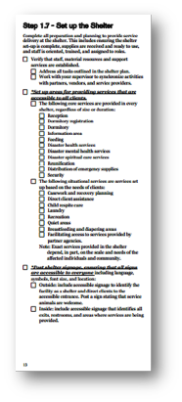
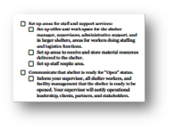

Slide 19
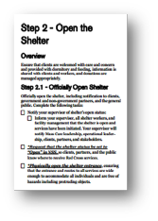
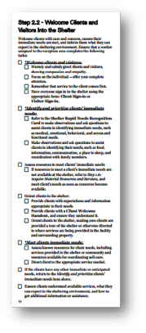
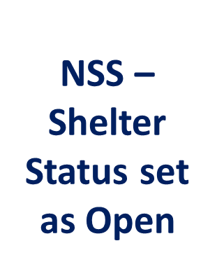

Slide 20
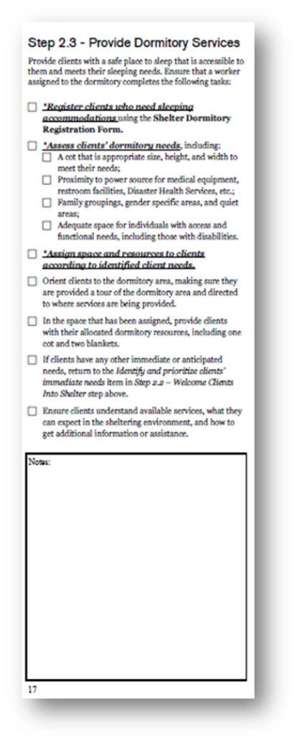
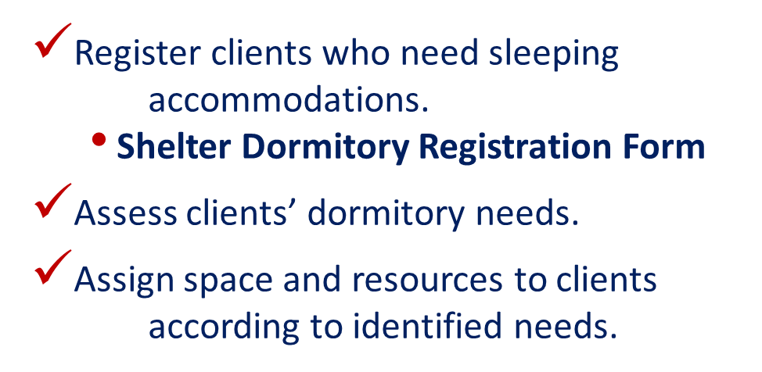

Slide 21
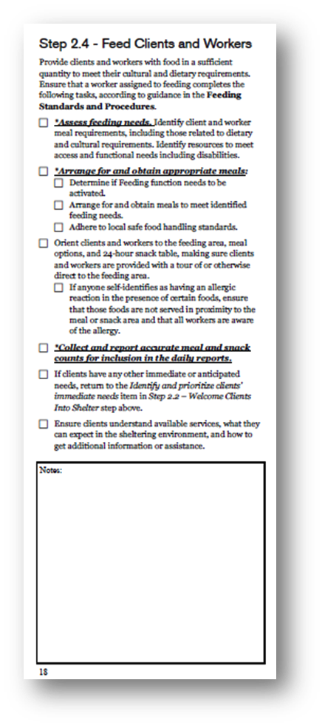
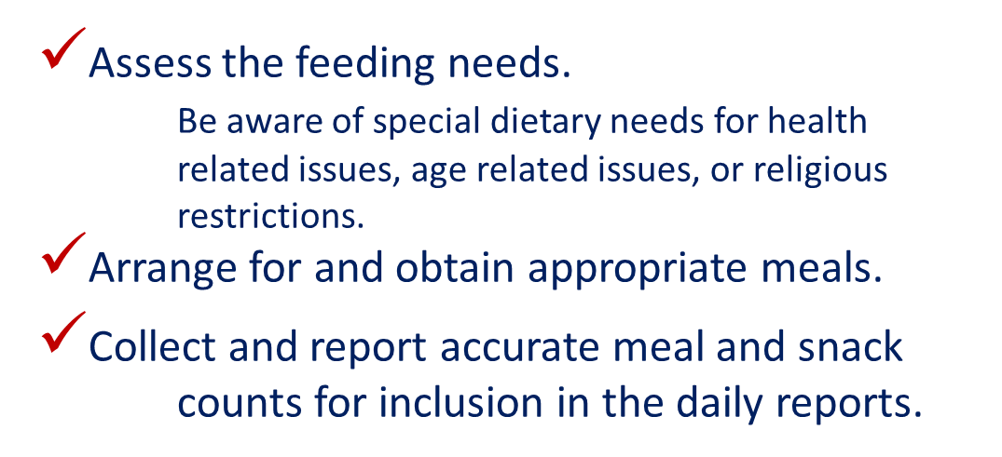
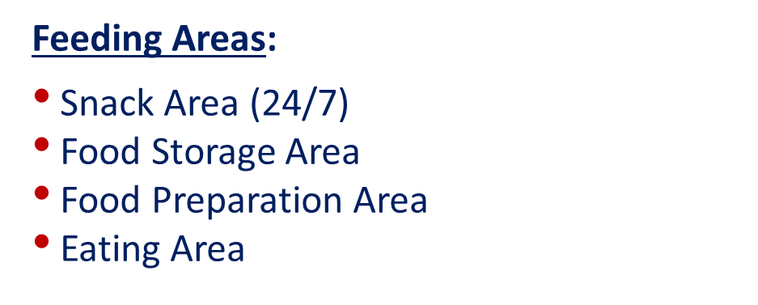

Slide 22
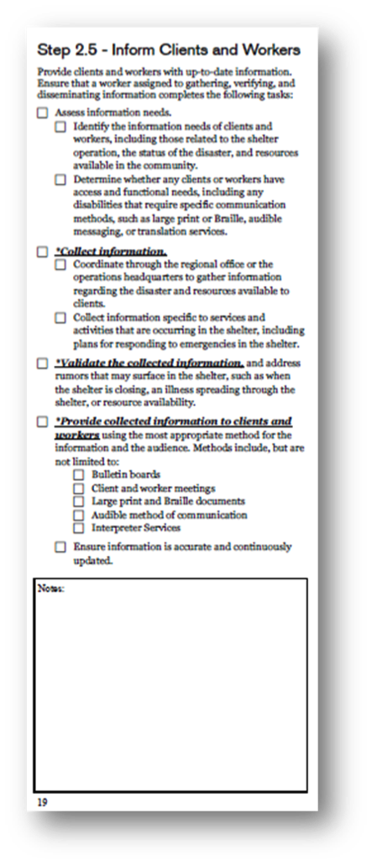
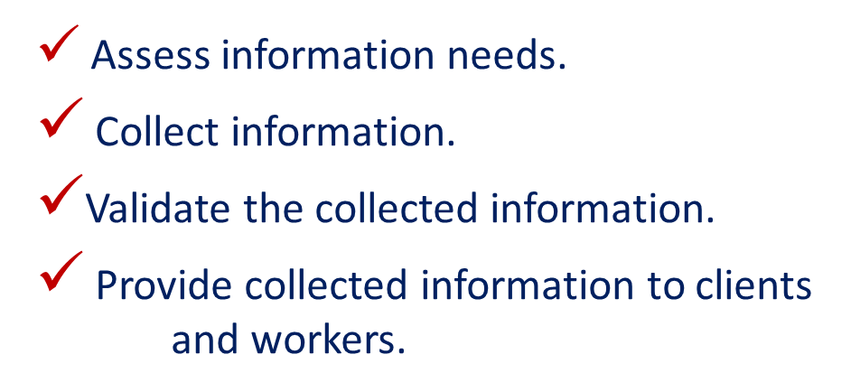
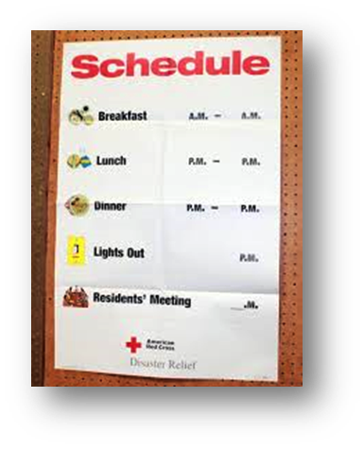
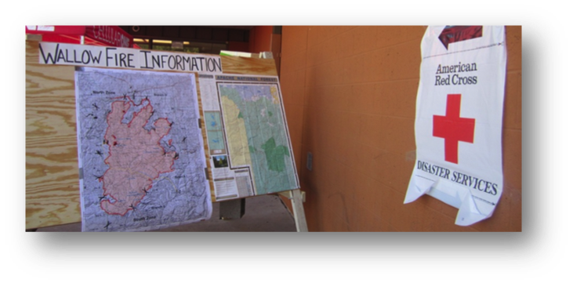

Slide 23
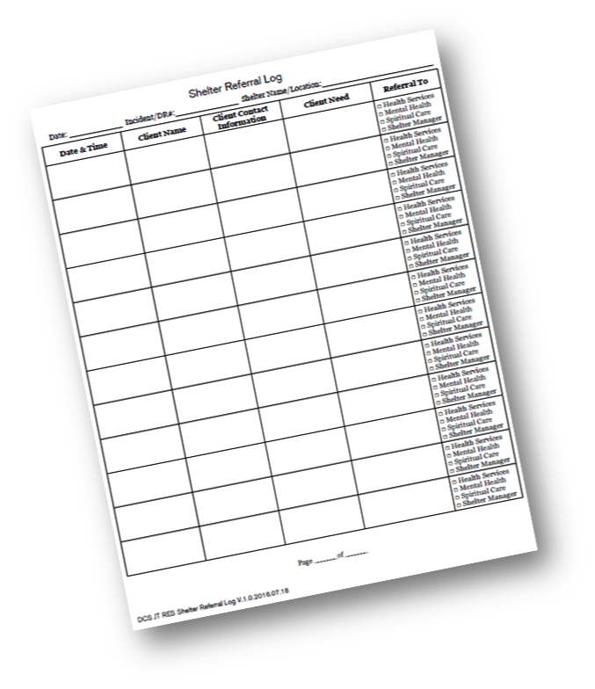
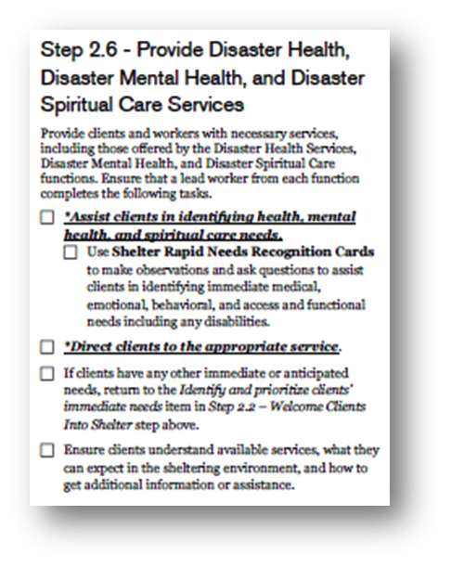

Slide 24
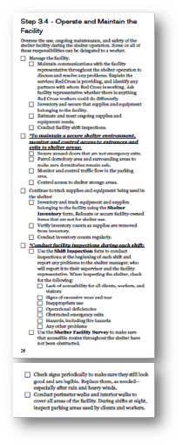
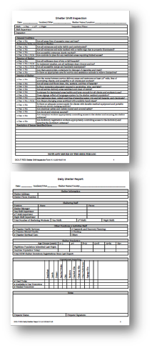
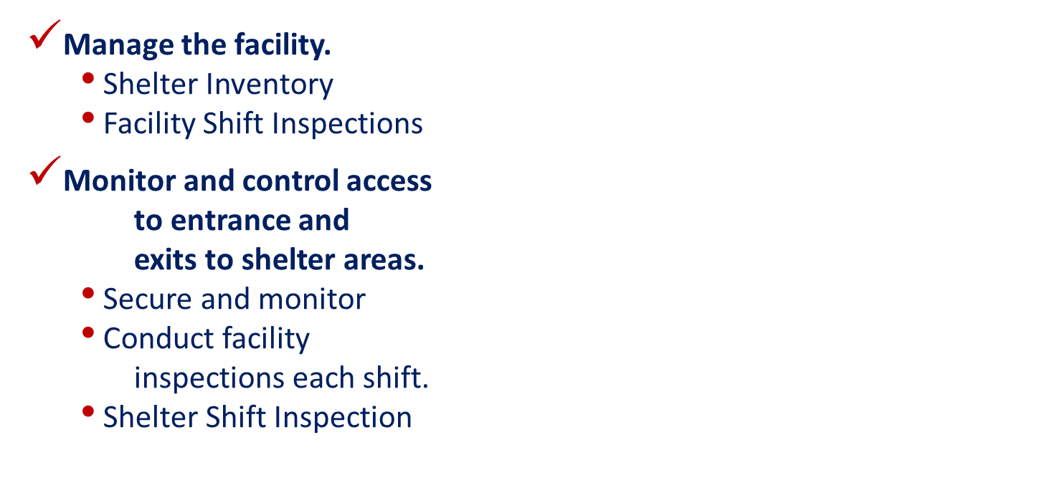

Slide 25
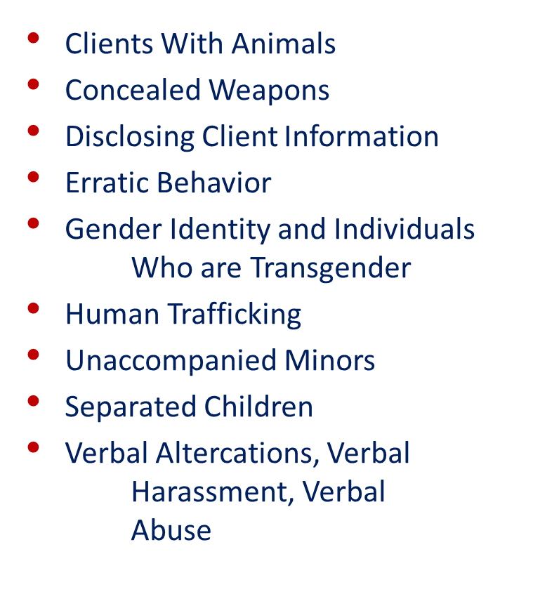
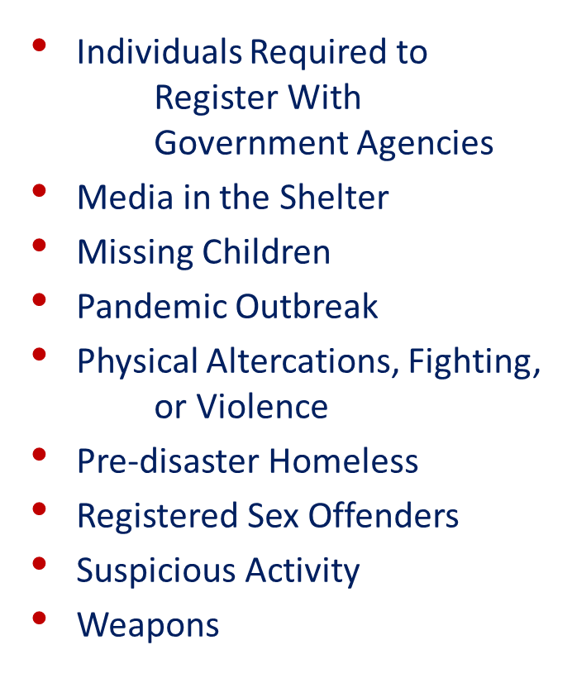

Slide 26
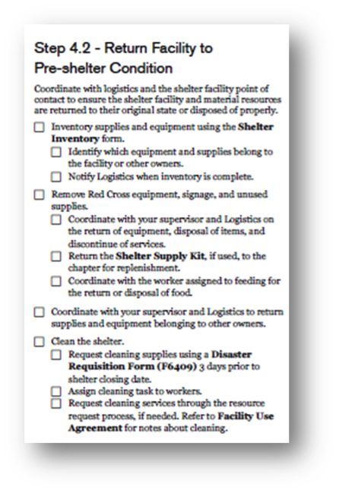
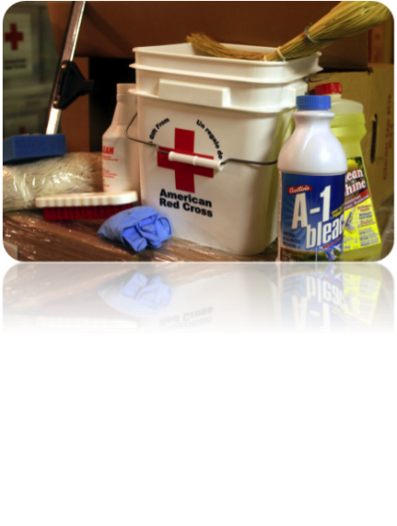

Slide 27
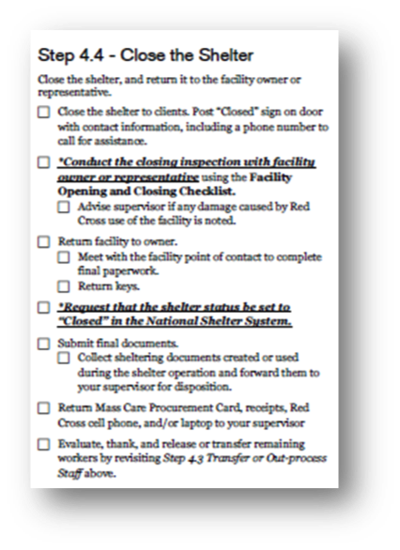

Slide 28
MASTTF
Multi-Agency Shelter Transition Team/Task Force - MASTTF
Definition of MASTT or MASTTF – Multi-Agency Shelter Transition Team/Task Force is an approach that looks for transitional or permanent housing solutions for disaster survivors through a multi-agency approach using immediate casework from all available stakeholders
History - 2016
MASTT is not a new concept. We have done this in an informal manner for years
No doctrine or written guidance (federal or otherwise) existed on transitioning survivors from sheltering to interim housing

Slide 29
A New Approach
TSA
We needed to look at Shelter Transitioning in a whole community approach
Client in Shelter
Stability
Local Housing Experts
IHP
Instead of working through a continuum of options, case workers can use the concept to build a recovery plan that will best address the needs of the client
To re-energize this strategy, we established a Shelter Transition Workgroup consisting of representatives from the whole community

Slide 30
Multi-Agency Shelter Transition Workgroup
The Project Plan called for:
Revising the Shelter Transition Appendix of the Multi-Agency Sheltering/Sheltering Support Plan Template
Develop a document that outlines the shelter transition process
Develop a sample Shelter Transition Team operational procedure
Develop checklists and other job aids on shelter transition oriented to local emergency managers
This work plan was presented at the 2016 National Hurricane Conference
In 2017 we reported on the progress of the Plan along with the sub-work groups at the NHC
In 2018 we can report that the document is completed

Slide 31
Use of MASTFF in 2016
In 2016 the MASTTF process was used to transition over one thousand residents out of shelters in Louisiana to temporary or permanent housing options
Lessons Learned in Louisiana were:
No one size fits all approach
All agencies (on the MASTT) needed to be on board and committed to the cause
HUD and Homeless Coalition as well as Independent living centers were key to our success

Slide 32
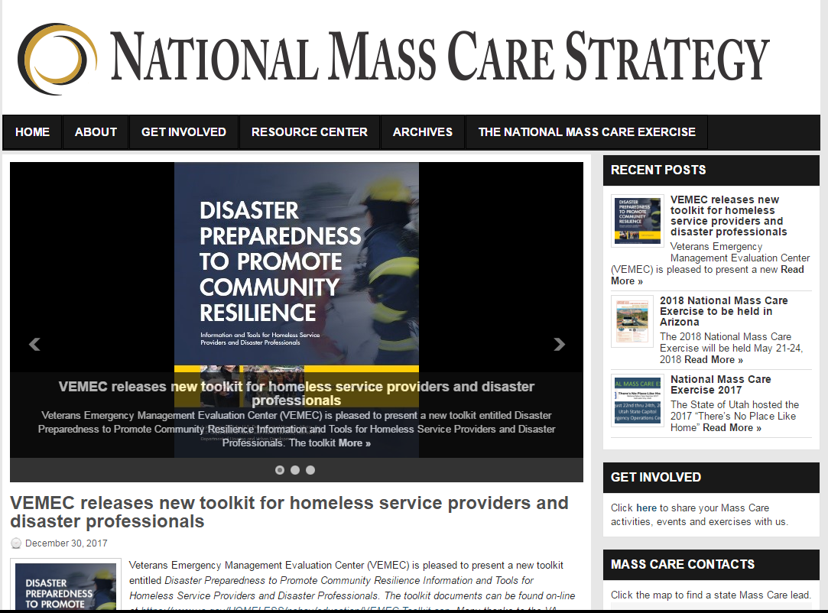
We’ve made progress
2018 Continuing engagement between Red Cross, FEMA, & HUD
Many lessons were learned as and the Red Cross, FEMA and HUD, committed resources to address disaster sheltering needs of the impacted populations.
Agreed on an agency level that we would commit to supporting MASTT
MAST Appendix to the Multi-Agency Sheltering/Sheltering Support Plan Template (available on the National Mass Care Strategy Website)

Slide 33
Next Steps
Understand how the variables enhance, support community outcomes after a disaster
Achieve multi-agency consensus, agreement, and training on MASTTF concepts
Develop interagency AND intra-agency training
Achieve multi-agency agreement on a tool to capture data from shelter clients (e.g. Survey123, HMIS)
Ensure the MASTTF concepts are flexible to each shelter, jurisdiction, state, tribe or territory
Initial casework and ongoing case management

