Slide 1



Governor’s Office of
Homeland Security & Emergency Preparedness
Annual GOHSEP Conference
OHSEP Directors + Staff
May 4th and 5th, 2016

Slide 2


Annual GOHSEP Conference
OHSEP Directors + Staff
Director’s Update

Slide 3
Welcome Comments
James “Jim” Waskom
  Director
  Governor’s Office of Homeland Security
  and Emergency Preparedness
  James.Waskom@la.gov
  (225) 925-7345, office

Slide 4
Annual GOHSEP Conference
OHSEP Directors + Staff
A Look Forward

Slide 5
Annual GOHSEP Conference
OHSEP Directors + Staff
Grants and Administration

Slide 6
Preparedness Grants
FY 2016 Notice of Funding Opportunity Announcement (NOFO): February 2016
  Emergency Management Performance Grant (EMPG)
    $5,640,547 ($9,554 reduction from FY 2015)
  Homeland Security Grant Program (HSGP )
    State Homeland Security Program (SHSP)/Operation Stonegarden (OPSG)
    $3,978,000 (same award as FY 2016)
Regional OHSEP Directors and First Responders Subcommittees approved using FY 2015 grant allocation formula
  $25,000 base and the remaining amount on population
Anticipated Federal Award: Summer 2016
  Parish awards to follow within 2 weeks

Slide 7
Legislative Sessions
March 10th – June 6th, Regular Legislative Session
  FY 16/17 Executive Budget
    Testified to House Appropriations and will testify soon to Senate Finance
    Proposed Amendments:
      Increase in State General Fund for GOHSEP
      Full funding for current FEMA Debt
      $11.4 million for LWIN software upgrade/console replacement
  Monitoring any legislative instruments of interest
Additional Special Legislative Session, possibly June 7th
  Address revenue needs

Slide 8
Annual GOHSEP Conference
OHSEP Directors + Staff
Preparedness, Response & Interoperability

Slide 9
Operations
State EOC maintained an open dialogue with parishes throughout recent events. Will continue to follow that model in future events.
  Phone calls
  Emails
  WebEOC requests
Parish to Parish assistance during the recent flooding events and tornado outbreak was extremely beneficial to the success of the response effort:
  Numerous parishes stepped up to help out when resources at the state level were exhausted including; heavy equipment, sandbags, transportation and personnel.
Request WebEOC training for your parish EOC staff working in your EOC during an activation.

Slide 10
Training
Numerous Training Opportunities through GOHSEP
  Visit our website for a comprehensive course listing: www.gohsep.la.gov
  Contact GOHSEP Training for other interest/needs not listed: gohseptraining@la.gov
Highlights of upcoming courses:
  National Emergency Management Basic Academy to begin in 2016
  ICS-300 & 400
  L548 COOP Managers Course
  L550 COOP Planners Workshop
  Communications Unit Leader Course (COML)
  AWR-147 Rail Car Incident Response

Slide 11
Exercises
State Wide Exercise/Vigilant Guard
  April 11-16
Severe Weather/Flooding Event
  Regional AARs, May 2016
School Emergency Management Planning Regionalized
  May-July 2016
Radiological/Nuclear
  Later in 2016
Port Security Tabletop
  June 8, 2016
New Orleans Large-Scale Aviation Accident Response
  June 2016

Slide 12
Planning
2016 State Emergency Operations Plan (EOP) update
  Scheduled for Governors signature by August 2016
Two new All Hazards Planners
  Begin Mid May
National Disaster Recovery Framework (NDRF):
  Recovery Support Function Planning
  Governor Appointed GOHSEP Director as Recovery Coordinator

Slide 13
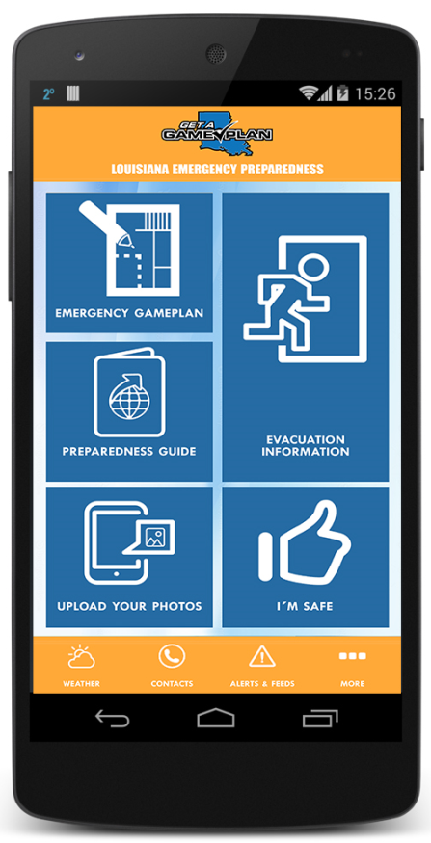


GOHSEP Preparedness Apps
Originally two (2) Apps
  Get A Game Plan
  Get a Business Plan
  Consolidated to one (1) Preparedness App
Outdated and high cost to upgrade
Removed from iTunes
Redesigning to one (1) App
  OTS contractor support (no cost to GOHSEP)
  Tentative start date, June 2016

Slide 14
Website Updates
GOHSEP staff is working with the Office of Technology Services to update the following websites:
  www.emergency.la.gov
  www.GetAGamePlan.org
More user friendly
Able to update information quicker
Tentatively scheduled for release, Summer 2016

Slide 15



Louisiana Business EOC (LA BEOC)
State Public-Private Partnership
Extensively active in flood response
  Coordinated and secured critical resources:
    Bottled water
    Cleaning and packing supplies for residents
    Pallets for sandbag operations
    Response personnel
Planned Outreach:
  Conduct LA BEOC member meetings held at NIMSAT
  Host tabletop exercise with GOHSEP and stakeholders
  Participate in parish Chamber of Commerce meetings
  Continued development of the LA BEOC website and portal
Notes:
Additionally we consider what supply chains, materials, goods and services are needed and available post event. Through the Louisiana Business Emergency Operations Center or LA BEOC, GOHSEP looks to Louisiana businesses first to ensure supply chains in the aftermath of an emergency or disaster.
Using local businesses to provide immediate support expedites the recoveries of those businesses, as opposed to purchasing and shipping supplies in from out of state.

Slide 16
Sheltering
GOHSEP continues to work with the following parishes to develop additional Point to Point Sheltering capacity between At Risk and Host Parishes
  *St. Mary has an agreement in place with Rapides Parish when Rapides Parish Coliseum renovations are complete
Host | At Risk
Caddo | Calcasieu
Concordia | Jefferson
Lincoln | St. Mary (*2016 season)
Union | Open

Slide 17
Sheltering
Continue to seek additional Host Parishes to help reach our goal of becoming 100% shelter independent.
Partnering with the Department of Education to develop a plan to use Colleges and Universities or other State facilities throughout the state for future sheltering operations.

Slide 18
Fusion Center/Cyber
Suspicious Activity Reports (SARs) have increased:
  On-line website, hot line, “See Something, Send Something” App, National Response Centers (NRCs), LSP Hazmat, and regular telephonic reports.
Fusion Liaison Officer (FLO) training continues
  Over 350 trained FLOs
  LA-SAFE has begun satellite classes across the state to reach more
GOHSEP/LA-SAFE developed a regional Awareness Workshop for “All crimes, All hazards” with emphasis on Cyber.
  Delivered to Desoto Parish Sheriffs Office. Working on regional training this summer.
LA CBRNE Working Group planning for workshop in fall 2016.
NEW!! LA Food/Ag and Water Working Group established and will be joining other conferences, e.g., LRWA in Alexandria this summer.
Cyber Awareness Briefing developed and available on request.

Slide 19

Annual GOHSEP Conference
OHSEP Directors + Staff
Disaster Recovery

Slide 20
Disaster Recovery
Final Recovery Initiative - FEMA & the State are pushing hard to identify & cost all unidentified damage related to Hurricanes Katrina/Rita
Public Assistance (PA) - FEMA is pushing hard to show progress in recovery through closeout of PA projects
  Applicants should expect to see more activity to finalize documentation requirements to support the closeout effort

Slide 21
Disaster Recovery
Hazard Mitigation (HM):
  FEMA is pushing to get all HM funding ($2.4 billion) “obligated” (i.e. all projects approved)
  GOHSEP will increase activity with Parishes to assist in getting projects to the obligation phase
    Focusing on Gustav/Ike
Outreach:
  Targeted parish conference calls with GOHSEP/FEMA/Parish to discuss technical and EHP issues.

Slide 22
Annual GOHSEP Conference
OHSEP Directors + Staff
Other Events

Slide 23
FEMA Monitoring Visit
February 2016
  2 observations that affect subrecipients: (EHP, Closeout Strategy)
June 2016, FEMA’s Homeland Security Grant Program (HSGP) Site Visit
  FY 2013 + 2014 Programs
  Site Visit to New Orleans and potentially other Region 1 agencies

Slide 24

National Homeland Security Conference
Tampa Bay, Florida
June 28-30, 2016
2016 Tracks/Topics:
Recent Events
Training for Preparedness
Grant Management
Emergency Medical Response
Port and Transit Security
Intelligence + Information Sharing
Whole Community Preparedness
Public Safety
National Counter Terrorism Center
http://nationaluasi.com/dru/

Slide 25
Annual GOHSEP Conference
OHSEP Directors + Staff
Questions

Slide 26

FIND US ON THE WEB
+
gohsep.la.gov
getagameplan.org

