Slide 1
DSNAP Site Assessment and Logistics
19-20 FEB13

Slide 2
DSNAP MISSION
Provide victims of a disaster with relief benefits in the most expeditious manner possible
Federal program administered by USDA FNS (Food and Nutrition Service)

Slide 3
DSNAP GOAL
Provide DSNAP benefits to qualified victims of a disaster with a reduced wait time and lines to receive the benefits

Slide 4
DSNAP Sites Status (as of 4 Jan 13)
Claiborne
Union
Morehouse
West
Carroll
Bossier
East
Carroll
Webster
Lincoln
Signed CEA
Caddo
Ouachita
Richland
Madison
Bienville
Jackson
Unresolved issues
De Soto
Red River
Caldwell
Franklin
Tensas
Waiting Signatures
Winn
Natchitoches
Catahoula
OFS office
Sabine
Grant
La Salle
Concordia
No site identified
Vernon
Rapides
Avoyelles
West
Feliciana
East
Feliciana
Washington
St.
Helena
Beauregard
Allen
Evangeline
Pointe
Coupee
East
Baton
Rouge
Tangipahoa
St. Landry
West
Baton
Rouge
Livingston
St. Tammany
Jefferson Davis
Acadia
St. Martin
Iberville
Calcasieu
Lafayette
Ascension
St.
John
St.
James
Orleans
Cameron
Vermilion
Iberia
Assumption
St.
Charles
St. Bernard
St. Mary
St. Martin
Jefferson
Lafourche
Plaquemines
Terrebonne

Slide 5
SITES ASSESSMENTS
The following assessments / agreements are needed per site:
Cooperative Endeavor Agreement
Emergency Lease Agreement
Parking
Security
Ingress / Egress
AC / Heat
Internet Connectivity
Layout Interior / Exterior
Traffic Flow / Patterns
Comfort Station needs
Commodity Needs
Medical Monitoring
Lighting

Slide 6
Lafourche Parish DSNAP
South Lafourche Library 16241 E. Main St. Cut Off, LA 70345
Historical Data: 15,667
Sf. 1,860
Site POC: Mr. Chiquet 985-632-7140
Site Manager: Mike Jones 985-857-3621
985-859-0058

Slide 7
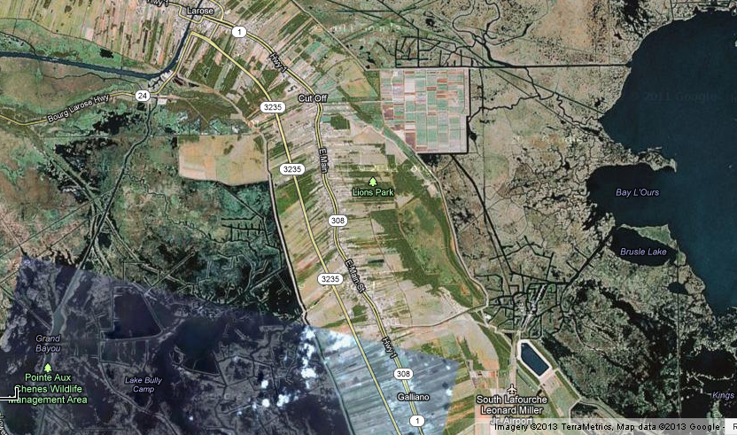
South Lafourche Library

Slide 8
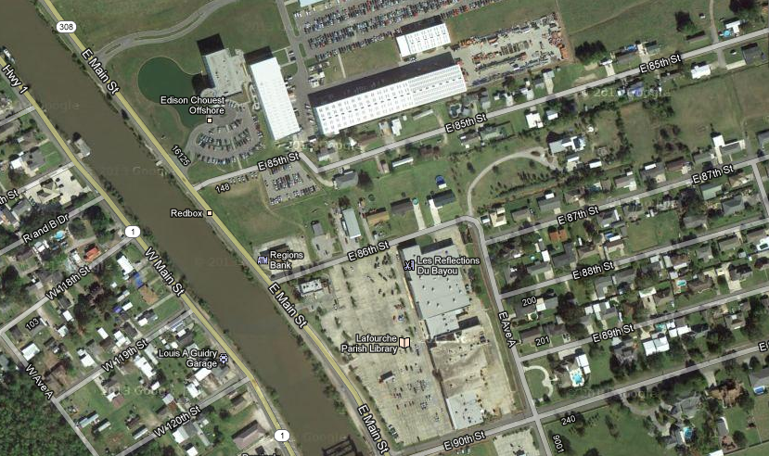

Slide 9
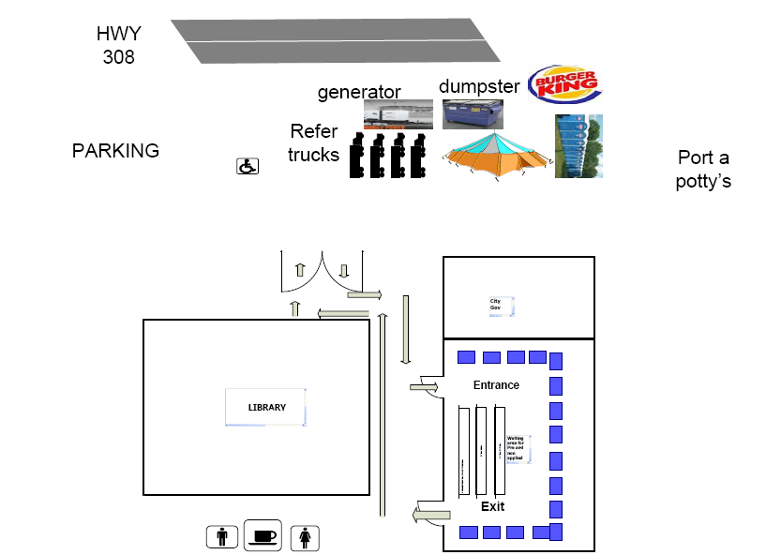

Slide 10
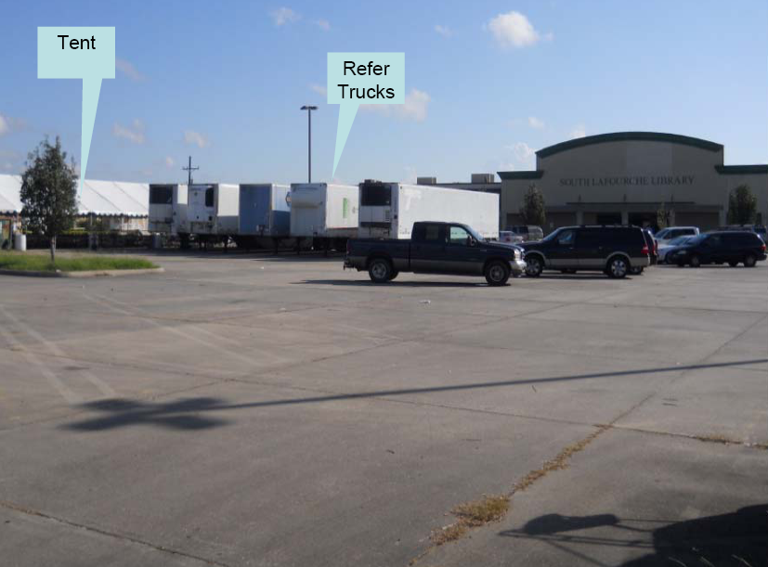

Slide 11
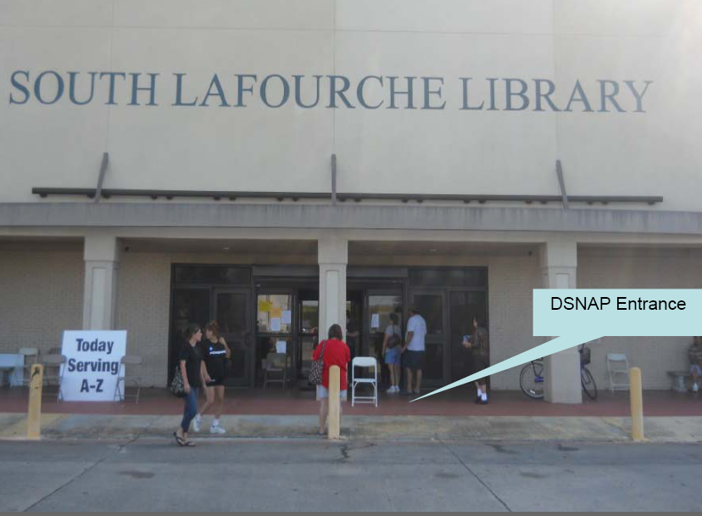

Slide 12
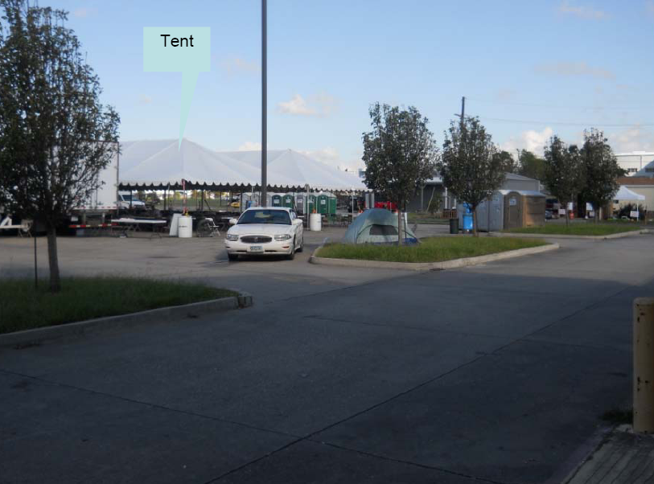

Slide 13
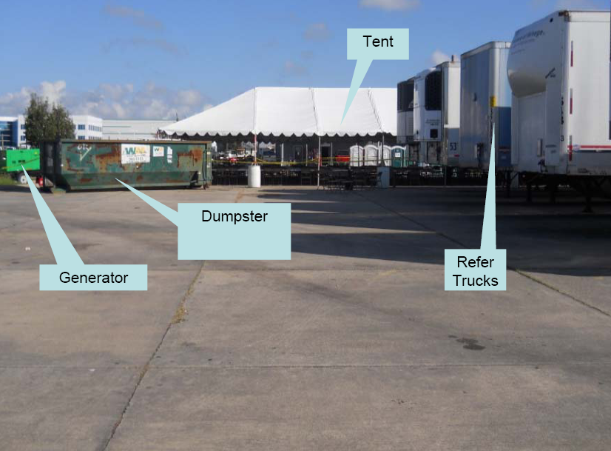

Slide 15
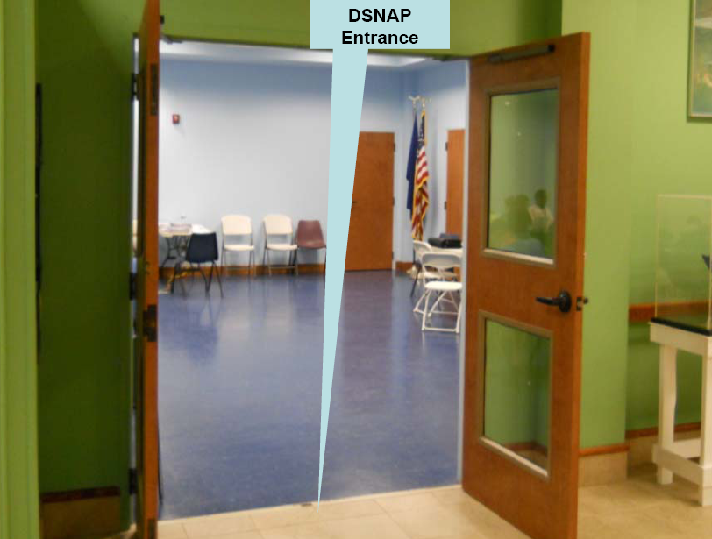

Slide 16
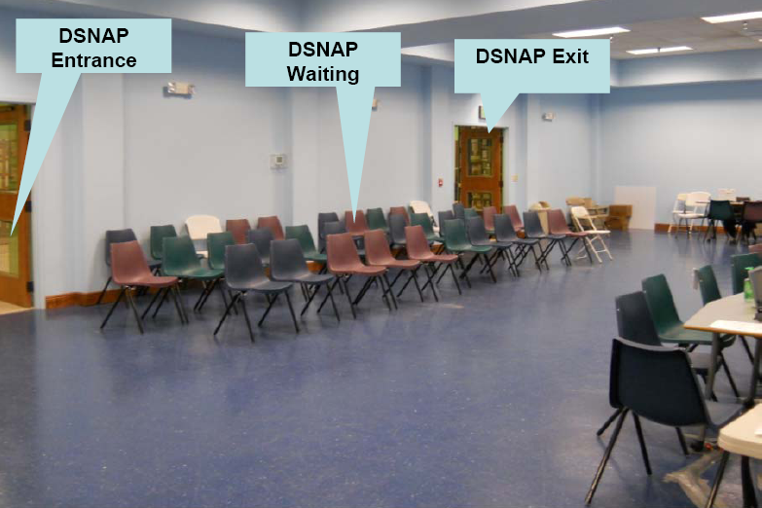

Slide 17
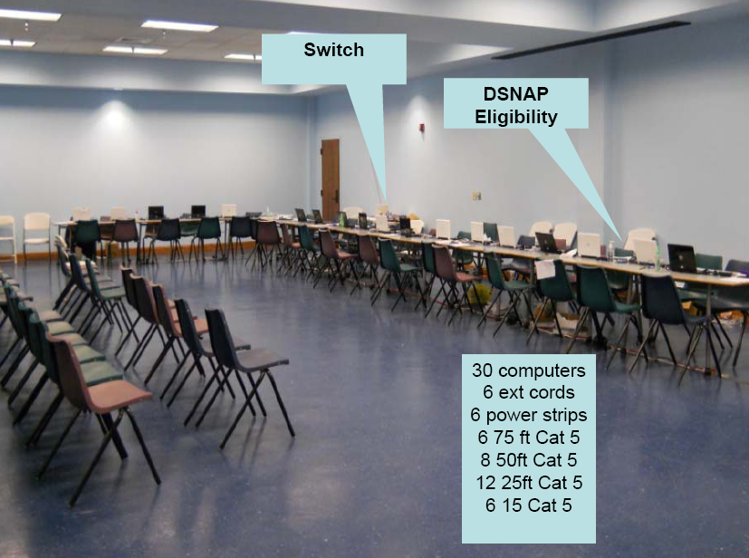

Slide 18
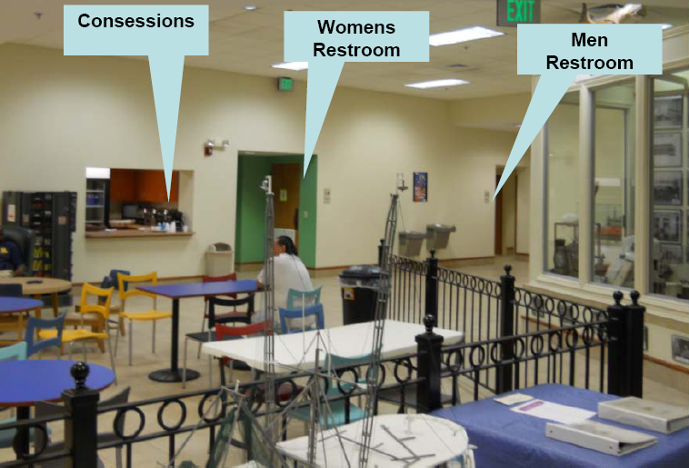

Slide 19
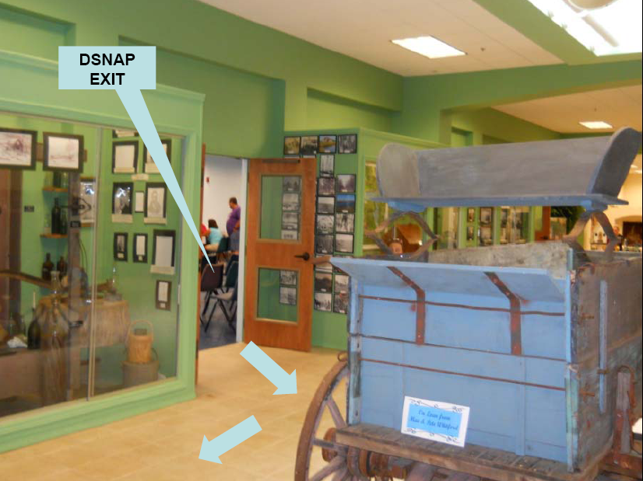

Slide 20
STAFFING NEEDS
DCFS Staff
Eligibility
Processing
Greeter
Management
Stakeholder Staff
Security
Medical Monitoring
Traffic Control

Slide 21
COMFORT STATIONS
Comfort Stations
NIMS Typed
Tents
60’ x 100’
67 tables
500 chairs
Fans
20 kw generator
Lighting package
Bottled water
1 on site resource / package manager
24 hour resource security (not crowd security)
12 portapotties (1 ADA Compliant) with cleaning
Dumpsters / trash cans / can liners

Slide 22
RESOURCE NEEDS EXTERNAL
DOTD
Variable Message Boards
Super Cone
Rope
Signage
Light Plants
Transportation (Buses)
LNO at trans points
LSP / Local LEA
Security
DHH
Ambulances / Medical Monitoring

Slide 23
RESOURCE NEEDS INTERNAL
LWC
Meals for employees
3x daily
Snacks for clients
LSP / Attorney General Office / Local LEA
Security
DHH
Ambulances / Medical Monitoring
Eligibility Staff
Translators

