Slide 1
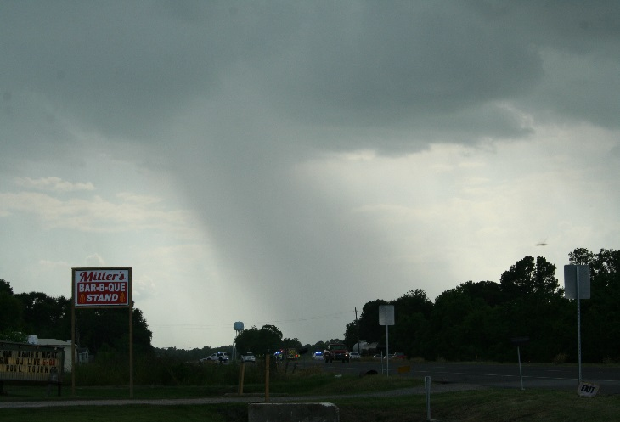
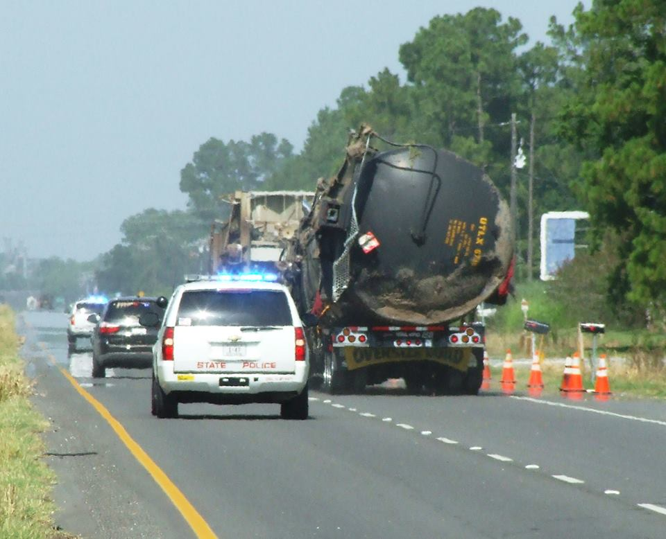
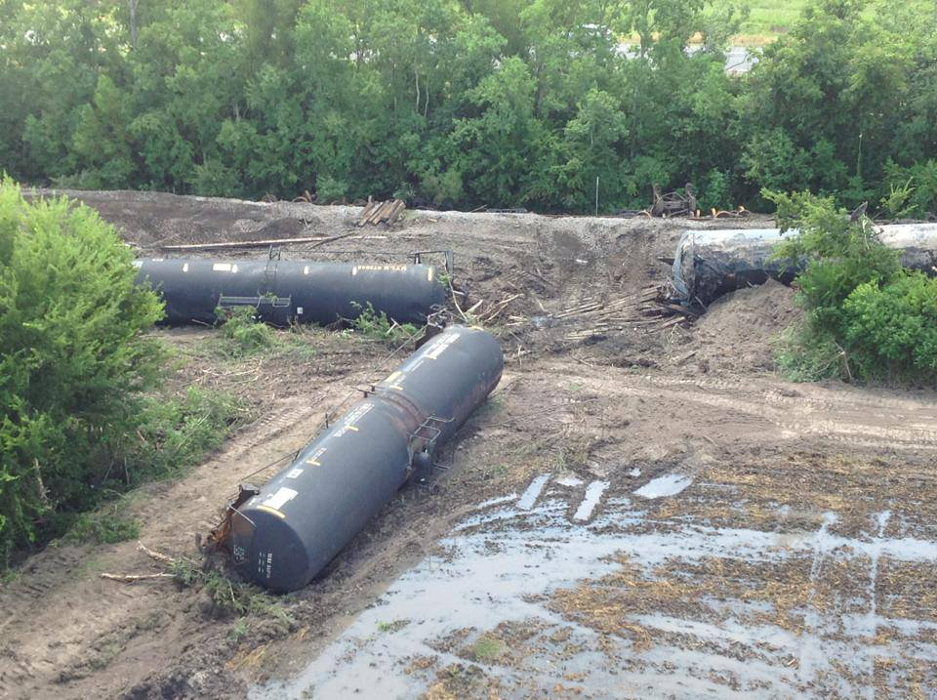
ST. LANDRY PARISH LAWTELL TRAIN DERAILMENT
AUGUST 4, 2013
Notes:
Film Strip
(Intermediate)
To reproduce the effects on this slide, do the following:
On the Home tab, in the Slides group, click Layout and then click Blank.
On the Design tab, in the Themes group, click the arrow next to Colors and then click Adjacency.
On the Insert tab, in the Images group, click Picture.
In the left pane of the Insert Picture dialog box, click the drive or library that contains the film strip graphic. In the right pane of the dialog box, click the film strip graphic and then click Insert.
On the slide, select the picture. Under Picture Tools, on the Format tab, in the bottom right corner of the Size group, click the arrow to launch the Format Picture dialog box.
In the Format Picture dialog, click Size in the left pane and under Size and Rotate in the right pane set Height to 3.02” and Width to 10.1”.
Also in the Format Picture dialog box, click Position in the left pane, under Position pane in the right pane, do the following:
Horizontal: -0.05” From Top Left Corner.
Vertical: 2” From Top Left Corner.
In the Format Picture dialog, click Shadow in the left pane and under Shadow in the right pane do the following:
Color: Brown, Text 1 (under Theme Colors, first row, second option from left).
Size: 100%.
Blur: 12 pt.
Angle: 45 Degrees.
Distance: 5 pt.
Close the Format Picture dialog box.
On the Insert tab, in the Media group, click Video, and then click Video from File.
In the left pane of the Insert Video dialog box, click the drive or library that contains the video. In the right pane of the dialog box, click the first video that you want and then click Insert.
Select the video. Under Video Tools, on the Format Tab, click the arrow in the bottom right corner of the Video Styles group to launch the Format Video dialog box.
In the Format Video dialog box, click Size in the left pane, and under Size and Rotate in the right pane, set Width to 3.35” and Height to 2.26”.
Option 1: In the Format Video dialog box, click Size in the left pane, and under Scale in the right pane, uncheck Lock Aspect Ratio to set video size out-of-aspect.
Option 2: In the Format Video dialog box, click Crop in the left pane, and under Crop Position the in the right pane, set the viewable Width to 3.35” and the Height to 2.26”. Still in Crop on the right pane, under Picture Position, adjust the Offset X and Offset Y to view desired portion of video.
Also in the Format Video dialog box, click Position in the left pane. Under Position on Slide in the right pane, set Horizontal to 0” and Vertical to 2.4”.
Select the video, on the Animations tab, in the Timing group, to the right of Start, choose After Previous.
On the Home tab, in the Drawing group, click Arrange and select Send to Back.
On the Insert tab, in the Media group, click Video, and then click Video from File.
In the left pane of the Insert Video dialog box, click the drive or library that contains the video. In the right pane of the dialog box, click the second video that you want and then click Insert.
Select the second video. Under Video Tools, on the Format Tab, click the arrow in the bottom right corner of the Video Styles group to launch the Format Video dialog box.
In the Format Video dialog box, click Size in the left pane, and under Size and Rotate in the right pane, set Width to 3.35” and Height to 2.26”.
Also in the Format Video dialog box, click Position in the left pane and under Position on Slide set Horizontal to 3.32” and Vertical to 2.4”.
Select the video. On the Animations tab, in the Timing group, to the right of Start, choose After Previous.
On the Home tab, in the Drawing group, click Arrange and select Send to Back.
On the Insert tab, in the Media group, click Video, and then click Video from File.
In the left pane of the Insert Video dialog box, click the drive or library that contains the video. In the right pane of the dialog box, click the third video that you want and then click Insert.
Select the second video, under Video Tools, on the Format tab, click the arrow in the bottom right corner of the Video Styles group to launch the Format Video dialog box.
In the Format Video dialog box, click Size in the left pane, and under Size and Rotate in the right pane, set Width to 3.35” and the Height to 2.26”.
Also in the Format Video dialog box, click Position in the left pane and under Position on Slide in the right pane, set the Horizontal to 6.65” and the Vertical to 2.4”.
Select the video, on the Animations tab, in the Timing group, to the right of Start, choose After Previous.
On the Home tab, in the Drawing group, click Arrange and select Send to Back.
Close the Format Video dialog box.
To reproduce the background effects on this slide, do the following:
On the Design tab, in the bottom right corner of the Background group, click the arrow opening the Format Background dialog box.
Under Gradient stops, click Add gradient stop or Remove gradient stop until two stops appear on the slider. Customize the gradient stops as follows:
Select the first stop on the slider, and then do the following:
In the Position box, enter 40%.
Click the button next to Color, and then under Theme Colors click Tan, Accent 5, Lighter 80% (second row, ninth option from the left).
Select the last stop on the list, and then do the following:
In the Position box, enter 100%.
Click the button next to Color, and then under Theme Colors click Tan, Accent 6, Darker 25% (fifth row, tenth option from the left).
Close the Format Background dialog.

Slide 2
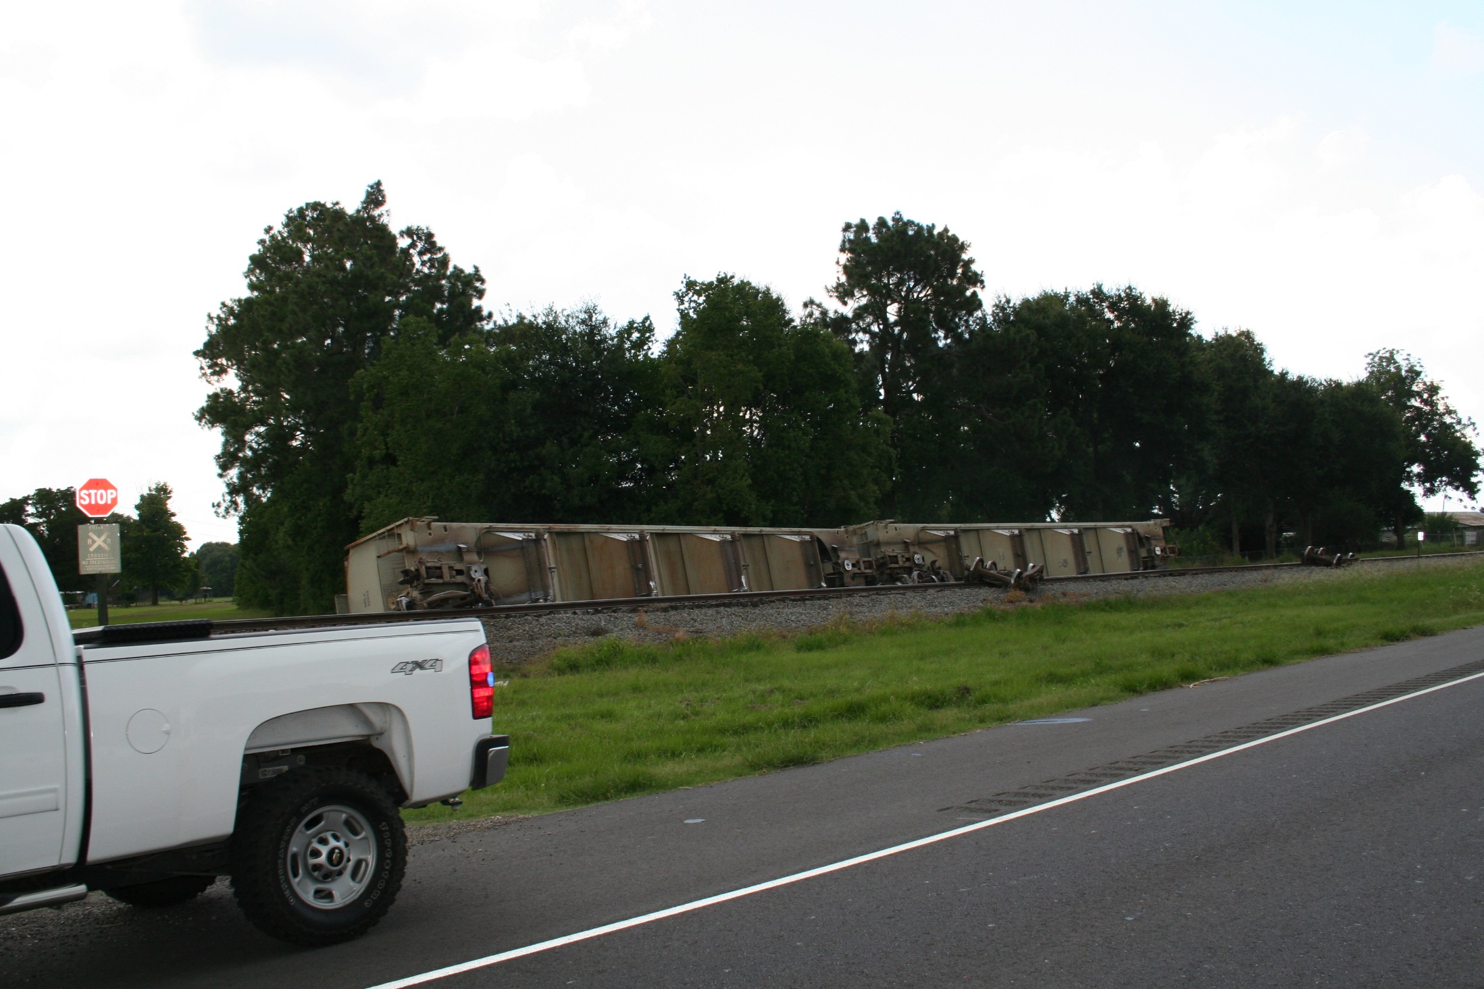
TRAIN DERAILS AT APPROXIMATELY 3:22 PM ON SUNDAY AFTERNOON
26 CARS DERAILED, 23 OF THOSE CARS WERE ON THEIR SIDES AND 3 REMAINED UPRIGHT, OF THE 26 CARS 14 WERE CARRYING HAZARDOUS MATERIALS OF WHICH 3 WERE LEAKING
1800 FEET OF RAIL TRACK IN NEED OF REPAIRS

Slide 3
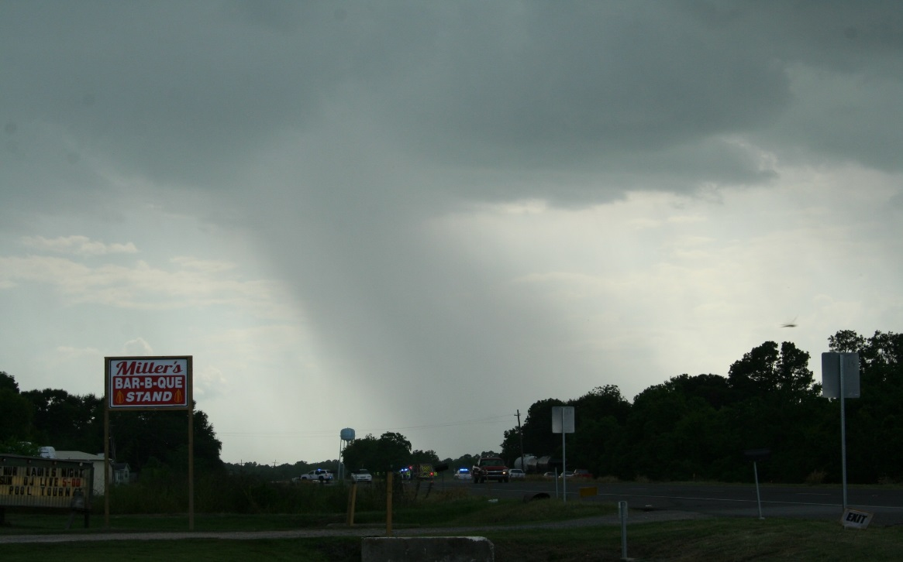
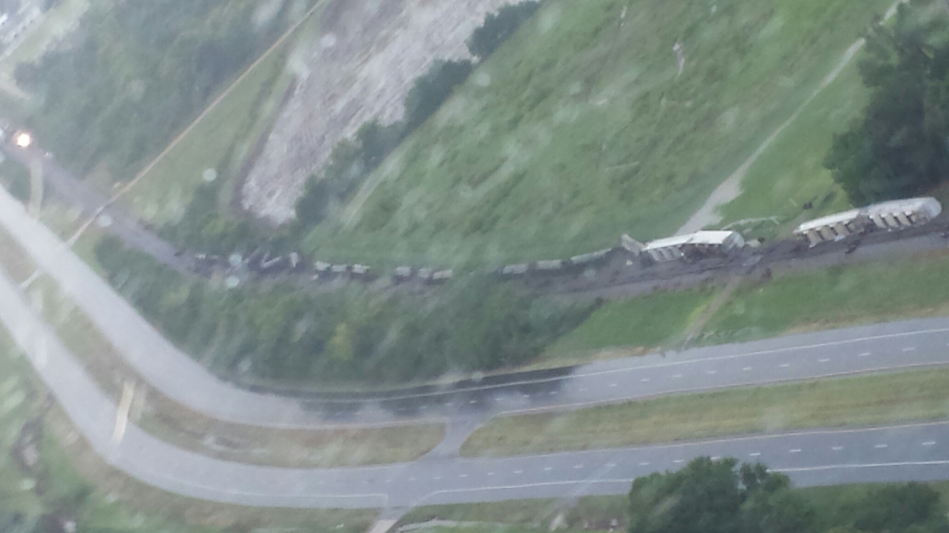
RAINS BEGAN ABOUT 1 HOUR LATER
WITHIN A 2 HOUR PERIOD, 0.78 INCHES OF RAIN FELL

Slide 4
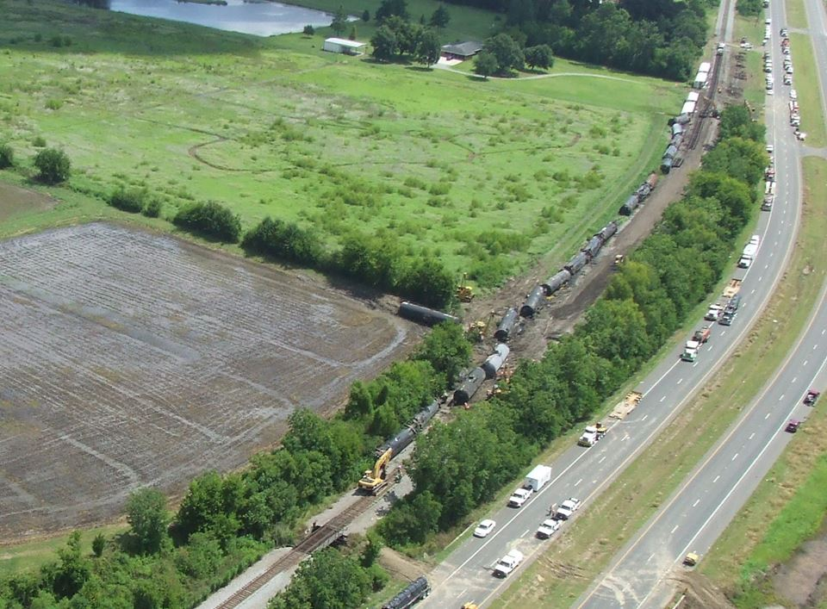
US 190 CLOSED TO TRAFFIC, TURNED INTO STAGING AREA FOR UNION PACIFIC AND CONTRACTORS

Slide 5
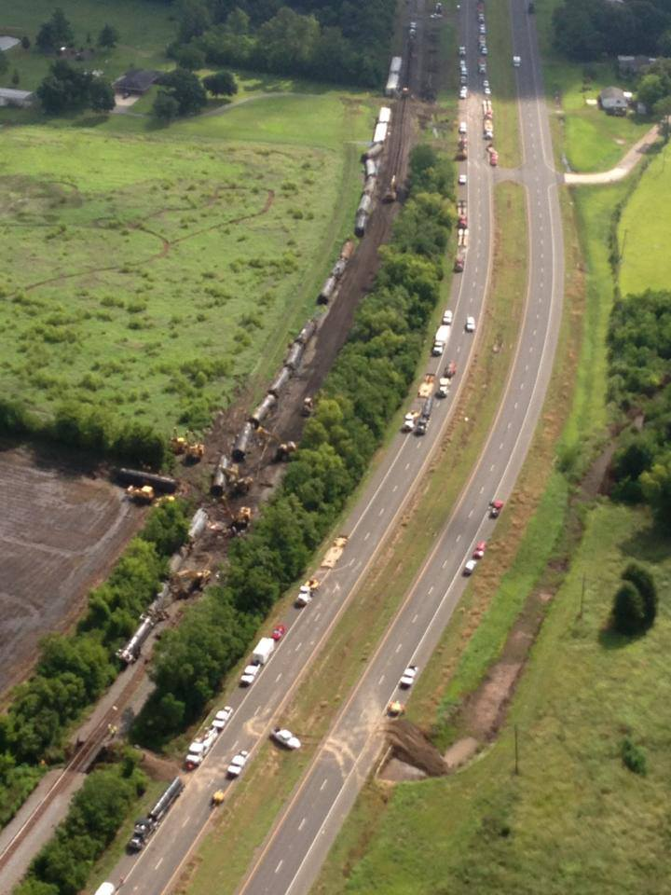

Slide 7
What products were released from the derailment?
Sulfidic Caustic Solution
Sulfidic caustic solution is mainly water with sodium hydroxide and sodium sulfide in it. The solution is
caustic, meaning that if the liquid gets on the skin, it may cause a burn. Measurements of surface water
near the derailment site indicate that if the sulfidic caustic solution did enter the ditches near the
derailment site, the amount was so small that it did not cause the water to go over the limit set by the
United States Environmental Protection Agency. Although spilled sulfidic caustic solution does not get into the air, the product may release hydrogen sulfide, a gas that smells like sulfur or rotten eggs. Hydrogen sulfide was not detected with monitoring
instruments in the community air.
Lubricating Oil
Lubricating oil is a petroleum distillate that has been water treated to remove sulfur; it is a bright strawcolored
liquid with a mild lube oil odor. Lubricating oils are commonly used for a variety of commercial and
industrial applications. Spilled lubricating oils evaporate very slowly and do not affect air quality.
Lubricating oil was not detected in water samples from ditches or the bayou near the derailment site.
Dodecanol
Dodecanol is an alcohol that gives off a fatty odor. Dodecanol is commonly used in shampoos, cosmetics,
and pharmaceuticals. Dodecanol is also a common flavoring ingredient in drinks, ice cream, candy, chewing
gum, and syrups. Dodecanol is considered practically non‐toxic to humans and animals.
Dodecanol liquid spilled in water and soil breaks down quickly in the environment. Dodecanol was detected
in water samples collected from ditches and the bayou near the derailment site. For 12 days after the
derailment, dodecanol was detected in water samples collected from areas near the derailment site. The
most recent water samples collected on August 17 and 18 did not have detectable amounts of dodecanol.

Slide 8
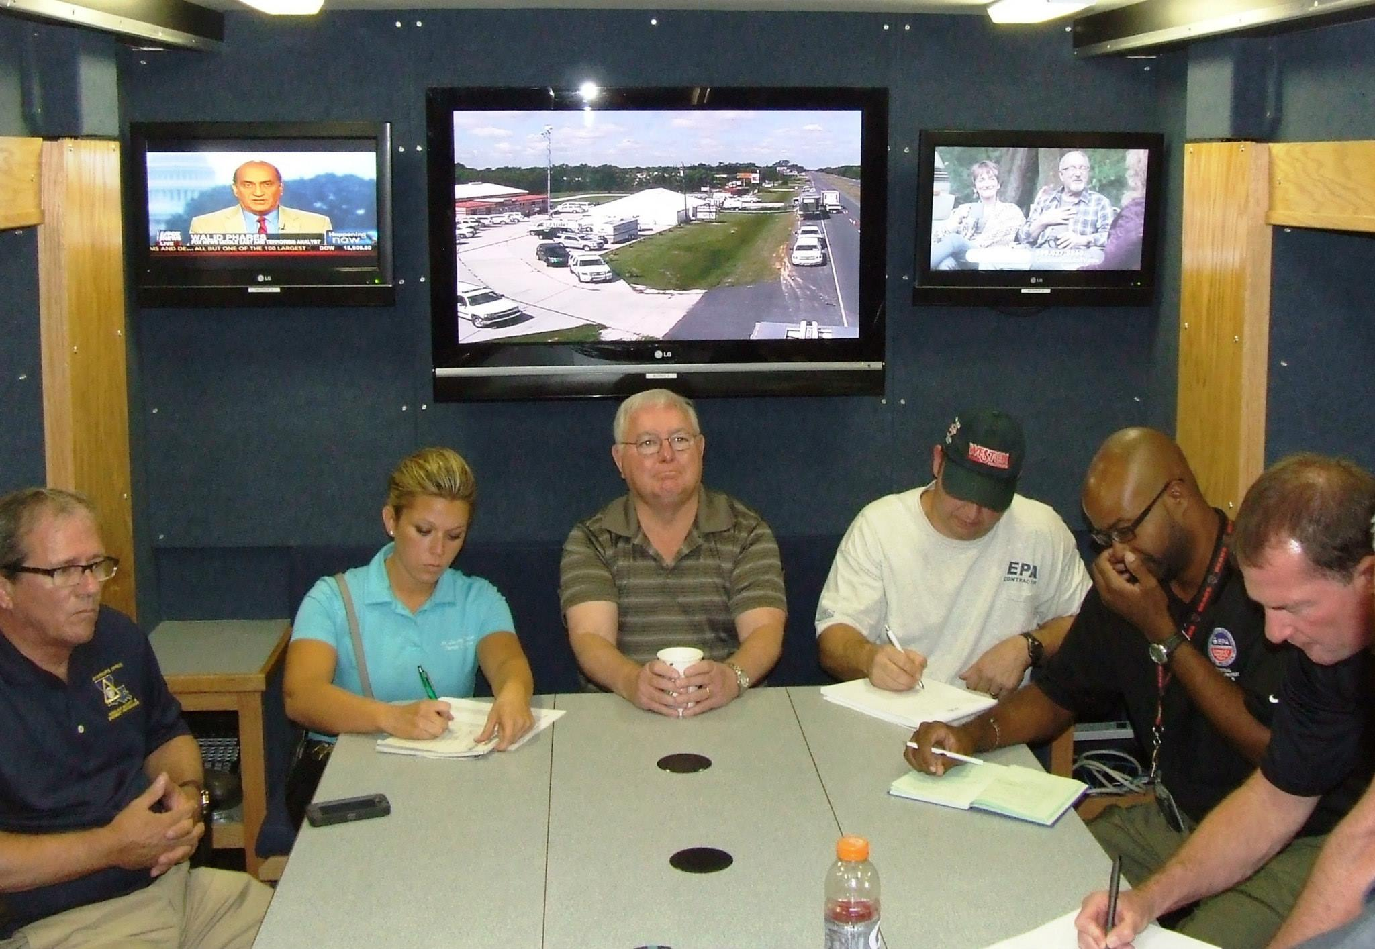
KNOW THE PEOPLE AROUND THE TABLE, BEFORE INCIDENT NOT AFTER

Slide 9
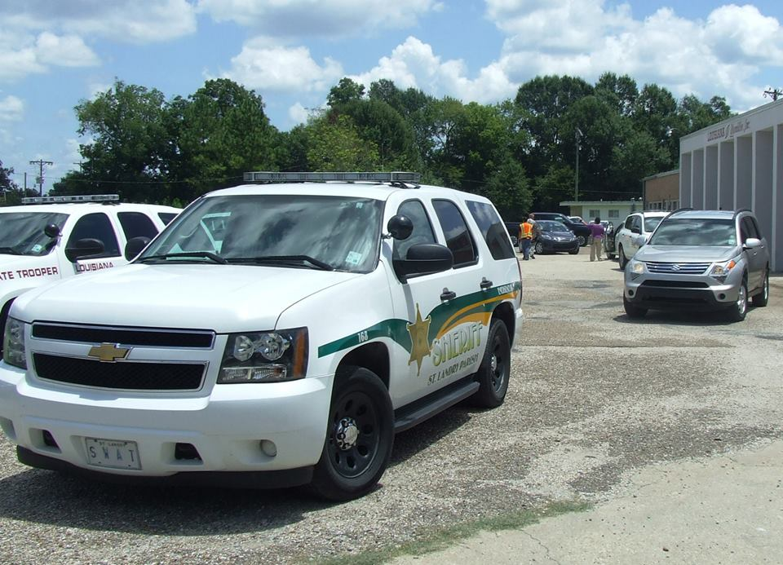
EVACUATIONS & RE-ENTRY
226 homes, 11 businesses, 237 addresses in the 1 mile radius, estimated 791 people

Slide 10
EVACUATIONS & RE-ENTRY
1 MILE RADIUS REDUCED TO ¼ MILE RADIUS ON AUGUST 6TH

Slide 11
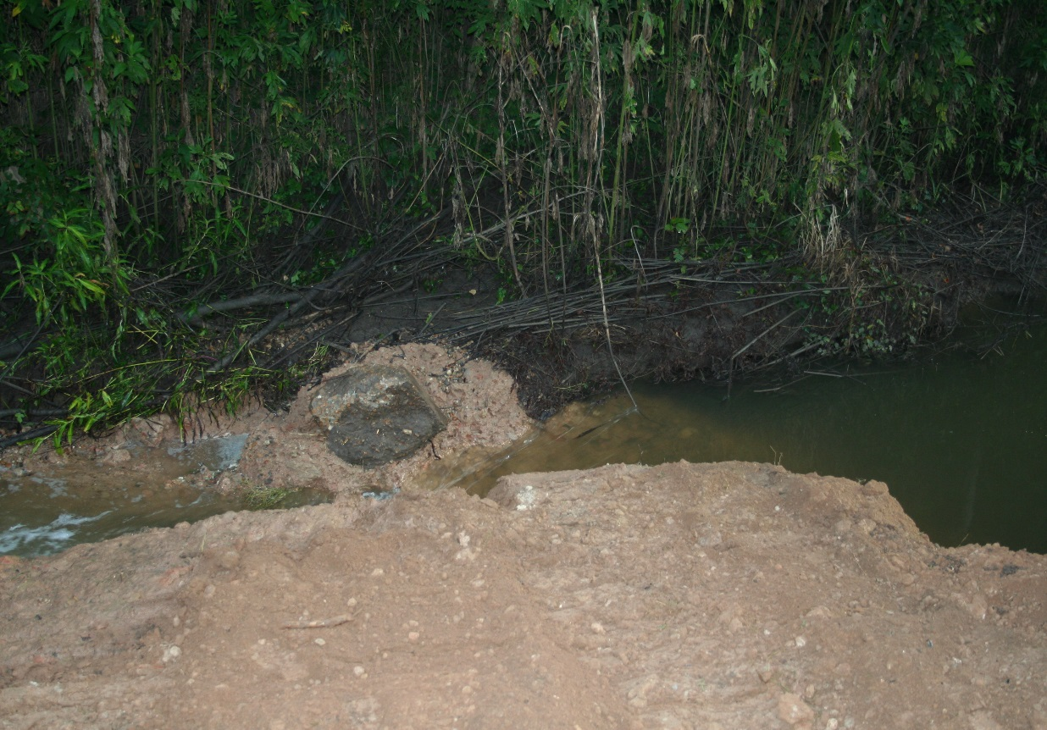
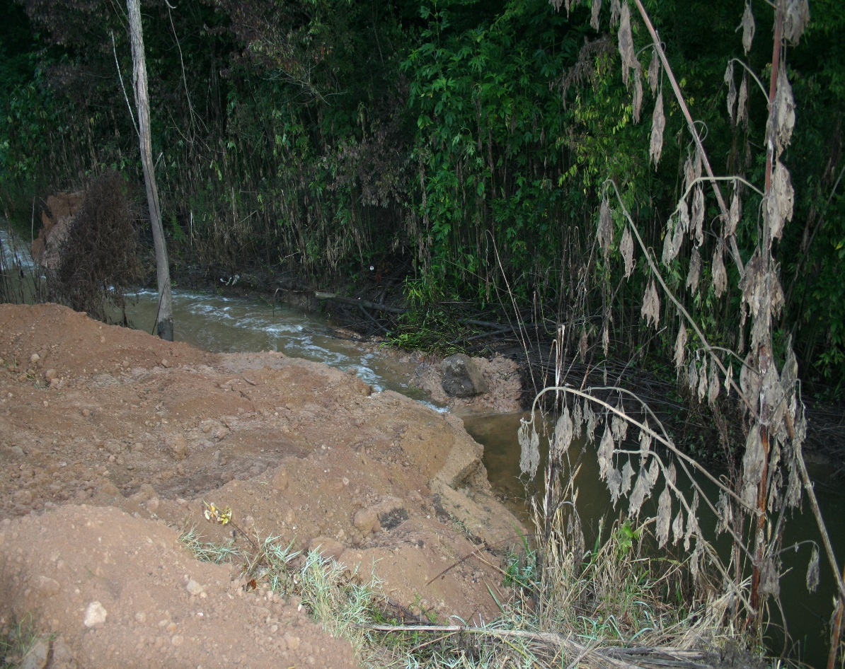
EXPECT THE UNEXPECTED

Slide 12
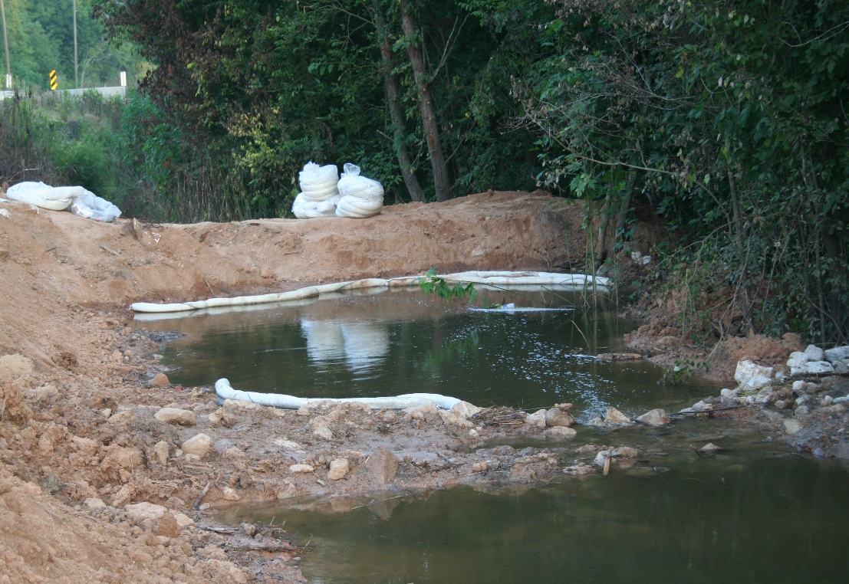
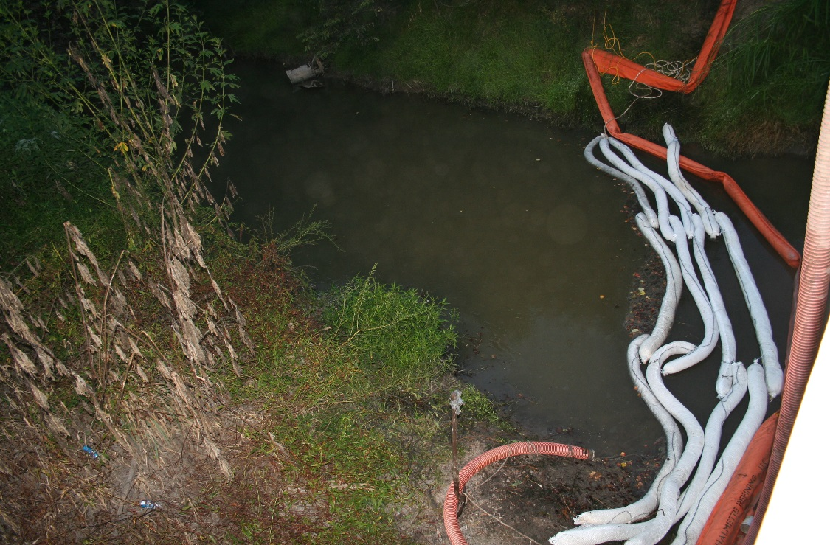
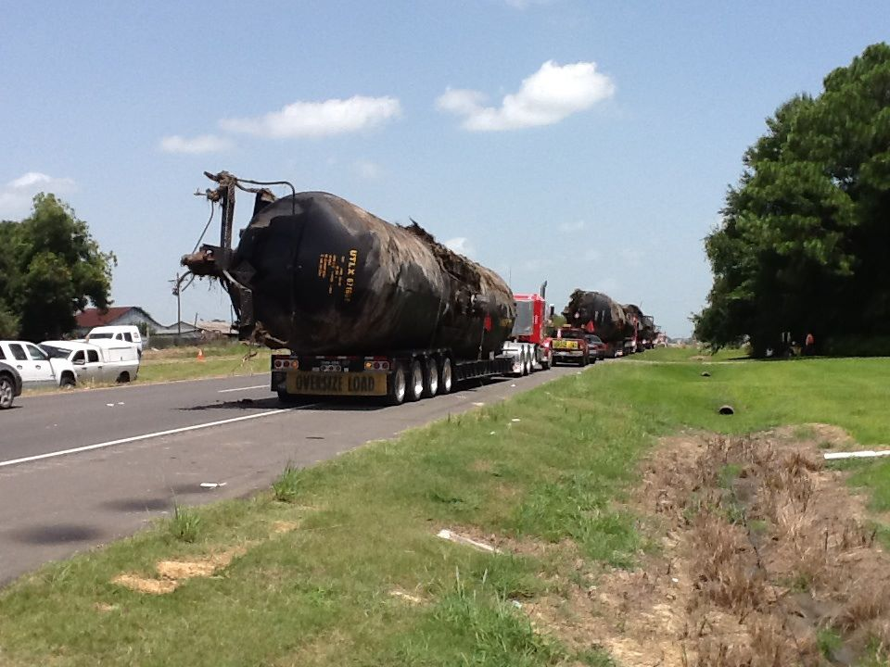
CLEAN UP & RECOVERY

Slide 13
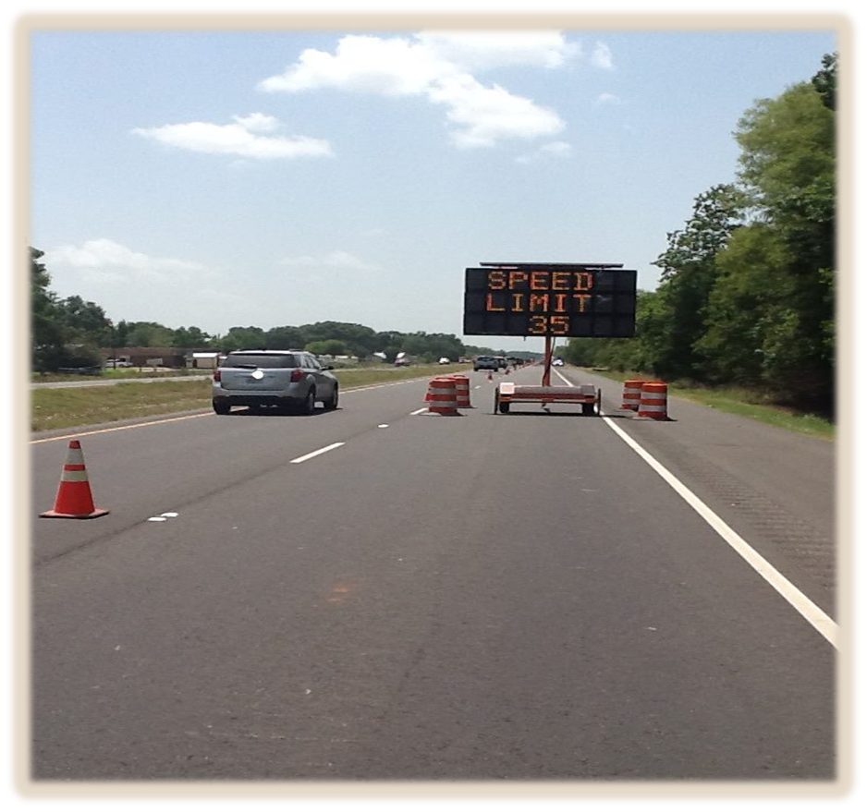
CLEAN UP & RECOVERY
AUGUST 6, 2014 @ 9:00 a.m. THE FIRST TRAIN WENT THROUGH DERAILMENT SITE ON REPAIRED TRACK AT A REDUCED SPEED
AUGUST 8, 2014 EVACUATIONS LIFTED AND U.S. 190 OPEN TO THE PUBLIC, ONE LANE AT A REDUCED SPEED

Slide 14
CLEAN UP & RECOVERY
AUGUST 9, 2013 ALL REMAINING EVACUEES STAYING IN HOTELS PROVIDED BY UNION PACIFIC RETURN HOME
AUGUST 13, 2013 THE LAST THREE BOX CARS WERE REMOVED FROM THE DERAILMENT SITE
AUGUST 13, 2013 DRAINAGE DITCHES ALONG FRANK RD AND SUMMNER RD INTO BAYOU MALLET TRAVELING ALL THE WAY TO HWY 752 WERE WALKED AND CLEANED
AUGUST 14, 2013 U.S. 190 COMPLETELY RE-OPENED FOR NORMAL OPERATIONS

Slide 15
CLEAN UP & RECOVERY
AUGUST 27, 2013 FARMERS WERE ALLOWED TO START DRAINING FIELDS WITH PUMPS UNRESTRICTED
AUGUST 29, 2013 EXCAVATION OF CONTAMINATED SOIL BEGINS AT THE DERAILMENT SITE ALONG U.S. 190, FIBER OPTIC CABLE COMPLICATIONS PROLONGED BEGINNING OF CLEAN UP
NOVEMBER 1, 2013 COMPLETE CLEAN UP OF DERAILMENT SITE AND AFFECTED AREA FINISHED

