Slide 1
Debris

Slide 2

Debris removal is usually the most expensive activity that takes place after an event.
Today we’re going to talk about how to get + keep eligible debris reimbursements.
Notes:
Debris removal is usually the most expensive activity that takes place after an event.
You want to be sure that you get reimbursed for eligible expenses and you want to be sure you get to keep the reimbursements you get.
To help mi

Slide 3
Remember 3 things to help maximize your reimbursements and minimize your risk . . .

Slide 4
Debris Plan.
Ownership of the entire process.
Know the rules!
Notes:
Briefly speak to each of the 3 and the importance of each in planning for a debris causing event

Slide 5
1. Debris plan
Develop a Debris Management Plan NOW . . .
and use it!
Notes:
DOTD after hurricane Katrina (No Plan, No Contract,
Develop a plan that fits your needs, Use it, Maintain it, OWN IT (ownership again)
Discuss the advantages/disadvantages of pre and post contracting
What do you clean up first (Response then Recovery) Push and Shove then pick up

Slide 6
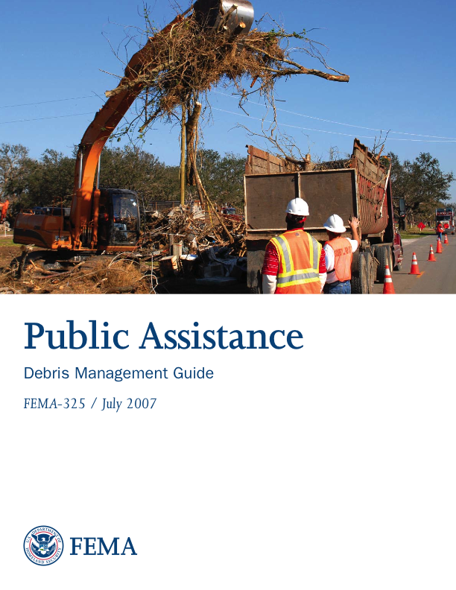
1. Debris plan (Continued . . . )
See FEMA: Debris Management Guide 325 (July 2007) chapters 5 – 14 for guidance.
Notes:
DOTD after hurricane Katrina (No Plan, No Contract,
Develop a plan that fits your needs, Use it, Maintain it, OWN IT (ownership again)
Discuss the advantages/disadvantages of pre and post contracting
What do you clean up first (Response then Recovery) Push and Shove then pick up

Slide 7
1. Debris plan (Continued . . . )
Debris management sites (DMS) . . .
  Louisiana Department of Environmental Quality (LDEQ) permitted . . .
Notes:
Where are you going to take the debris? (Pre Planned and Permitted sites) Anywhere you haul debris to needs to be permitted LDEQ
GAP analysis conducted will determine if you can do the work with your forces or you need contract help
Developing you own scope of work and a schedule of pay items will help you make comparisons as well as control your contract.

Slide 8
1. Debris plan (Continued . . . )
Do not use a boiler-plate plan.
Develop a plan that fits YOUR needs.
  Address every possibility . . .
    E.g. Oil refinery, pogy boats, meat processing facilities, etc.
Notes:
Where are you going to take the debris? (Pre Planned and Permitted sites) Anywhere you haul debris to needs to be permitted LDEQ
GAP analysis conducted will determine if you can do the work with your forces or you need contract help
Developing you own scope of work and a schedule of pay items will help you make comparisons as well as control your contract.

Slide 9

2. Ownership of the process
Who is ultimately responsible?
  Applicant is ultimately responsible.
Notes:
The applicants that turn the entire process over to the Management/Monitoring firms and take a hands off approach are more likely to have a problem with everything, documentation, quantification, reimbursement etc.
ACT LIJKE THE MONEY IS YOUR MONEY
Always know what is going on.
Turning loose of the process is like signing a blank check.
Relationship FEMA and GOHSEP have with YOUR contractors, they do not work for anyone other than you
FEMA and/or GOHSEP can provide technical assistance when you request (Pre or Post event)

Slide 10
2. Ownership of the process (Continued . . . )
Assign someone from your staff as YOUR Debris Manager.
Notes:
The applicants that turn the entire process over to the Management/Monitoring firms and take a hands off approach are more likely to have a problem with everything, documentation, quantification, reimbursement etc.
ACT LIJKE THE MONEY IS YOUR MONEY
Always know what is going on.
Turning loose of the process is like signing a blank check.
Relationship FEMA and GOHSEP have with YOUR contractors, they do not work for anyone other than you
FEMA and/or GOHSEP can provide technical assistance when you request (Pre or Post event)

Slide 11
2. Ownership of the process
(Continued . . . )
  Maintain independent relationship between monitor(s) and the debris contractor.
Notes:
Administer as your own.
25% cost share.
De-obligation risk.
The applicants that turn the entire process over to the Management/Monitoring firms and take a hands off approach are more likely to have a problem with everything, documentation, quantification, reimbursement etc.
ACT LIJKE THE MONEY IS YOUR MONEY
Always know what is going on.
Turning loose of the process is like signing a blank check.
Relationship FEMA and GOHSEP have with YOUR contractors, they do not work for anyone other than you
FEMA and/or GOHSEP can provide technical assistance when you request (Pre or Post event)

Slide 12

2. Ownership of the process (Continued . . . )
Emphasize: Failure to know what’s going on puts you at risk.
Notes:
The applicants that turn the entire process over to the Management/Monitoring firms and take a hands off approach are more likely to have a problem with everything, documentation, quantification, reimbursement etc.
Always know what is going on.
Turning loose of the process is like signing a blank check.
Relationship FEMA and GOHSEP have with YOUR contractors, they do not work for anyone other than you
FEMA and/or GOHSEP can provide technical assistance when you request (Pre or Post event)

Slide 13
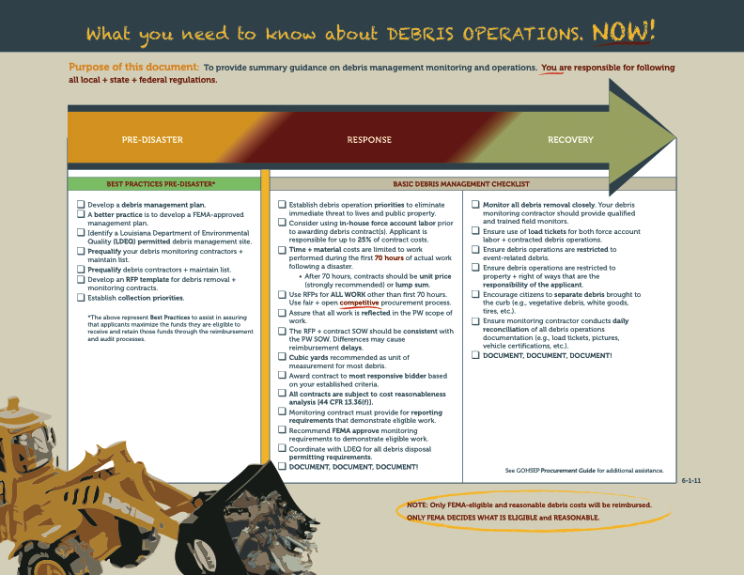
3. Know the rules!
Follow the GOHSEP Debris Guide.
Notes:
Reference handout backside with FEMA debris related references
Know what the procurement process is and follow the rules (Discussed earlier by Mr. Plaia)
That cost are incurred have to be reasonable (FEMA determines what is reasonable as well as eligible)
Owner again needs to monitor/manage the process either force account or contract of both
Become familiar with Louisiana Dept. of Environmental Quality (LDEQ) rules for collection and disposal

Slide 14
3. Know the rules! (Continued . . . )
LDEQ:
  Debris management site (DMS) permit.
  http://www.deq.louisiana.gov
Notes:
Reference handout backside with FEMA debris related references
Know what the procurement process is and follow the rules (Discussed earlier by Mr. Plaia)
That cost are incurred have to be reasonable (FEMA determines what is reasonable as well as eligible)
Owner again needs to monitor/manage the process either force account or contract of both
Become familiar with Louisiana Dept. of Environmental Quality (LDEQ) rules for collection and disposal

Slide 15
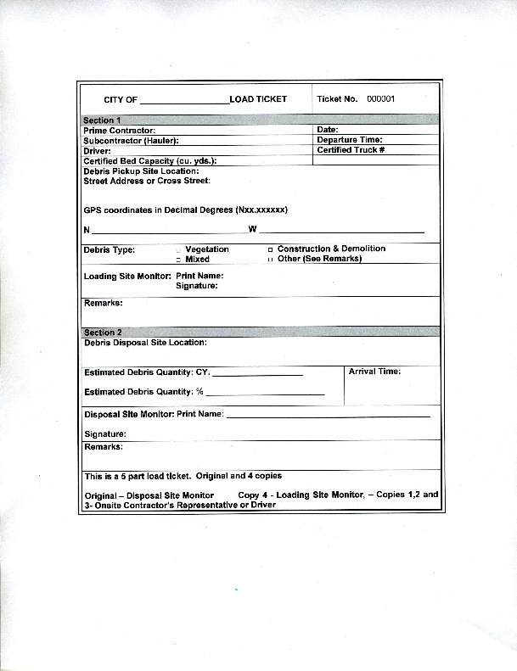
3. Know the rules! (Continued . . . )
Critical documentation
Notes:
Develop a documentation template and ask FEMA to review and comment
Labor hours and equipment hours documented correctly will validate equipment usage (operator charges 8 hours of time and the equipment usage is show as 12 hours) problem
Recommend anything hauled be documented using a haul ticket (hard copy or electronic)
FEMA 325 pg 24-25 detail required documentation for Dangerous Trees, Limbs and stumps

Slide 16
3. Know the rules! (Continued . . . )
Each type of debris requires a specific type of documentation.
Notes:
Chapter 3 of FEMA 325 describes Debris Removal form Public Property and the eligibility of such
The level of documentation needed for PW formulation will be different than a request for reimbursement from GOHSEP. The GOHSEP documentation will need to be more detailed
The cheapest thing you will ever buy is a digital camera to capture the threat
Who removed the debris? (We Did), What kind of debris did you remove?(don’t remember)Where did you take the debris?(Don’t have any record of that) How Much did it cost? (500k) = no reimbursement for undocumented work

Slide 17
3. Know the rules! (Continued . . . )
WHO + WHAT + WHERE +
WHEN + HOW MUCH!
Notes:
Chapter 3 of FEMA 325 describes Debris Removal form Public Property and the eligibility of such
The level of documentation needed for PW formulation will be different than a request for reimbursement from GOHSEP. The GOHSEP documentation will need to be more detailed
The cheapest thing you will ever buy is a digital camera to capture the threat
Who removed the debris? (We Did), What kind of debris did you remove?(don’t remember)Where did you take the debris?(Don’t have any record of that) How Much did it cost? (500k) = no reimbursement for undocumented work

Slide 18
Quantification: Reduces YOUR risk!
Best Practice/Best Protection:
How much of what did you remove?
Notes:
BIGGEST PROBLEM AND THE BIGGEST HEADACHE
All debris removal work should be quantified to determine if the work is reasonable
Making a reasonable determination is impossible without some type of quantity and cost
Minimize your risk and use best practices:
Lump Sum Contracts (You Paid $100,000.00 to have debris removed, did you pay to get one stick or 100 sticks removed)
Unit Price Contracts (capture everything reference pay items in your contract)

Slide 19
Check FEMA 325 Debris Management Guide for details.
Notes:
Knowing these five things will assist you in getting FEMA reimbursement as well as keeping the funds. Don’t let the grant become a short term loan.
Joke about golf (Mike not being able to see very far----)

Slide 20
3 things to remember . . .
Debris Plan.
Ownership of the entire process.
Know the rules!
Notes:
Knowing these five things will assist you in getting FEMA reimbursement as well as keeping the funds. Don’t let the grant become a short term loan.
Joke about golf (Mike not being able to see very far----)

Slide 21
Freddie Gardner
(225) 303-6610
Johnny Gonzales
  (225) 379-4028

