Slide 1

Hazard Mitigation Planning + Your Community

Slide 2
Hazard Mitigation Planning + Your Community
A Hazard Mitigation Plan (HMP) is required for your community to receive FEMA hazard mitigation funding.

Slide 3
Authorities
Robert T. Stafford Disaster Relief and Emergency Assistance Act (Stafford Act)
44 Code of Federal Regulations (CFR) Part 201
44 CFR Part 206

Slide 4
Acronyms
APA Approved Pending Adoption
HIRA Hazard Identification Risk Assessment
SDMI Stephenson Disaster Management Institute
THIRA Threat and Hazard Identification Risk Assessment

Slide 5
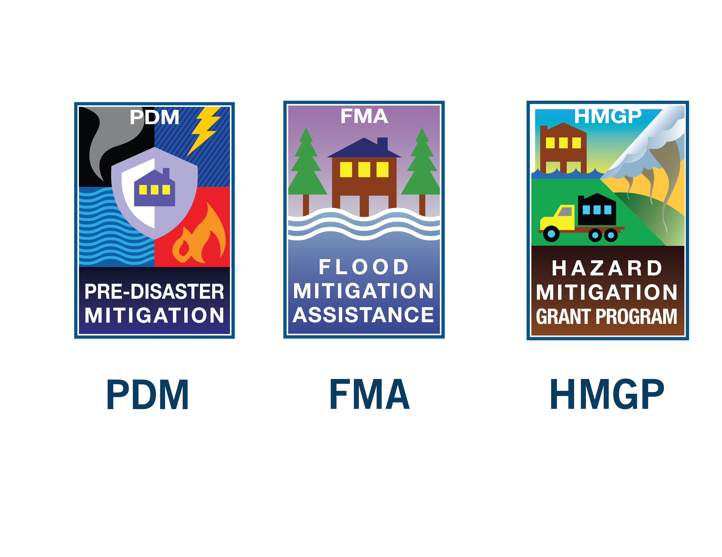
Why they are important to you
State + local + Federally recognized Tribal governments are required to develop a HMP as a condition for receiving certain types of grant funding:
Hazard Mitigation Grant Program (HMGP)
Pre-Disaster Mitigation (PDM) Grant Program
Flood Mitigation Assistance (FMA) Program

Slide 6
Who needs a plan?
Jurisdictions who own property AND . . .
Have governing authority over the property.

Slide 7
Do I need my own plan?
Yes, if you’re a Parish.
If you are NOT a Parish, we encourage you to be a participating jurisdiction within the Parish-level plan.

Slide 8
Participating jurisdiction
Provide input + attend meetings.
Provide a point of contact (POC).
Participate in risk assessment development + individual risk assessment.
Adopt the plan.

Slide 9
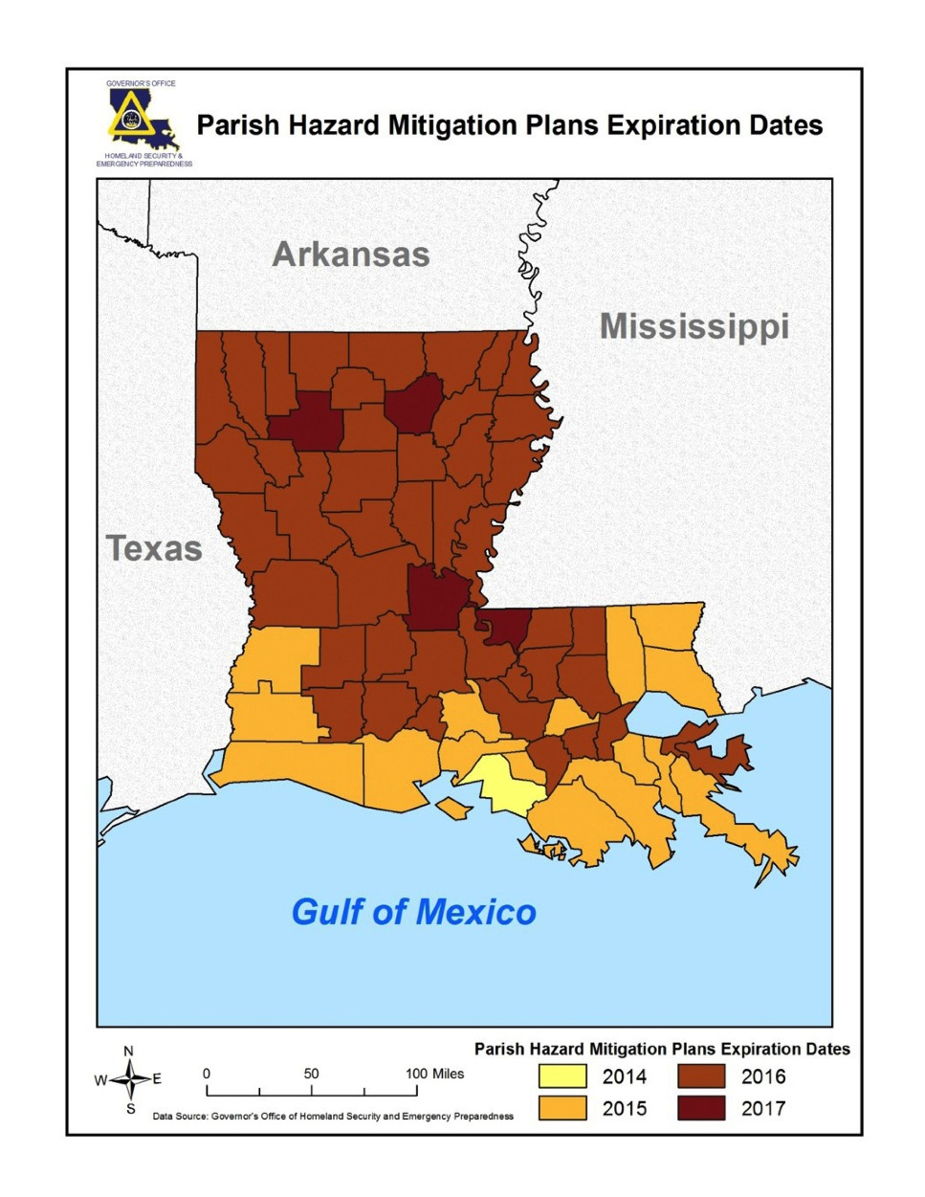
Parish Hazard Mitigation Plan Expiration Dates
Parish plans have a
5-year update cycle.

Slide 10
If you’re building your own plan, here are some things to know . . .

Slide 11
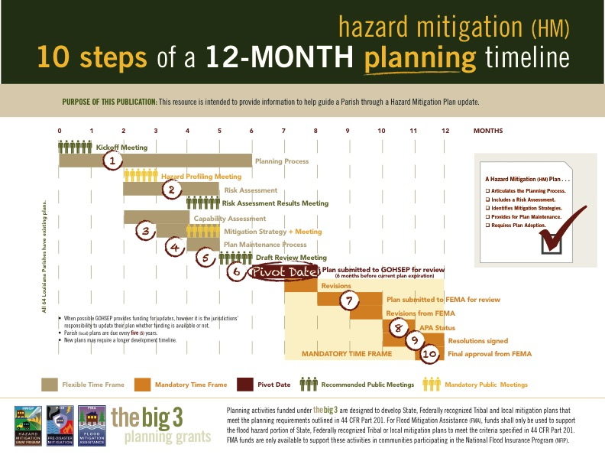





10 steps of a
12-month timeline
Develop a Planning Process.
Complete a Risk Assessment.
Conduct a Mitigation strategy meeting.
Address plan maintenance.
Convene a draft review meeting.

Slide 12





10 steps of a 12-month timeline (Continued . . . )
GOHSEP review.
FEMA review.
Obtain Approval Pending Adoption (APA) status from FEMA.
Resolution signed.
FINAL approval from FEMA.

Slide 13


Slide 14

Plan development . . .
State-assisted (SDMI) . . .
You . . .
Or a Parish contractor?

Slide 15
Choosing a contractor
Follow proper procurement guidelines.
  MUST be competitively bid.

Slide 16

Initial meeting with planning team + stakeholders to:
  Explain planning process.
  Decide on timeline.
  Define participation roles + responsibilities.

Slide 17

Determine the planning area + resources.
Build the planning team.
Create an outreach strategy to stakeholders.

Slide 18

Each jurisdiction in the Plan must:
  Identify hazards.
  Profile hazards.
  Determine vulnerability + impact.

Slide 19

Identify hazards
Describe all natural hazards that effect the jurisdictions in the planning area.
  Flood
  Hurricane
  Tornado
  Winter storm
  Thunderstorms
  Coastal land loss
  Storm surge
  Subsidence
  Wildfire
  Dam failure
  Levee failure

Slide 20
Profile hazards
Location.
Extent.
Previous occurrences.
Probability of future occurrences.

Slide 21
Determine vulnerability + impact
Vulnerability
  Demonstrated through past occurrences.
  Characteristics of the community’s assets that make jurisdictions susceptible to damage.
Impact
  Consequences or effects of past occurrences on the community assets.

Slide 22
HIRA vs. THIRA
Hazard Identification Risk Assessment (HIRA):
  Natural hazards.
  Location + extent.
  Previous occurrences + probability of future occurrences.

Slide 23
HIRA vs. THIRA (Continued . . . )
Threat + Hazard Identification + Risk Assessment (THIRA):
  Technological + human caused threats
  Capability a jurisdiction has to respond to a natural or manmade threat event.

Slide 24

Blueprint for mitigation disaster losses
State goals:
  Improve education + outreach efforts.
  Improve data collection . . .
Possible actions:
  HM workshops.
  Mitigation projects.
  Other . . .
Prioritize actions to guide how you implement funding.

Slide 25
Remember . . .
PROJECT FUNDING is ONLY available if the action is in the Plan.

Slide 26

The plan is a living document.
  Monitor
  Evaluate
  Update/amend

Slide 27

Planning Team
Stakeholders
Public
Comment period

Slide 28

Submit DRAFT to GOHSEP for review:
  PIVOT DATE (6 months before expiration).

Slide 29


submits to FEMA.
has a 45-day review period.

Slide 30

Plan receives APA status from FEMA.

Slide 31

All participating jurisdictions must sign the resolution page.

Slide 32

Plan must be adopted by all participating jurisdictions to receive final approval from FEMA.

Slide 33
Secure planning grant funding
Post-disaster
Non-disaster
Hazard Mitigation Grant Program (HMGP) + Pre-Disaster Mitigation (PDM) can fund complete plan development.
Flood Mitigation Assistance (FMA) can only fund flood portion of plan development.
Non-disaster

Slide 34
Remember . . .
No Hazard Mitigation Plan.
No grant funding.

Slide 35
Contact
Jeffrey Giering
jeffrey.giering@la.gov
Brenda Cooper
brenda.cooper@la.gov
Nicolette English
nicolette.english@la.gov

Slide 36
Questions?

Slide 37
For more information + to download materials from today’s seminar:
gohsep.la.gov/outreach.aspx

