Slide 1
Cemetery Disruption Response
How to Respond

Slide 2
Introduction and Background
Heavy rains and/or storm surges from hurricanes generally cause some degree of cemetery disruptions.
Disruptions can include:
Dislodged caskets and vaults in and out of cemetery perimeters
Exposed remains within cemeteries
Large tombs displaced and/or destroyed in and out of cemetery perimeters
These disruptions will create both public health and public relations effects, requiring a response by local, state and possibly federal authorities

Slide 3
Key Stakeholders
Public and private cemeteries, and families with loved ones in these areas
Parish Coroner’s Offices and Local Funeral Homes
Parish Offices of Emergency Preparedness
Parish Health Units
State and Federal ESF 8 (HHS and DMORT)
Attorney General’s Office
FACES Lab at LSU

Slide 4
Assumptions and Constraints
Federal funding through the Stafford Act is available:
Directly to parishes through Public Assistance is the cemeteries are public cemeteries
Indirectly to parishes through Individual Assistance to individual families and/or sponsors
State or parish funding will have to address private cemetery response actions if the IA process is not rigorously followed

Slide 5
Assumptions and Constraints
The local coroner, while not legally responsible, should be approached to be the Incident Commander on the local level.
By law, the coroner is not responsible for cemetery disruptions, but they often have valuable knowledge of the community and the local funeral industry
Federal assets such as DMORT teams will likely not be available unless the disruption is extremely large (currently, this tipping point is unknown)
If DMORT is available (uncertain), there will likely be limitations on DMORT actions (i.e. no remains recovery)

Slide 6
Assumptions and Constraints (cont.)
GOHSEP will be asked to broker parish-to-parish asset loans
State contracts are available for certain resources(but not all)
There will be single point of contact at the State level for response coordination, resource acquisition, and data management
A single point of contact for parishes is required as operational control will remain at the local parish level

Slide 7
Assumptions and Constraints (cont.)
While the event is still unfolding, many areas are still in a response mode.
Because of this it is not prudent to divert scarce assets currently being used to rescue citizens to remains recovery, particularly if these remains are secured.
We also need a full picture of the disruption in order to request the appropriate assets and determine if federal help can be obtained.
After everyone else is standing down, this operation will continue for months. We are still responding to disruptions from the August floods.

Slide 8
Operational Flow
There are four general phases to a Cemetery Disruption CONOPS:
Assessment
Recovery
Identification
Re-casketing and Re-interment

Slide 9
Cost Modeling
There can be significant costs associated with this CONOPS
Excessive costs can be avoided if a complete assessment is completed before any equipment or other resources are requested
We have a cost model that can estimate the probable costs of the response.
If the cemetery is a public cemetery, the parish can file a PA claim.
If the cemetery is private, an organized effort to secure IA claims has to be organized

Slide 10
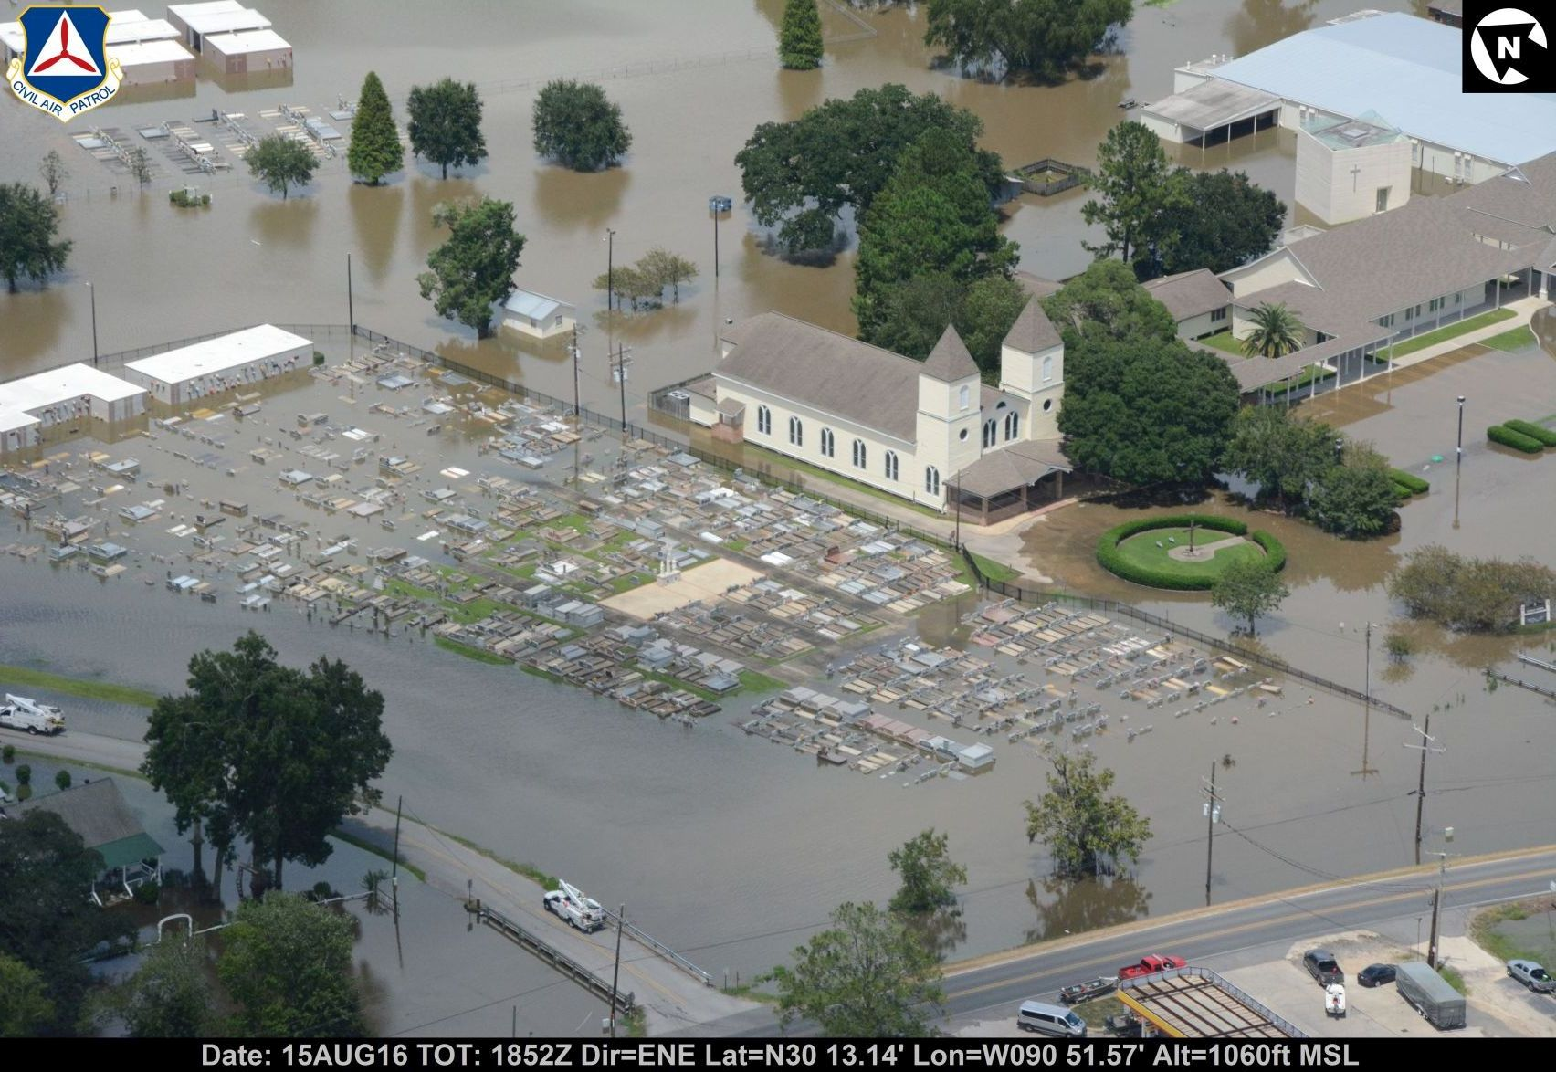
Damage Snapshots

Slide 11
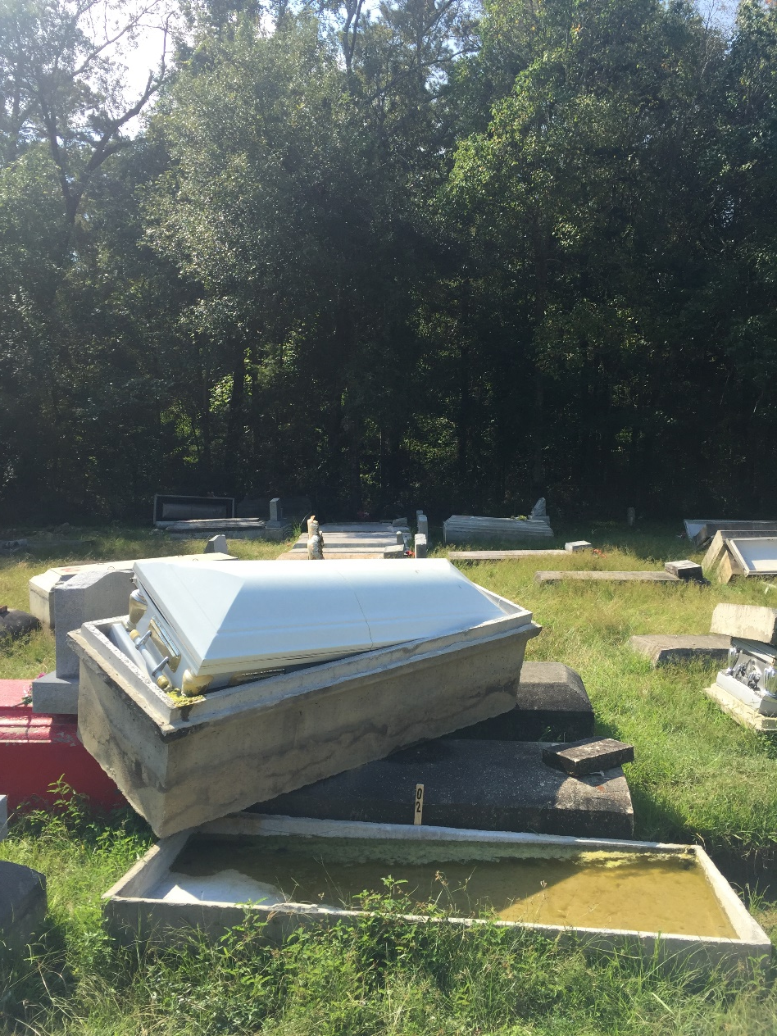
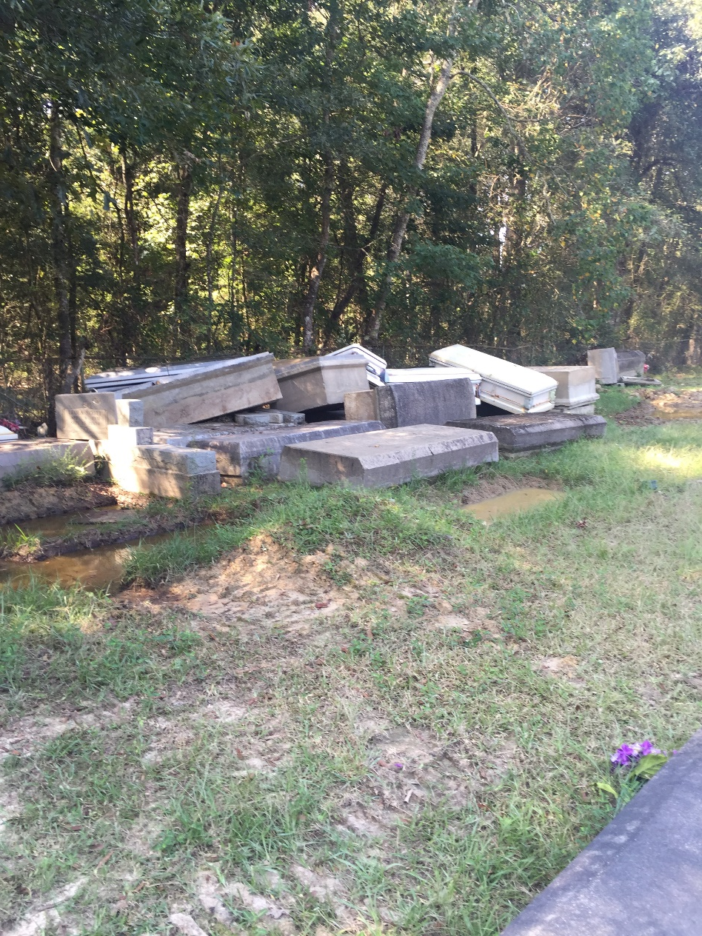
Damage Snapshots

Slide 12
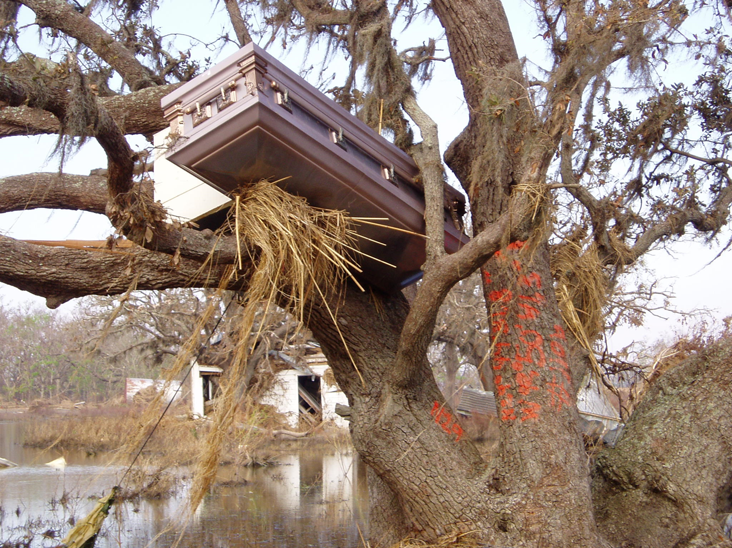
Damage Snapshots

Slide 13
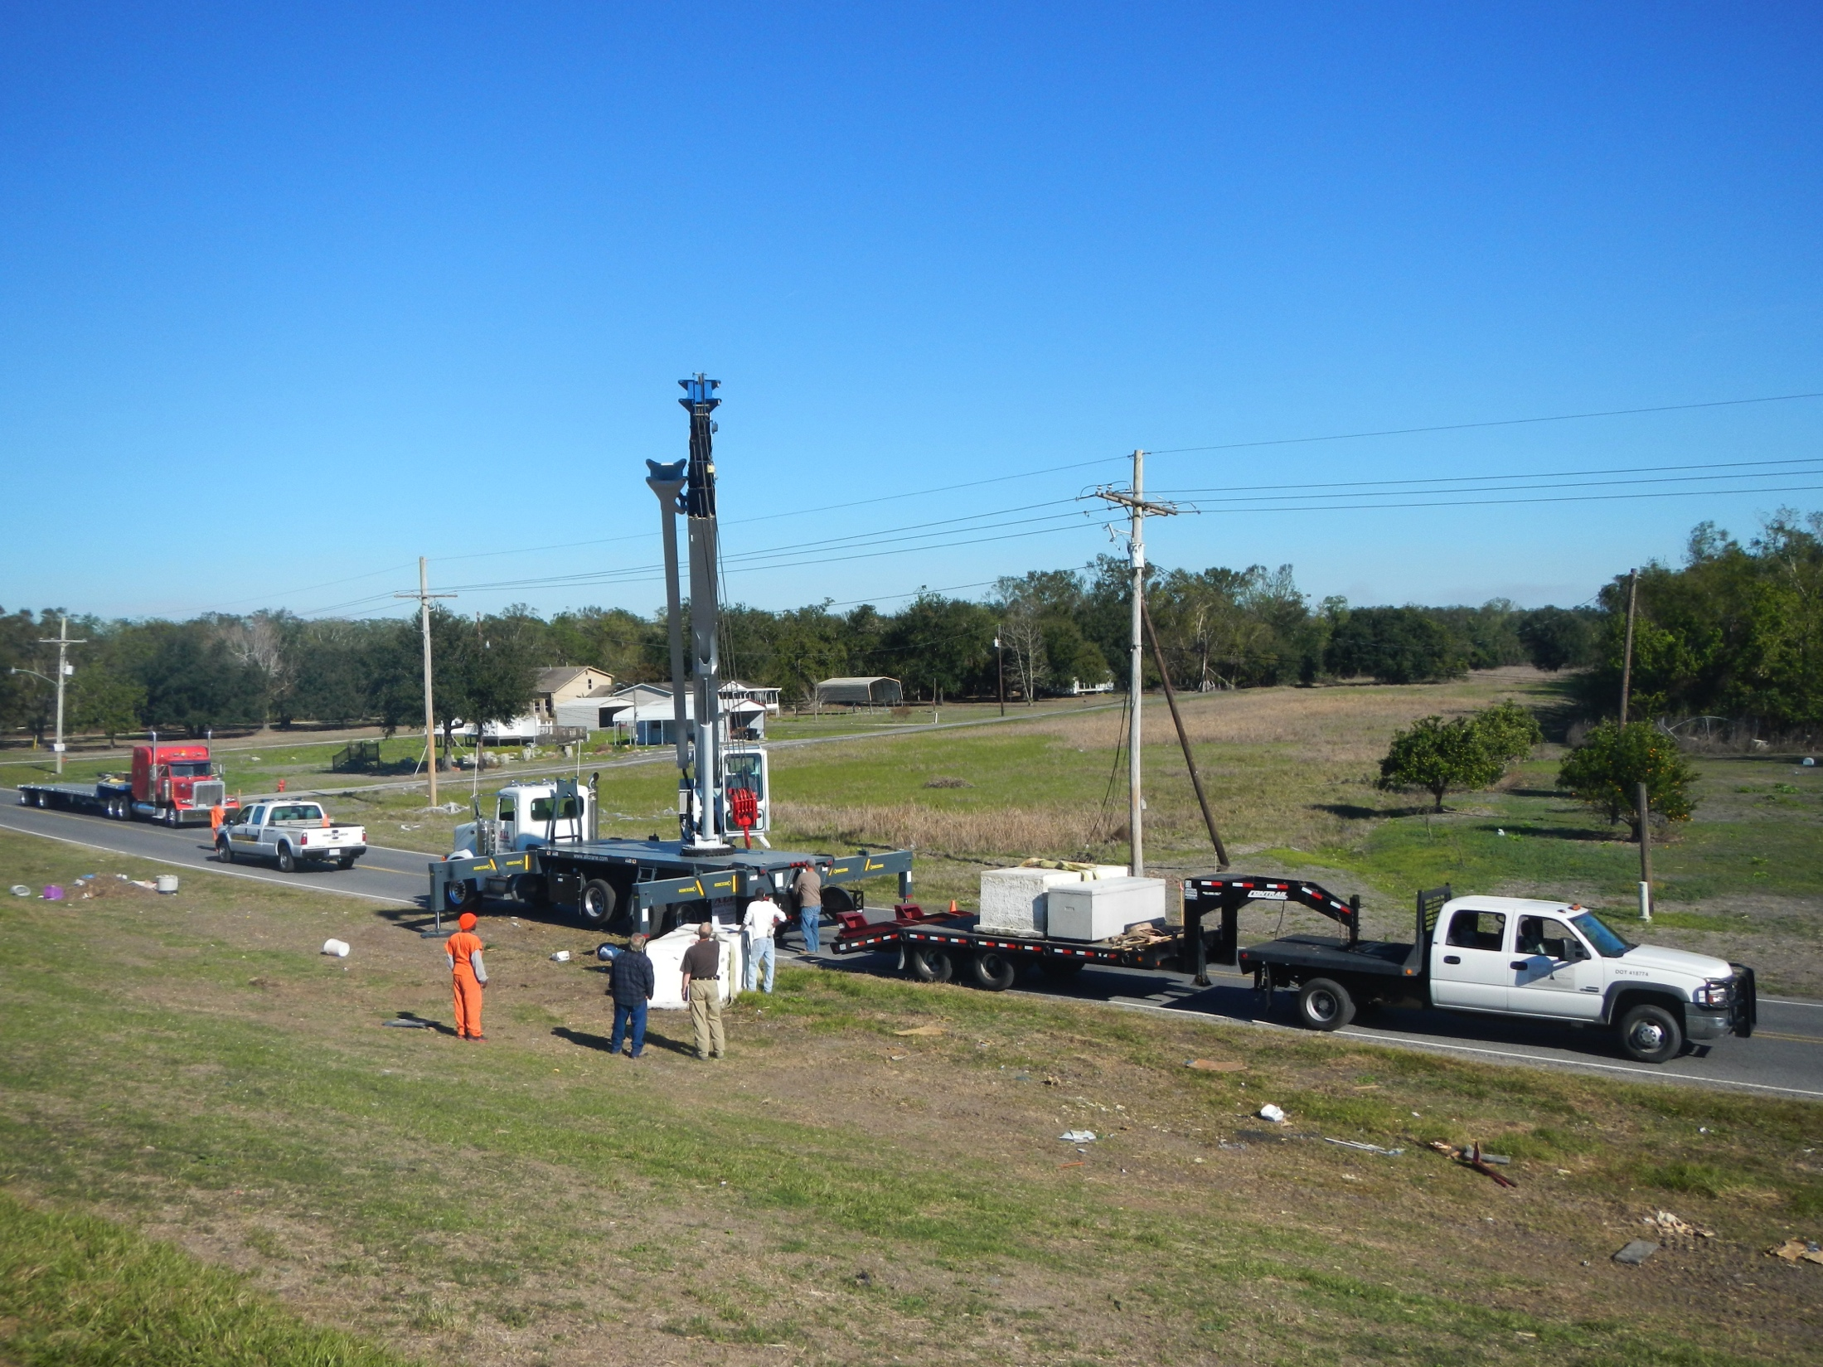
Damage Snapshots

Slide 14
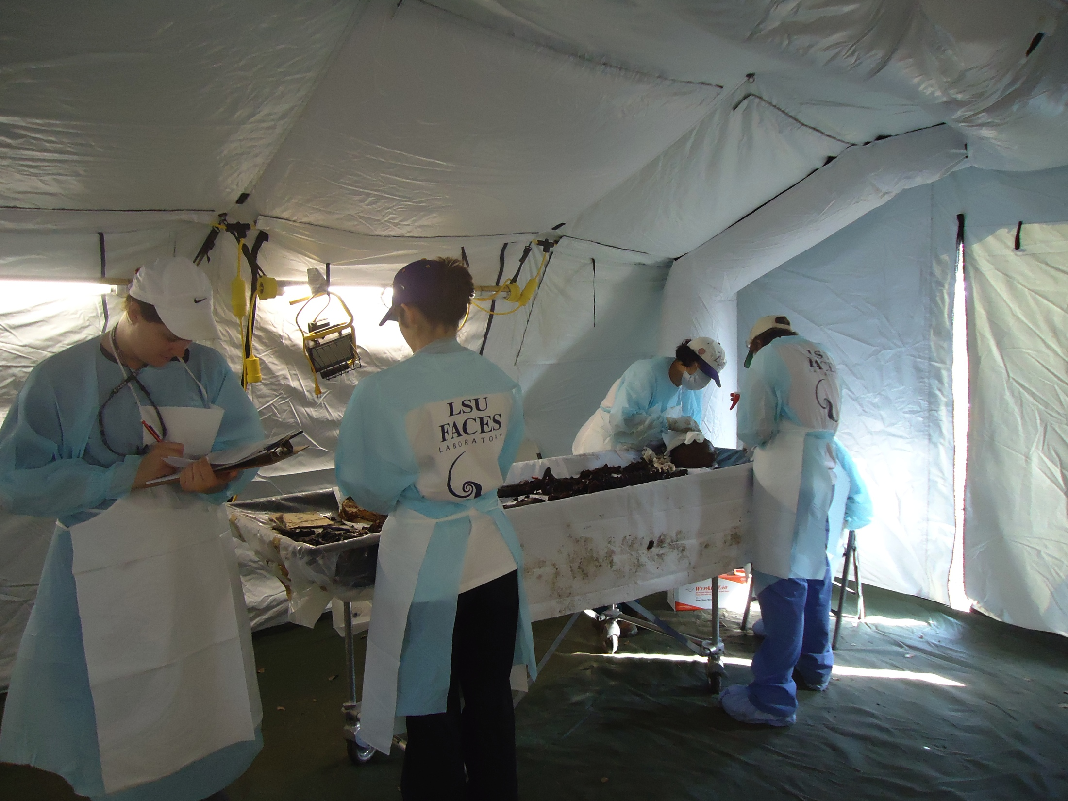
Damage Snapshots

Slide 15
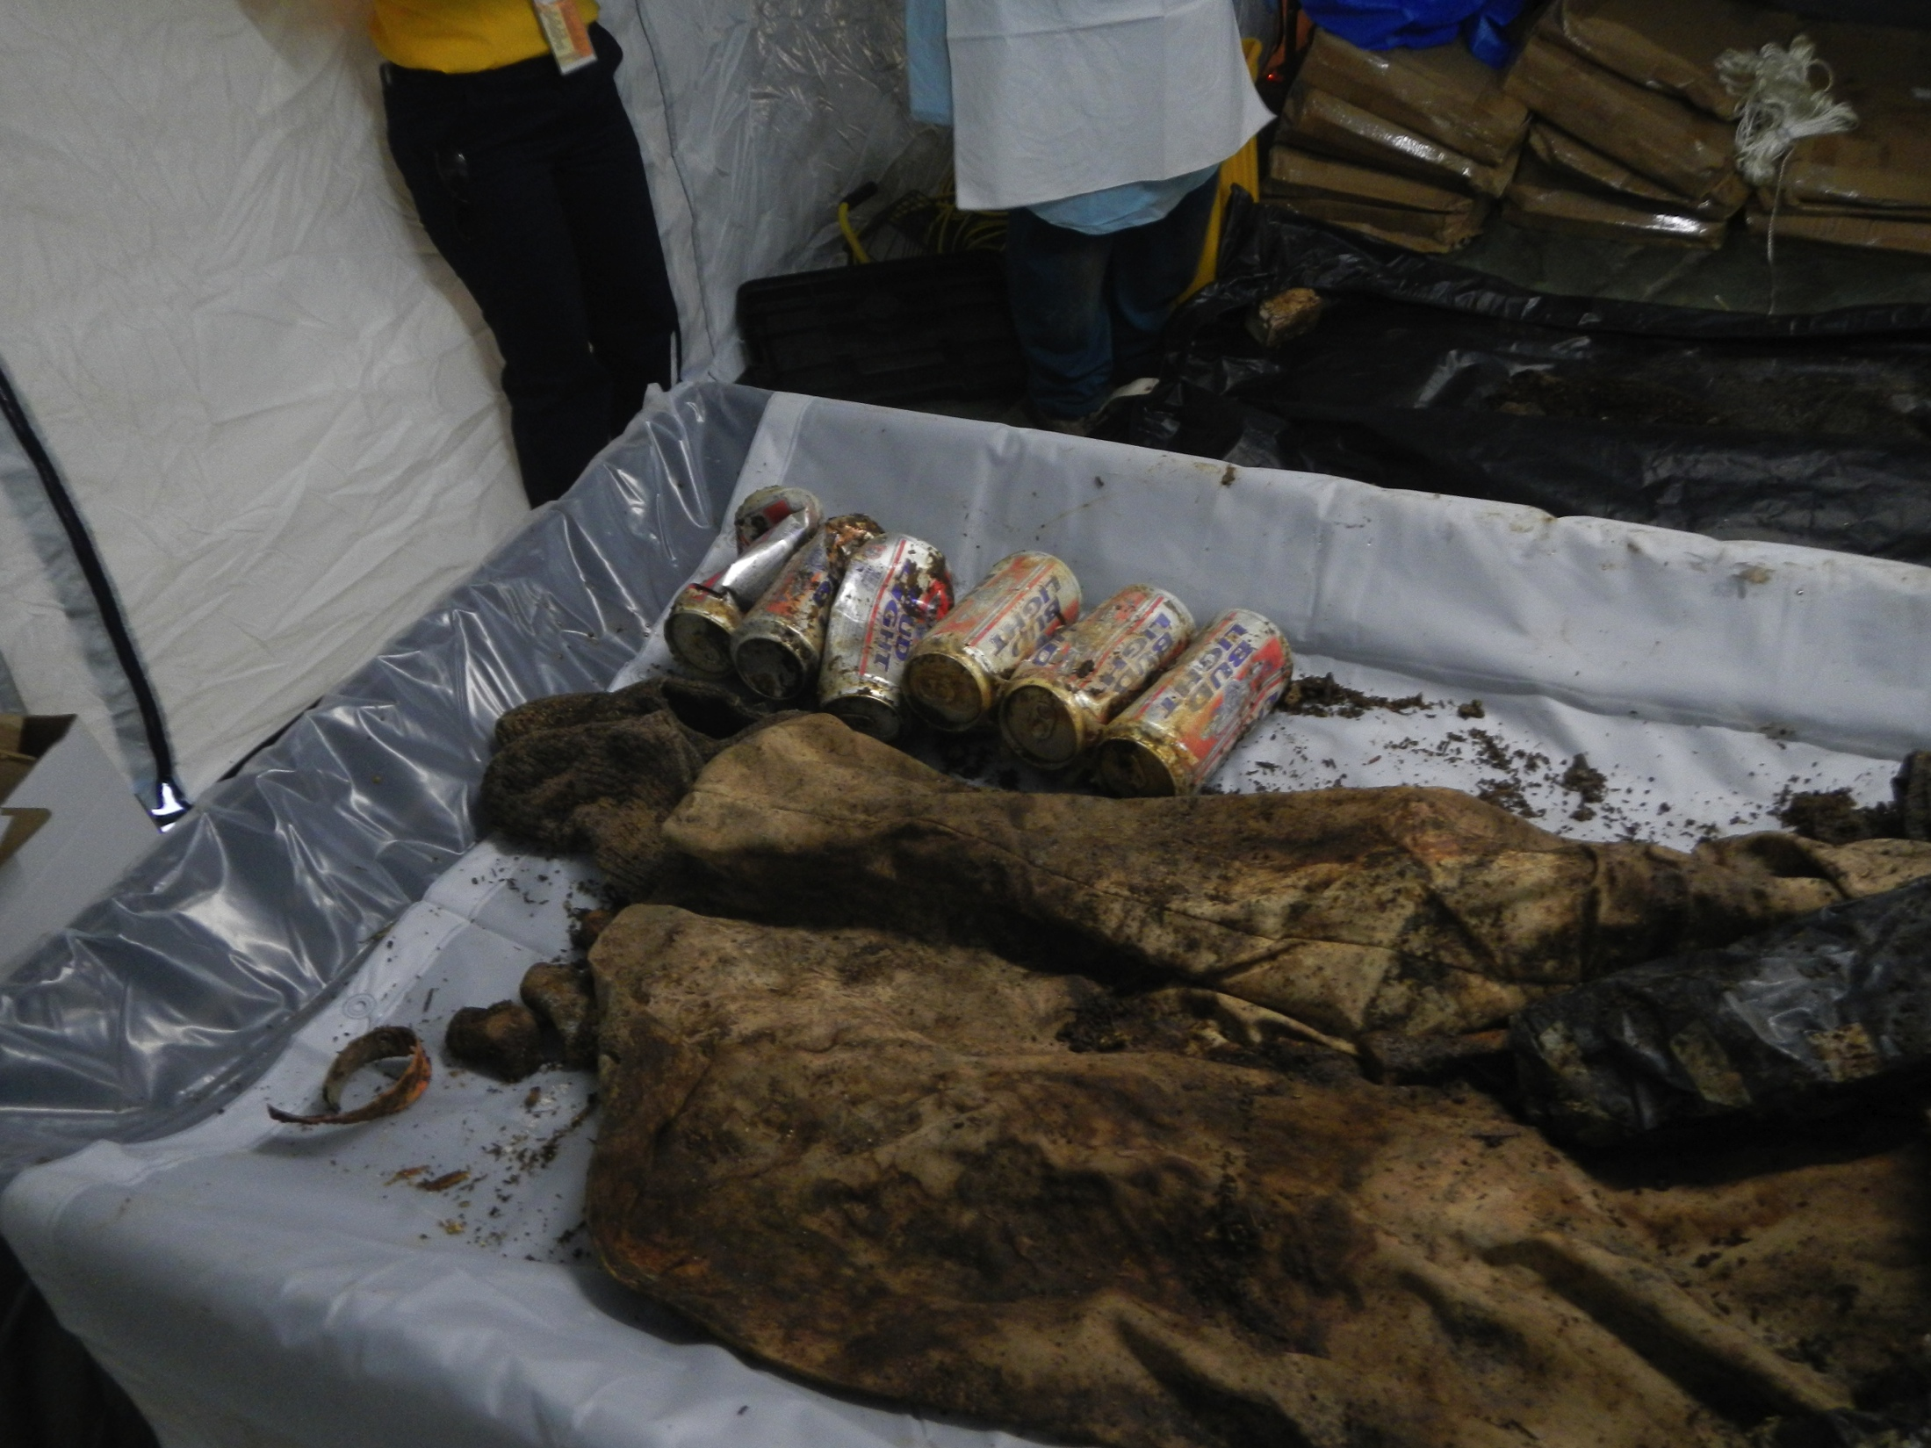
Damage Snapshots

Slide 16
Conclusion
Status of logistics is dependent upon an initial assessment of the problem
The Mass Fatality Task Force can assist with coordinating operations and information flow with the parish Coroners. They can also interface with the FAC team.

Slide 17
First Steps for Local Officials
Before the assessment is complete, local authorities can do the following:
Contact the cemetery owner and determine the level of support they can provide. Legally, they are the responsible party.
Contact the parish coroner to determine if, and how much, he can help in remediating the problem. The coroner is the second contact to make.
If there are floating bodies or caskets outside of the cemetery, the parish coroner or fire department can recover and store and/or place back inside of the cemetery
Have the cemetery owner or local officials assemble a work force of parish public works staff, or parish inmates under supervision of the sheriff’s office to do the following:
Secure all of the disinterred caskets so that further damage doesn’t occur. They can also cover anything exposed with a tarp or something
Determine if there is a cemetery sexton and get them involved. If the cemetery isn’t abandoned, there should be a sexton available. This person can assist with plot plans, identifications, and funeral homes.
If you can determine the funeral home involved, contact them to see if they would assist in re-interment, particularly if the burial was recent.
Secure the site so that vandalism doesn’t occur. Believe it or not, this does occur.
Use the Casket Recovery Form to identify the remains, or gather as much information about the remains and the casket if they are unidentified.
Do the same activities if other cemeteries are affected.
We have an Assessment Package

Slide 18
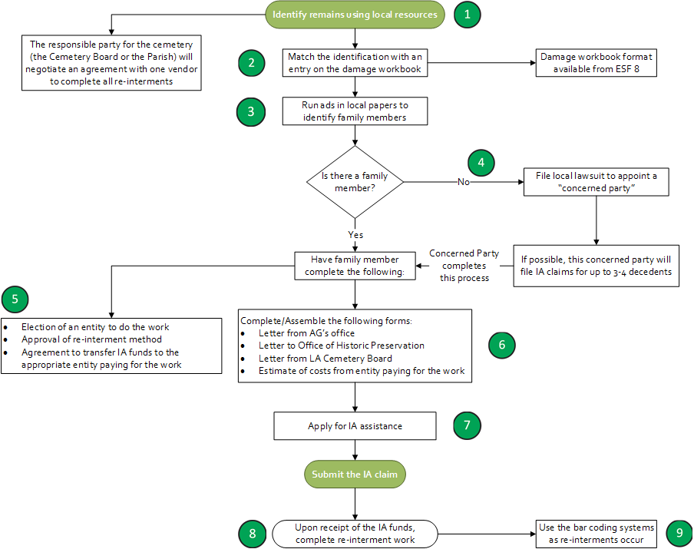
IA Process

Slide 19
Questions?
Contacts
henry.Yennie@la.gov
seidemannr@ag.state.la.us
HallingC@ag.louisiana.gov

