Slide 1
National Sheltering and Housing Workshop NDRF
National Disaster Recovery Framework
Second Edition
January 2016

Slide 2
NDRF Introduction
Leda Khoury
Federal Disaster Recovery Coordinator
(FDRC)

Slide 3
The NDRF is NOT a Plan
Defines roles and responsibilities
Promotes the establishment of post-disaster organizations to manage recovery
Promotes a deliberate and transparent process that provides well-coordinated support to the Community
Prescribes how to organize, plan and manage restoring communities after disasters
The Framework is a Scalable, Flexible Guide to Effective Recovery

Slide 4
Core Principles
Individual and Family Empowerment
Leadership and Local Primacy
Pre-Disaster Recovery Planning
Partnerships and Inclusiveness
Public Information
Unity of Effort
Timeliness and Flexibility
Resilience and Sustainability
Psychological and Emotional Recovery

Slide 5
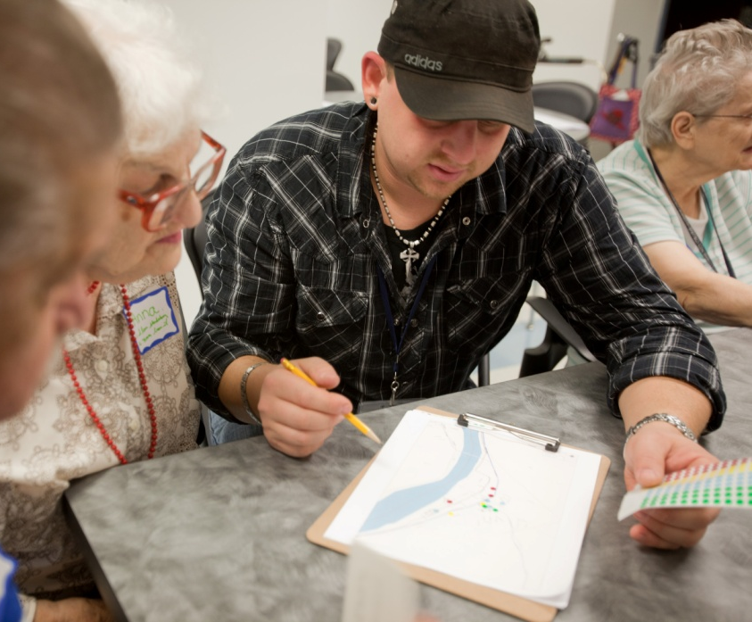
Recovery Support Strategy (RSS)
Strategy and unified approach
Objectives and Milestones
Level, type and duration of RSF support
Living document
60 day timeline for MSA/RSS
Public document

Slide 6
DR-4277 Recovery Support Functions (RSFs)
RSF 1:
Community Planning & Capacity Building
Federal:
FEMA /CPCB
RSF 2:
Economic
Federal:
EDA
Vicki Hendershot
RSF 3:
Health & Social Services
RSF 6:
Natural & Cultural Resources
RSF 4:
Housing
RSF 5:
Infrastructure Systems
State Primary Agency
Federal:
HHS
Federal:
HUD
Federal:
USACE
Federal:
NCR
State Primary
OCD Staff POC
RLTF
Working Group Lead:
State Primary Agency
LA Co-Lead: LED
State Primary
OCD Staff POC
RLTF
Working Group Lead:
State Primary Agency
LA Co-Lead: LDH
State Primary
OCD Staff POC
RLTF
Working Group Lead:
State Primary Agency
LA Co-Lead: LHC
State Primary
OCD Staff POC
RLTF
Working Group Lead:
State Primary Agency
LA Co-Lead: DOTD
State Primary
OCD Staff POC
RLTF
Working Group Lead:
State Primary Agency
LA Co-Lead: LDWF
RLTF
Working Group Lead:
State Primary
OCD Staff POC
Notes:
NDRF RSF Structure, Louisiana-specific federal, state and local partners

Slide 7
Housing RSF Recovery Support Strategy Objectives/Outcomes
Objective
To bring federal resources and partners together to assist all impacted individuals and households to attain accessible temporary and permanent housing solutions
Outcome
To transition all impacted individuals and households from stable temporary housing solutions into sustainable and resilient permanent housing solutions that meet the needs for affordability and accessibility

Slide 8
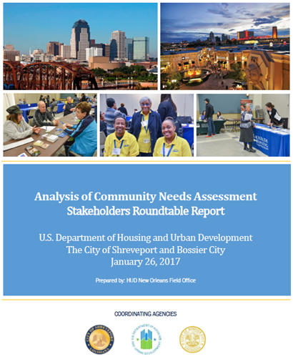
Housing RSS FEMA/HUD Collaboration
Goal: Create an awareness campaign and participation in the development of safe, sanitary, affordable and accessible housing options, programs, and opportunities.
Objective: Coordinate with state partners to develop public service announcements and workshops to inform the public of currently available housing choices (state, federal, and local).
Action: Coordination with HUD with on
Shreveport/Bossier City Community Needs
Assessment Stakeholder Roundtables

Slide 9
Housing RSS FEMA/HUD Collaboration
Goal: Improve the affordable, accessible and disaster resilient housing options for people with disabilities and others with access and functional needs
Objective: Increase awareness and access to affordable, accessible and disaster resilient housing options for adults with disabilities and others with access and functional needs.
Action: Disability Integration inclusion in
Rapid Rehousing Program
Notes:
Rapid rehousing fairs are now a "Best Practice" demonstration for other disasters to emulate demonstrating the core capabilities, relationships, and coordination in support of the state of Louisiana Housing Corporation. The private sector, NGO's, FEMA NDRS Cadre, Housing RSF, and HUD added value in linking the "Housing Heroes" programmatic resources to survivors occupying Manufactured Housing Units.
Approximately 200 survivors were provided Rapid Rehousing assistance.
Disability integration determined individuals disabilities who were in attendance and eligible for the rapid rehousing program and coordinated with housing heroes to ensure that they were placed in accessible units.

Slide 10
Louisiana Long-Term Recovery Planning

Slide 11
Long Term Recovery Housing Projects
DENHAM SPRINGS
Improve Blighted Properties
Increase Opportunities for Affordable Housing
BAKER
Comprehensive Housing Strategy
First-Time Homebuyers Program
Blight and Housing Vacancy
TANGIPAHOA
Home Ownership Education Program
Increase Special Needs & Senior Housing
Landlord Disaster Recovery Program
Increase Available Rental Housing

Slide 12
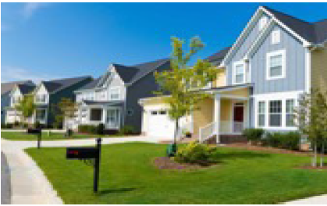
Housing Long-Term Recovery FEMA/HUD Collaboration
Project: Implement First-Time Homebuyers Program for Denham Springs and Baker
Implementation: FEMA, HUD and City of Denham Springs held project planning meeting for Denham Springs Homeownership Housing Fair. Fair will be held June 9, 2018. Program will be replicated in Baker, LA
Notes:
June is National Home ownership month.

Slide 13
Leda Khoury leda.khoury@fema.dhs.gov 312-659-2987
National Disaster Recovery Framework
Second Edition
January 2016

