Slide 1
L.W.I.N.
Louisiana Wireless Information Network
System Management & Maintenance
August 26, 2026
Department of Public Safety
Office of State Police
Mobility and Communication Services
(225) 925-6036

Slide 2

Infrastructure Update

Slide 3
SYSTEM SUMMARY
156 Total Tower Sites in Operation
6 Operational Mobile Sites

Slide 4
Zone 1:
42 Sites in Full Operation
Livonia
Laplace
St. Tammany Simulcast
Lacombe
Abita Springs
Waldheim
Pearl River
Covington
Slidell
Talisheek
Blond
Sheridan
Geismar
St. James
Larose
Gibson
BR Simulcast
BR
Central
LSU
WBR
Hammond
Gray
Berwick
Baywood
Ramah
Sage Hill
Parker Road
Iberville
Livingston
Jackson
Greensburg
Superdome
South Baton Rouge
Baldwin
Pointe Coupee
Theriot
Paincourtville
Boothville
Mobile Units
94
96
97
98
99
100
Denham Springs
Clinton
St. George
Independence
Zachary

Slide 5
Zone 2:
22 Sites in Full Operation
N. Simulcast
Gretna
Galleria
NO East
Houma
Lafitte
Bayou Gauche
Hahnville
St. Rosalie
Kenner
Airport
Port Fourchon
Reggio
Montegut
Bourg
Buras
Wilmer
Grand Isle
Thibodeaux
Golden Meadow
Pan Am
Bridge City
Port Sulphur

Slide 6
Zone 3:
56 Sites in Full Operation
Clearwater
Monroe
Winnfield
Delhi
Chopin
Dry Prong
Hagewood
Bossier(City)
Farmerville
Minden
Natchitoches
Bastrop
Greenwood
Ruston
Hineston
Ashland
Vivian
Newellton
Noble
Transylvania
Alexandria
Avoyelles
Bellevue
Bernice
Calhoun
Columbia
Ferriday
Homer
Jena
Jonesboro
Mansfield
Many
Marion
Oak Grove
Plain Dealing
Ringgold
Sentell
Tallulah
Wheeling
Shreveport
West Monroe
Chase
Keachi
Coushatta
Shongaloo
Sibley
Vick
Calvin
Arcadia
Enterprise
Holloway
Chatham
Cypress/
Ouachita
Logansport
Pelican
Hunter Road

Slide 7
Zone 4:
36 Sites in Full Operation
Abbeville
Acadia
Arsene LeBleu
DeQuincy
Dry Creek
Jeanerette
Jennings
Johnson Bayou
Lafayette
Lake Charles
Leesville
Merryville
Opelousas
Parks
Rockefeller
Rosepine
Scott
Sulphur
Vermillion
Ville Platte
Vinton
Craven
Hicks
Hornbeck
Oakdale
Roseland
E.Jennings
Anacoco
Oberlin
Moss Bluff
New Iberia
Eunice
Starks
Bell City
Calcasieu Jail
Longville

Slide 8
Channel Summary
Total Channels 1660
1609 Channels on 156 Sites
51 Channels on 6 Mobile Sites

Slide 9
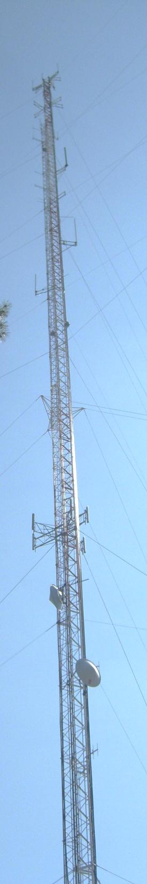
System
Statistics

Slide 10
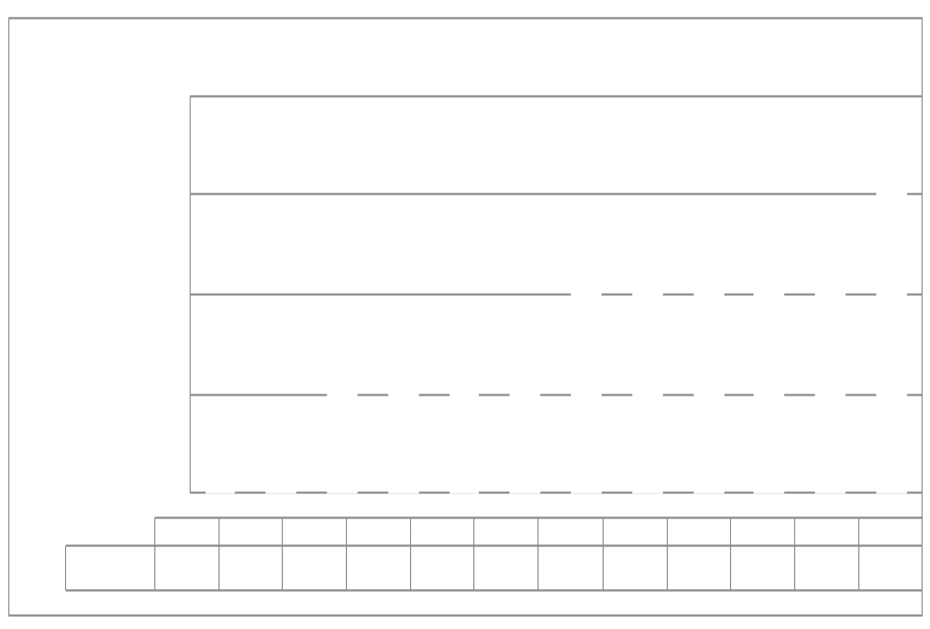
SUBSCRIBERS

Slide 11
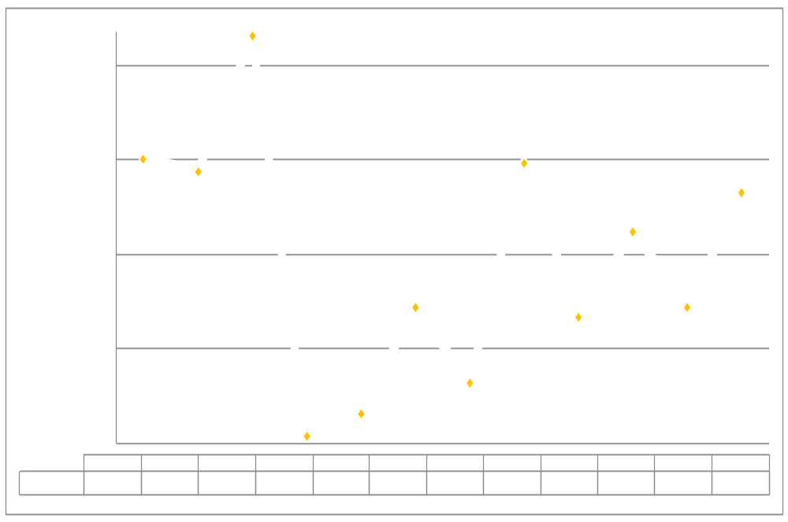
PUSH TO TALK

Slide 12
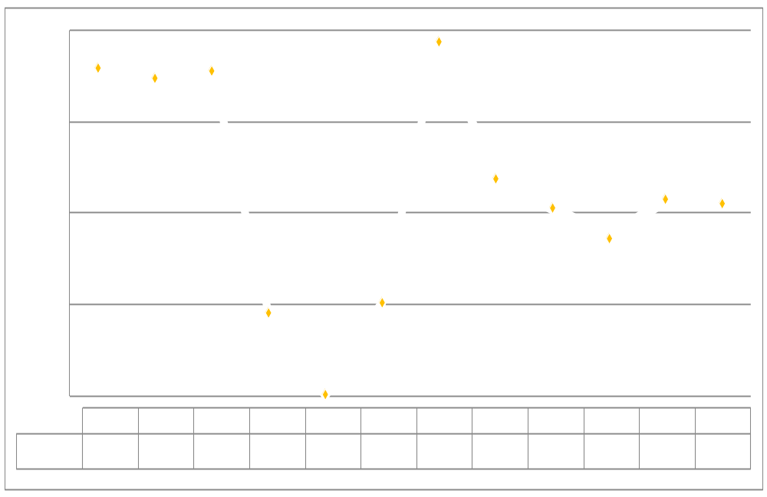
PUSH TO TALK PER DAY

Slide 13
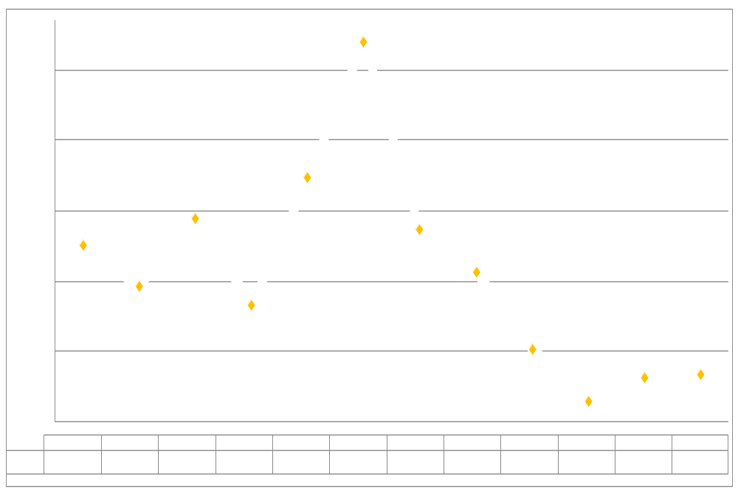
BUSIES

Slide 14

Top Busy Sites
Calcasieu Jail 202
St. George 41
Vermilion 27

Slide 15
SITE OUTAGES
Abbeville | Acadia | Arcadia | Arsene Lebleu | Ashland
Avoyelles | Bayou Gauche | Bell City | Bernice | Berwick
Bootheville | Bridge City | Buras | Clearwater | Cravens
Dequincy | Enterprise | Eunice | Farmerville | Geismar
Gibson | Golden Meadow | Grand Isle | Gray | Green
Hahnville | Hicks | Houma | Hunter Road | Independence
Jena | Johnson Bayou | Livionia | Logansport | Longville
Marion | Merryville | Moss Bluff | Natchitoches | Newellton
Total Downtime: 203 Hours

Slide 16
SITE OUTAGES
Logansport | Longville | Marion | Merryville | Moss Bluff
Natchitoches | Newellton | Noble | Opelousas | Ouachita
Pan Am | Parker Road | Pelican | Plain Dealing | Port Fourchon
Port Sulphur | Ramah | Reggio | Rockefeller | Roseland
Sentell | Shongaloo | Sibley | St. James | St. Rosalie
Starks | Theriot | Vermilion | Vivian | Winnfield North
Zachary
Total Downtime: 203 Hours

Slide 17
SITE OUTAGE DATA
69%

Slide 18
SYSTEM STATISTICS

Slide 19
Subscriber Statistics
Security Groups
192
Agencies
620
Talkgroups
6,669

Slide 20

Agencies Added Last 4 Months
Delta utilities
Kinder police department

Slide 21
System Coverage

Slide 22
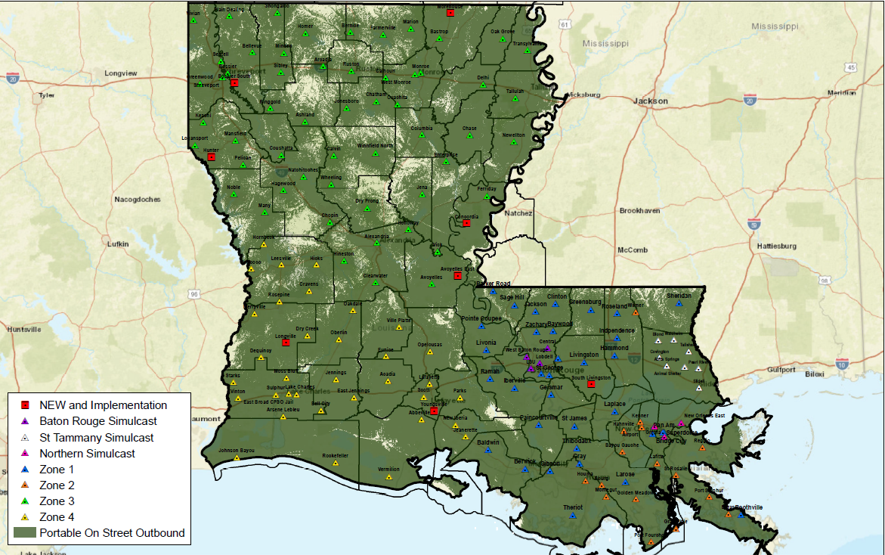
Present Coverage
Updated: 08/2026

Slide 23
Questions?

Slide 24
Ethernet Update

Slide 25
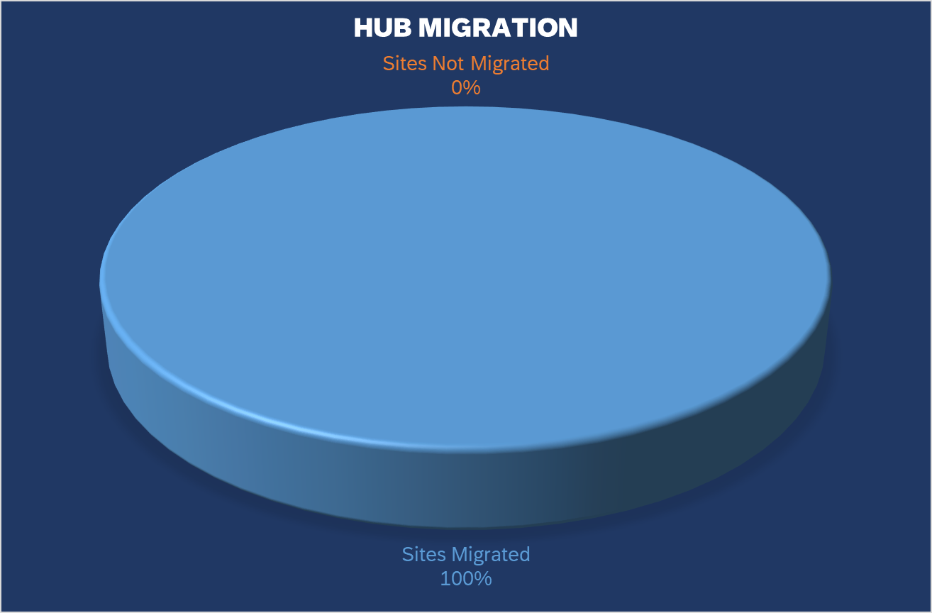
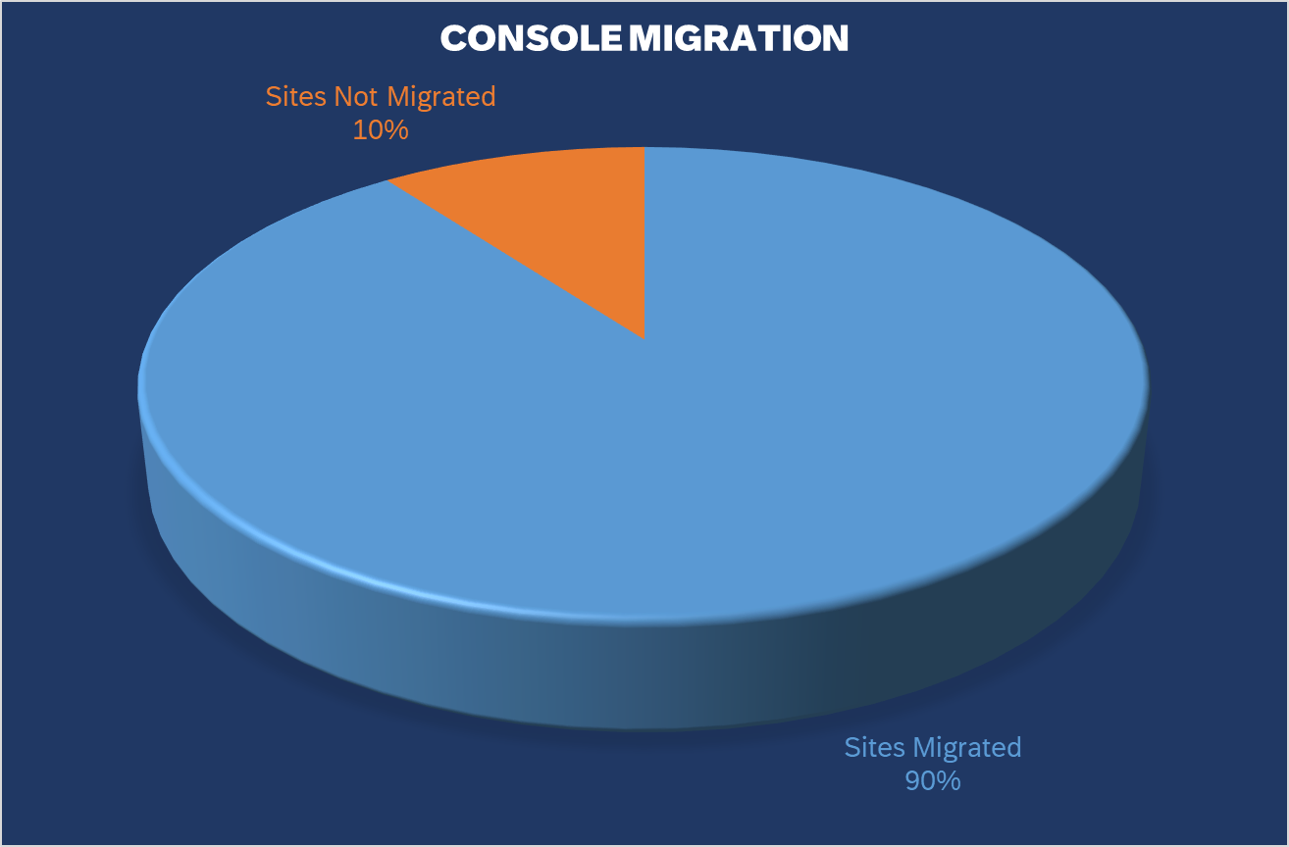
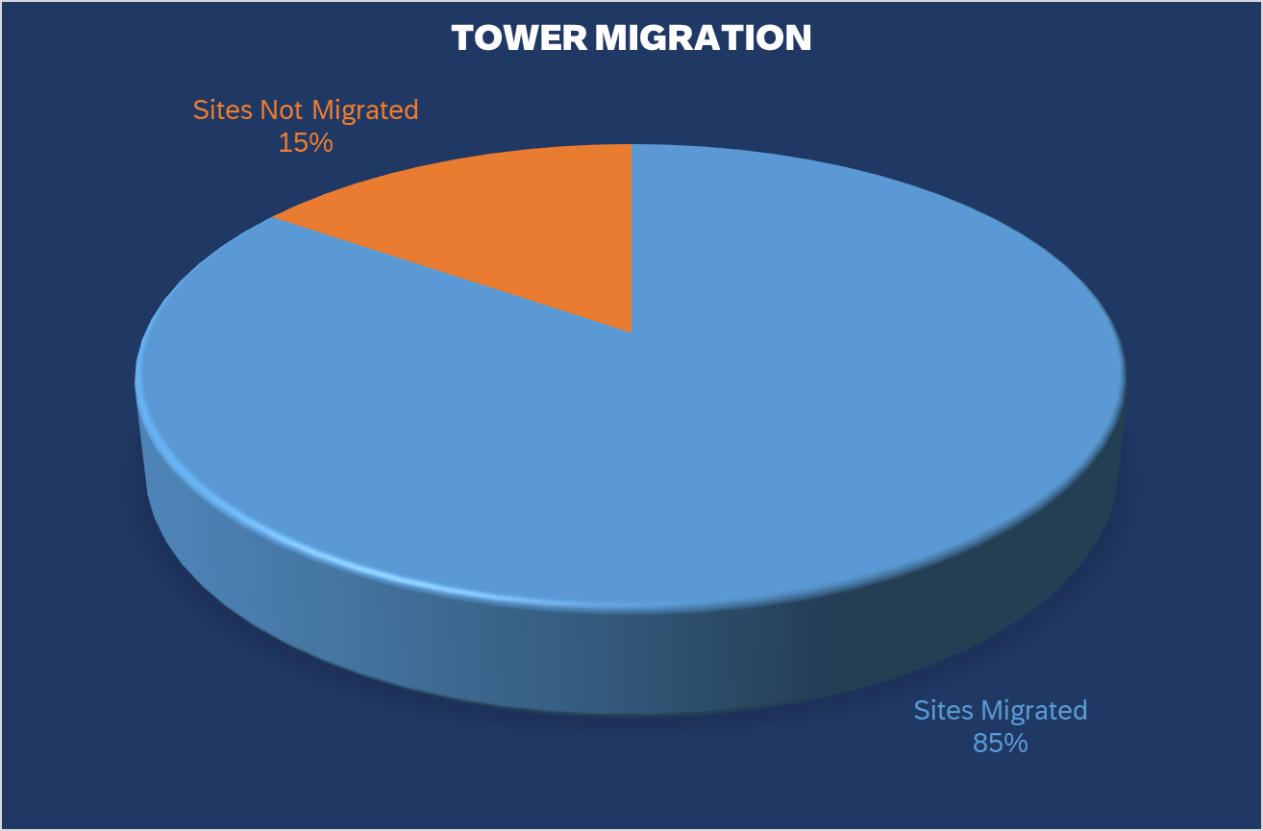
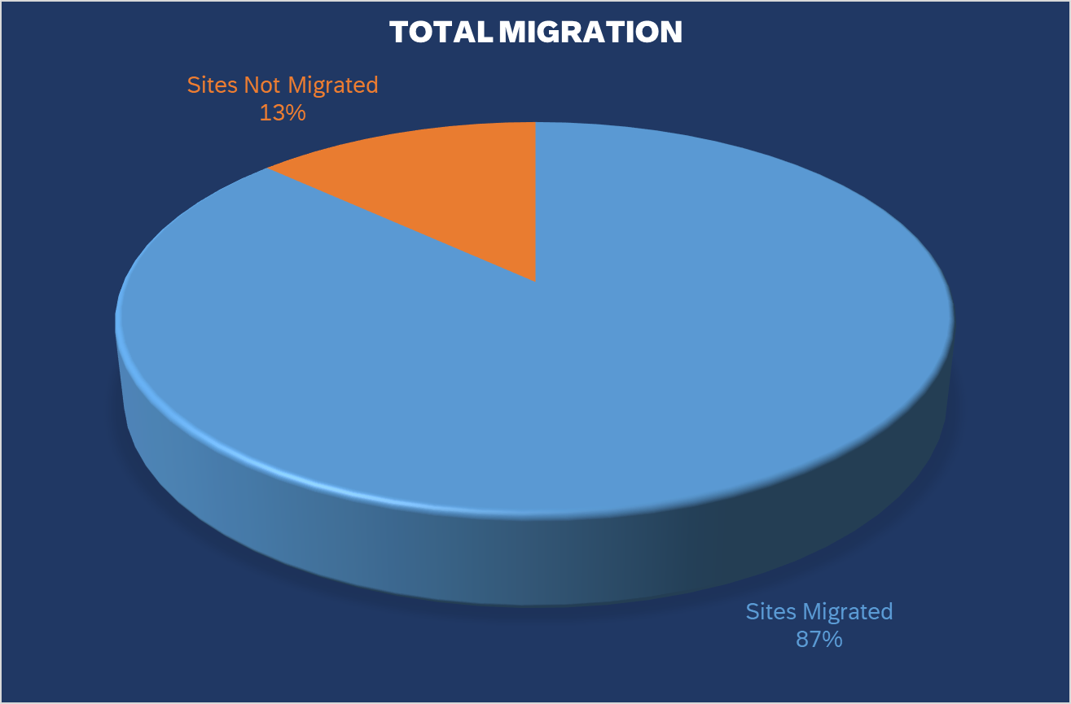
State of Louisiana - LWIN Program Review
 | Ckts On Order | Ckts Delivered | ATT Trouble Sites | Ckts Pending Order | Cradlepoint Installed | External Antenna Installed | Program Ckt Total | Sites Migrated | Sites Not Migrated
Hubs | 8 | 8 | 0 | 0 | 0 | 0 | 8 | 8 | 0
Consoles | 55 | 54 | 6 | 5 | 54 | 25 | 59 | 53 | 6
Towers | 121 | 113 | 14 | 18 | 164 | 100 | 131 | 111 | 20
Total | 184 | 175 |  | 23 | 169 | 125 | 198 | 172 | 26

Slide 26
Thank You!

