Slide 1
Grants Management: Don’t Wait to Communicate

Slide 2
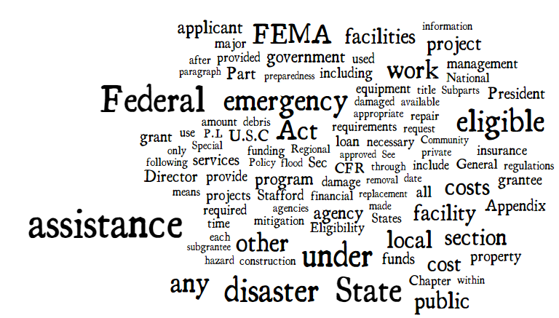

Slide 3
Before
During
After
Communication
is
Critical

Slide 4
YOU
FEMA
GOHSEP

Slide 5
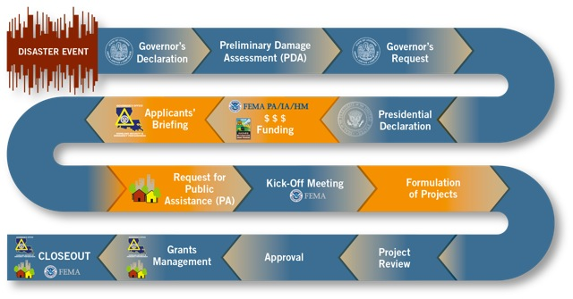

Slide 7
Grants Management: Don’t Wait to Communicate

Slide 8
Do we need a version?
Is a version being written?
Have we requested this before?
What’s taking so long?
Do I need an extension?
Why should I care about this?
What else do I need to do?
Why do I need to do this?
What is this used for?

Slide 9
Communication
We don’t know what you don’t tell us.
We can’t answer the questions you don’t ask.

Slide 10
Communication (Continued . . . )
Communication allows for:
Anticipation of future needs.
Acceleration of funding.
Opportunities for GOHSEP to assist you.
Proper direction of resources.

Slide 11
Time Extensions
Backlog

Slide 12
Quarterly Reports (QRs)
Quarterly Reports (QRs) are critical to ensuring that FEMA and the State have up-to-date information on PA Program grants.

Slide 13
. . . And why should I care?
QRs are your report card.
They help you to self-monitor and ensure you’ve done everything you need to do.

Slide 14
. . . And why should I care? (Continued . . . )
They serve as a checklist to make sure all your I’s are dotted and T’s are crossed.
QRs “keep the money flowing” to you and your community.

Slide 15
QRs (Continued . . . )
QRs help facilitate communication between you, the State and FEMA.

Slide 16
QRs (Continued . . . )
QRs are required by law, but are especially useful in that they identify when you . . .
May need a version.
May need a time extension.
Are ready to closeout.
Still have money left to reimburse.

Slide 17
QRs (Continued . . . )
QRs are a primary contributing factor to FEMA’s timeline for the entire grant.
QRs also help identify stagnant projects for both of us.

Slide 18
QRs (Continued . . . )
Failing to do QRs could result deobligations or loss of funding!
It’s important that QR information come from you since you are most familiar with your projects.

Slide 19
QRs (Continued . . . )
The information coming from you allows us to report the most accurate information possible to FEMA.
Identify the best people who can provide the most timely and accurate information.

Slide 20
QR Training #1

Slide 21
QR Training #2

Slide 22
What kinds of questions will it ask?
QRs will include:
The status of the project, such as "in design" or "percentage of construction completed;”
Time extensions granted, if any;

Slide 23
What kinds of questions will it ask? (Continued . . . )
A projected completion date;
The amount of expenditures and amount of payment for each project; and . . .
Any problems or circumstances that could delay the project.

Slide 24
QRs
Answer all the questions
“Our menu has changed.”
Links to create Time Extension and Closeout requests are available from here.

Slide 25
QRs (Continued . . . )
Version Requests are also available if scope or cost alignment(s) are needed.

Slide 26
FEMA PW obligated
PW
Closeout
Quarterly Reports Due
1st QR Due
Construction
Ends
Construction
Begins
Disaster
Declaration
Date
Work
Deadline
July 15, 2016
June 7, 2017
October 1, 2015
April 15, 2016
April 15, 2017
July 15, 2017
August 30, 2015
March 30, 2017
October 15, 2016
October 11, 2015
January 15, 2017
August 17, 2017
October 15, 2015
January 15, 2016

Slide 27
Common Hiccups
Proj # | Type | Title | % Complete | Est. Completion
1555 | E | John Doe Elementary School | 95 | May 2, 2014
2801 | E | Frank Lee High School Gym | 100 | Dec 4, 2015
3196 | A | Rockford School Debris Removal | 45 | Dec 1, 2015
2430 | E | Glendale Elementary School | 100 | Nov 14, 2013
2012’s Hurricane Isaac

Slide 28
“I should only report on the FEMA money.”
“This is a financial report.”
“I should keep my Current Percent Complete below 100% if all I have left to do is administrative work.”

Slide 29
“I assume if I’m done with my work, my Quarterly Reports are done too as long as I’ve reported everything at 100%.”
“Not doing my Quarterly Reports can result in loss of funding.”

Slide 31
Time Extensions
Backlog

Slide 32
Time extensions
Work must be completed within timeframes established by FEMA.
These deadlines are measured from the declaration date of the major disaster or emergency.
The deadlines are established according to the type of work.

Slide 33
Time extensions (Continued . . . )
A Time Extension is needed if your work is going to take longer than your current deadline.

Slide 34
Time extensions (Continued . . . )
Type of Work | Standard Deadline from Declaration Date
Debris Clearance | 6 months
Emergency Protective Measures | 6 months
Permanent Work | 18 months

Slide 35
Time extensions (Continued . . . )
The State has limited authority to grant extensions of the above default deadlines.
FEMA grants time extensions beyond the State’s authority on a case-by-case basis.

Slide 36
6 months
18 months
FEMA
Emergency Work
Deadline
FEMA
Permanent Work
Deadline
Disaster
Declaration
Date
Sept 15, 2015
March 15, 2016
March 15, 2017

Slide 37
6 months
Up to 6 months extension
Further extensions
FEMA
Emergency Work
Deadline
Disaster
Declaration
Date
The more time passes, the harder it is to get an extension
Sept 15, 2015
March 15, 2016
Sept 15, 2016
Emergency Work

Slide 38
18 months
Up to 30 months extension
Further extensions
FEMA
Permanent Work
Deadline
Disaster
Declaration
Date
The more time passes, the harder it is to get an extension
Sept 15, 2015
March 15, 2017
Sept 15, 2019
Permanent Work

Slide 39
Time extensions (Continued . . . )
Will you finish on time?
Does your current work deadline reflect the anticipated completion date for your work?
Remember a PW doesn’t “spell out” a deadline; refer to LAPA for an exact date.

Slide 40
Work Deadline in LAPA

Slide 41
Time extensions (Continued . . . )
If your work is going to take longer than the current work deadline, request an extension sooner rather than later!
We strongly recommend 6 months or more in advance!

Slide 42
Time extensions (Continued . . . )
Remember!
You will only be reimbursed for those costs incurred up to the latest approved work deadline for a particular project.

Slide 43
Time extensions (Continued . . . )
Anticipate your needs!
Time extension requests take time … sometimes a long time!

Slide 44
Time extensions (Continued . . . )
Attachments with justifications help expedite requests and eliminate Requests for Information (RFI) and roll-backs.
Speak specifically about why you need the extension.

Slide 45
Time extensions (continued . . . )
TIP! - Time extensions are much harder to get if you haven’t even started yet!
TIP! - Deadlines do not include administrative work such as Direct Administrative Costs (DAC).

Slide 46
. . . And why should I care so much?
Not getting your time extension can abruptly stop your funding! It can also result in deobligations!
Many Subrecipients (Applicants)
miss this critical step!

Slide 48
T.E. Training #1

Slide 49
T.E. Training #2

Slide 50
Let’s look at a “real world” example . . .

Slide 51
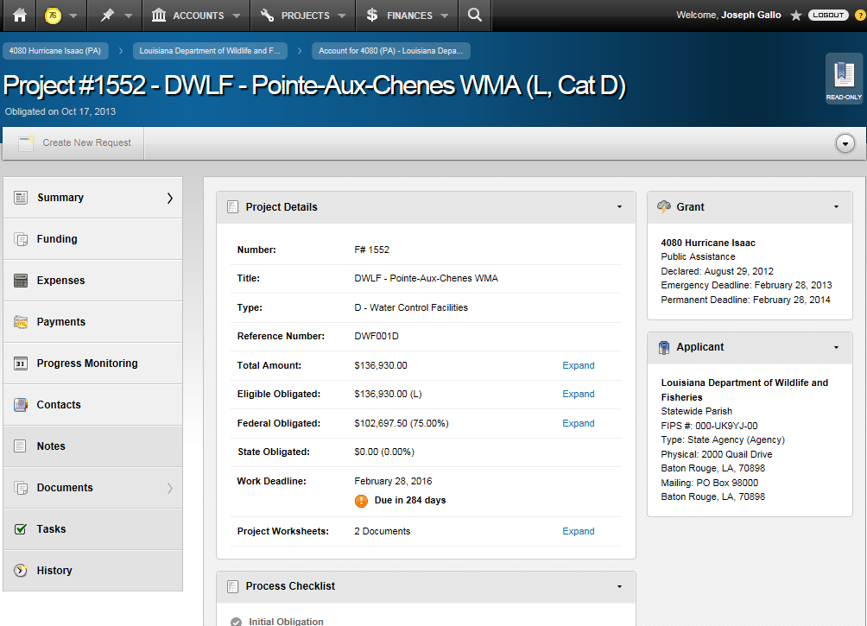

Slide 52
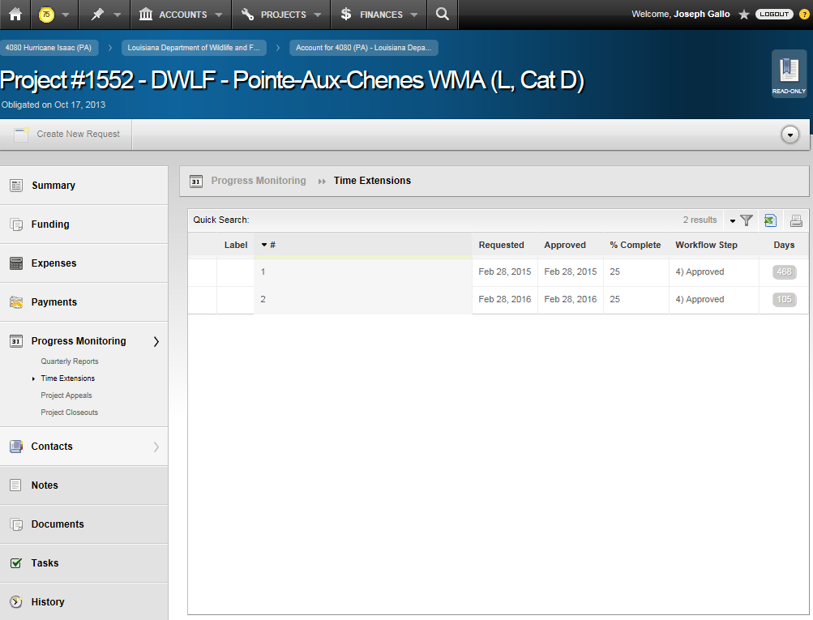

Slide 53
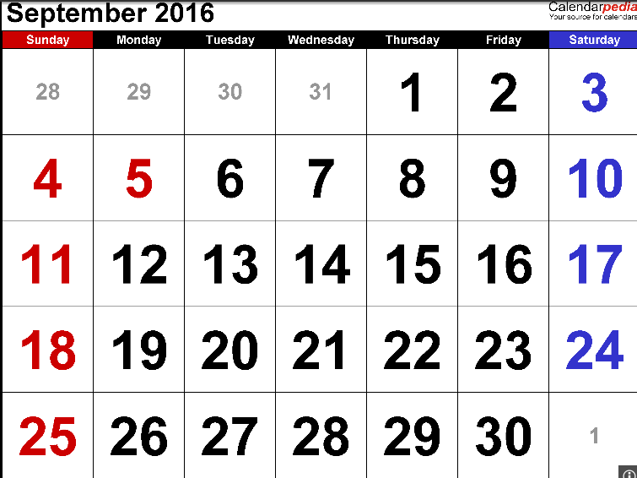
Gustav/Ike deadlines
Disasters as a whole have an 8-year window to completely close the grant.
September 2016 is the conclusion of the 8 year window for Hurricanes Gustav and Ike.

Slide 54
Gustav/Ike deadlines (Continued . . . )
Therefore, as notified to all Subrecipients (Applicants) in an e-mail blast from December 2014:
In September 2016, no further FEMA funding will be provided for Hurricanes Gustav & Ike.

Slide 55
Gustav/Ike deadlines (Continued . . . )
What this means is – as of today - every project must be completed and closed by September 2016.

Slide 56
Gustav/Ike deadlines (Continued . . . )
This is why we push QRs and Time Extensions.
We have to show significant progress in our recovery efforts in order to keep both the extensions and the money coming.

Slide 57
Gustav/Ike deadlines (Continued . . . )
Remember the State works to help you! We help you build the cases for extensions, versions, etc.

Slide 58
Time Extensions
Backlog

Slide 59
What is the “backlog”?
The backlog is all the requests for reimbursements (RRFs) which have not fully undergone the entire review process.

Slide 60
Why is there a backlog? (Continued . . . )
Two (2) primary contributing factors:
Express Pay
Get the money out fast!

Slide 61
Why is there a backlog? (Continued . . . )
Processing Time
Roadblocks such as missing or incomplete documentation prevent the speedy processing of reimbursements.

Slide 62
O U T B O X

Slide 63
In action . . .

Slide 64
. . . And why is it a big deal now?
Getting the last 10% retainage on Express Pay.
PW and grant deadlines.
Impedes project closeout.

Slide 65
Backlog
Grants Management has a streamlined standard operating procedure for eliminating the backlog.
You may be contacted to provide information.

Slide 66
Backlog (Continued . . . )
Strict deadlines.
Need a timely response.
Unmet deadlines may result in reductions, likely hindering future funding.
Once reductions are made, Subrecipient (Applicant) may resubmit if/when the issue is rectified.

Slide 67
Backlog (Continued . . . )
Examples of things you may be contacted about:
Missing documentation.
Proof of cost reasonableness / Cost analysis.
Time extension needed.
Version request needed due to out of scope items.

Slide 68
Backlog (Continued . . . )
Individual projects will be automatically moved to Closeout in 60 days if project is 100% complete.

Slide 69
Communication
is
Critical

Slide 70
Contacts
Joseph Gallo
Problem Resolution Officer – PA Grants Management
(225) 334-7781
joseph.gallo@la.gov

Slide 71
Questions?

